Slide 1
Technology Stock Analysis - DRAFT
AI Boot Camp – Project 1
Module 9 & 10
© 2023 edX Boot Camps LLC. Confidential and Proprietary. All Rights Reserved.
Notes:
Brief overview of what students will learn in this class.

Slide 2

Project Objectives
Equity Trading: While working for a large equity-trading company, you’re tasked with researching a client’s portfolio. Your client wants to invest in tech stocks and needs expert analysis to make the right decision. Using NASDAQ historical data (https://www.nasdaq.com/market-activity/quotes/historical), pull five year’s worth of trading data for the major US technology companies: Apple, Microsoft, and Google and compare to each other and the S&P 500 and NASDAQ indexes. Which stocks are trending upward? Which are trending downward? Based on the data, what would you recommend to your client? How does the tech stock performance compare to the S&P and NASDAQ indexes?

Slide 3

Data Collection, Clean-Up, and Exploration
5 years of daily close data was downloaded from https://www.nasdaq.com/ for each of the stocks (Apple, Google, Microsoft) and both of the indexes (NASDAQ and S&P 500) resulting in 5 csv files
Data Collection:
Data Exploration:
After the 5 csv files were read in as DataFrames and each file was explored through the info() method. This method revealed that there were no null values and the files for the indexes had 1 less row. Additionally, the closing price was read in as an object in the three stock since there was a dollar sign ($) included in the price
Data Clean-Up:
Rename – closing price columns were renamed to reference the stock or index
Merge files with only needed columns (closing price columns)
Remove $ - replace() method was used to replace $ with ’’
Change data type from object to float by using the astype() method

Slide 4

Approach in Achieving Project Goals
Also additional questions – like compare to non-tech stocks

Slide 5

Results and Conclusions
Notes:
Learning Outcomes:
Understand the concept of pseudocoding
Source Material:
Coding prework: adapt content from Practice Computational Thinking section - some of this should be presented in a slideshow, and some of it could be presented by the instructor in VS Code.
Additional details:
The pseudocode provided in the source material uses JavaScript commenting style (double slashes //); we’re using Python for this course so the commenting style should use # instead.

Slide 6
Disclosure
No guarantee can be offered that projections or estimates will actually occur. Actual results may be materially different from projections or estimates. Additionally, past performance should not be relied upon as a forecast of future performance.
Notes:
Learning Outcomes:
Understand the concept of pseudocoding
Source Material:
Coding prework: adapt content from Practice Computational Thinking section - some of this should be presented in a slideshow, and some of it could be presented by the instructor in VS Code.
Additional details:
The pseudocode provided in the source material uses JavaScript commenting style (double slashes //); we’re using Python for this course so the commenting style should use # instead.

Slide 7
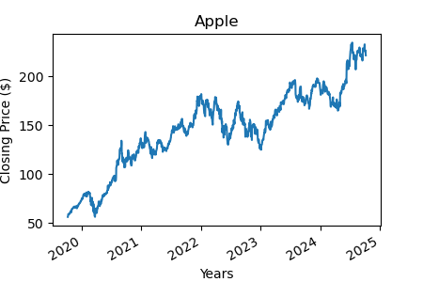
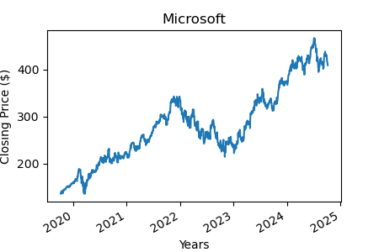
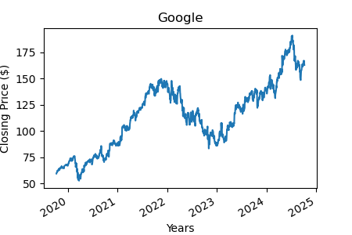
UPDATED
Historical Trends
APPLE
MICROSOFT
GOOGLE (class A)
Industry – Computer Manufacturing
5 year performance - 250% increase
Share volume – 19,342,616
Current yield – 0.44%
Summary Statistics
Mean - $146.07
Standard Deviation - $41.33
Industry – Computer Software
5 year performance - 245% increase
Share volume – 9,090,960
Current yield – 0.72%
Summary Statistics
Mean - $281.25
Standard Deviation - $80.22
Industry – Computer Software
5 year performance - 174% increase
Share volume – 21,606,095
Current yield – 0.49%
Summary Statistics
Mean - $113.88
Standard Deviation - $31.75

Slide 8
DRAFT – Graph of stocks for 2024 needed
Correlation
With the trending graphs visually looking similar correlation was explored
The correlation matrix shows how the daily returns of Microsoft, Apple, and Google relate to each other in 2024
Microsoft and Apple (0.46) - There’s a moderate positive relationship, meaning they sometimes move in the same direction but not strongly aligned.
Microsoft and Google (0.61) - A stronger positive relationship, indicating that their returns tend to move together more often.
Apple and Google (0.39) - A weak positive relationship, showing that their returns are relatively independent.
Drilling into 2024 performance shows more variation in trends

Slide 9
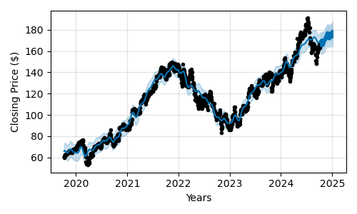
DRAFT – Apple and Microsoft needed
Forecast and Expected Growth
GOOGLE (class A)
The time series forecast for Google (class A) shares shows an upward trend for the next 90 days
The forecast predicts that the Google share price will increase 1.77% over the next 90 days

Slide 10
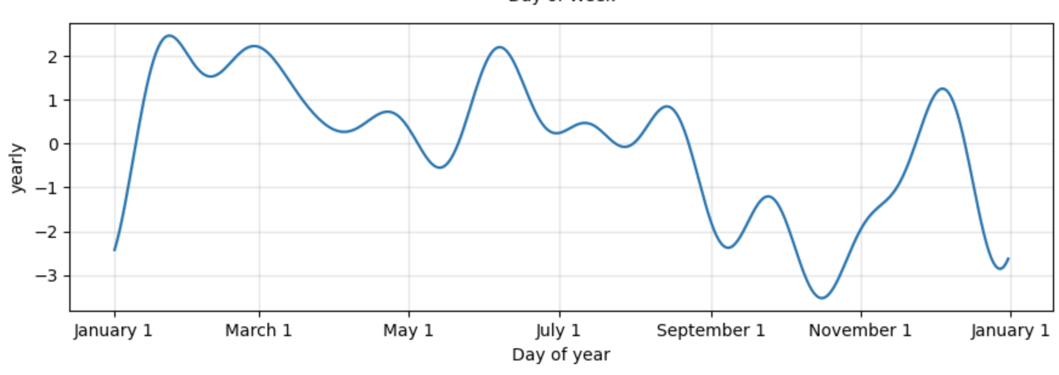
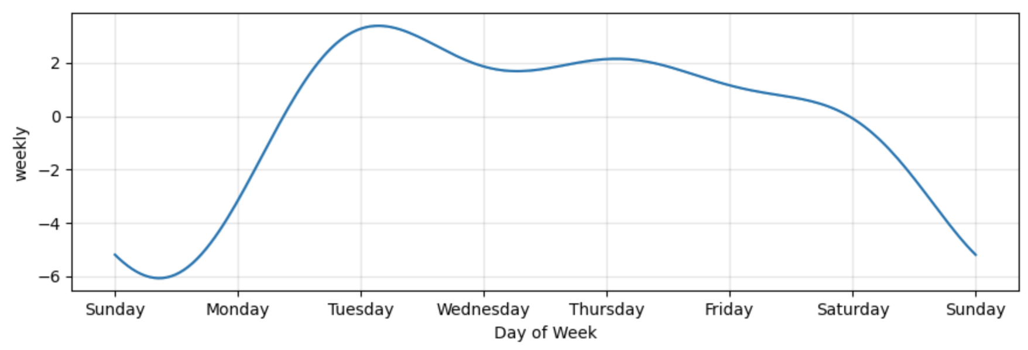
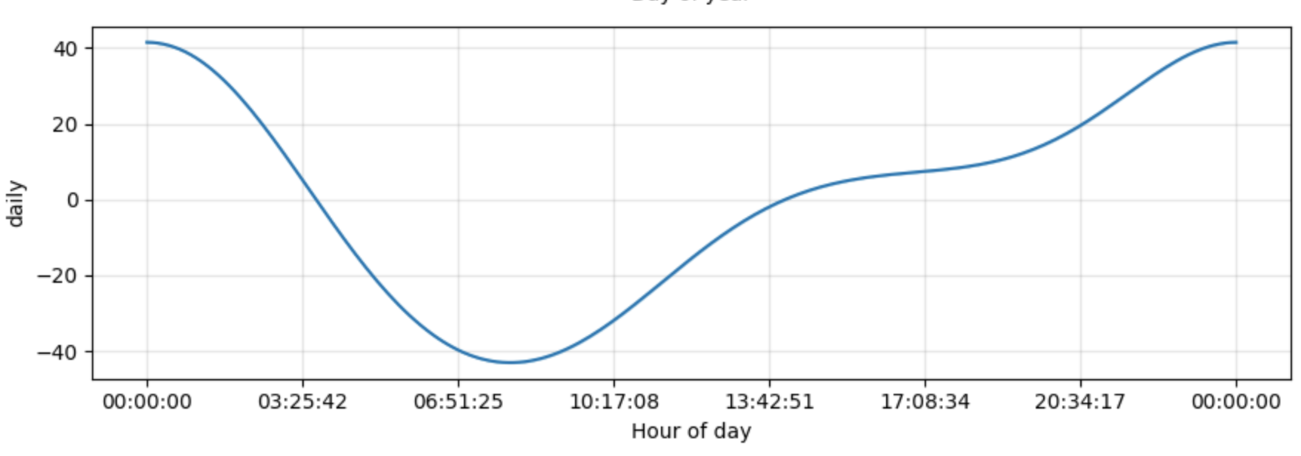
DRAFT
Focused Component Graphs
Optimal time to buy (month of year, day of week, hour of day) for highest growth stock

Slide 11
DRAFT
Comparisons to Indexes

Slide 12
Recommendations
Recommendations

Slide 13
Next
Additional items to research are impacts of research and development investment and compare to non-technology stock performance.

Slide 14
Let’s recap

Slide 15
Recap
1
Comparison on performance over last 5 years is similar
2
No correlation
3
Time series forecast shows highest expected growth in xxxx
4
Performance of indexes is higher/lower than the technology stock performance.

Slide 16


Questions?

Slide 17
Appendix

Slide 18
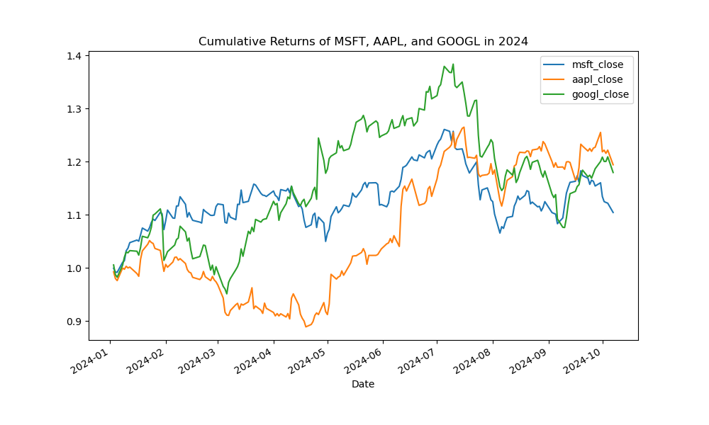
DRAFT
Cumulative Returns - 2024
The .cumprod() function in pandas calculates the cumulative product of a series. It's often used in finance to calculate cumulative returns by multiplying daily returns over time.
For example, if a stock grows 5% on Day 1 and 2% on Day 2, .cumprod() multiplies these growth factors (1.05 * 1.02) to show cumulative growth. It tracks how much an investment increases or decreases over time, assuming all returns
are reinvested.
In short, .cumprod() is useful for analyzing
cumulative growth, especially for investment returns.

Slide 19

The End

