Slide 1
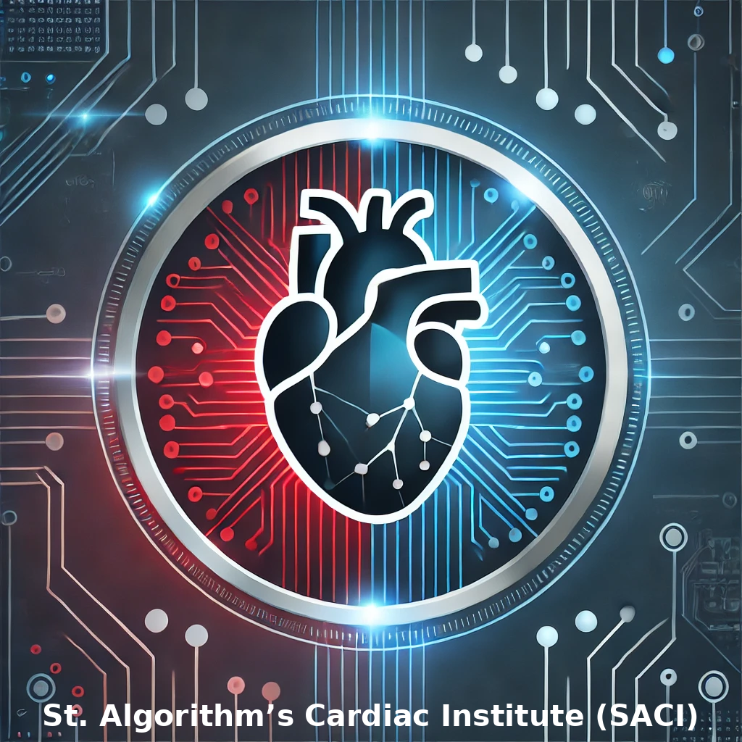

Heart Attack Outcome by Myocardio Minds in partnership with St. Algorithm’s Cardiac Institute (SACI)
AI Boot Camp Project 3
Myocardio Minds Team Members:
Rebecca Carr Arrhythmia Algorithm Architect
Ronak Dsouza Data Palpitation Engineer
Pete Link Chief Infarction Officer (CIO)
Stephen Vierling Plaque Buster Data Wrangler
Notes:
Pete

Slide 2
Goals/Problem to be solved
Goal #1:
Create two Neural Network Models:
a) Prediction of heart disease risk
https://www.kaggle.com/datasets/alexteboul/heart-disease-health-indicators-dataset
b) Mortality prediction after having a heart attack
https://www.kaggle.com/datasets/asgharalikhan/mortality-rate-heart-patient-pakistan-hospital/
Goal #2:
Develop a questionnaire for the patient to predict their own mortality danger, using Kaggle source data based on the previously trained Neural Network model.
https://www.kaggle.com/datasets/asgharalikhan/mortality-rate-heart-patient-pakistan-hospital/
Goal #3:
Develop a GUI for the questionnaire, using tkinter
Goal #4:
Create a LLM that would translate the questionnaire from English to their preferred language (Spanish and German)
Project Overview
Notes:
Pete

Slide 3
Project Overview
Overview of data collection, cleanup and exploration process
Exploratory Data Analysis was performed to learn data types
Data was standardized using OrdinalEncoder, OneHotEncoder and LabelEncoder.
Data was scaled using StandardScaler
Performed train-test split
Notes:
Pete

Slide 4
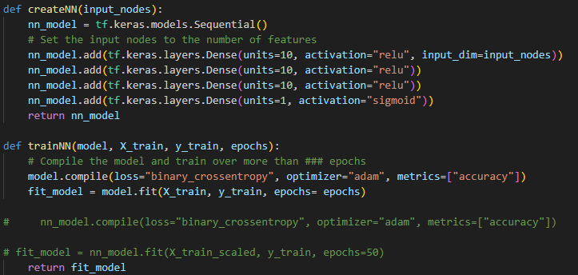
Project Overview
Model optimization
Create two Neural Network Models using Keras and TensorFlow to predict heart attack risk and outcome
Create a utilities.py to efficiently call functions
Important features were identified in order to create meaningful user questionnaires
Notes:
Pete

Slide 5
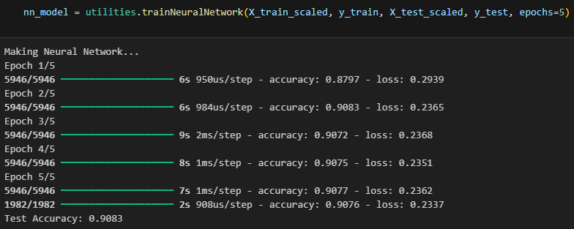
Result/Conclusion 1
Goal #1:
Create two Neural Network Models:
a) Prediction of heart disease risk
https://www.kaggle.com/datasets/alexteboul/heart-disease-health-indicators-dataset
b) Mortality prediction after having a heart attack
https://www.kaggle.com/datasets/asgharalikhan/mortality-rate-heart-patient-pakistan-hospital/
Result:
Successfully created two Neural Network Models
Notes:
Rebecca

Slide 6
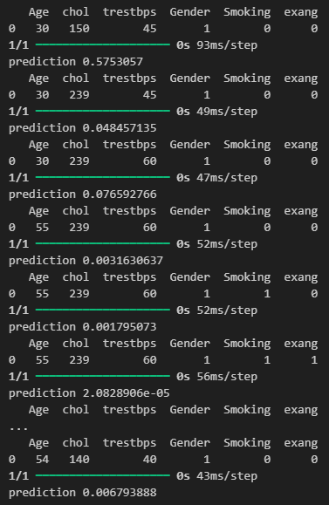
Result/Conclusion 2
Goal #2:
Develop a questionnaire for the patient to predict their own mortality danger, using Kaggle source data based on the previously trained Neural Network model.
Feature importance was taken into consideration
Heart Disease Data Set:
Age
Gender General Health Previous Stroke High Cholesterol
Mortality Data Set:
Age
Gender
Smoking history
Exercise-induced Angina
Resting Heart Rate
Notes:
Rebecca

Slide 7
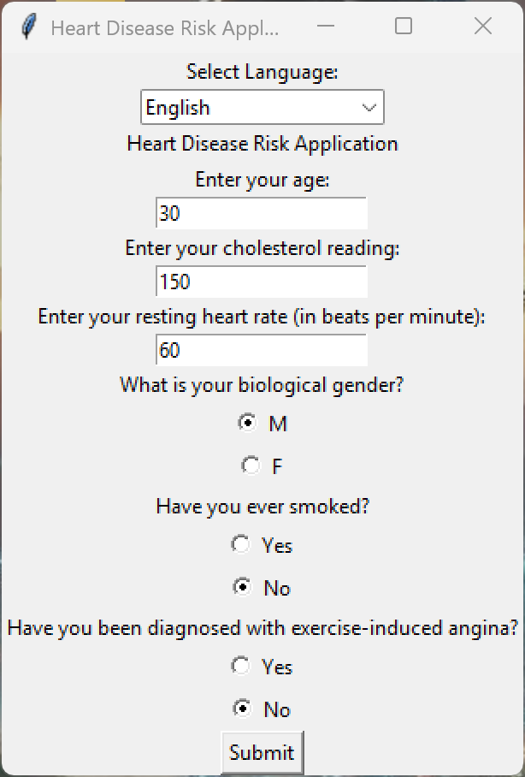
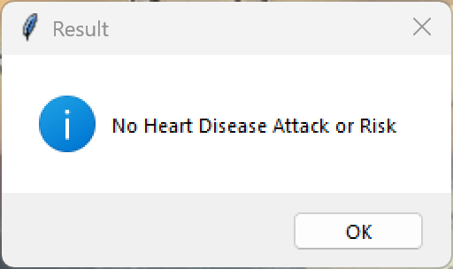
Result/Conclusion 3
Goal #3:
A GUI was developed using tkinter
What is tkinter?
Tkinter is the standard Python library for creating graphical user interfaces (GUIs), offering a simple yet powerful way to build desktop applications.
It provides widgets like buttons, labels, text fields, and frames, allowing developers to design interactive applications with minimal code.
Tkinter is lightweight, cross-platform, and comes pre-installed with Python, making it an accessible choice for GUI development.
For reference: https://docs.python.org/3/library/tk.html
Notes:
Rebecca

Slide 8
Result/Conclusion 4
Goal #4:
Create a LLM for the GUI that would translate the questionnaire from English to their preferred language (Spanish and German)
What we used:
MarianMTModel and MarianTokenizer are components from the Hugging Face Transformers library that enable neural machine translation, an efficient open-source translation model developed by Microsoft.
MarianTokenizer is used to preprocess text into tokenized inputs that the model can understand and convert back into human-readable text after translation.
Why Use MarianMT for Translation?
Fast and lightweight: Optimized for efficiency, making it suitable for real-time translation.
No need for an external API.
Pretrained models available: Supports many language pairs, eliminating the need for extensive retraining.
Customizable: Can be fine-tuned for domain-specific translations.
Translation between desired languages is supported: English ←→ Spanish ←→ German
Notes:
Ronak

Slide 9
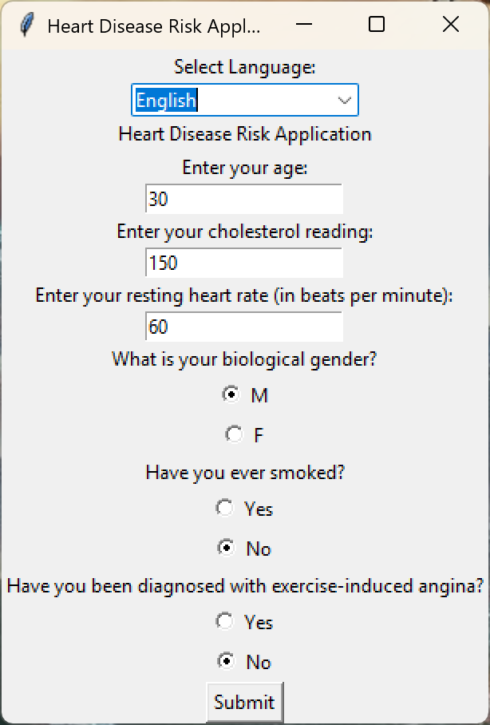
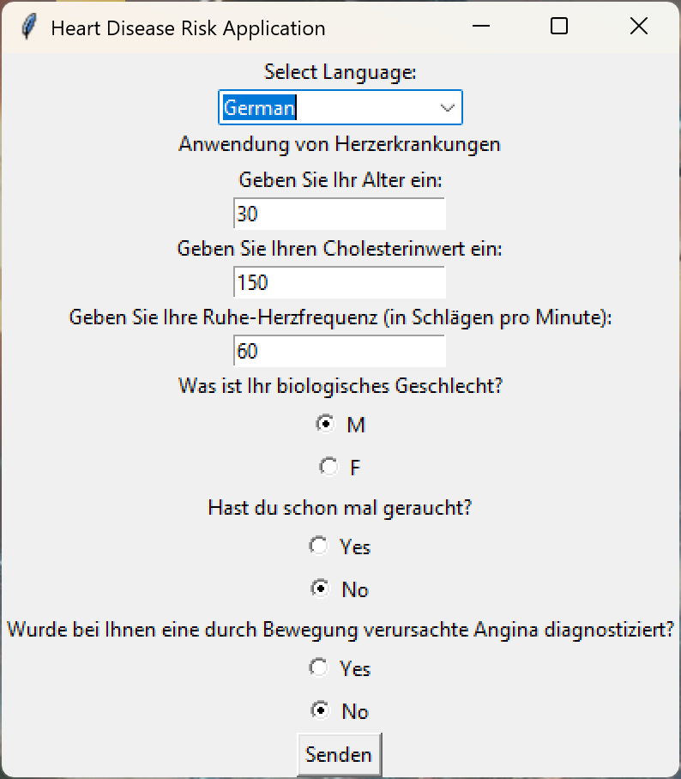
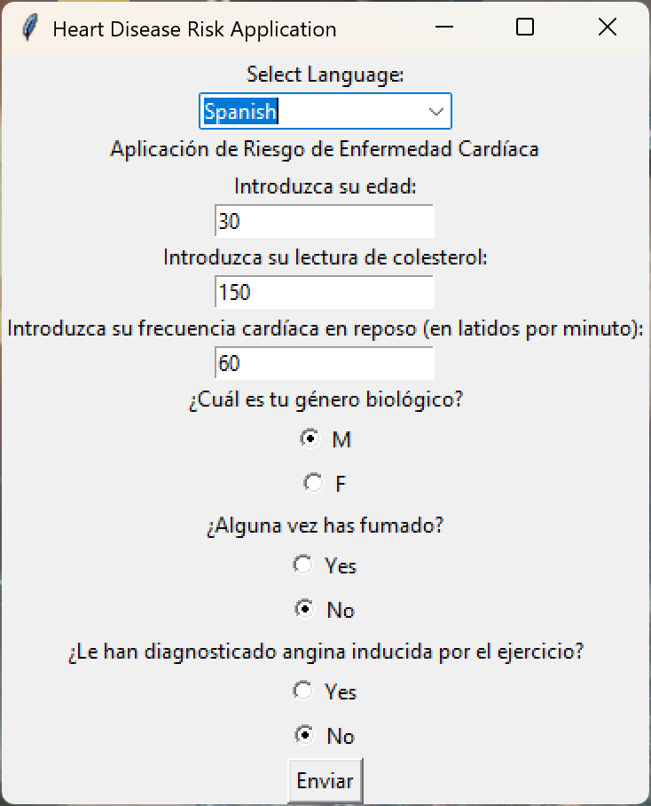
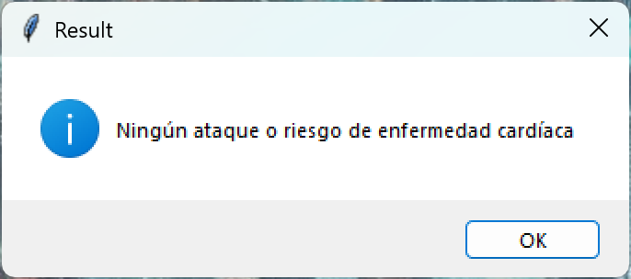
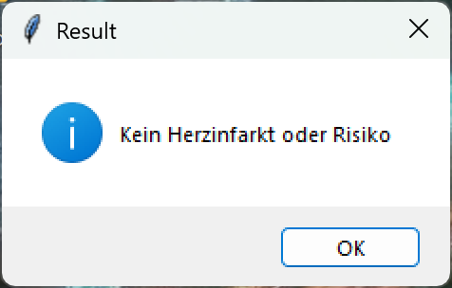
Result/Conclusion 4
Notes:
Ronak

Slide 10
Our first attempt to develop and train an app, that predicts a heart attack outcome, we used sourced data https://www.kaggle.com/datasets/ankushpanday1/heart-attack-risk-predictions (heart_attack_predictions.csv).
This dataset proved to be unreliable and we could not get any model to make a prediction with accuracy being extremely low; thus, we investigated other datasets. This dataset was synthetically created and dynamically balanced and proved to be unusable.
Originally, we had discussed creating a second questionnaire, along with its own GUI. That second questionnaire would predict one’s risk of heart disease. However, the (above described) dataset accuracy complication plus GUI creation complications, led to insufficient time to complete the second questionnaire.
During code testing we noticed some inconsistencies with the logical prediction. We determined that this is due to biased data, because the data had more mortalities (0) than survivors (1).
Problems Encountered
Notes:
Ronak

Slide 11

Summary
→We successfully created two Neural Network models
→Despite the complications with the original dataset, we persevered.
We worked with other datasets, until one gave us a favorable accuracy rate. Then, we successfully developed a questionnaire to predict one’s mortality.
→We were able to generate a GUI for the questionnaire.
→We were able to create an LLM that translates the questionnaire from English to either Spanish or German.
Notes:
Steve

Slide 12
With more time...
Spend more time in balancing data sets and/or looking for additional source data.
Include additional languages, as well as explore different pre-trained models that might tokenize faster.
Add features to the GUI to strongly encourage the patient to visit a physician when results are unfavorable.
Future developers should consider the work it takes to recreate a model appropriate for the GUI.
Future
enhancements
Notes:
Steve

Slide 13



Questions?
Notes:
Steve

Slide 14

The End
Notes:
Steve

