Slide 1
CORONAVIRUS: PPP LOANS IN VIRGINIA
Pedro Aida, Al Misa, Bridget Reardon

Slide 2
AGENDA
01
02
03
04
INTRODUCTION
DATA
COMPLICATIONS
ANALYSIS
Explains the project
Contents, process & tools
Lessons learned
Visualizations & conclusion

Slide 3
01
INTRODUCTION

Slide 4
Paycheck Protection Act (PPP)
Business loan program administered by the Small Business Administration to provide small businesses with funding to cover payroll and expenses with the goal of keeping people employed
Part of the CARES Act which is a $2.2 trillion economic stimulus bill that was passed by the U.S. congress in response to the economic devastation caused by the Covid-19 pandemic
$525 billion in PPP loans were issued in 2020
$12.6 billion of those loans were issued to businesses in Virginia
$3.3 billion of those loans were for amounts under $150,000

Slide 5

INTRODUCTION
Our project is an analysis of the PPP loans that were issued in Virginia for amounts less than $150,000
Data was pulled to determine the total amount of loans each industry received
We were curious how different regions of the state were affected
We determined the total amount each congressional district received and which industry in that district received the most loans

Slide 6
02
DATA

Slide 7
TOOLS & PROCESS
CSV
DATABASE
VISUALIZATIONS
WEBSITE
Collected data from the US Department of Treasury
Cleaned and loaded data into PGAdmin
Created visuals using: Chart.js
D3
Leaflet
Used Heroku to build a website

Slide 8

PPP DATA
LOAN AMOUNT
INDUSTRY TYPE
CONGRESSIONAL DISTRICT
Dollar amount for each loan under $150,000 that was issued (98,408 total)
For each loan, an NAICS code was listed and had to be converted to get the specific industry type
The congressional district for each loan was listed
Notes:
- Used the first 2 digits of the NAICS code to pull the industry in which the business is categorized

Slide 9
03
COMPLICATIONS

Slide 10
LESSONS LEARNED
Data Complications
3% of the records are labeled as unknown
12 of the loan records were in congressional districts for other states or not identified
Heroku
Uploading the bar chart
Notes:
- 2,802 of the loan records (about 3% of the total) did not have the NAICS codes or were labeled as unknown so we don’t know what industries those loans went to.

Slide 11
04
ANALYSIS

Slide 12
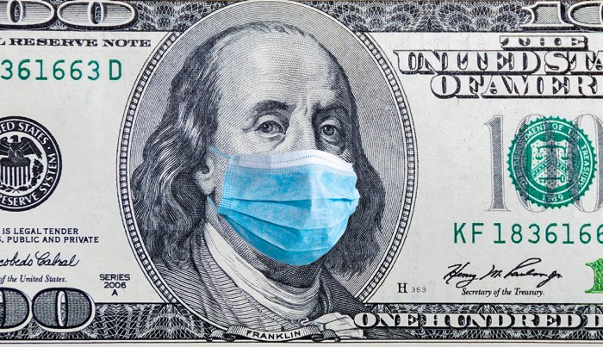
$3,358,747,651
in PPP loans under $150,000 issued to Virginia as of August 8, 2020
Notes:
$3.3 billion dollars granted for companies

Slide 13
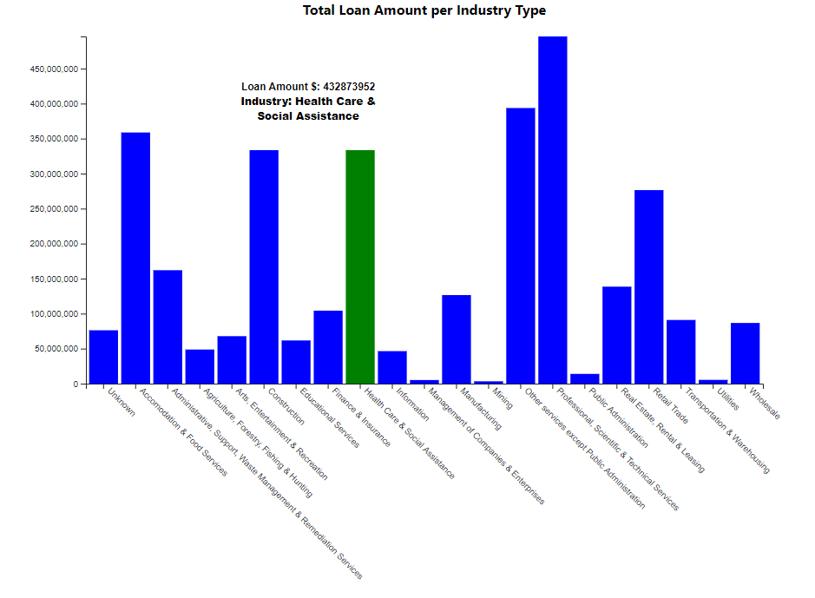
D3 BAR GRAPH

Slide 14

TOTAL LOAN AMOUNT PER INDUSTRY
HIGHEST
LOWEST
INTERESTING
Professional, Scientific & Technical Services
Mining
Healthcare & Social Assistance (2nd)

Slide 15
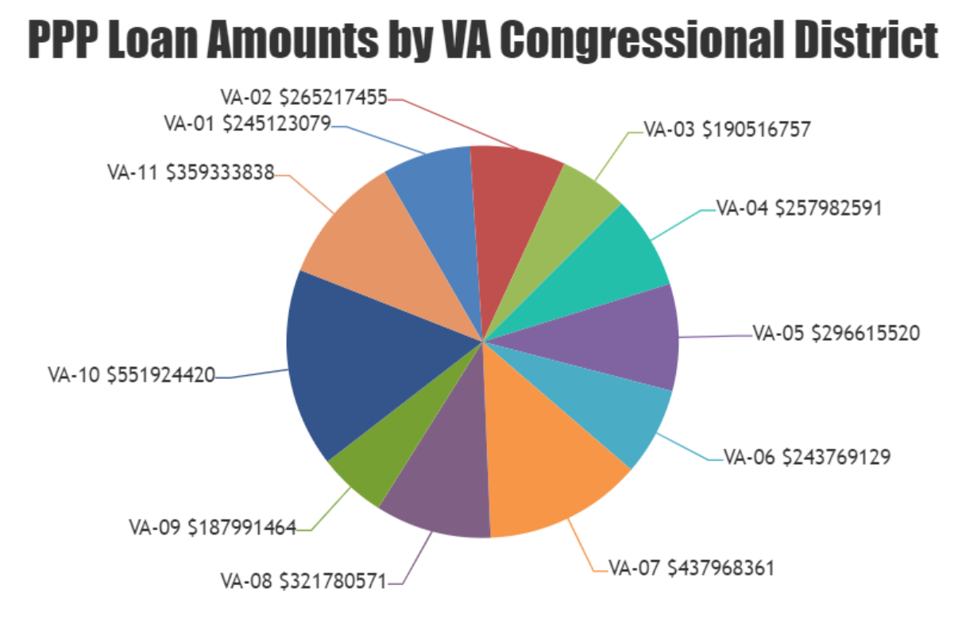
CHART.JS

Slide 16
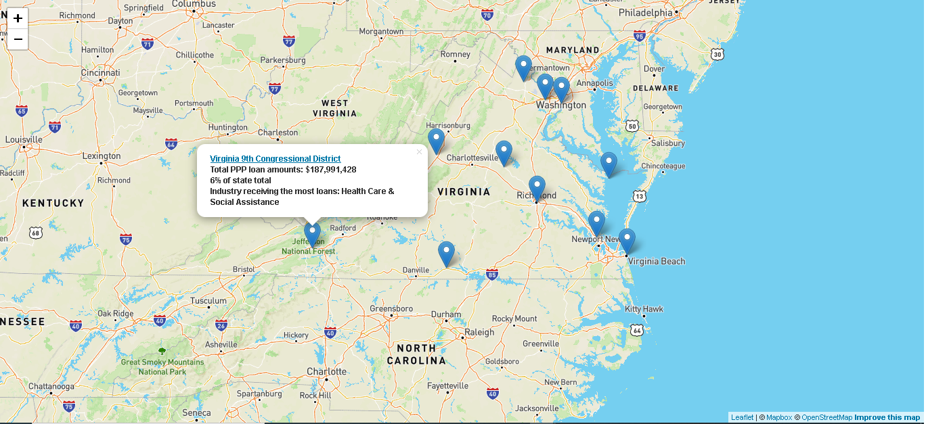
LEAFLET

Slide 17
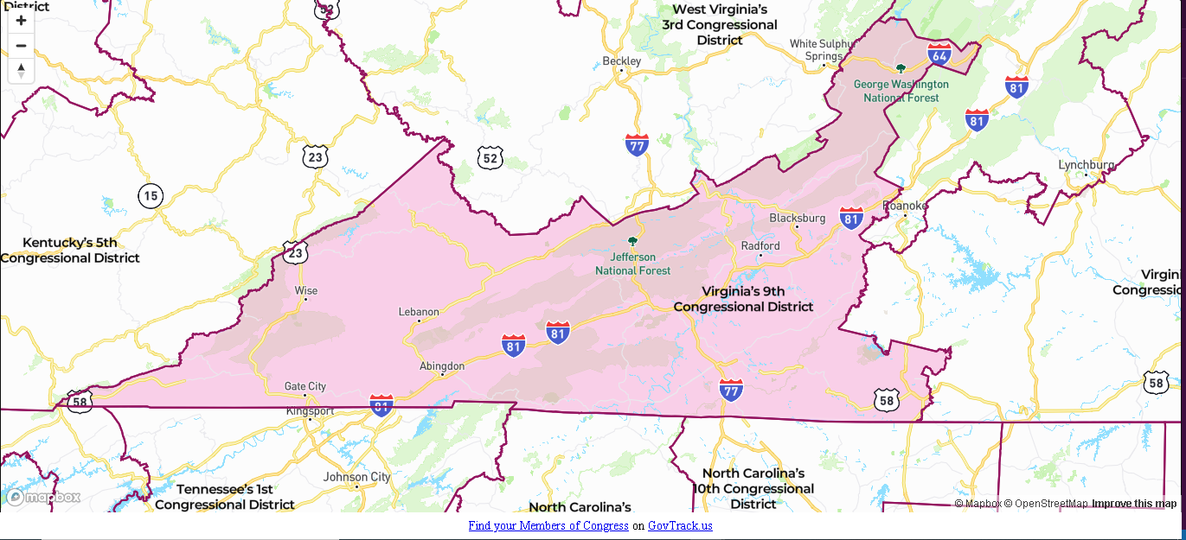

Slide 18



Half of the loans (around $1.7 billion) went to districts in northern and central Virginia where the Professional, Scientific & Technical Services industries received the most loans

Slide 19

THANKS!
Al Misa
Pedro Aida
Bridget Reardon
Please keep this slide for attribution.

