Slide 1

Smart Dustbin
Guide: Team: Gautam G Raikar[4PM12CS029]
Sunil M E Ankitha [4PM12CS008]
Lecturer, CSE Dept. Ashik S[4PM12CS013]
PESITM, Shimoga Bhuvana M S[4PM11CS015]

Slide 2
ABSTRACT
As people are getting smarter so are the things. While the thought comes up for Smart cities there is a requirement for Smart waste management. The idea of Smart Dustbin is for the Smart buildings, Colleges, Hospitals and Bus stands. The Smart Dustbin thus thought is an improvement of normal dustbin by elevating it to be smart using sensors and logics. Smart dustbins is a new idea of implementation which makes a normal dustbin smart using sensors for garbage level detection and sending message to the user updating the status of the bin. As soon as the dustbin is full, it moves in the predefined path to reach the larger container with the help of motors and wheels.

Slide 3
CONTENTS
Background Research
System Analysis
System Design
Implementation
Result
Feasibility
Future scope
Conclusion

Slide 4
Background research
“Smart Garbage Management System” is a concept where the large dustbins placed in public are provided with sensors to monitor the garbage level and the message is sent to the authorized person using GSM Modem. The entire working is monitored using a GUI.
When the authorities receive the message the cleaning vehicle is sent to that location immediately to empty the dustbin.

Slide 5
System analysis
HARDWARE REQUIREMENTS
SOFTWARE REQUIREMENTS
Ultrasonic Sensors
IR Sensor
GSM Modem
DC motor
Arduino Board
L293D
Battery, Bread board, Jump wires
Wheels and Chassis
Arduino IDE
Arduino Language

Slide 6
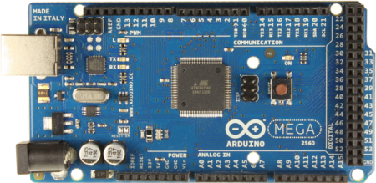
Arduino Board
Microcontroller | ATmega2560
Operating Voltage | 5V
Input Voltage (recommended) | 7-12V
Input Voltage (limit) | 6-20V
Digital I/O Pins | 54 (of which 15 provide PWM output)
Analog Input Pins | 16
DC Current per I/O Pin | 20 mA
DC Current for 3.3V Pin | 50 mA
Flash Memory | 256 KB of which 8 KB used by bootloader
SRAM | 8 KB
EEPROM | 4 KB
Clock Speed | 16 MHz
Length | 101.52 mm
Width | 53.3 mm
Weight | 37 g

Slide 7
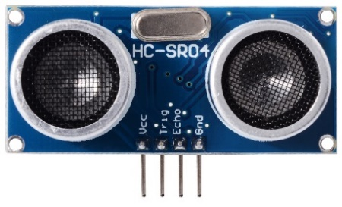
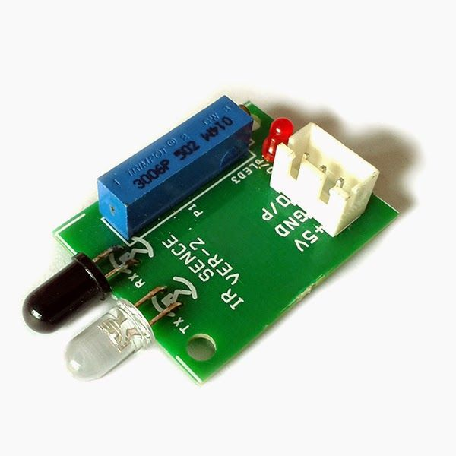
Ultrasonic sensor
IR sensor

Slide 8
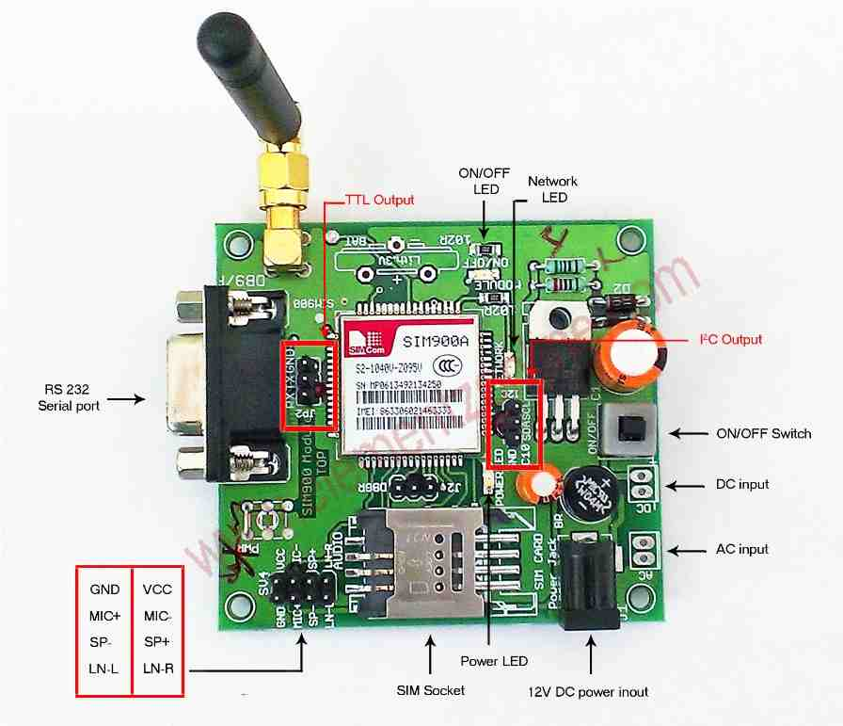
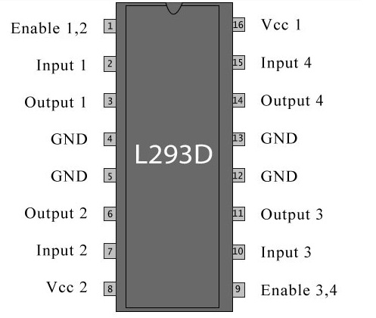
GSM Modem
L293D

Slide 9
System Design
Module1:Garbage level Detection
Ultrasonic Sensor is used for the garbage level detection in the dustbin. When the dustbin is full, it sends the message indicating the status of the dustbin through GSM modem
Module2:Motion of the dustbin in the predefined path.
The dustbin moves in the predefined path to reach the lager container. This is enabled by the hardware setup consisting of power supply, DC motors and wheels.

Slide 10

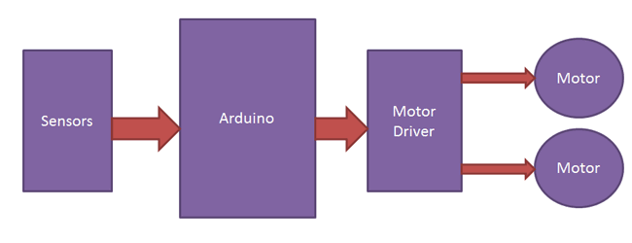

Slide 11
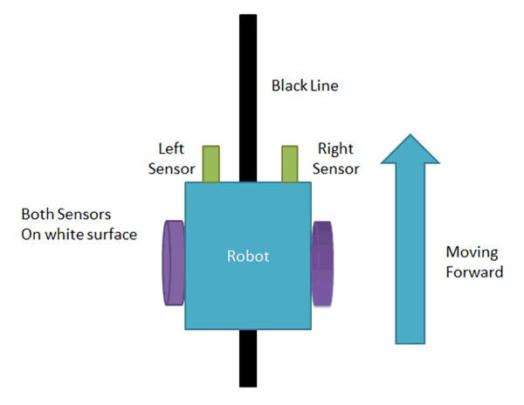
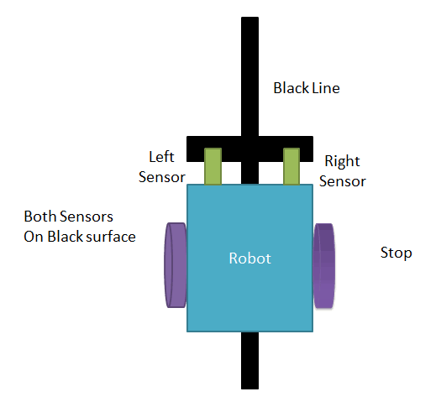

Slide 12
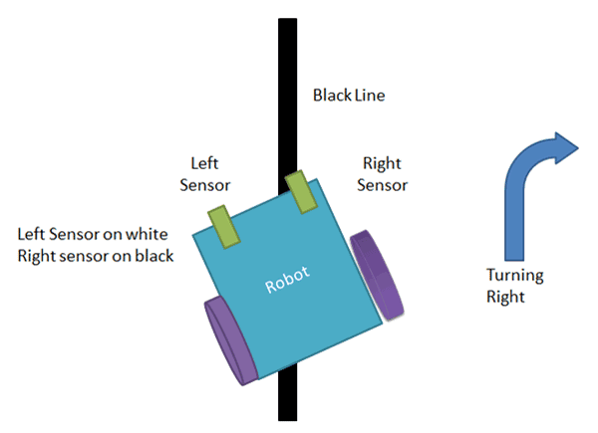
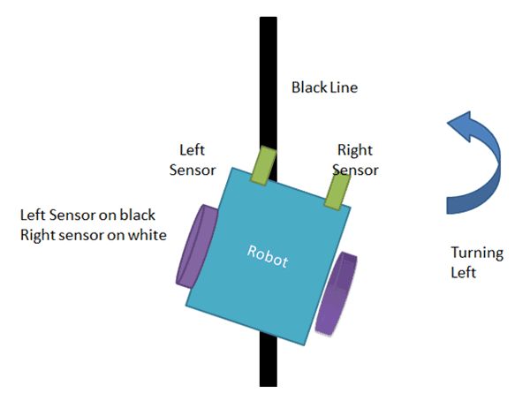

Slide 13
Implementation
Checking the garbage level in the dustbin
Garbage level detection is done by ultrasonic sensor(HC-SR04). The four pins of ultrasonic sensor namely echo, trigger, vcc, gnd are connected to the Arduino board.
Send message to the user
Updating the status of the dustbin when it is full and about to be moving to the larger container is intimated to the user through a message sent by the system. The message is sent via GSM modem which is connected to the Arduino board. GSM uses sim card of any possible network.
Motion of the dustbin towards the larger container
As soon as the garbage level in the dustbin reaches the specified level it initiates the line follower robot. The path is specified by providing dedicated lane to the smart dustbin. The follower robot is used to trace the path and reach the container. The line follower follows the black line in the predefined path.
Dumping waste
Dumping of waste is done manually by the person in charge.

Slide 14
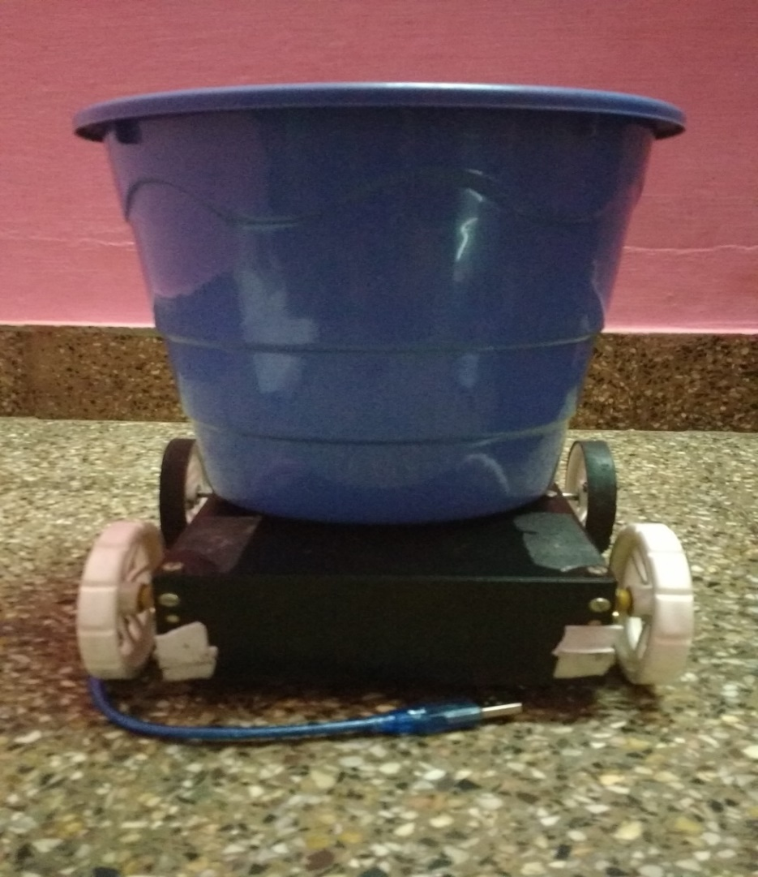
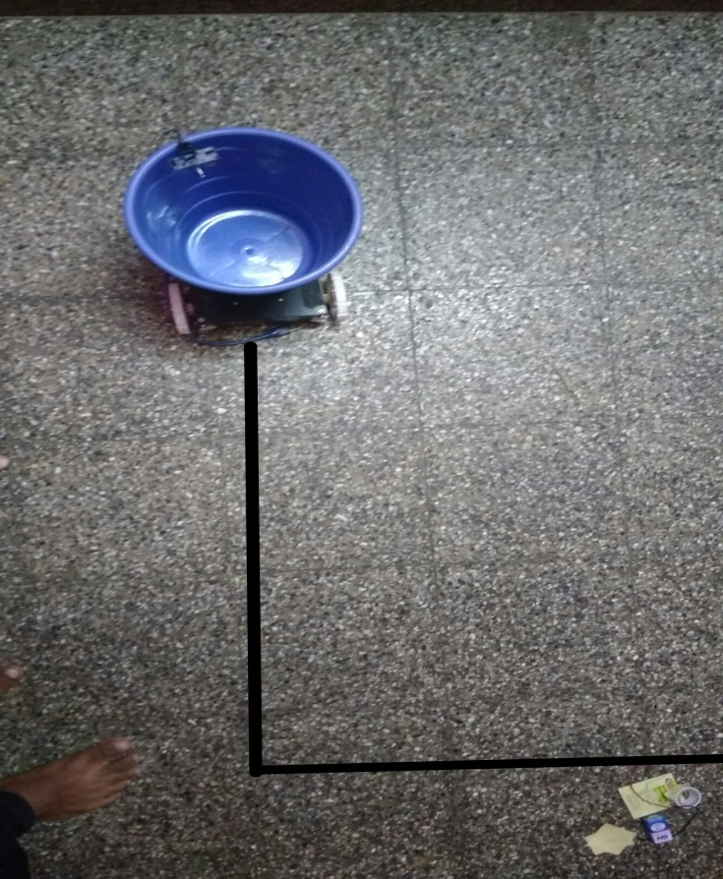
result

Slide 15
Feasibility
While the thought comes up for Smart cities there is a requirement for Smart waste management.
The idea of Smart Dustbin is for the Smart buildings, Hospitals and Bus stands.

Slide 16
Future scope
There is a great scope for the modifications of the Smart Dustbin in future. The system can be improved by adding new functionalities. Dumping of the waste was manual in Smart dustbin this can be automated by fixing a robot arm or a tipper. The path tracking can be GPS enabled and the dustbins can be monitored through a GUI. The Smart dustbins can be well widely used in the Smart buildings of Smart cities.

Slide 17
conclusion
Smart dustbins are the now the needs of Smart buildings. Smart waste monitoring and management is the keen idea of smart city planners. Smart dustbins is a new idea of implementation which makes a normal dustbin smart using sensors for garbage level detection and sending message to the user updating the status of the bin. As soon as the dustbin is full it moves in the predefined path to reach the larger container with the help of motors and wheels. The garbage is dumped to the container manually and the dustbin moves back in the same direction back to its initial place.

