Slide 1
MusicStoreDB
Re-runnable script

Slide 2
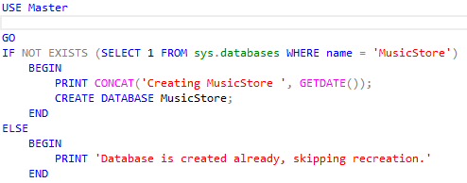
Creation of MusicStoreDB

Slide 3
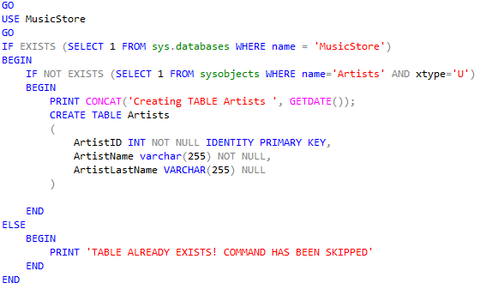
Creation of Artists table

Slide 4
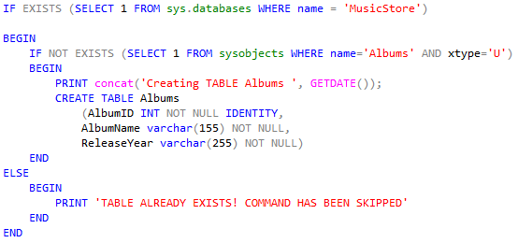
Creation of Albums table

Slide 5
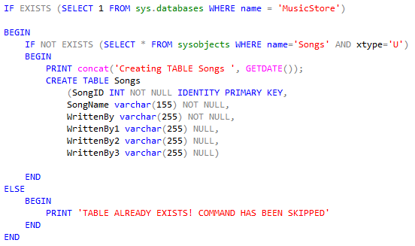
Creation of Songs Table

Slide 6
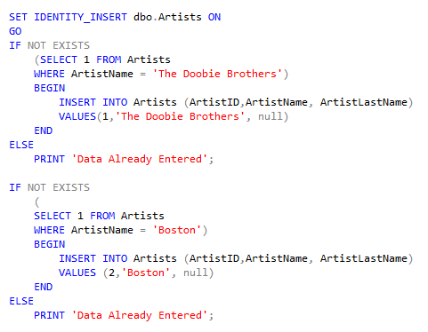
Inserting Artist data into Tables
If else for each entry in case some how one of them is deleted, they are all reentered into database table.

Slide 7
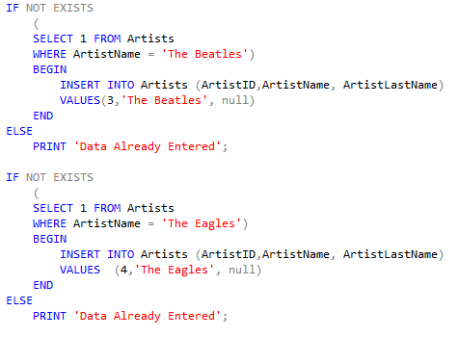

Slide 8
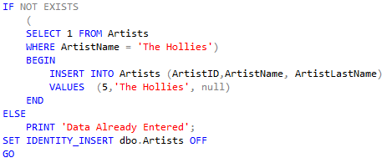

Slide 9
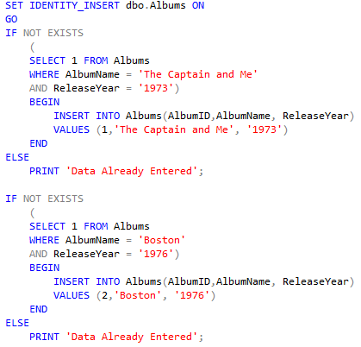
Insert Album Data into Table

Slide 10
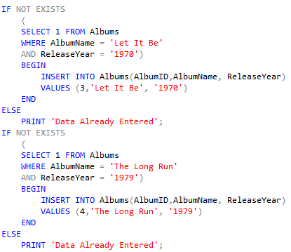

Slide 11
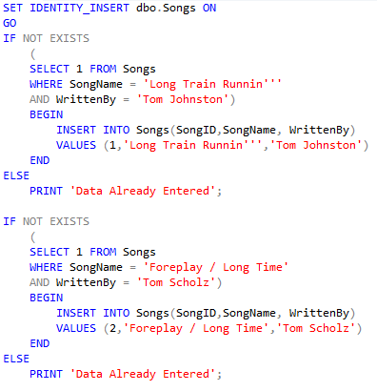
Insert Song names into Song Table and who wrote them

Slide 12
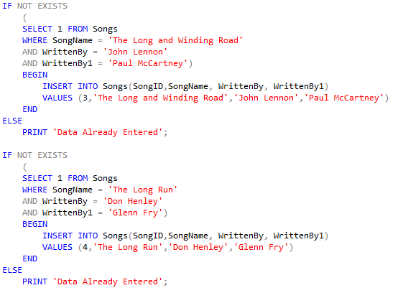

Slide 13
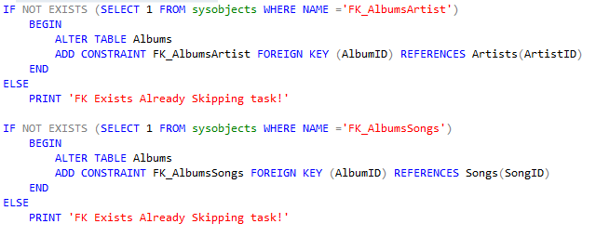
Add PK's and FK's to the tables

Slide 14
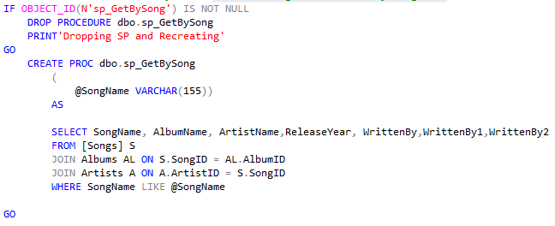
Store Procedure for searching for All info by Song Name

Slide 15
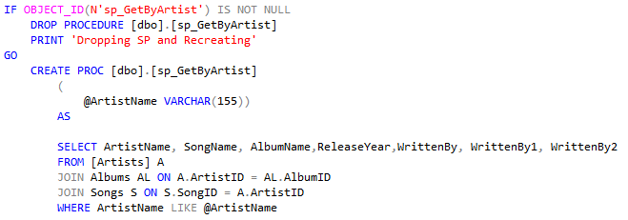
Store Procedure for search by artist

Slide 16
Indexes

