Slide 1
IDEs & Notebooks Peter Davis

Slide 2
Agenda
- What is an IDE?
- What is a notebook?
- Why browser-based notebooks?

Slide 3
What is an IDE?
An IDE is an app in which you can write and run code
Stands for Integrated Development Environment
Can be used with any language
Your one stop shop for:
Editing
Debugging
Compiling/Interpreting (language dependent)
Git integration

Slide 4
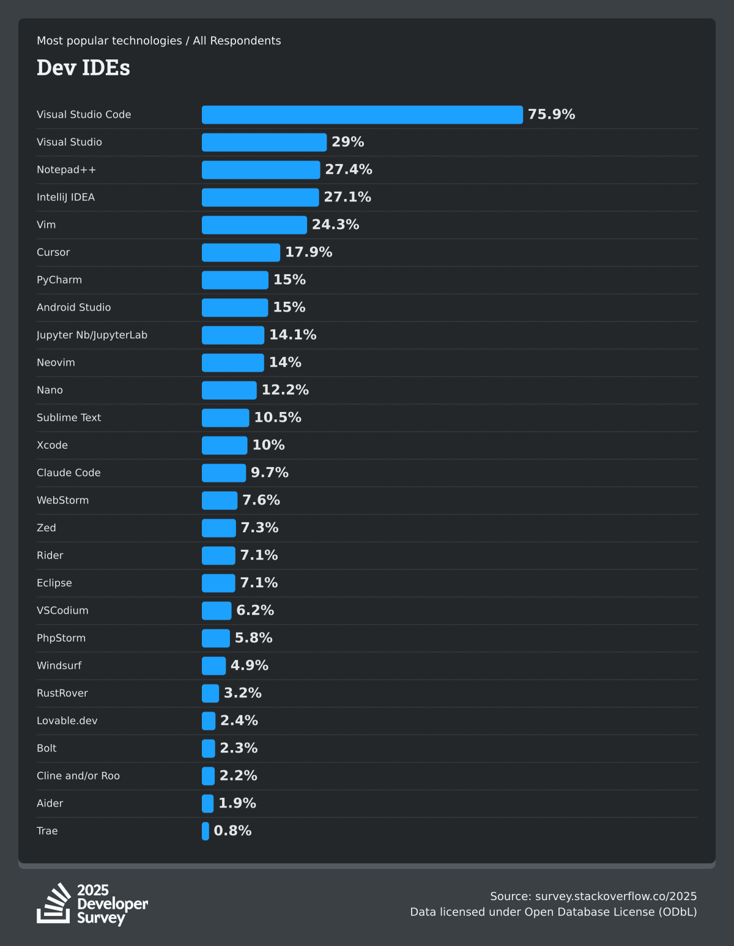
Examples of IDEs
Visual Studio Code
IntelliJ
PyCharm
Notepad++
Results of the 2025 StackOverflow Dev Survey

Slide 5
VSCode vs Intellij & Pycharm
VSCode
Started out as an editor
Open source
Highly modular
Customizable through extensions
Free to use
Jetbrains
Purpose built IDE
Optimized for one language
Strong autocomplete
Premium version costs $$$

Slide 6
What is a notebook?
A notebook allows code to be mixed with documentation and visualizations
Require an interpreted and interactive language
Often limited to iPython or R
Java and JS could theoretically work but…
They aren’t “DSA” languages
They lack established library ecosystems
Not worth the effort

Slide 7
Some Popular Notebooks
Browser-Based
Google Colab
Deepnote
Kaggle
Run Locally
Jupyter
Anaconda
R Markdown (in Rstudio)

Slide 8
Browser Based vs Local Notebooks
Browser Based
Cloud kernel
Performance can be affected by browser
May require a subscription (Colab+, Deepnote Team)
Local
Code executes on your hardware
Performance can be affected by hardware constraints
Usually an IDE plugin

Slide 9
Notebooks vs IDEs
Notebooks
Allow visualizations to be mixed with code
Optimized for DSA
Requires interactive languages
IDEs
Offers file management
Optimized for SoftDev
Can be used with any language

Slide 10
THANK YOU
https://survey.stackoverflow.co/2025/technology#most-popular-technologies-dev-envs-dev-envs
https://github.com/PeteDavis2002/NotebooksVsScriptsKeyDifferences

