Slide 1

UML

Slide 2
Unified Modeling Language
Standard language for software diagramming
Essentially a pictorial language used to make software blueprints

Slide 3
Class Diagram
Class diagram shows classes, interfaces, and associations
It describes the responsibilities within a software application
By far the most popular of the UML diagrams
Part of the structure diagram

Slide 4
Relationships
One-to-Many
Body has many Body Parts (head, chest, legs, arms, feet, hands)
Many-to-Many
Students take many Subjects and Subjects will be studied by many Students
One-to-One
One Person has one Social Security Number

Slide 5
Multiplicity Indicators and Values
Indicator
0..1
1
0..*
1..*
Values
Zero or one
One only
Zero or more
One or more
Note: Indicators can be whatever you want it to be

Slide 6
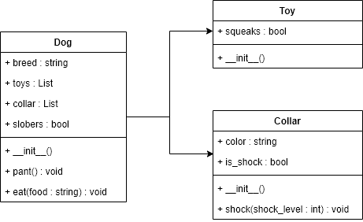
Class Diagram Example
Notes:
Dog → Toy is 0..*
Dog → Collar is 0..*

Slide 7
Class Diagram Example
Dog → Toy is 0..*
Dog → Collar is 0..*
0..
*
0..
*

Slide 8
UML Diagrams
There are many different types of UML diagrams.
Even though class diagrams are the most popular, UML diagrams, like anything else in coding, applies to the right tool for the job philosophy.
UML Drawing Resource:
draw.io
www.gliffy.com
Microsoft Visio

