Slide 1
SignalR
Bringing the awesome

Slide 2




Me
petegoo.com
@petegoo
github.com/petegoo

Slide 3


Who is SignalR
Started by two guys from the ASP.Net team
Started as an open source project
Taken on by Microsoft as part of ASP.Net (2012.2)
Shipped 19th February 2013
Damian Edwards
David Fowler

Slide 4
What is SignalR
ASP.NET SignalR is a new library for ASP.NET developers that makes it incredibly simple to add real-time web functionality to your applications.
What is "real-time web" functionality? It's the ability to have your server-side code push content to the connected clients as it happens, in real-time.
from github.com/signalr/signalr

Slide 5
Demo
SignalR Stock Ticker

Slide 6
How Not
Polling
Client
Server
Client opens a connection to the server
Server returns any messages
Client waits
Client checks again
Request
Response
Request
Response

Slide 7
How
Long Polling
Client
Server
Client opens a connection to the server
Server keeps the connection open until there are messages
Server returns response with messages as they arrive and closes the connection
Client re-opens connection immediately to receive next batch of messages
Request
Response

Slide 8
How
Server Sent Events
Client
Server
Client opens a connection to the server
Server keeps the connection open
Server streams response with messages as they arrive, keeps the connection open
Uses forever frame in IE
Request
Streamed Response
Streamed Response

Slide 9
How
Web Sockets
Client
Server
Client opens a connection to the server requesting web sockets
Server accepts and sends a 101 which initiates a bi-directional web socket connection
Server sends web socket messages as they arrive
Only available on some browsers
Server must be Win 8 or 2012 and .net 4.5
Request
101 Web Socket Accept
Web Socket Message
Web Socket Message

Slide 10
Connection Negotiation
SignalR will perform connection negotiation when opening a connection
Chooses best protocol available
Will automatically switch when e.g. websockets are available

Slide 11
Demo
Simple SignalR RPC Hub

Slide 12
Persistent Connection
The low level connection object
You must specify the route
Override
OnReceived
OnConnected
OnDisconnected

Slide 13
Hubs
Higher Level RPC style connection
Specify a method on the server class that is called from clients
Call client methods from server via dynamic

Slide 14
Demo
A SignalR Chat Web App

Slide 15
Demo
A SignalR Client App

Slide 16
Clients
Javascript
.Net 4.0+
WinRT
Windows Phone 8
Node
iOS
Android

Slide 17
Sending from outside SignalR
Use the GlobalHost.ConnectionManager
GetConnection<T> or GetHubContext<T> will get a connection object you can use to:
Broadcast
Send (including to groups)

Slide 18
How does it scale?
All requests are async, no thread pool hogging
Tested to hundreds of thousands of idle connections per node (IIS tweaks)
Combined with a backplane or persistent message store can scale horizontally.
Azure Service Bus and Redis available out of the box

Slide 19
What would I use it for
Anywhere you need real time updates over HTTP
Long running async requests
Thick client toast notifications (Pre-Win8)
Chat
Telemetry
Change Notification / Cache Eviction

Slide 20
Demo
Real time change notification

Slide 21
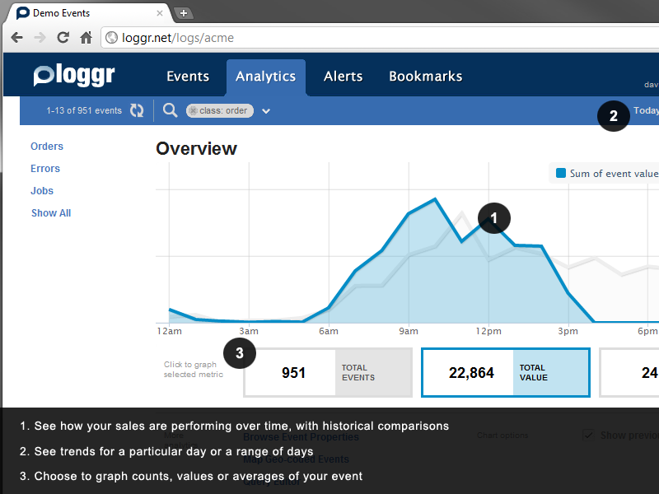
Projects using SignalR
JabbR – Real time chat LoggR – Real time web app monitoring Complify.net – .Net repl in the browser
Workflow Tracking Viewer – Real time WF monitoring Pushqa – Rx Queryable Pub/Sub

Slide 22
Where next
Signalr.net
Long running async requests
Thick client toast notifications (Pre-Win8)
Chat
Telemetry
Change Notification / Cache Eviction

