Slide 1
SignalR
Bringing the awesome

Slide 2




Me
petegoo.com
@petegoo
github.com/petegoo

Slide 3


Who is SignalR
Started by two guys from the ASP.Net team
Started as an open source project
Taken on by Microsoft as part of ASP.Net (2012.2)
Shipped 19th February 2013
Damian Edwards
David Fowler

Slide 4
What is SignalR
ASP.NET SignalR is a new library for ASP.NET developers that makes it incredibly simple to add real-time web functionality to your applications.
What is "real-time web" functionality? It's the ability to have your server-side code push content to the connected clients as it happens, in real-time.
from github.com/signalr/signalr

Slide 5
Demo
SignalR Stock Ticker

Slide 6
How
Long Polling

Slide 7
How
Server Sent Events
Forever Frame in IE

Slide 8
How
Web Sockets

Slide 9
Demo
Simple SignalR RPC Hub

Slide 10
Hubs

Slide 11
Persistent Connection

Slide 12
Demo
A SignalR Chat Web App

Slide 13
Clients
Javascript
.Net 4.0+

Slide 14
Demo
A SignalR Client App

Slide 15
How does it scale?
All requests are async, no thread pool hogging
Tested to …..
Combined with a backplane or persistent message store can scale horizontally.

Slide 16
What would I use it for
Anywhere you need real time updates over HTTP
Long running async requests
Thick client toast notifications (Pre-Win8)
Chat
Telemetry
Change Notification / Cache Eviction

Slide 17
Demo
Real time change notification

Slide 18
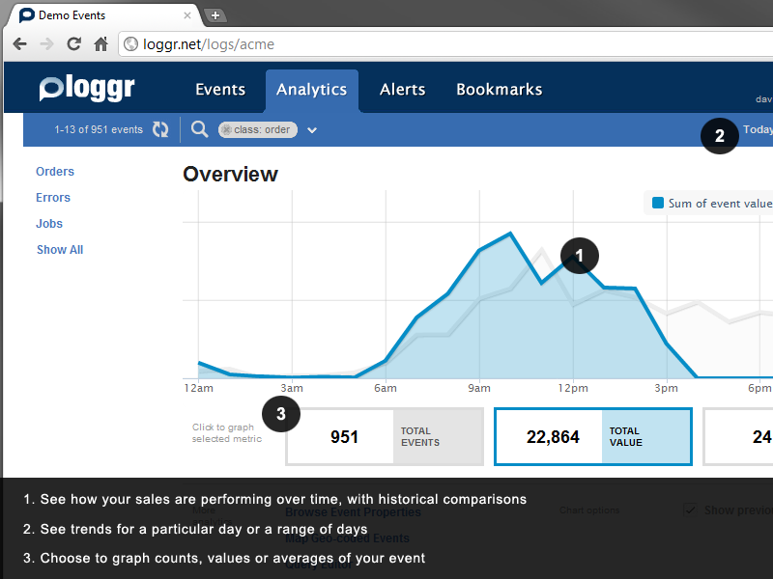
Projects using SignalR
JabbR – Real time chat LoggR – Real time web app monitoring Complify.net – .Net repl in the browser
Workflow Tracking Viewer – Real time WF monitoring Pushqa – Rx Queryable Pub/Sub

