Slide 1
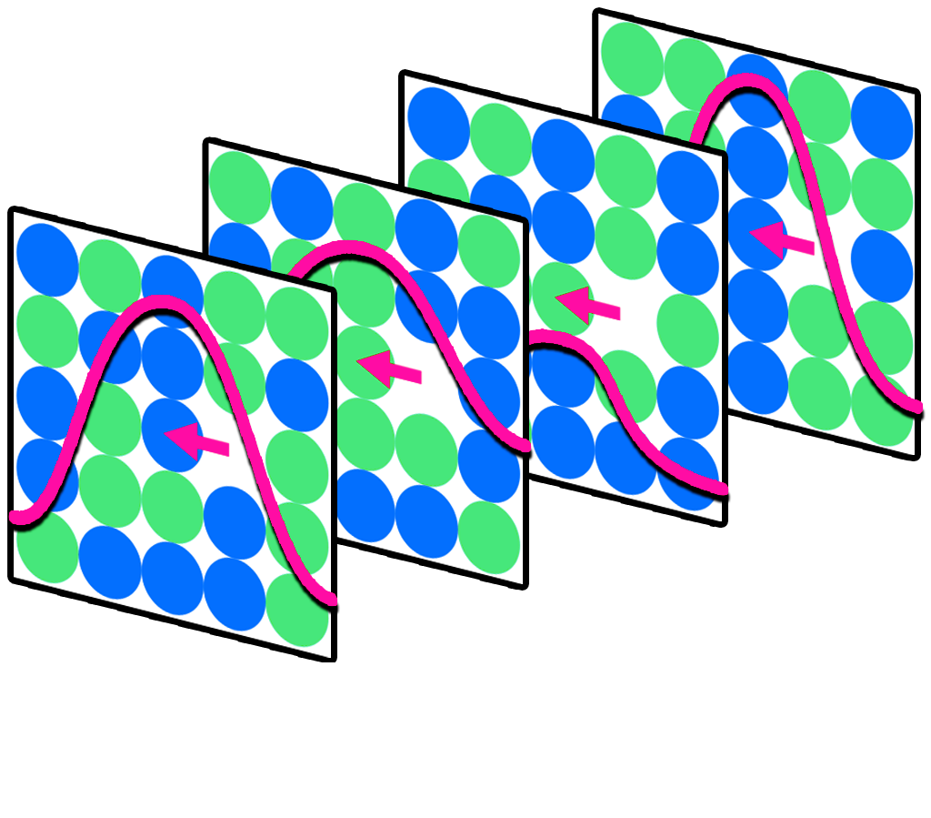
Hop-Decorate Tutorial High-throughput Atomistic Workflow for Chemically Complex Materials
Peter Hatton
MST-8
In collaboration with the Thrust 1 team of 20220063DR: Accelerated Dynamics Across Computational and Physical Scales
https://gitlab.lanl.gov/peter_hatton/hopdecorate

Slide 2
Agenda
Motivation and context for the code development.
Main functionality (State Space Mapping and Redecoration)
Parallelization strategies
Worked examples.

Slide 3
Agenda
Motivation and context for the code development.
Main functionality (State Space Mapping and Redecoration)
Parallelization strategies
Worked examples.

Slide 4
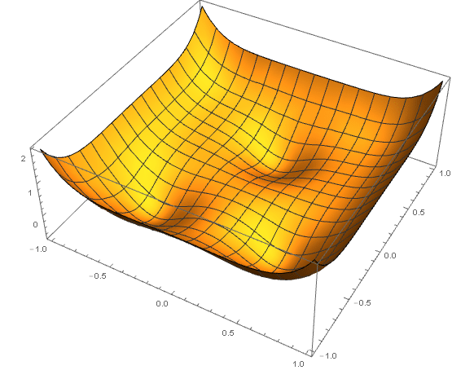
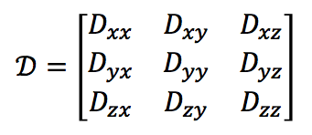
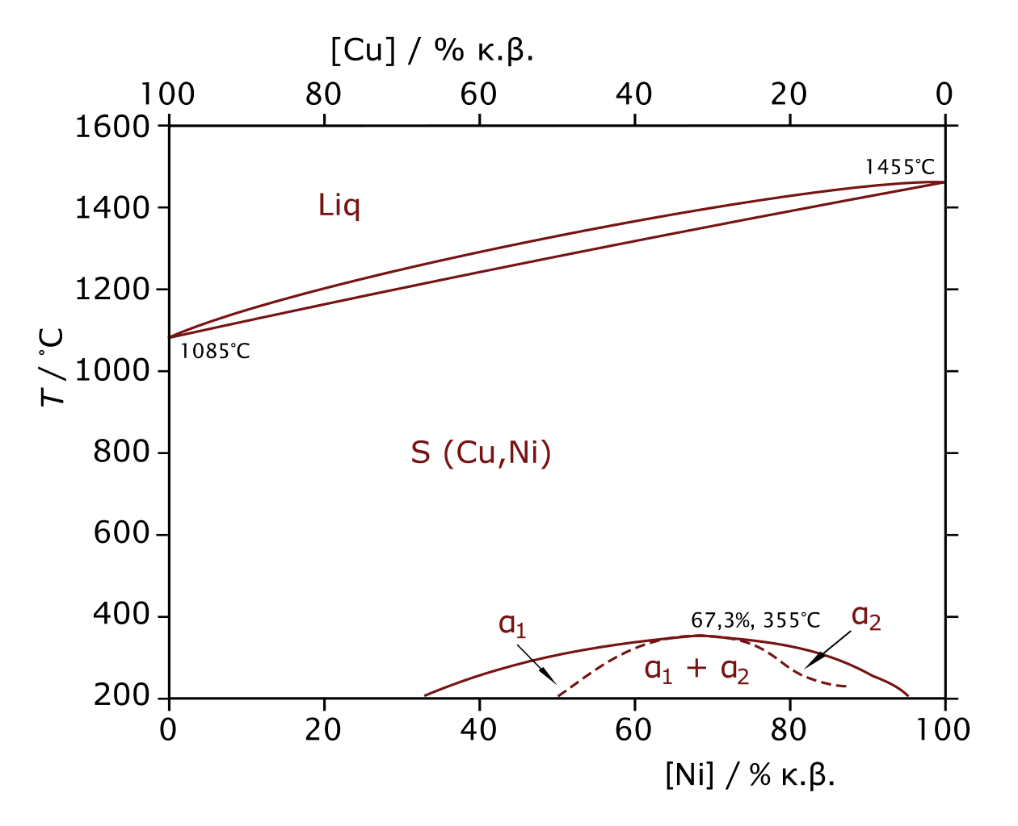
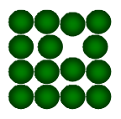
Accelerated Dynamics Across Computational and Physical Scales Thrust 1: Point defect transport in MPEAs.
Given
Interatomic potential
Alloy composition
Defect
Automated
Loop
Cluster dynamics models of damage evolution

Slide 5
State Space in ‘Simple’ Materials
In a ‘Simple’ material – vacancy defect transport is fully characterized by
1 unique state and 1 unique transition.
Notes:
IN SOMETHING LIKE PURE NI, WE FIND 1 VAC POSITION AND 1 BARRIER AND WE’RE DONE.
Can just do MSD and get the D tensor
IN SOMETHJING LIKE NI20CR WE HAVE TO FIND ~ X VACANCY POSTIIONS AND ~Y BARRIERS…
Current methodologies are not sufficient – it’s a sampling issue…
The trajectory will be the sum of many such hops over a multitude of environments
We can’t a priori enumerate all hops… what do we do???

Slide 6
State Space in ‘Simple’ Materials
In a ‘Simple’ material – vacancy defect transport is fully characterized by
1 unique state and 1 unique transition.
State Space
Notes:
IN SOMETHING LIKE PURE NI, WE FIND 1 VAC POSITION AND 1 BARRIER AND WE’RE DONE.
Can just do MSD and get the D tensor
IN SOMETHJING LIKE NI20CR WE HAVE TO FIND ~ X VACANCY POSTIIONS AND ~Y BARRIERS…
Current methodologies are not sufficient – it’s a sampling issue…
The trajectory will be the sum of many such hops over a multitude of environments
We can’t a priori enumerate all hops… what do we do???

Slide 7
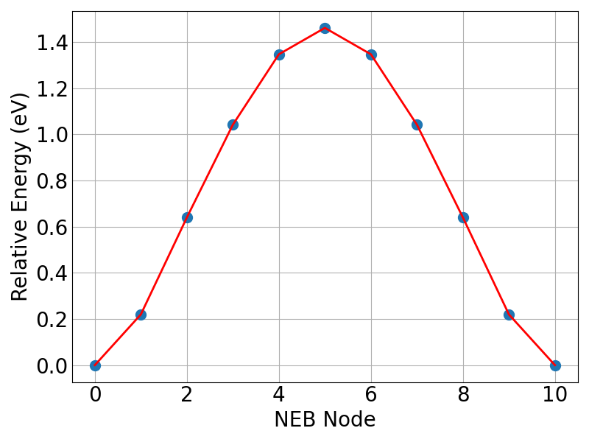
State Space in ‘Simple’ Materials
In a ‘Simple’ material – vacancy defect transport is fully characterized by
1 unique state and 1 unique transition.
State Space
Notes:
IN SOMETHING LIKE PURE NI, WE FIND 1 VAC POSITION AND 1 BARRIER AND WE’RE DONE.
Can just do MSD and get the D tensor
IN SOMETHJING LIKE NI20CR WE HAVE TO FIND ~ X VACANCY POSTIIONS AND ~Y BARRIERS…
Current methodologies are not sufficient – it’s a sampling issue…
The trajectory will be the sum of many such hops over a multitude of environments
We can’t a priori enumerate all hops… what do we do???

Slide 8
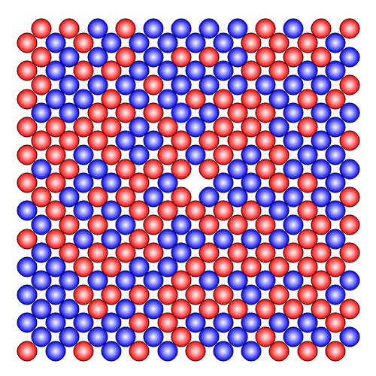
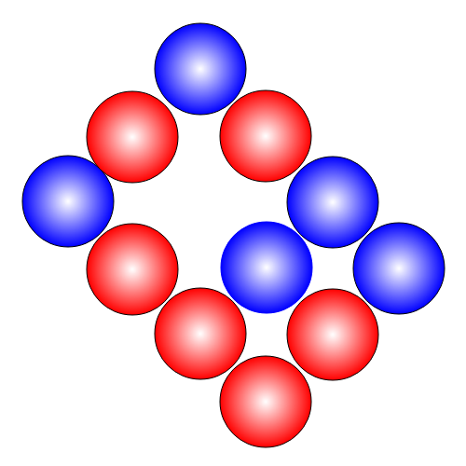
State Space in Chemically Complex Materials
A vacancy in a concentrated alloy encounters many different chemical environments
The characterization of transport will be the sum of many such hops over a multitude of environments
Swinburne, Thomas D. Computational Materials Science 193 (2021): 110256.
Notes:
IN SOMETHING LIKE PURE NI, WE FIND 1 VAC POSITION AND 1 BARRIER AND WE’RE DONE.
Can just do MSD and get the D tensor
IN SOMETHJING LIKE NI20CR WE HAVE TO FIND ~ X VACANCY POSTIIONS AND ~Y BARRIERS…
Current methodologies are not sufficient – it’s a sampling issue…
We can’t a priori enumerate all hops… what do we do???

Slide 9
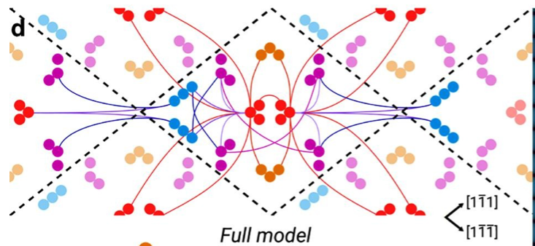
State Space
State Space in Chemically Complex Materials
A vacancy in a concentrated alloy encounters many different chemical environments
The characterization of transport will be the sum of many such hops over a multitude of environments
Swinburne, Thomas D. Computational Materials Science 193 (2021): 110256.
Notes:
IN SOMETHING LIKE PURE NI, WE FIND 1 VAC POSITION AND 1 BARRIER AND WE’RE DONE.
Can just do MSD and get the D tensor
IN SOMETHJING LIKE NI20CR WE HAVE TO FIND ~ X VACANCY POSTIIONS AND ~Y BARRIERS…
Current methodologies are not sufficient – it’s a sampling issue…
We can’t a priori enumerate all hops… what do we do???

Slide 10
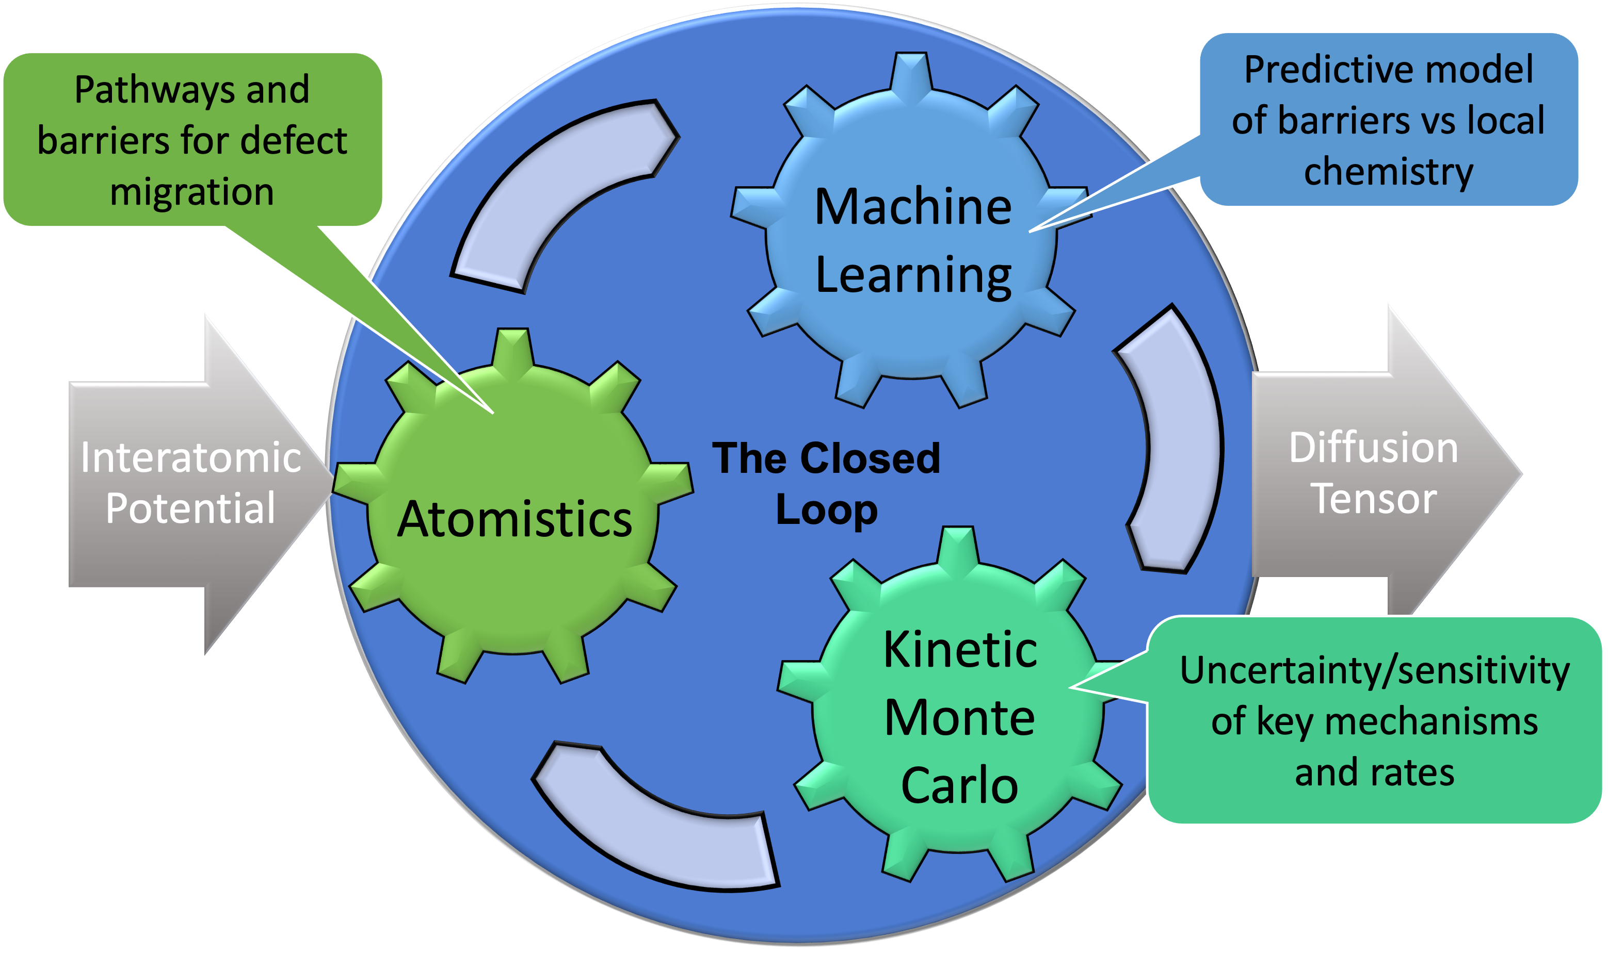
The Closed Loop

Slide 11
The Closed Loop
Pathways and barriers for defect migration
Atomistics

Slide 12
State Space in Chemically Complex Materials
Hop Dec Approach

Slide 13
State Space in Chemically Complex Materials
Hop Dec Approach
Composition of Interest

Slide 14
State Space in Chemically Complex Materials
Hop Dec Approach
Composition of Interest
Simple Analogous Structure (“Ansatz”)

Slide 15
State Space in Chemically Complex Materials
Hop Dec Approach
Composition of Interest
Simple Analogous Structure (“Ansatz”)
State Space
Map State Space of Simple Structure

Slide 16
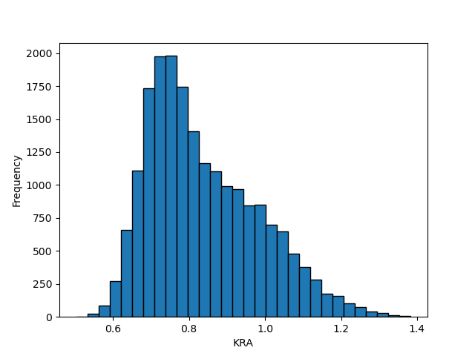
State Space in Chemically Complex Materials
Hop Dec Approach
Composition of Interest
Encode the barrier variation in the transition
Simple Analogous Structure (“Ansatz”)
State Space
Map State Space of Simple Structure

Slide 17
Agenda
Motivation and context for the code development.
Main functionality (State Space Mapping and Redecoration)
Parallelization strategies
Worked examples.

Slide 18
Nudged Elastic Band like you’ve NEBer seen it before…
Current NEB implementation in LAMMPS is insufficient to implement high-throughput barrier calculations.
Output
Connection
Transition
Transition
initialState (State)
finalState (State)
initialState (State)
finalState (State)
Forward Barrier
dE
Forward Barrier
dE

Slide 19
Nudged Elastic Band like you’ve NEBer seen it before…
Current NEB implementation in LAMMPS is insufficient to implement high-throughput barrier calculations.
Step 1: Initial NEB calculated between user-defined Initial and Final State.
Output
Connection
Initial State
Final State
Transition
Transition
initialState (State)
finalState (State)
initialState (State)
finalState (State)
Forward Barrier
dE
Forward Barrier
dE

Slide 20
Nudged Elastic Band like you’ve NEBer seen it before…
Current NEB implementation in LAMMPS is insufficient to implement high-throughput barrier calculations.
Step 1: Initial NEB calculated between user-defined Initial and Final State.
Output
Connection
Initial State
Final State
Transition
Transition
initialState (State)
finalState (State)
initialState (State)
finalState (State)
Forward Barrier
dE
Forward Barrier
dE

Slide 21
Nudged Elastic Band like you’ve NEBer seen it before…
Current NEB implementation in LAMMPS is insufficient to implement high-throughput barrier calculations.
Step 1: Initial NEB calculated between user-defined Initial and Final State.
Step 2: NEB Nodes minimized to search for intermediate minima.
Output
Connection
Initial State
Intermediate
State
Final State
Transition
Transition
initialState (State)
finalState (State)
initialState (State)
finalState (State)
Forward Barrier
dE
Forward Barrier
dE

Slide 22
Nudged Elastic Band like you’ve NEBer seen it before…
Current NEB implementation in LAMMPS is insufficient to implement high-throughput barrier calculations.
Step 1: Initial NEB calculated between user-defined Initial and Final State.
Step 2: NEB Nodes minimized to search for intermediate minima.
Step 3: NEB calculated between new states in correct order.
Output
Connection
Initial State
Intermediate
State
Final State
Transition
Transition
initialState (State)
finalState (State)
initialState (State)
finalState (State)
Forward Barrier
dE
Forward Barrier
dE

Slide 23
Nudged Elastic Band like you’ve NEBer seen it before…
Current NEB implementation in LAMMPS is insufficient to implement high-throughput barrier calculations.
Step 1: Initial NEB calculated between user-defined Initial and Final State.
Step 2: NEB Nodes minimized to search for intermediate minima.
Step 3: NEB calculated between new states in correct order.
Step 4: Go To Step 2
Output
Connection
Initial State
Intermediate
State
Final State
Transition
Transition
initialState (State)
finalState (State)
initialState (State)
finalState (State)
Forward Barrier
dE
Forward Barrier
dE

Slide 24
Nudged Elastic Band like you’ve NEBer seen it before…
Current NEB implementation in LAMMPS is insufficient to implement high-throughput barrier calculations.
Step 1: Initial NEB calculated between user-defined Initial and Final State.
Step 2: NEB Nodes minimized to search for intermediate minima.
Step 3: NEB calculated between new states in correct order.
Step 4: Go To Step 2
Step 5: If no intermediate minima detected. End.
Output
Connection
Initial State
Intermediate
State
Final State
Transition
Transition
initialState (State)
finalState (State)
initialState (State)
finalState (State)
Forward Barrier
dE
Forward Barrier
dE

Slide 25
Nudged Elastic Band like you’ve NEBer seen it before…
Current NEB implementation in LAMMPS is insufficient to implement high-throughput barrier calculations.
Output
Connection
Transition
Transition
initialState (State)
finalState (State)
initialState (State)
finalState (State)
Forward Barrier
dE
Forward Barrier
dE
Connection: Between any two states.
Transition: Single saddle point between states – contains several useful Attributes
A Connection can contain many Transitions.
Connection object returned to the user.
Initial State
Intermediate
State
Final State

Slide 26
Nudged Elastic Band like you’ve NEBer seen it before…
# read HopDec parameters
params = getParams()
# read atomic configurations from file.
initialState = readStateLAMMPSData('DV1.dat')
finalState = readStateLAMMPSData('DV2.dat’)
# run the NEB method and save as a Connection object
connection = neb.main(initialState, finalState, params)
for i in range(len(connection.transitions)):
print(f'Transition {i+1}')
print(f"{connection.transitions[i].forwardBarrier = } eV")
print(f"{connection.transitions[i].reverseBarrier = } eV")
print(f"{connection.transitions[i].KRA = } eV")
print(f"{connection.transitions[i].dE = } eV \n")
Output
Connection
Transition
Transition
initialState (State)
finalState (State)
initialState (State)
finalState (State)
Forward Barrier
dE
Forward Barrier
dE
Connection: Between any two states.
Transition: Single saddle point between states – contains several useful Attributes.
A Connection can contain many Transitions.
Connection object returned to the user.

Slide 27
State Space Mapping (NEB + MD)
Notes:
Canonical label and centrosymmetry
Model contains info.

Slide 28
State Space Mapping (NEB + MD)
State Space Model
HASH = 1
Notes:
Canonical label and centrosymmetry
Model contains info.

Slide 29
State Space Mapping (NEB + MD)
State Space Model
HASH = 1
Notes:
Canonical label and centrosymmetry
Model contains info.

Slide 30
State Space Mapping (NEB + MD)
State Space Model
HASH = 1
HASH = 2
Notes:
Canonical label and centrosymmetry
Model contains info.

Slide 31
State Space Mapping (NEB + MD)
State Space Model
Transition
HASH = 1
HASH = 2
Notes:
Canonical label and centrosymmetry
Model contains info.

Slide 32
State Space Mapping (NEB + MD)
State Space Model
Transition
HASH = 1
HASH = 2
HASH = 1
Notes:
Canonical label and centrosymmetry
Model contains info.

Slide 33
State Space Mapping (NEB + MD)
State Space Model
Transition
HASH = 1
HASH = 2
HASH = 1
Notes:
Canonical label and centrosymmetry
Model contains info.

Slide 34
State Space Mapping (NEB + MD)
State Space Model
Transition
HASH = 1
HASH = 2
Notes:
Canonical label and centrosymmetry
Model contains info.

Slide 35
State Space Mapping (NEB + MD)
State Space Model
Transition
HASH = 1
HASH = 2
Notes:
Canonical label and centrosymmetry
Model contains info.

Slide 36
State Space Mapping (NEB + MD)
State Space Model
Transition
HASH = 3
HASH = 1
HASH = 2
Notes:
Canonical label and centrosymmetry
Model contains info.

Slide 37
State Space Mapping (NEB + MD)
State Space Model
Transition
Transition
HASH = 3
HASH = 1
HASH = 2
Notes:
Canonical label and centrosymmetry
Model contains info.

Slide 38
State Space Mapping (NEB + MD)
State Space Model
Transition
Transition
HASH = 3
HASH = 1
HASH = 2
Notes:
Canonical label and centrosymmetry
Model contains info.

Slide 39
State Space Mapping (NEB + MD)
State Space Model
Transition
Transition
HASH = 3
HASH = 1
HASH = 2
HASH = 4
Notes:
Canonical label and centrosymmetry
Model contains info.

Slide 40
State Space Mapping (NEB + MD)
State Space Model
Transition
Transition
HASH = 3
HASH = 1
HASH = 2
Transition
HASH = 4
Notes:
Canonical label and centrosymmetry
Model contains info.

Slide 41
State Space Mapping (NEB + MD)
State Space Model
Transition
Transition
HASH = 3
HASH = 1
HASH = 2
Transition
HASH = 4
Notes:
Canonical label and centrosymmetry
Model contains info.

Slide 42
State Space Mapping (NEB + MD)
State Space Model
Transition
Transition
HASH = 3
HASH = 1
HASH = 2
Transition
Transition
HASH = 4
Notes:
Canonical label and centrosymmetry
Model contains info.

Slide 43
State Space Mapping (NEB + MD)
State Space Model
Transition
Transition
HASH = 3
HASH = 1
HASH = 2
Transition
Transition
HASH = 4
Notes:
Canonical label and centrosymmetry
Model contains info.

Slide 44
State Space Mapping (NEB + MD)
Transition
HASH = 1
HASH = 2
Notes:
Canonical label and centrosymmetry
Model contains info.

Slide 45
State Space Mapping (NEB + MD)
Transition
HASH = 1
HASH = 2
User-defined Concentration of species
,
,
,……..,
Notes:
Canonical label and centrosymmetry
Model contains info.

Slide 46
State Space Mapping (NEB + MD)
Transition
Energy Barrier
0.0
0.5
HASH = 1
HASH = 2
Concentration of ‘Green’
User-defined Concentration of species
,
,
,……..,
Notes:
Canonical label and centrosymmetry
Model contains info.

Slide 47
Hop-Decorate Main Functionality
State Space Model
Transition
Transition
HASH = 3
HASH = 1
HASH = 2
Transition
Transition
HASH = 4

Slide 48
Redecoration
And a user-provided concentration of species and number of decorations we can redecorate the transition and calculate the energy barrier.
Given an initial Transition:
,
,
,……..,
Initial State
Final State

Slide 49
Redecoration
And a user-provided concentration of species and number of decorations we can redecorate the transition and calculate the energy barrier.
Given an initial Transition:
,
,
,……..,
Initial State
Final State
Energy Barrier
0.0
0.5
Concentration of ‘Green’

Slide 50
Redecoration
Redecoration
Connection
Connection
Connection
Connection
Redecorate.connections
‘params.nDecorations’ – many connections
…
Transition
Transition
Transition
Transition
Transition
List of transitions:
Connection.transitions
initialState (State)
finalState (State)
initialState (State)
finalState (State)
initialState (State)
finalState (State)
transition.initialState
transition.finalState
transition.KRA
transition.dE
KRA
dE
KRA
dE
KRA
dE
# read HopDec parameters
params = getParams()
# load structures from file
initialState = readStateLAMMPSData('DV1.dat')
finalState = readStateLAMMPSData('DV2.dat’)
Redecoration = Redecorate.main(initialState, finalState, params)

Slide 51
Agenda
Motivation and context for the code development.
Main functionality (NEB, Discovery and Redecoration)
Parallelization strategies
Worked examples.

Slide 52
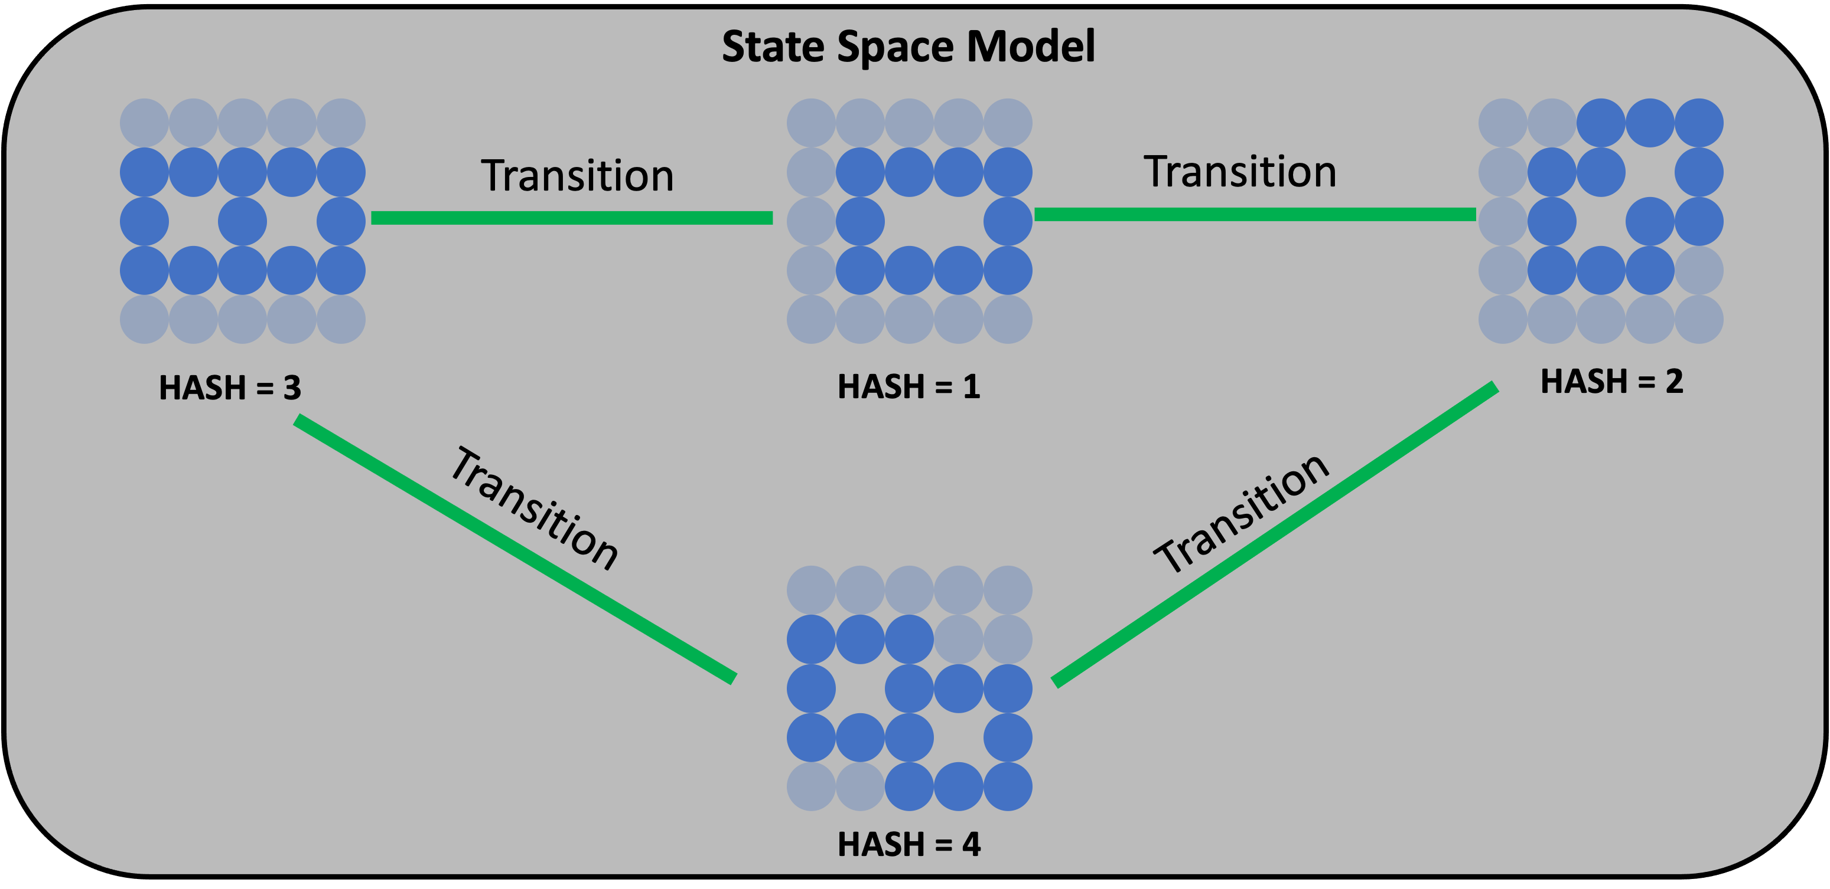
Strong Focus on Parallelization
Given, say, 100 MPI ranks we have two parallelization strategies:
Strategy 1: MD State discovery
Strategy 2: Redecoration
,
,
,……..,
Redecoration NEB Campaign (10,000 Decorations)
Rank = 0: Decorations 0 - 99
Rank = 1: Decorations 100 - 199
Rank = 2: Decorations 200 - 299
… and so on …
‘gather’ used to collect data onto rank 0 when redecorations are finished.
Hash = 1: ranks 0 - 24
Hash = 2: ranks 25 - 49
Hash = 3: ranks 50 - 74
Hash = 4: ranks 75 - 99

Slide 53
Agenda
Motivation and context for the code development.
Main functionality (NEB, Discovery and Redecoration)
Parallelization strategies
Worked examples.

Slide 54
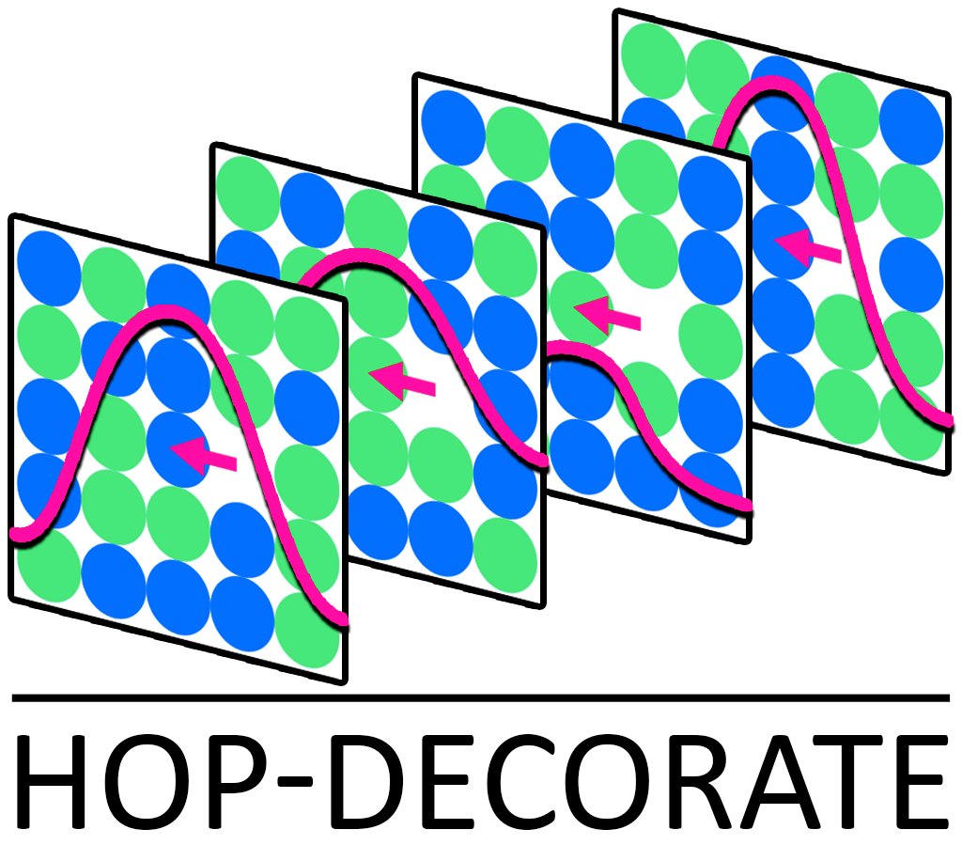
https://gitlab.lanl.gov/peter_hatton/hopdecorate

