Slide 1

Tuz & Friends Update
Peter Lawler

Slide 2

What Is A Tuz?

Slide 3

Tuz = Awesome
LCA 2009 Mascot Hobart, Tasmania
Tasmanian Devil with Strap-on Penguin Beak
Devil Facial Tumour Disease fundraising
Logo for Linux 2.6.29 release.
http://www.tassiedevil.com.au

Slide 4
Tasmanian Devil

Slide 5
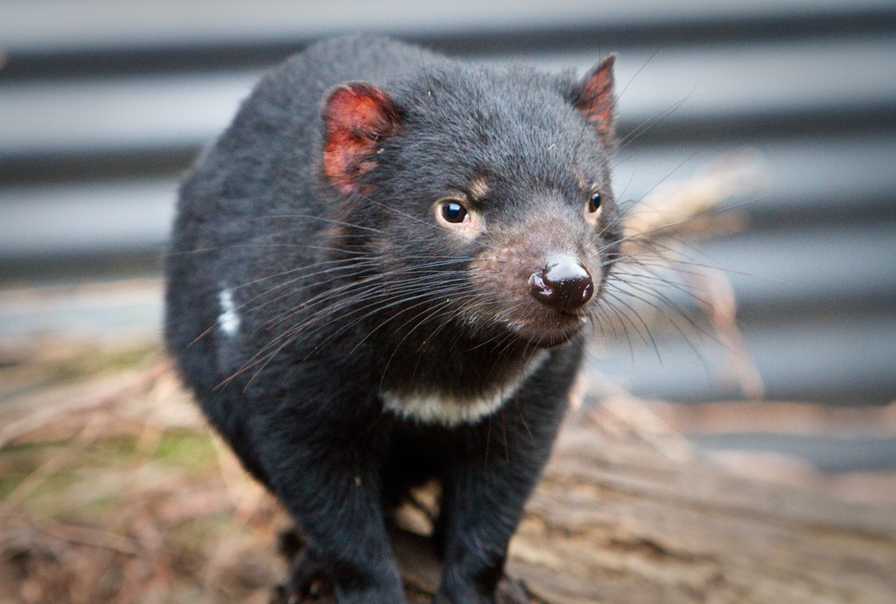
Tasmanian Devil
Native to main island of Tasmania
In the wild, mature at two years, live to around five years
Endangered species
Not like WB character
http://www.tassiedevil.com.au

Slide 6
DFTD
Graphic Medical Warning

Slide 7
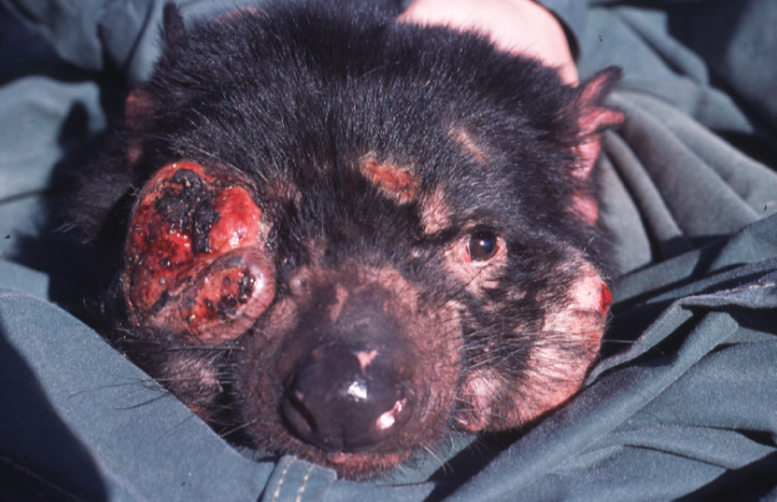
DFTD
First recordings 1996
Caused by infectious cancer cells
Always fatal
No known cure or vaccine
Wild sightings dropped 85-97% since 1996
http://www.tassiedevil.com.au

Slide 8
Save The Tasmanian Devil Report

Slide 9
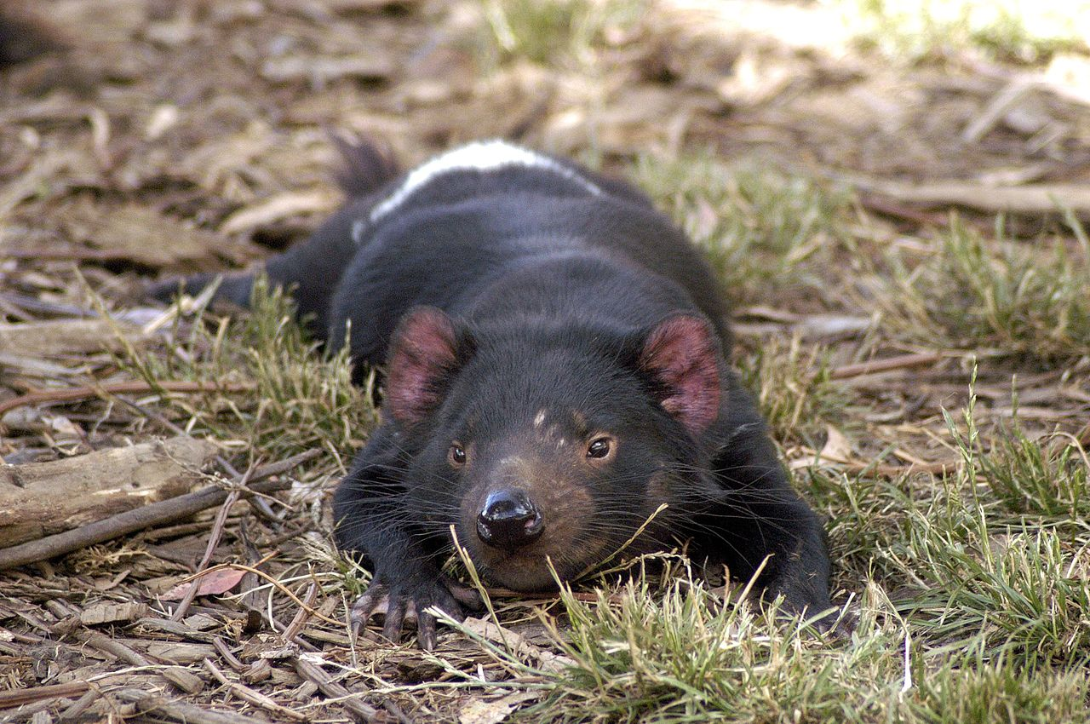
Fundraising
Shifted from ad-hoc to major donors
Collins-Debden (diaries)
Virgin Australia (airline)
Items for sale online, local stores, etc.
Tuz plushy no longer available
http://www.tassiedevil.com.au

Slide 10
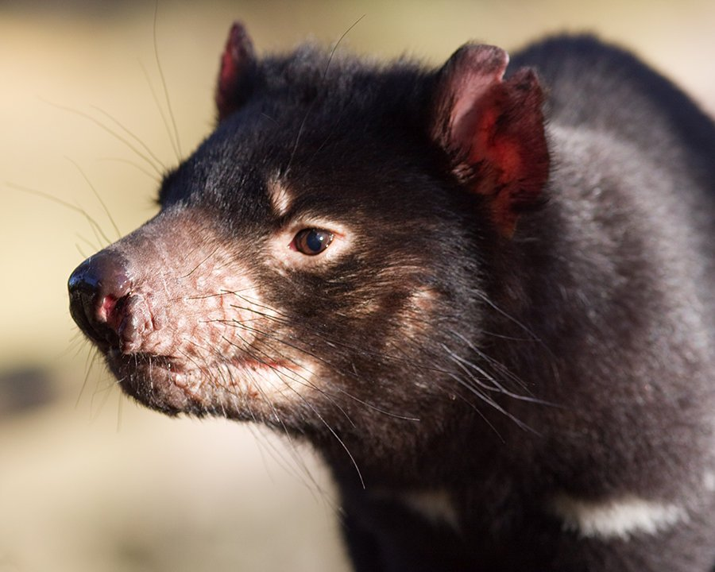
DFTD Supression
Disease suppression work attempted
Review in late 2010 indicated some success
Would not maintain populations or eradicate disease
http://www.tassiedevil.com.au

Slide 11
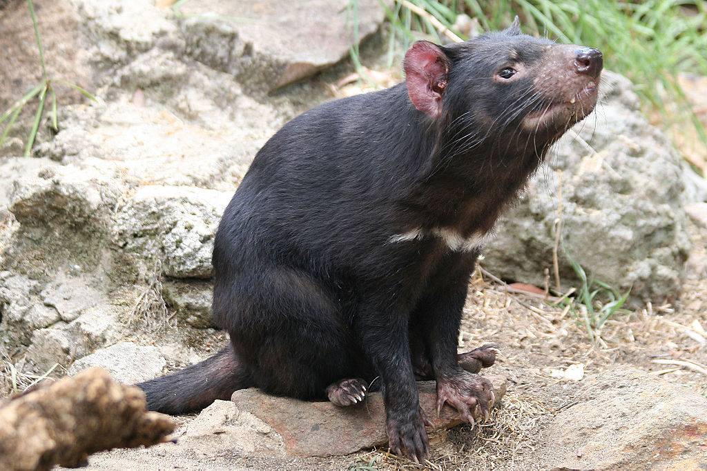
Insurance Populations
20 locations in every Australian state and territory
Organised by Zoo and Aquarium Association
Aims for 100% genetic diversity
Population expected to reach 450 by end of 2011
http://www.tassiedevil.com.au

Slide 12
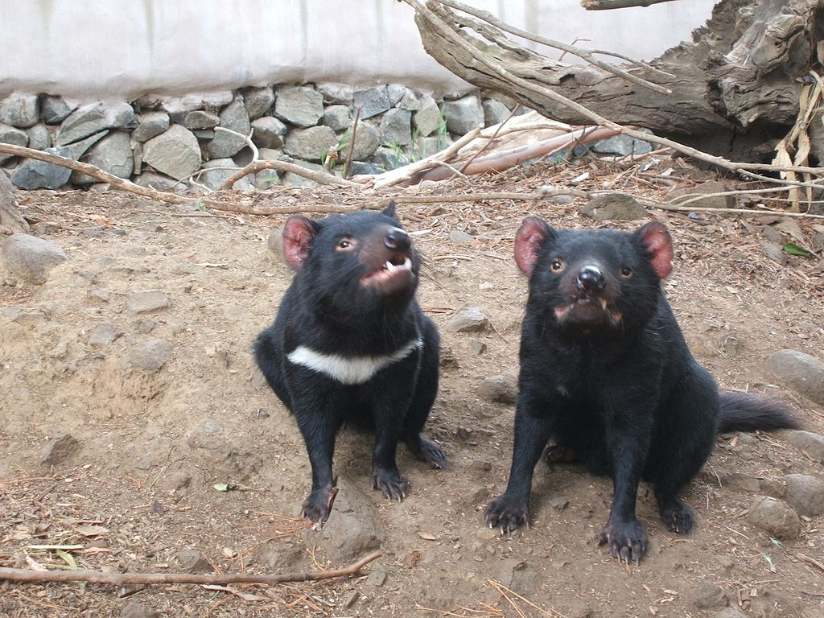
Devil Islands
Free range enclosures
Two new islands opened 2011
Hold 40 devils
Part of Insurance Population
http://www.tassiedevil.com.au

Slide 13
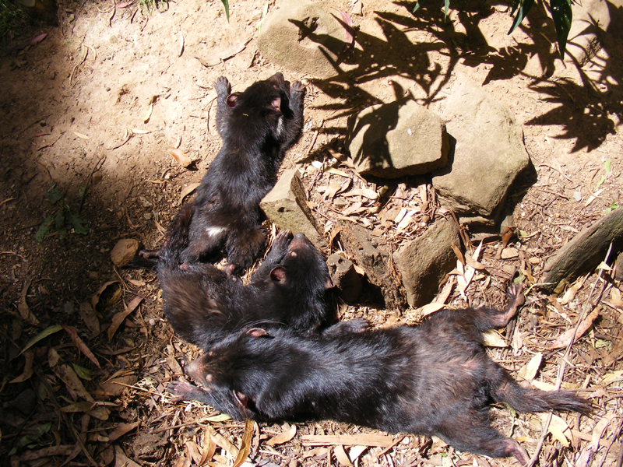
Devil Ark
Barrington Tops, NSW
500ha
Environment similar to Tasmania
8 of 13 females have pouch young*
Conditions at least heading in right direction
*At time of Devil Report writing
http://www.tassiedevil.com.au

Slide 14
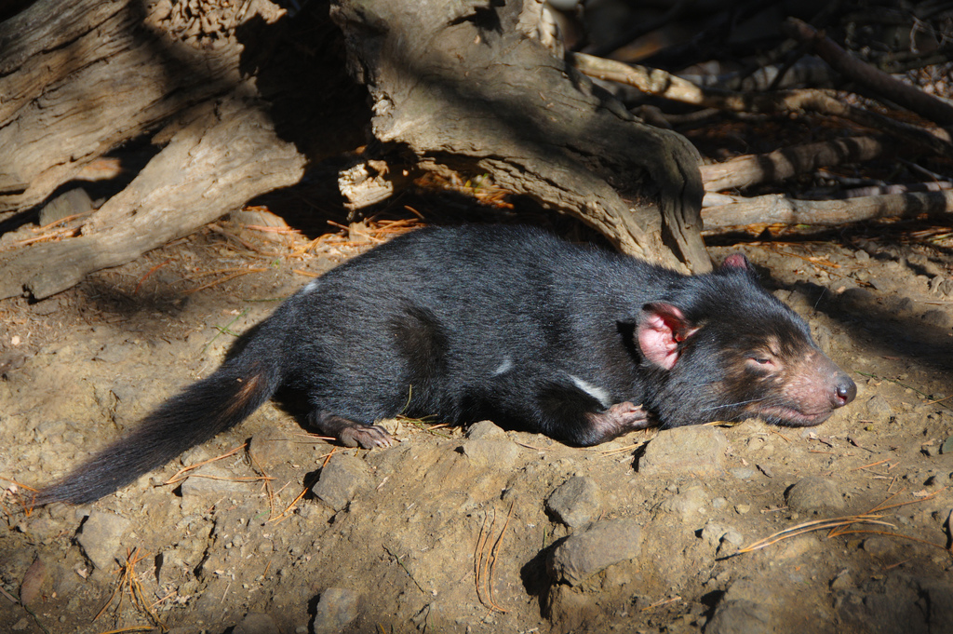
Tarkine Devil Program
Far north-west Tasmania
Australia's largest temperate rainforest
First results last week (13th Jan 2012)
1283 images of wild devils
Not a single image indicates infection
http://www.tassiedevil.com.au

Slide 15
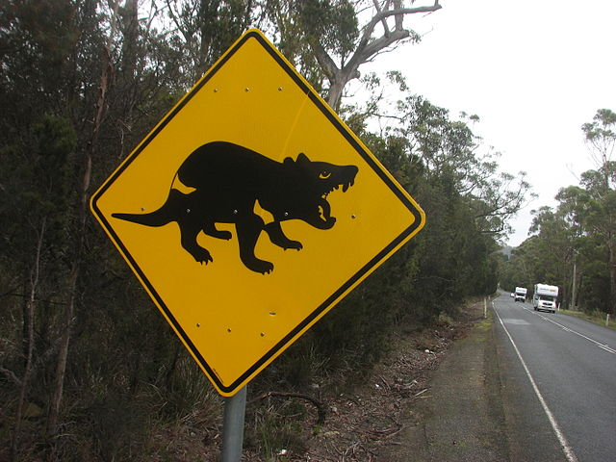
Roadkill Project
Crowdsourced (by dead trees) reports of squashed devils
Report forms from RACT, car rental companies, Visitor Info Centres, Parks and Wildlife Centres, Service Tas, Private Wildlife Parks, website
http://www.tassiedevil.com.au

Slide 16
Roadkill Project
Take form when travelling anywhere
Check website for details
West of Murchison Highway (western Tasmania) SMS IMMEDIATELY
http://www.tassiedevil.com.au

Slide 17
Wrapping up

Slide 18
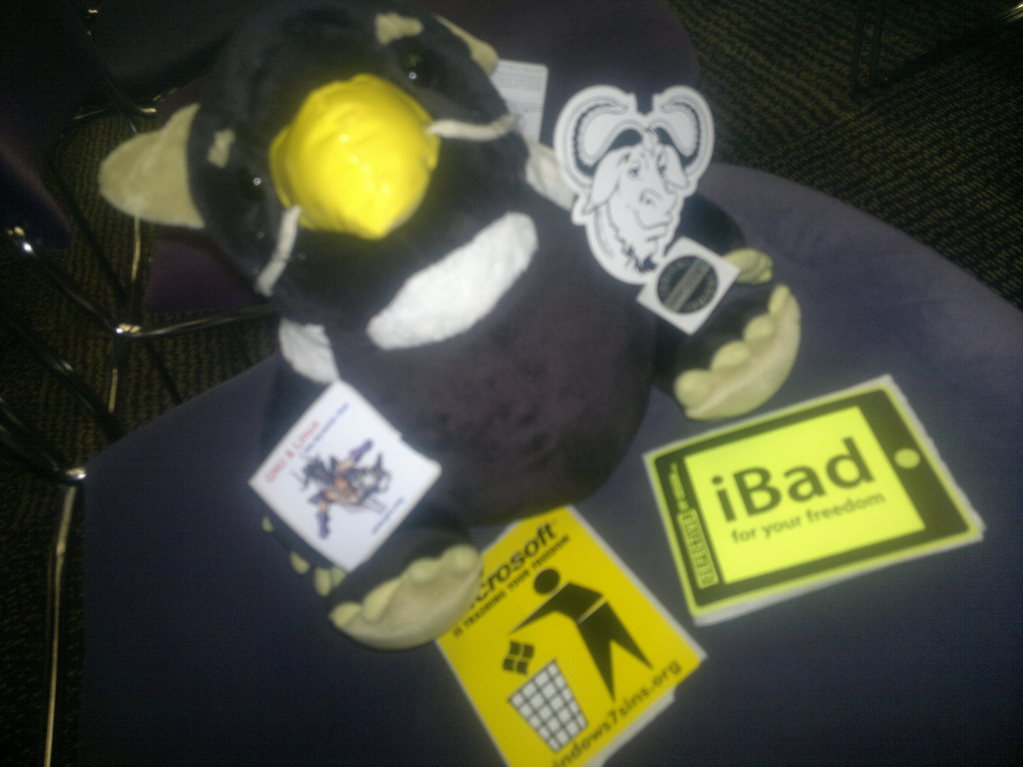
Free Tuz
Tuz sold at LCA '09
Tuz given away elsewhere
Excellent talking opener for both DFTD and Free & Open tech
If you received Free Tuz, please consider donating to Devil projects
http://www.tassiedevil.com.au

