Slide 1
Cooked
Lightning Talk for LCA 2017

Slide 2

Pasta Be Upon You
Notes:
I’m a Pastafarian Minister.

Slide 3

YARRRR
Notes:
I’m also a pirate. Working on the leg thing, you may remember me busting my knee up at LCA2009. I ended up having surgery...

Slide 4

WARNING
I do not endorse anything in this presentation.
Using electricity and liquids in close
proximity is for professionals
and/or idiots.
This is an exercise in
drunk programming

Slide 5
Mathematics
PID (proportional–integral–derivative) controller
Control loop feedback mechanism
Continuously calculates error value e(t) as difference between desired setpoint and a measured process variable
Applies a correction based on proportional, integral, and derivative terms, respectively (sometimes denoted P, I, and D) which give their name to the controller type
Use of PID algorithm does not guarantee optimal control of system or even stability
Notes:
NOOOO MATHS

Slide 6
Mathematics
PID (proportional–integral–derivative) controller
Control loop feedback mechanism
Continuously calculates error value e(t) as difference between desired setpoint and a measured process variable
Applies a correction based on proportional, integral, and derivative terms, respectively (sometimes denoted P, I, and D) which give their name to the controller type
Use of PID algorithm does not guarantee optimal control of system or even stability
Notes:
NOOOO MATHS

Slide 7

PID Controller
https://en.wikipedia.org/wiki/PID_controller#Fundamental_operation
Notes:
NOOOO EQUATIONS

Slide 8
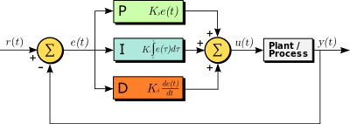
PID Controller
https://en.wikipedia.org/wiki/PID_controller#Fundamental_operation
Notes:
PICTURES ARE BETTER

Slide 9
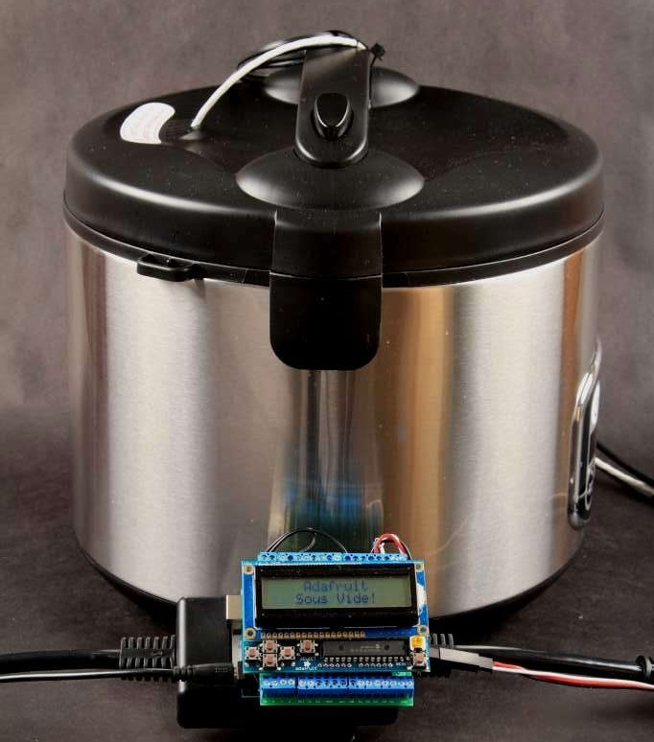
How I got into Sous Vide cooking
Adafruit SousViduino kit
Notes:
Brother in law runs a food bar. He vacuum seal, or ‘sous vide’ cooks a lot. This ensures steady heating and flavour retention. But is expensive equipment.

Slide 10
Platform change
Poor UI (LCD Display, 6 buttons)
No network
Didn’t own some specific hardware
Frustrasting to scale
Raspberry Pi widely used
Bad experience using Weewx on Rpi
Notes:
Other problems I had. I just wanted to cook (bro in law’s favourite chef is Walter White…..)

Slide 11
Liberate Someone Else’s Software
3rd party Raspberry Pi Sous Vide
4 thread python flask
Dallas 1Wire temperature sensor
Network
No onboard memory
Raspi random resets
‘fixed’ by replacing with BBB
Notes:
No idea why I chose what I did… remember, drunk programming. Forgot to document my choice here.

Slide 12

Forgot to document software choice

Slide 13
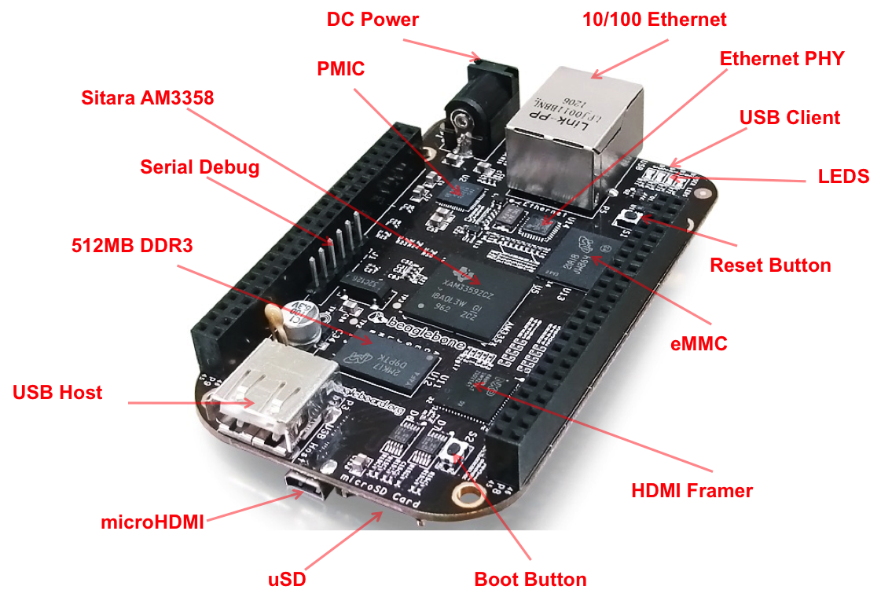
Beaglebone Black hardware
Notes:
System reference manual on Github, runs to 126 pages
Realtime unit for house monitoring
Tridge demos drone flying while kernel compiling

Slide 14
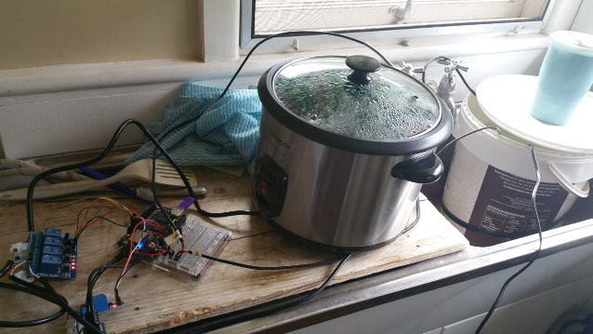
Cooking with Beaglebone Black
Rice cooker
Fish tank air pump
Tasty tasty food in an afternoon
Notes:
Cost about $120 all up
vs $450+ for ‘professional’ kit from hotel supplies store
YUMMMMM

Slide 15
BUT WAIT
THERE’S MORE!!!
Notes:
Around same time as planning spring planting
PID is exactly the same for keeping seed germination tables warm
Lead into gardening

Slide 16
Why cook before germanating
Cheaper establishment cost
Test setup in an afternoon
Nowhere near as labour intensive
Notes:
Practice makes perfect

Slide 17
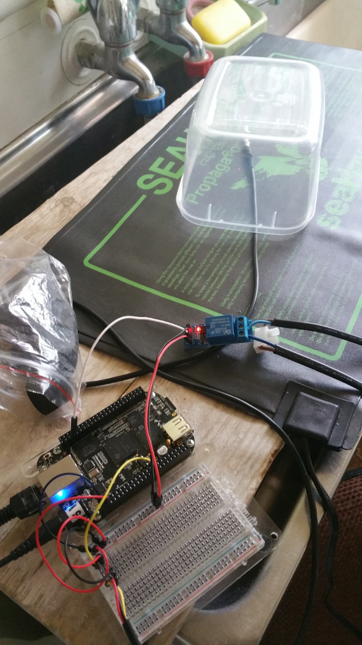
Seed germanation
No cooling required, only heating
Notes:
Deleted the pictures...

Slide 18

Seed germanation
Growing plants is YAYSCIENCE
Notes:
Deleted the pictures...

Slide 19
BUT WAIT
THERE’S MORE!!!
Notes:
Lead into pirates

Slide 20
MMMMMMMMMM
BEEEEEEER

Slide 21
Ginger Beer
Ingredient provenance
Open Source Cooking
No cooling required, only heating
Simple(!)
Notes:
Ginger beer is DEAD SIMPLE
Can’t stand beer
Ginger beer goes with rum

Slide 22
My First Brew
Purchased all in one kit from brew shop
Fermenter, bottles, water valve, etc.
Ginger beer pre-mix
Notes:
Used commercial off shelf kit to practice after horrible mistakes last year with Faulteh (from Taslug)…
Artificial sweetener because easier for corps to make… so second brew I got Young Tim (from Taslug) recipe

Slide 23
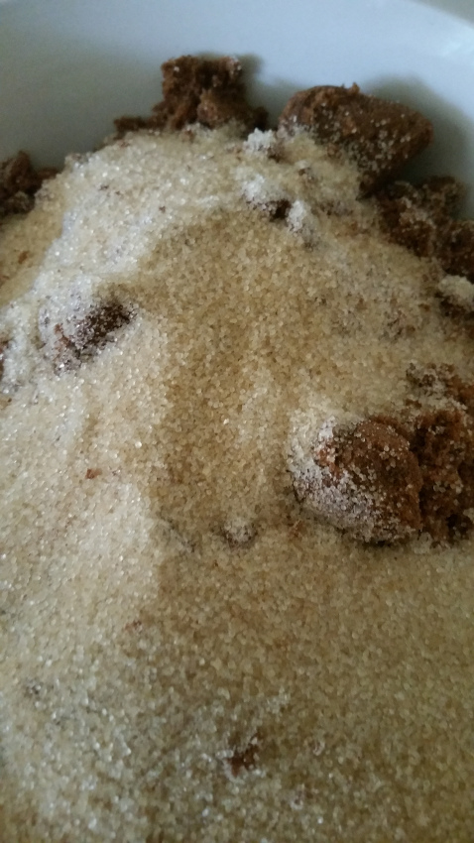
Young Tim’s Recipe
Notes:
Take this

Slide 24
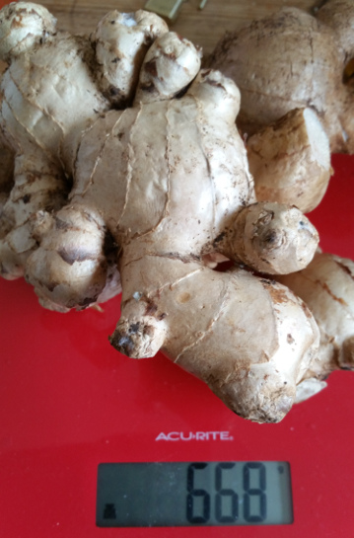
Young Tim’s Recipe
Notes:
Add some shredded of this

Slide 25
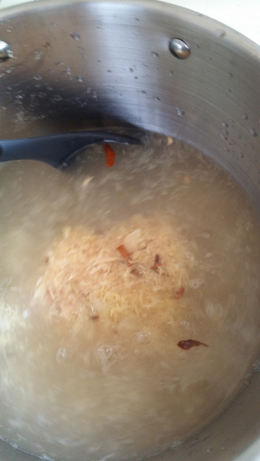
Young Tim’s Recipe
Notes:
Throw in some lemon juice and water

Slide 26
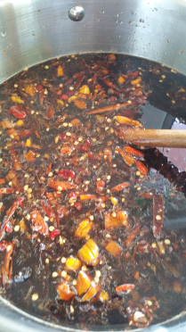
Young Tim’s Recipe
Notes:
Add chilli and cook for a little while

Slide 27
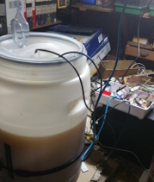
make(1)
Notes:
Throw into fermenter
In Tasmania, in winter, use a heat band and blanket

Slide 28

wait(2)

Slide 29
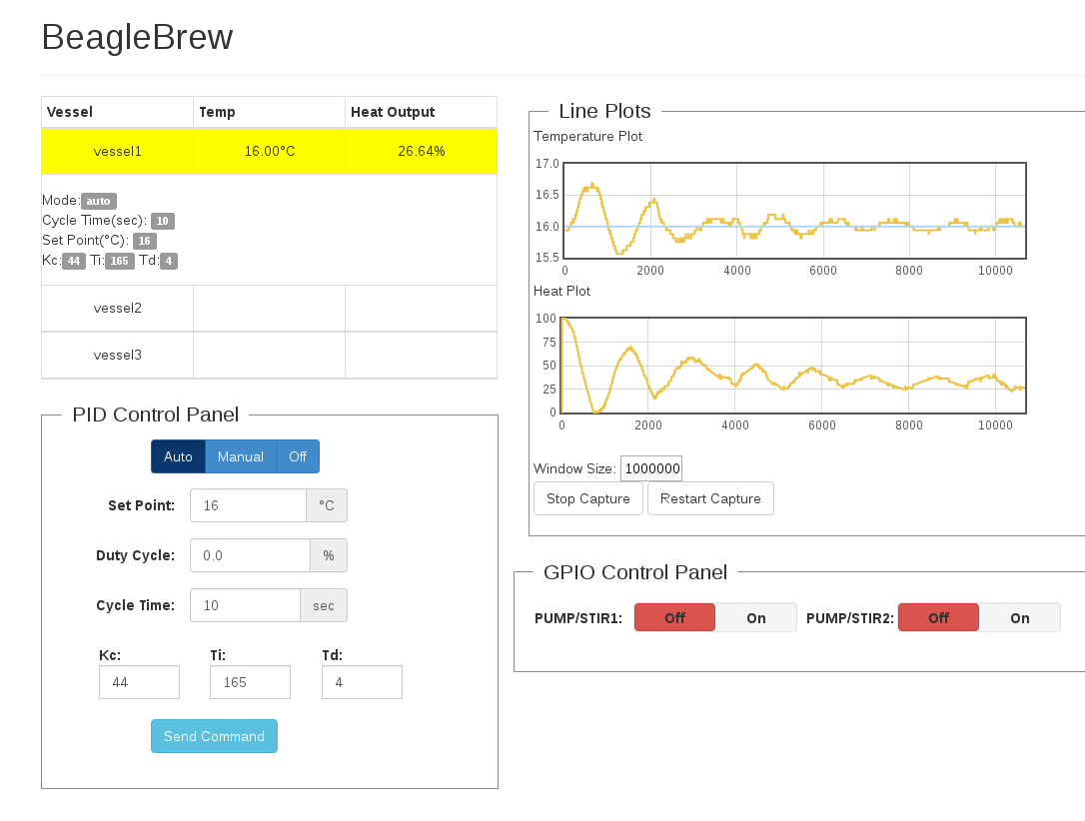
Pretty graphs
Notes:
Not all graphs are great
This graph would start again on refresh

Slide 30

Ooops
Notes:
Making graphs on embedded computers from oodles of data is fun

Slide 31
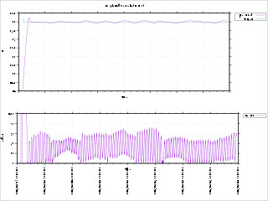
Pretty graphs
Notes:
Can eventually be made to work

Slide 32
tar(2) -J
Notes:
After a couple of weeks, bottle and wait a couple further weeks for maturation

Slide 33
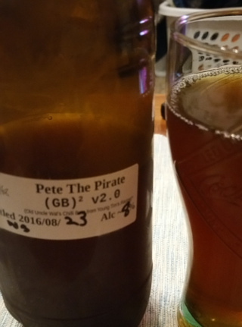
tar(2) -J
Notes:
No matter how bad it tastes, it tastes better with rum.

Slide 34
REMINDERS
ALCOHOL + WATER + ELECTRICITY = BAD MOJO
When moving power around, disconnect UPS from upstream
Chemical cleaners may cause unexpected skin reactions
Cooking and growing and heating and boozing are the same
Open Food and Open Cooking are important

Slide 35
References and Resources
http://beagleboard.org
http://elinux.org/BeagleBone_Community
http://elinux.org/Beagleboard:BeagleBoneBlack
https://groups.google.com/forum/#!forum/beagleboard
https://learn.adafruit.com/sous-vide-powered-by-arduino-the-sous-viduino/sous-vide
http://steve71.github.io/RasPiBrew
http://www.vandelogt.nl/uk_regelen_pid.php
https://en.wikipedia.org/wiki/PID_controller
https://github.com/PeteLawler/BeagleBrew
http://tronixlabs.com.au
http://freetronics.com.au

