Slide 1
BeagleBone Black Brewing
An overview of Beaglebone Black
with an emphasis on
how to use one to get drunk*.
Presentation for Taslug, October 2016.
*responsibly

Slide 2
WARNING
Do not try any of this
at home
or at work.
In fact, just don’t.
Please.

Slide 3
WARNING
I do not endorse anything in this presentation.
Drinking alcohol while coding and
or playing with electricity
is for professionals
and or idiots.

Slide 4
Why BBB for Brewing?
Arduino hardware cheap
Frustrasting to scale
Raspberry Pi widely used
Experience using Weewx on Rpi

Slide 5
Beaglebone History
First ‘Beagleboard’ developed 2008
Open Source SBC
Texas Instruments ARM
CCSA License
5 models: Beagleboard, xM, Beaglebone, Beaglebone Black, X-15
Beaglebone Black variants (Green, Blue, Wireless, Seeed, Industrial)
All Cortex-A8 with Dual PRU
New: X15 – Dual Cortex A15, Dual M4, Quad PRU, eSATA, 2 PCIe, USB2+3, Gigabit Ethernet, 157 GPIO, 7 UART, 185 PRU pins, 2 LCD, 1 Camera.

Slide 6
PRU wat
SOON

Slide 7
How open is open
Schematics are CC-SA
Reference manual on Github
CPU is licensed
PRU requires closed source compiler
No open accelerated graphics
Clones can’t use Beaglebone.org branding

Slide 8
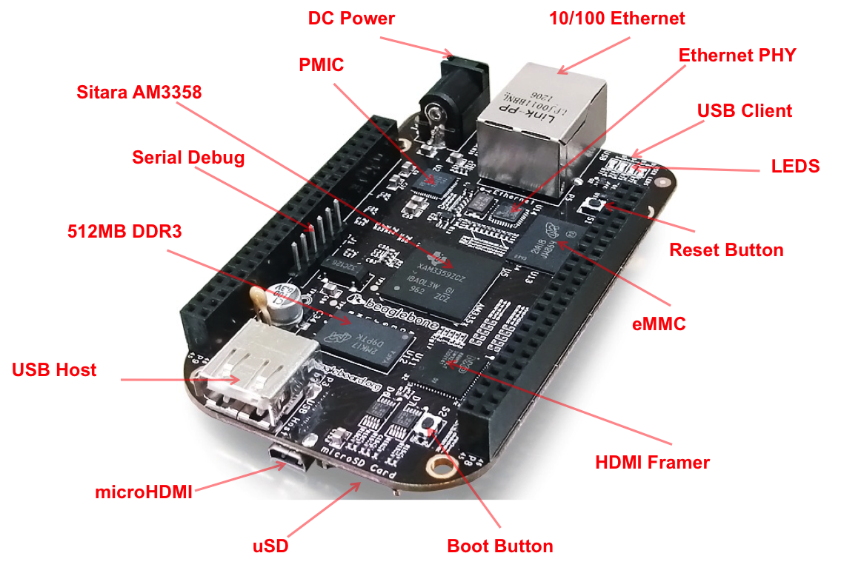
Beaglebone Black hardware
Notes:
Revision C.1
Cortex-A8 with Dual PRU
Sitara AM3358BZCZ100 1GHz ARM
512MB DDR3 800MHz
4GB 8bit eMMC
USB Host and USB Client
16bit HDMI
System reference manual on Github, runs to 126 pages

Slide 9
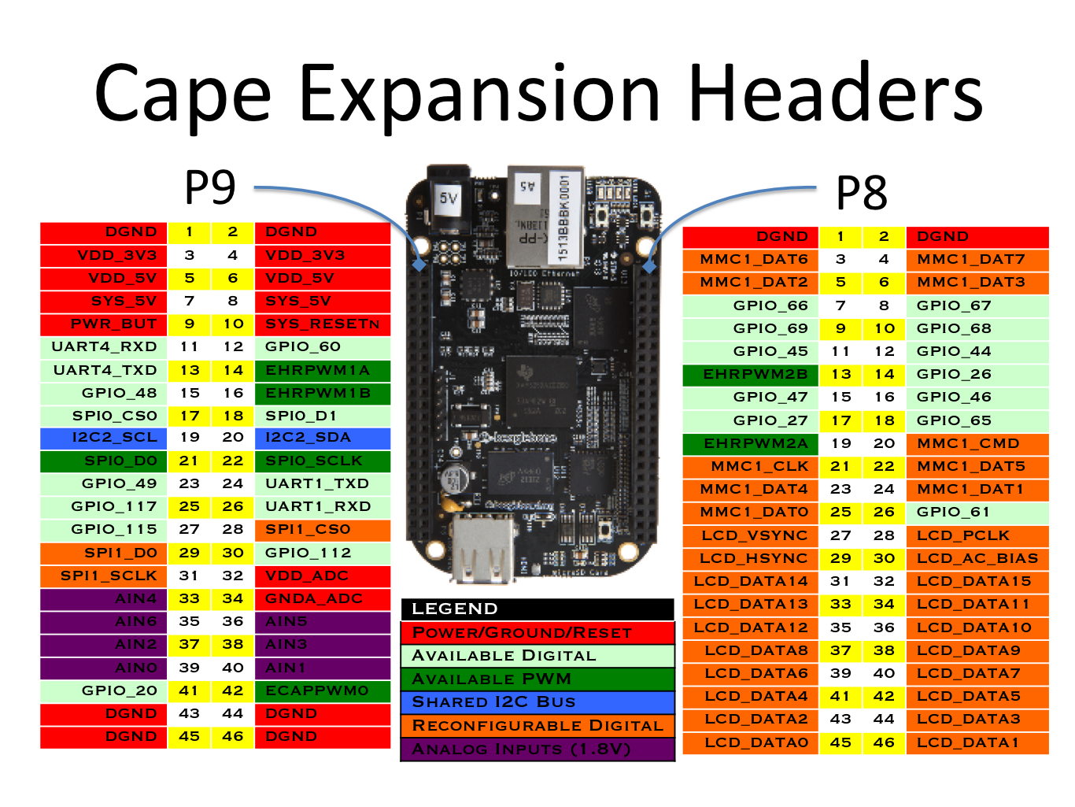
Notes:
4 capes per machine
EEPROM on capes if desired

Slide 10
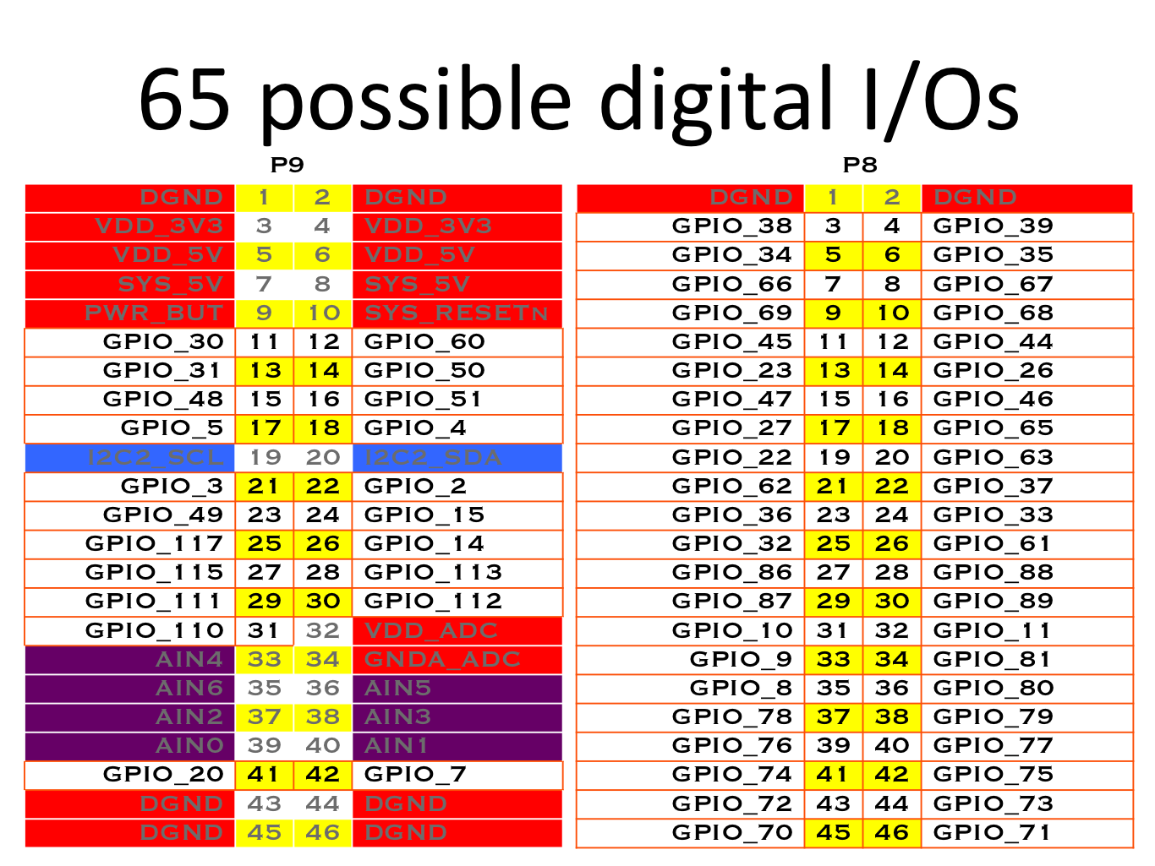
Notes:
General purpose IO
No predefined purpose
ALL VOLTAGE LEVELS ARE 3.3V MAX. APPLICATION OF 5V TO ANY I/O PIN WILL DAMAGE THE PROCESSOR AND VOID THE WARRANTY.

Slide 11
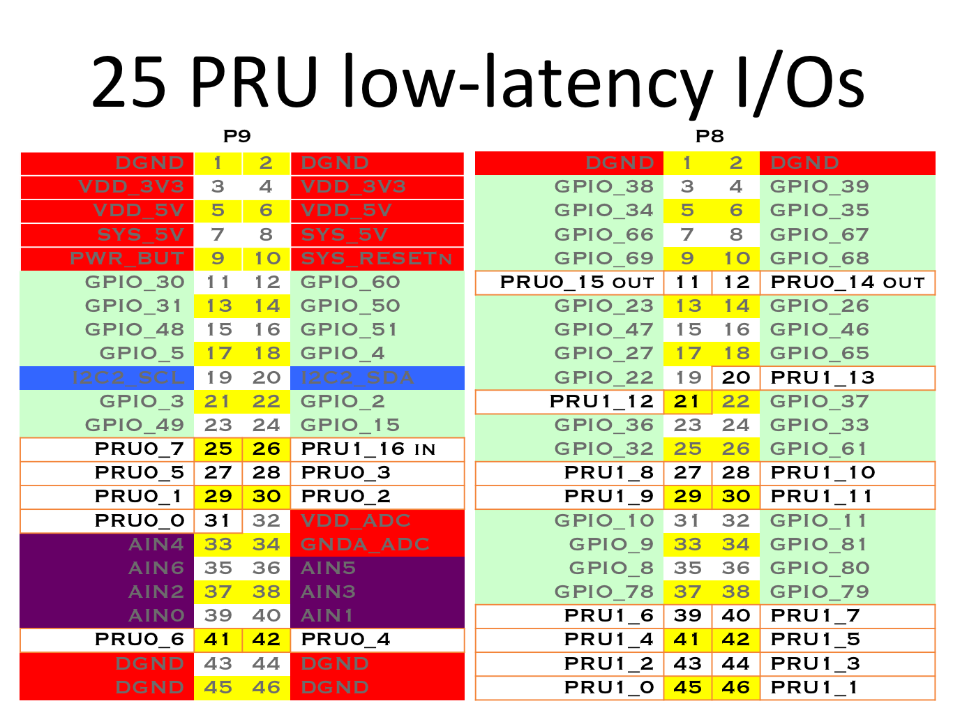
Notes:
Programmable Realtime Unit
32bit 200Mhz 8kb
Direct IO
Assembler
Single cycle
Most operations happen in 5ns
Compiler closed source
Accessible to main kernel, vice versa(?)
Eg, Ardupilot

Slide 12
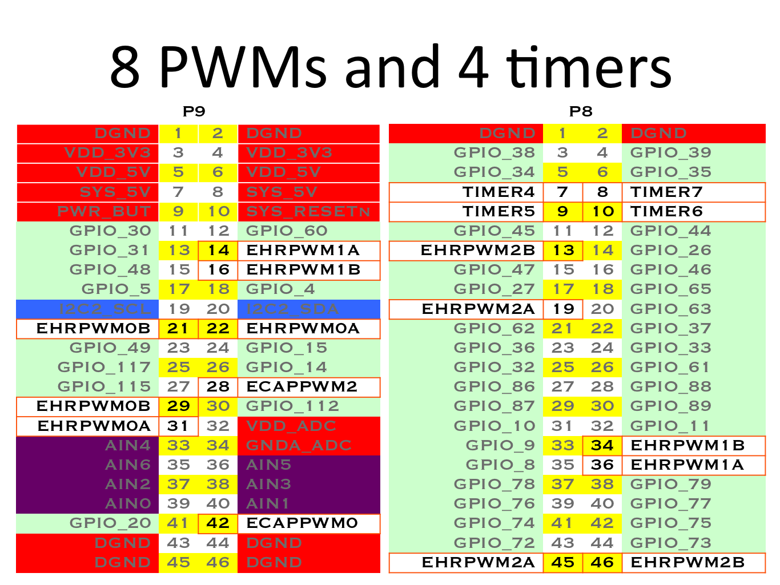
Notes:
Encode digital signal within analog

Slide 13
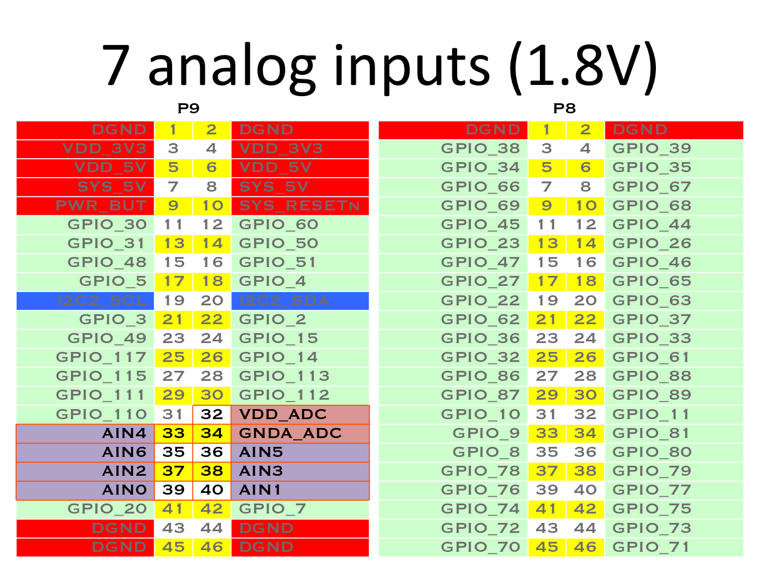
Notes:
ANALOG IN VOLTAGES ARE 1.8V MAX. APPLICATION OF >1.8V TO ANY A/D PIN WILL DAMAGE THE PROCESSOR AND VOID THE WARRANTY
Linked directly to RAM and other sensitive parts
No protection to keep costs and board size down

Slide 14
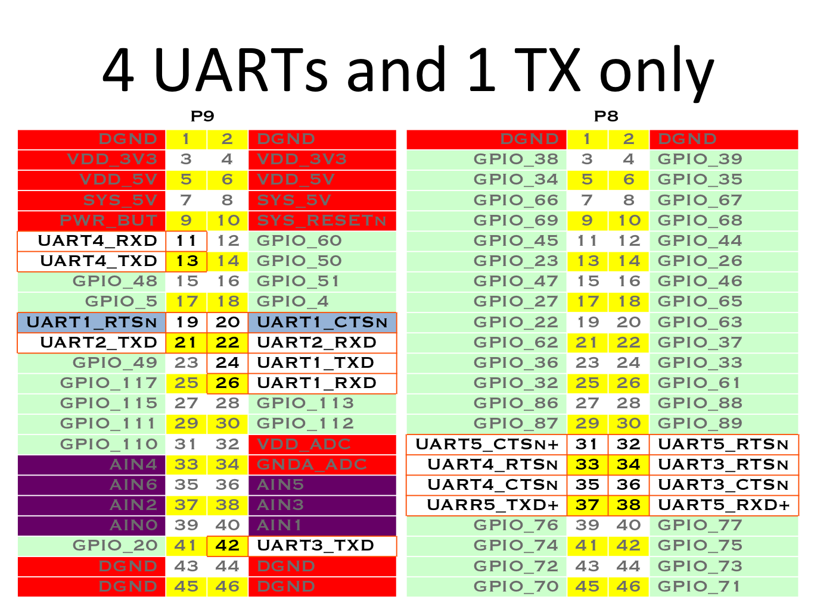
Notes:
Universal asynchronous receiver/transmitter
Really has 6
One reserved for Console
Maybe 7...

Slide 15
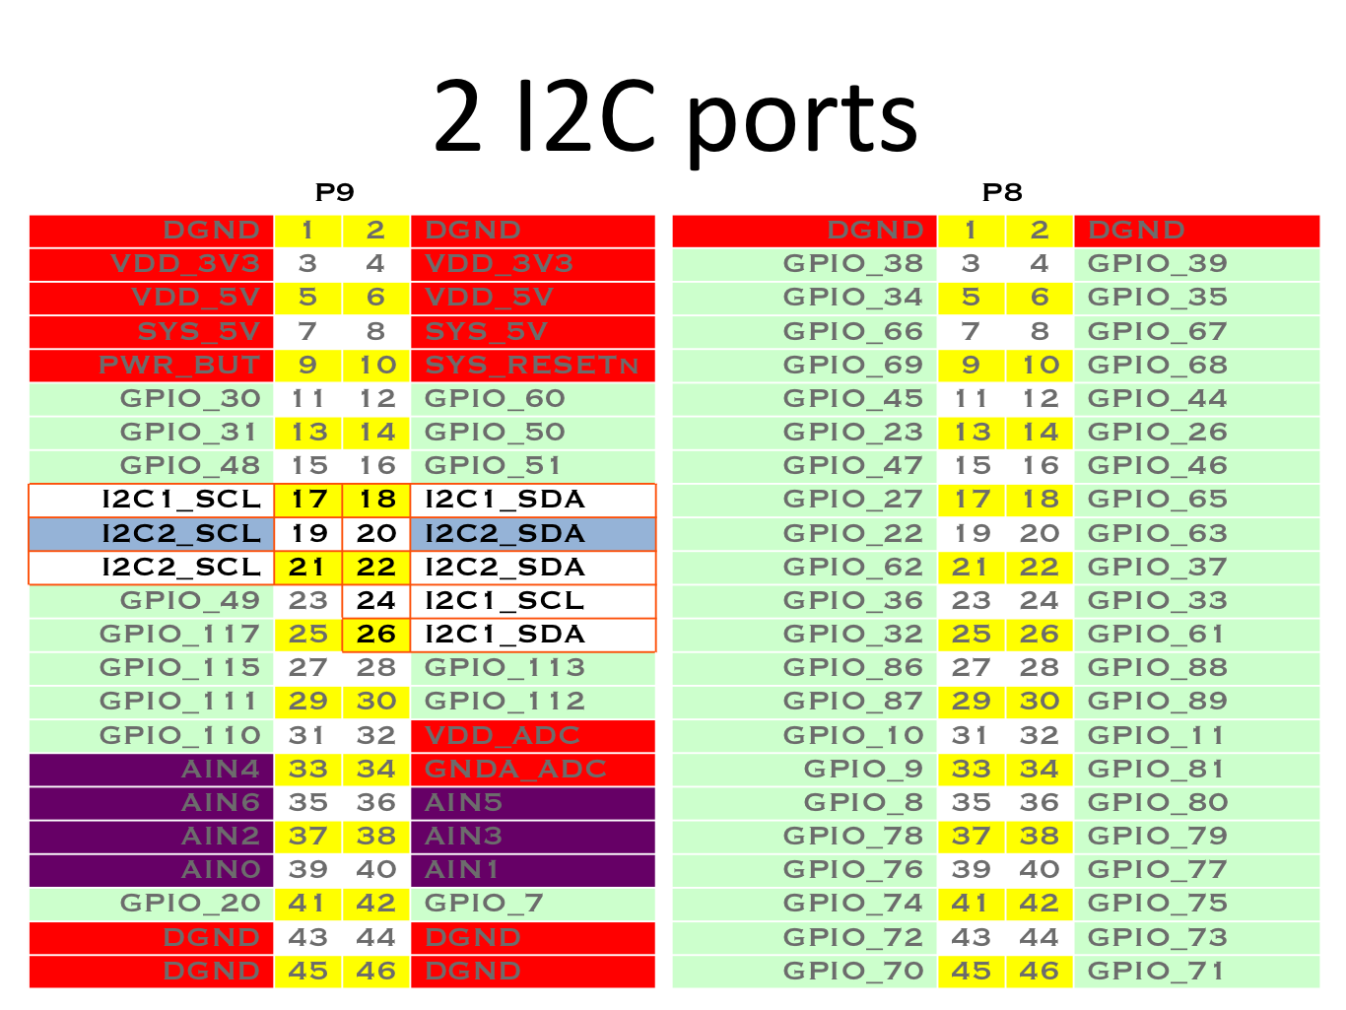
Beaglebone Black I²C
Notes:
Lower-speed peripheral ICs to processors and microcontrollers
Short-distance, intra-board communication
No licensing fee required to implement protocol
Fee required to obtain I²C slave addresses allocated by NXP
Intel’s SMBus a strict subset of I²C

Slide 16
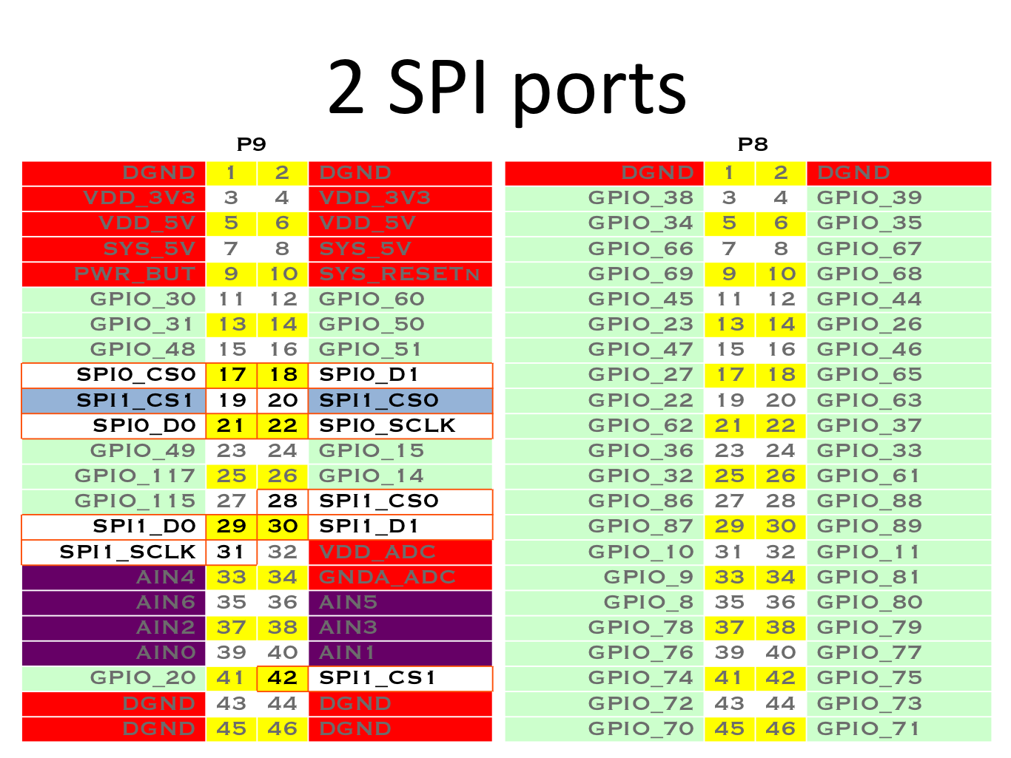
Notes:
Full duplex mode
Master-slave architecture
Single master
Multiple slave devices supported by slave select (SS) lines
Secure Digital cards
Liquid crystal displays

Slide 17
Beaglebone Black basic operation
Pre-loaded with Debian Linux
Boots from eMMC
Can boot from SD-Card
SD-Card can flash eMMC

Slide 18
Beaglebone Black overlays
Boot time
Compile
Slots
GPIO Pins
blah

Slide 19
Mathematics
PID (proportional–integral–derivative) controller
Control loop feedback mechanism
Continuously calculates error value e(t) as difference between desired setpoint and a measured process variable
Applies a correction based on proportional, integral, and derivative terms, respectively (sometimes denoted P, I, and D) which give their name to the controller type
Use of PID algorithm does not guarantee optimal control of system or even stability

Slide 20

PID Controller
https://en.wikipedia.org/wiki/PID_controller#Fundamental_operation

Slide 21
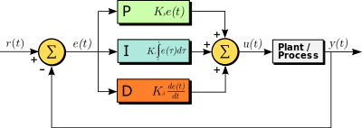
PID Controller
https://en.wikipedia.org/wiki/PID_controller#Fundamental_operation

Slide 22
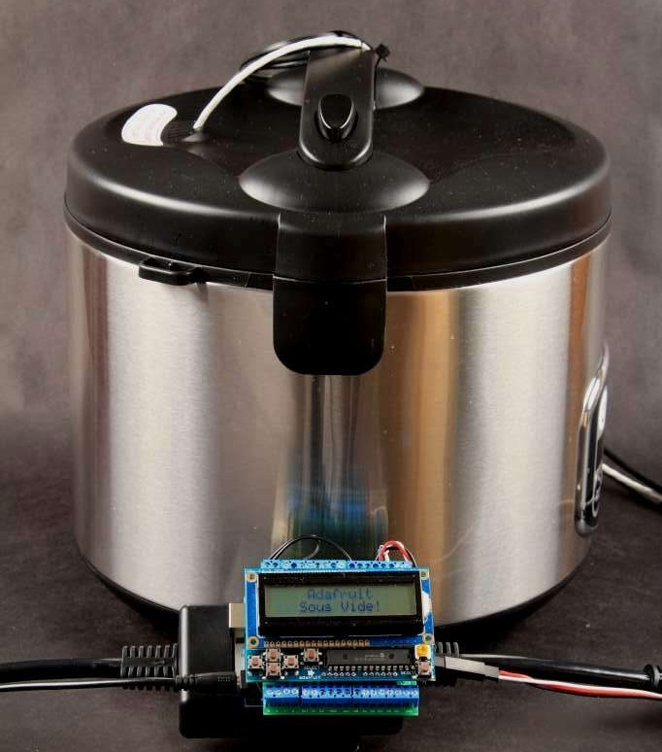
How I got into brewing with BBB
Adafruit ‘SousViduino’ kit
Poor UI (LCD Display, 6 buttons)
No network
Difficulties matching existing hardware

Slide 23
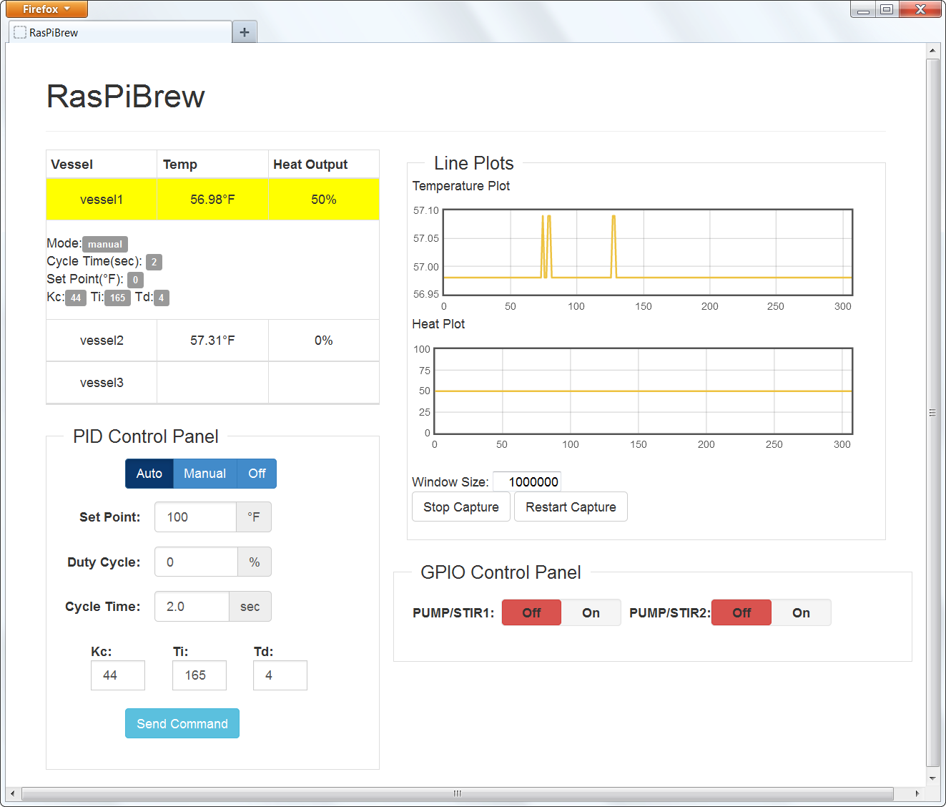
How I got into brewing with BBB
Raspberry Pi Sous Vide
Rather nice web UI
Dallas 1Wire temperature sensor
Network
No onboard memory
Raspi weewx random resets
‘fixed’ by replacing with BBB

Slide 24
Cooking with Beaglebone Black
Rice cooker
Fish tank air pump
Hacked on GPIO pin assignment
Tasty tasty food in an afternoon

Slide 25
Why cook before brew
Cheaper establishment cost
Test setup in an afternoon
Nowhere near as labour intensive

Slide 26
Ginger Beer
Low labour requirement = spend time on development
Grow all ingredients at home or via friends
Open Source cooking
No cooling required, only heating

Slide 27
Software Run-down
Python
Flask
4 threads
UI
temperature measure
PID
switching

Slide 28
My First Brew
Purchased all in one kit from brew shop
Fermenter, bottles, water valve, etc.
Ginger beer pre-mix

Slide 29
Does it brew?
‘bubbling’ (vessel pressure) is irrelevant
Temperature is important
Monitoring the monitor
Relay failures

Slide 30
My First Brew - Gotchas
Heat band for winter
Blanket
Drip bucket
Water
OMG so much water

Slide 31
How much water
27l fermenter
25l brew
Fermenter: Clean, rinse, brew, clean, rinse
Bottles: (optional clean), bottle, clean, rinse
4*27l + 2*25l = 158l or 4*27l + 3*25l = 183l
Roughly 200 brews to recover 100l water tank cost

Slide 32
OH & S REMINDERS
ALCOHOL + WATER + ELECTRICITY = BAD MOJO
When moving power around, disconnect upstream from UPS
Cleaners may cause unexpected skin reactions if handled poorly

Slide 33
FORK! FORK! FORK!
Want to control cook, brew, A/C, seedling tray and hot house all from one machine
All use basic PID style control
Software only handled three vessels

Slide 34
Aims of the fork
More detailed logging
SMS notifications
UPS monitoring
As many vessels as GPIOs are available
Pluggable temperature sensors
Multiple temperature sensors per vessel

Slide 35
Aims of the fork
Alcohol sensor on water valve
Vessel pressure sensor
Inbuilt SMS & UPS monitors

Slide 36
Aims of the fork
Improved graphing
Improved config
More descriptive UI
SQL data storage
Open mobile UI

Slide 37
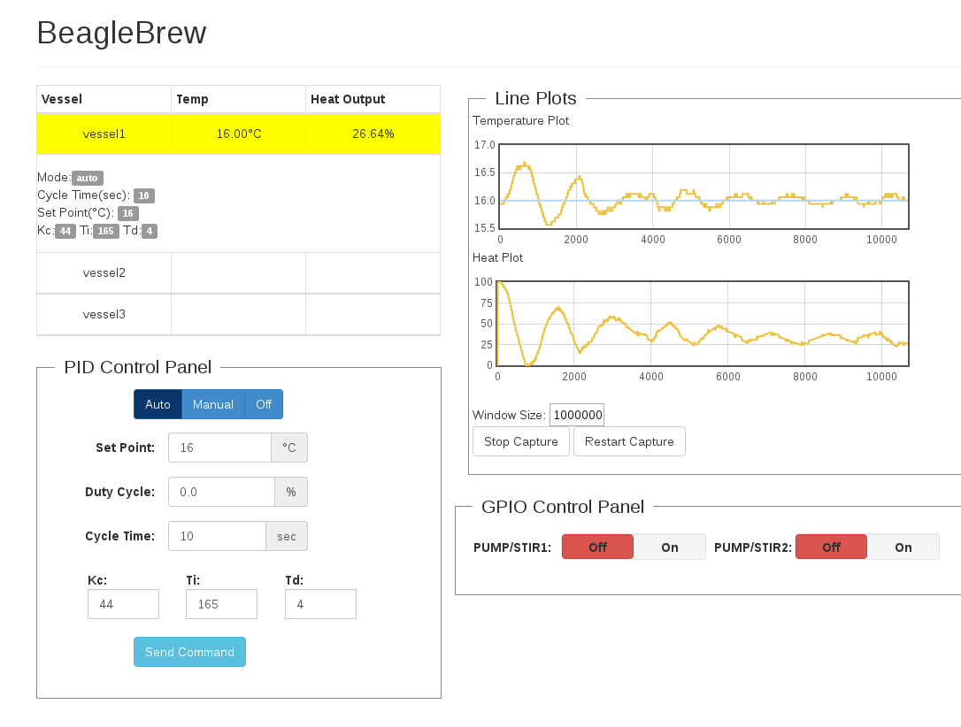
Pretty graphs

Slide 38
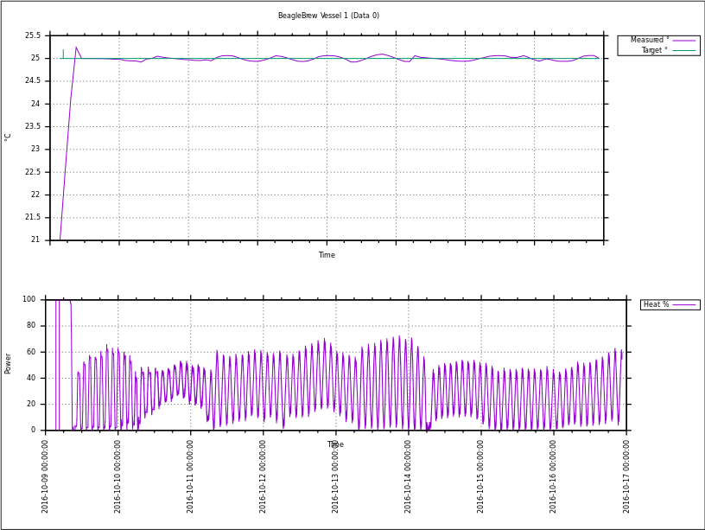
Pretty graphs

Slide 39

Ooops

Slide 40
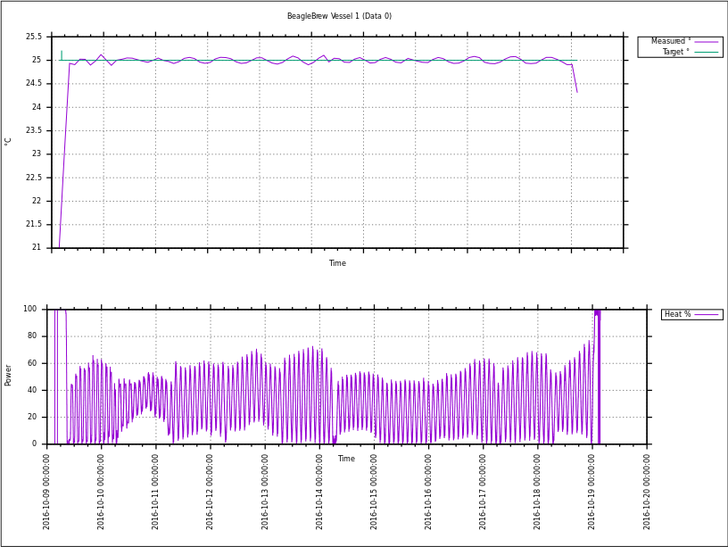
Pretty graph v2

Slide 41
Pretty graph v2.1

Slide 42
References and Resources
http://beagleboard.org
http://elinux.org/BeagleBone_Community
http://elinux.org/Beagleboard:BeagleBoneBlack
https://groups.google.com/forum/#!forum/beagleboard
https://learn.adafruit.com/sous-vide-powered-by-arduino-the-sous-viduino/sous-vide
http://steve71.github.io/RasPiBrew
http://www.vandelogt.nl/uk_regelen_pid.php
https://en.wikipedia.org/wiki/PID_controller
https://github.com/PeteLawler/BeagleBrew
http://tronixlabs.com.au
http://freetronics.com.au

