Slide 1

Self-Driving (Virtual) Car
Peter Sumners

Slide 2
Executive Summary
car: sensors and movement
neural network: weights and stuff
genetic algorithm: hello, darwin
courses (2 of them!)
why? because it’s cool

Slide 3
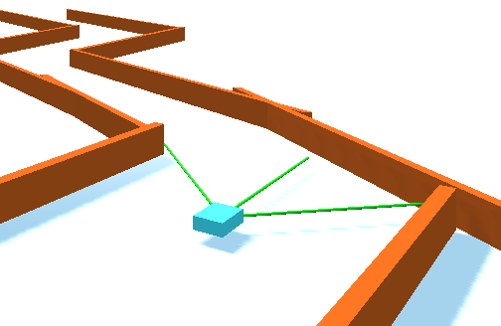
Car in maze

Slide 4
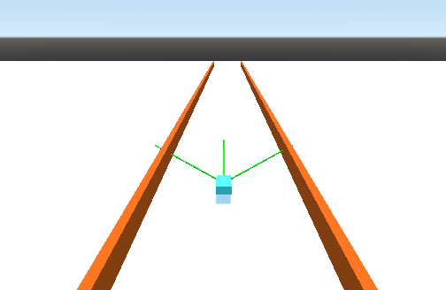
Car on straightway

Slide 5
Neural Network
.2
Gain(.2)=
.167
(.167*4.0)+(-.909*-.7)+
(1.0*-0.8)=
.503
Gain(.503)=...
4.0
Gain(x) =
x / (1+|x|)
-10
Gain(-10)=
-.909
-.7
-.8
1
(bias: no Gain function)

Slide 6
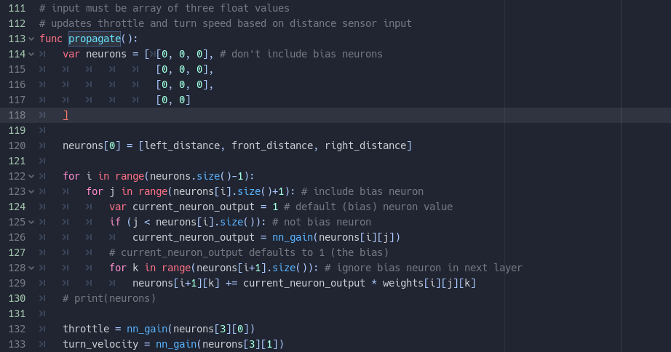
Neural Network

Slide 7
Genetic Algorithm
split time into “trials“ (10s) and “generations“ (4 trials)
modify weights each trial (one weight per trial)
take the best of the generation, and copy that weight set

Slide 8
Learning Performance (Maze)

Slide 9
Question time!

