Slide 1
P2P GOSSIP System
Klaus Cipi and Peter Banis

Slide 2
Introduction
P2p Gossip system
Concurrent server and client program handles PEER, GOSSIP, LEAVE, and PEERS command.
Written in C / C++.
Files used as a database.
Command arguments are parsed with getopt.
Supports TCP and UDP
Commands are encoded / decoded in ASN1 DER format.

Slide 3
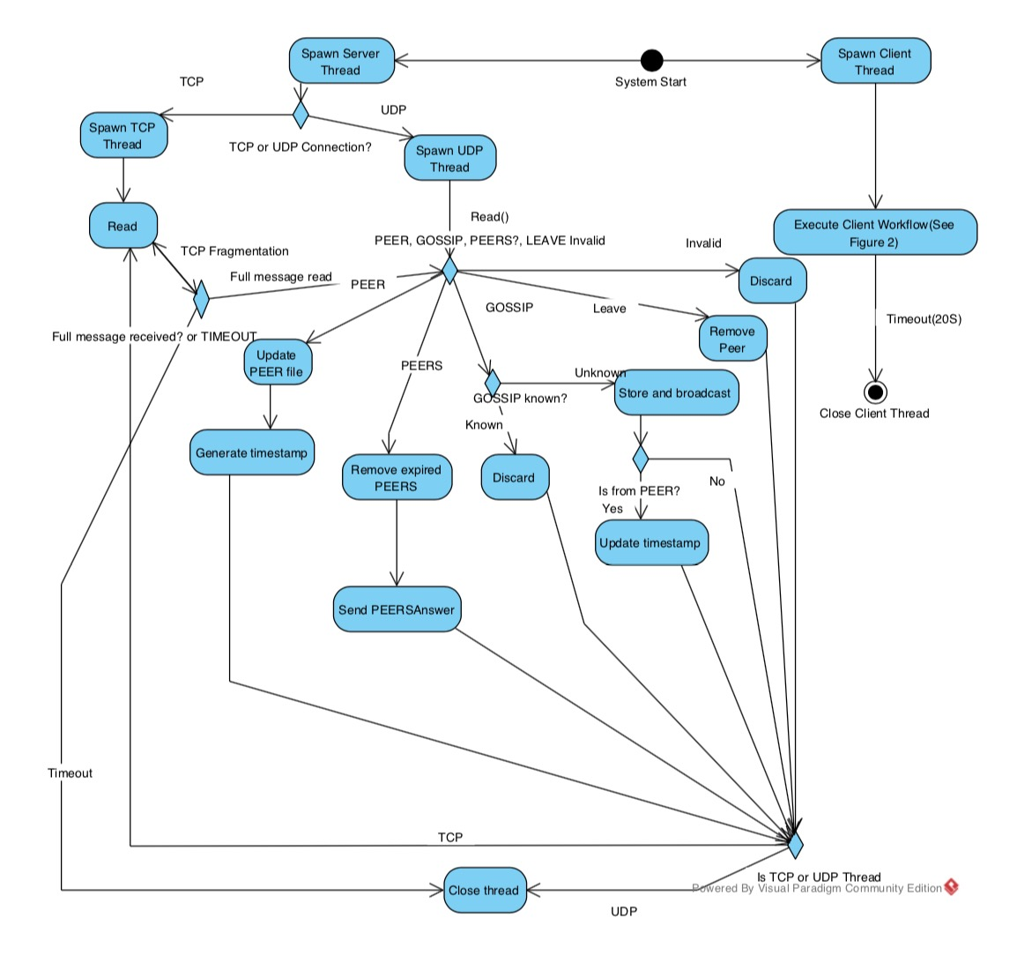
Server Diagram
P2p Gossip system

Slide 4
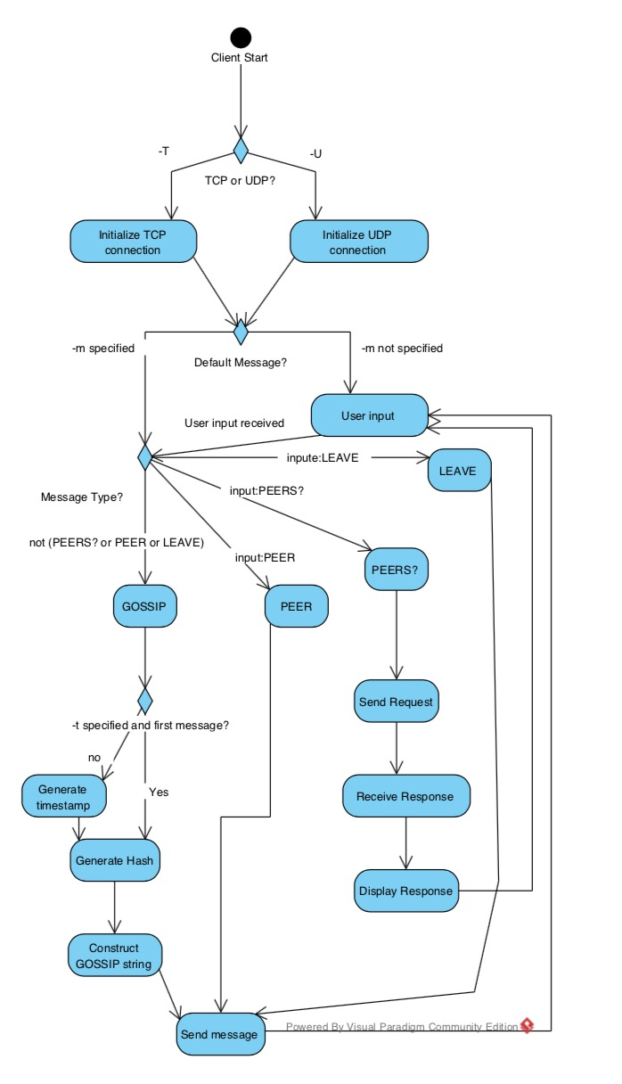
Client Diagram
P2p Gossip system

Slide 5
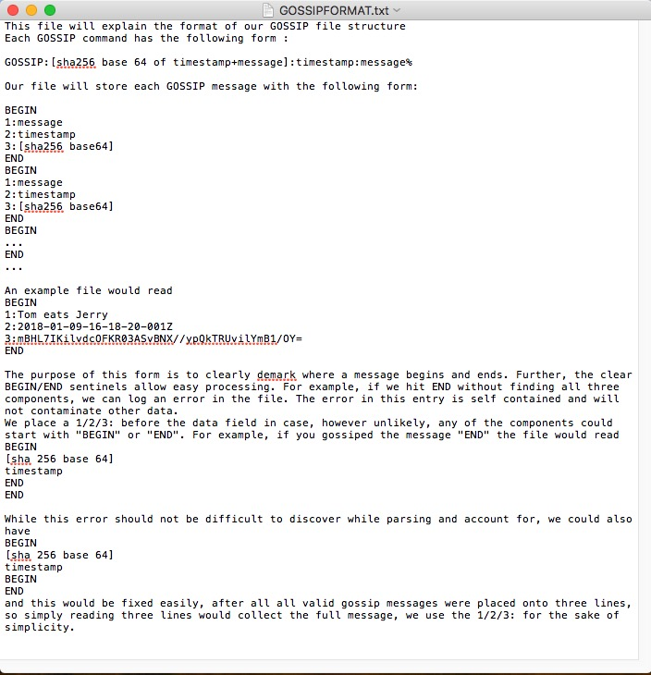
File Structure
P2p Gossip system

Slide 6
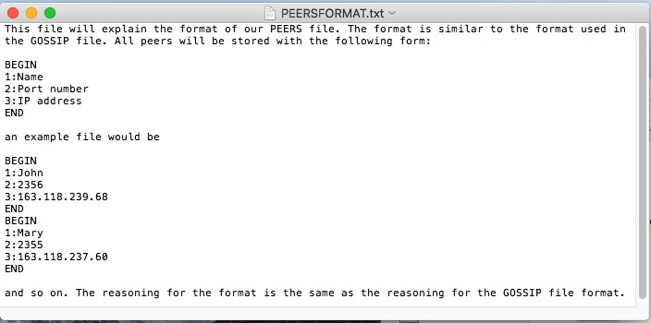
File Structure
P2p Gossip system

Slide 7
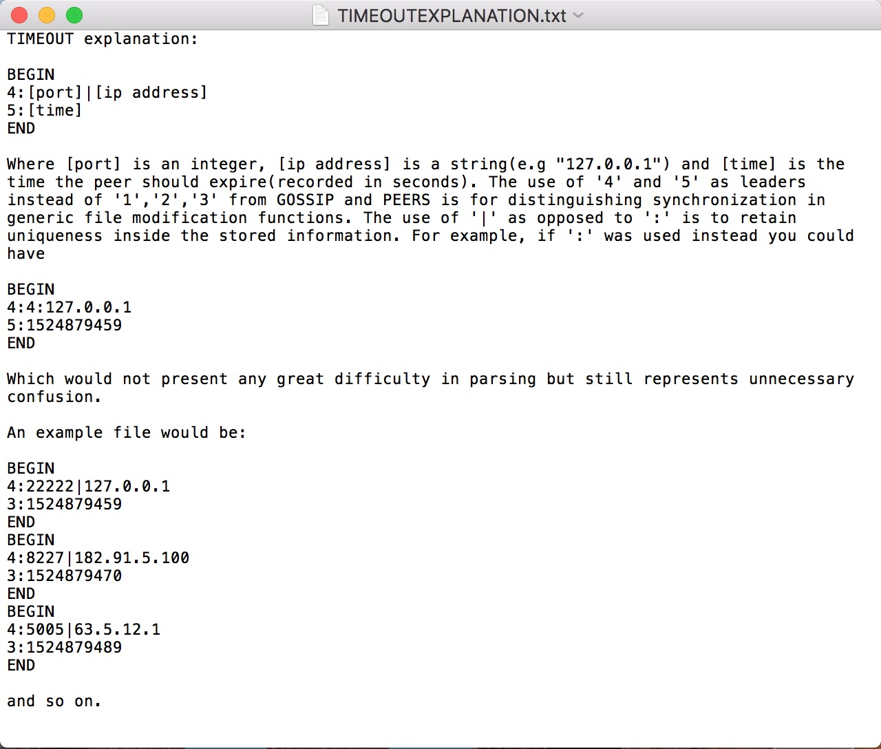
File Structure
P2p Gossip system

Slide 8
int isKnown(char*, char*, char);
File Structure
Checks the given filename to lock the appropriate semaphore
Opens the file for reading
Scans through the file to find the matching string
Unlocks the semaphore
Returns the line number of the match (starting at 1) , if any.
Returns 0, If there is not match.
Returns -1, If any error occurs.

Slide 9
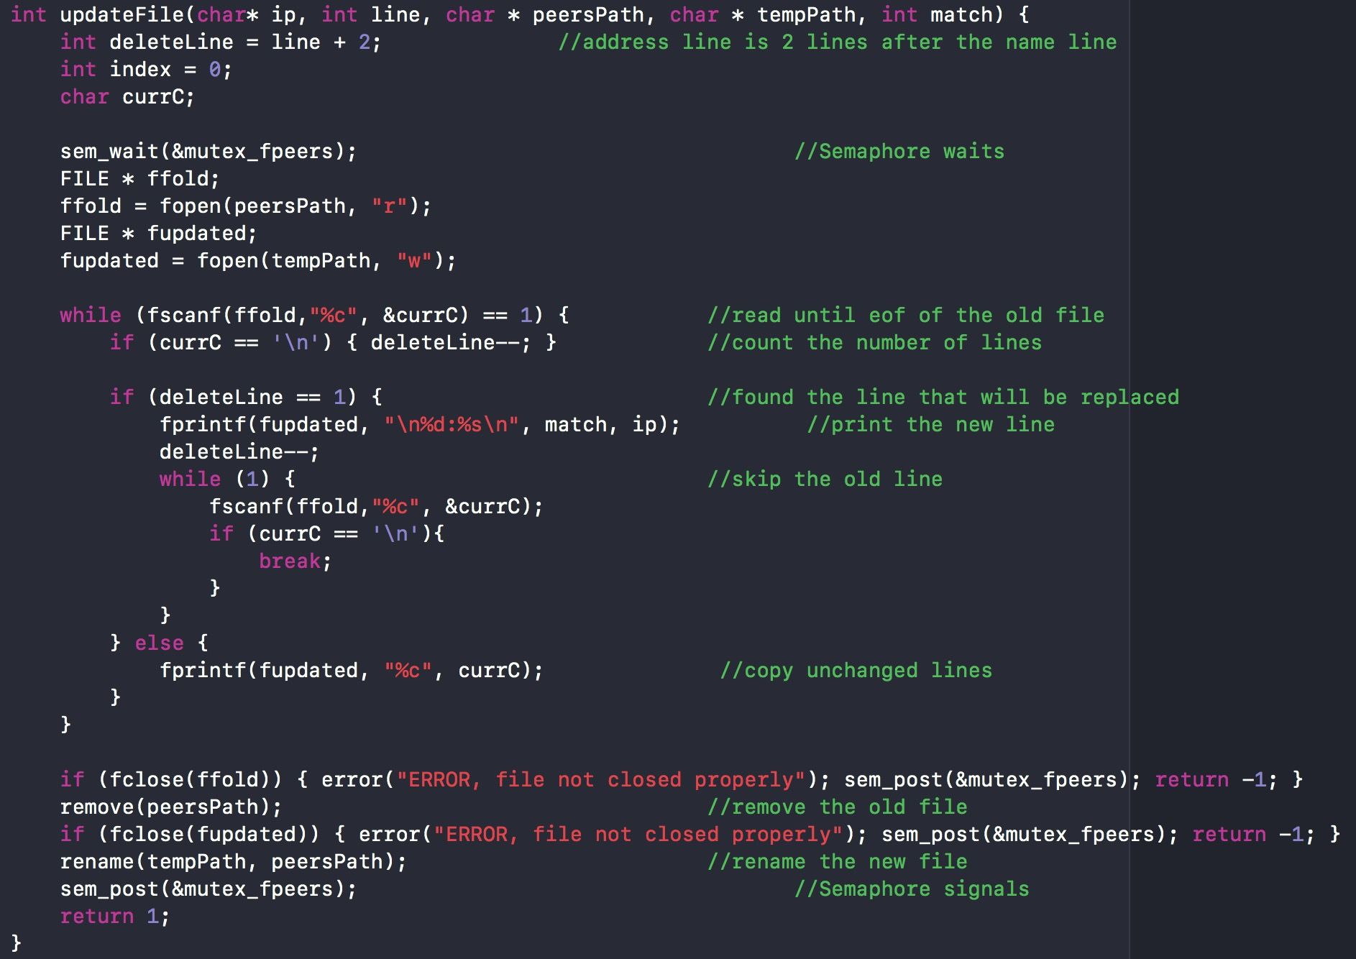
int updateFile(char*, int, char* ,char*, int);
File Structure

Slide 10
TCP Streaming Mechanism
P2p Gossip system
Initially saves the bytes that received in a bufTemp.
Append bufTemp into bufferByte.
Calculate the length of the first ASN1command.
Decode as many bytes as calculated in the previous step.
If decoding succeeds, parse the ASN1 command into a string, and feed it to the appropriate function
If decoding fails and if the number of bytes received is the same or higher than the length calculated, print error command.
If decoding fails and if the number of bytes received is low than the length calculated, wait for more bytes to arrive.

Slide 11
TCP Streaming Mechanism
P2p Gossip system
(OPEN SERVER.CPP)

Slide 12
Conclusions
P2p Gossip system
Don’t write the entire server-client in one file (2016 lines of code).
Don’t write the server and the client in different languages (because in the next milestone Dr.Silaghi will make you merge them together in one file).
Read the documentation of ASN1 before implementing it.
Have more frequent group meetings

