Slide 1

Primality Test
Ahmad Mongy (ID 120200033)
Ahmed Abdelkader (ID 120200028)
Mahmoud Akrm (ID 120200045)
Mohammed Ayman (ID 120200081)
Mohanned Ahmed (ID 120200113)
Peter Fayez (ID 120200073)
Yasser Ossama (ID 120190122)
Ziad Hesham (ID 120200078)

Slide 2
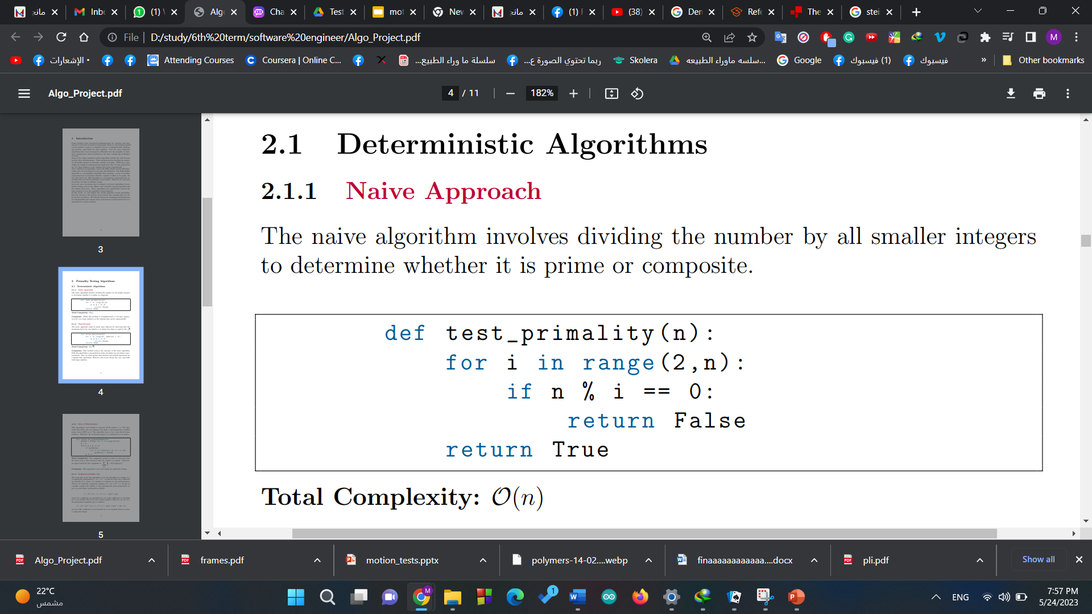
Naive Approach
The naive algorithm involves dividing the number by all smaller integers to determine whether it is prime or composite.
While this method is straightforward, it becomes impractical for very large numbers as the running time grows exponentially

Slide 3
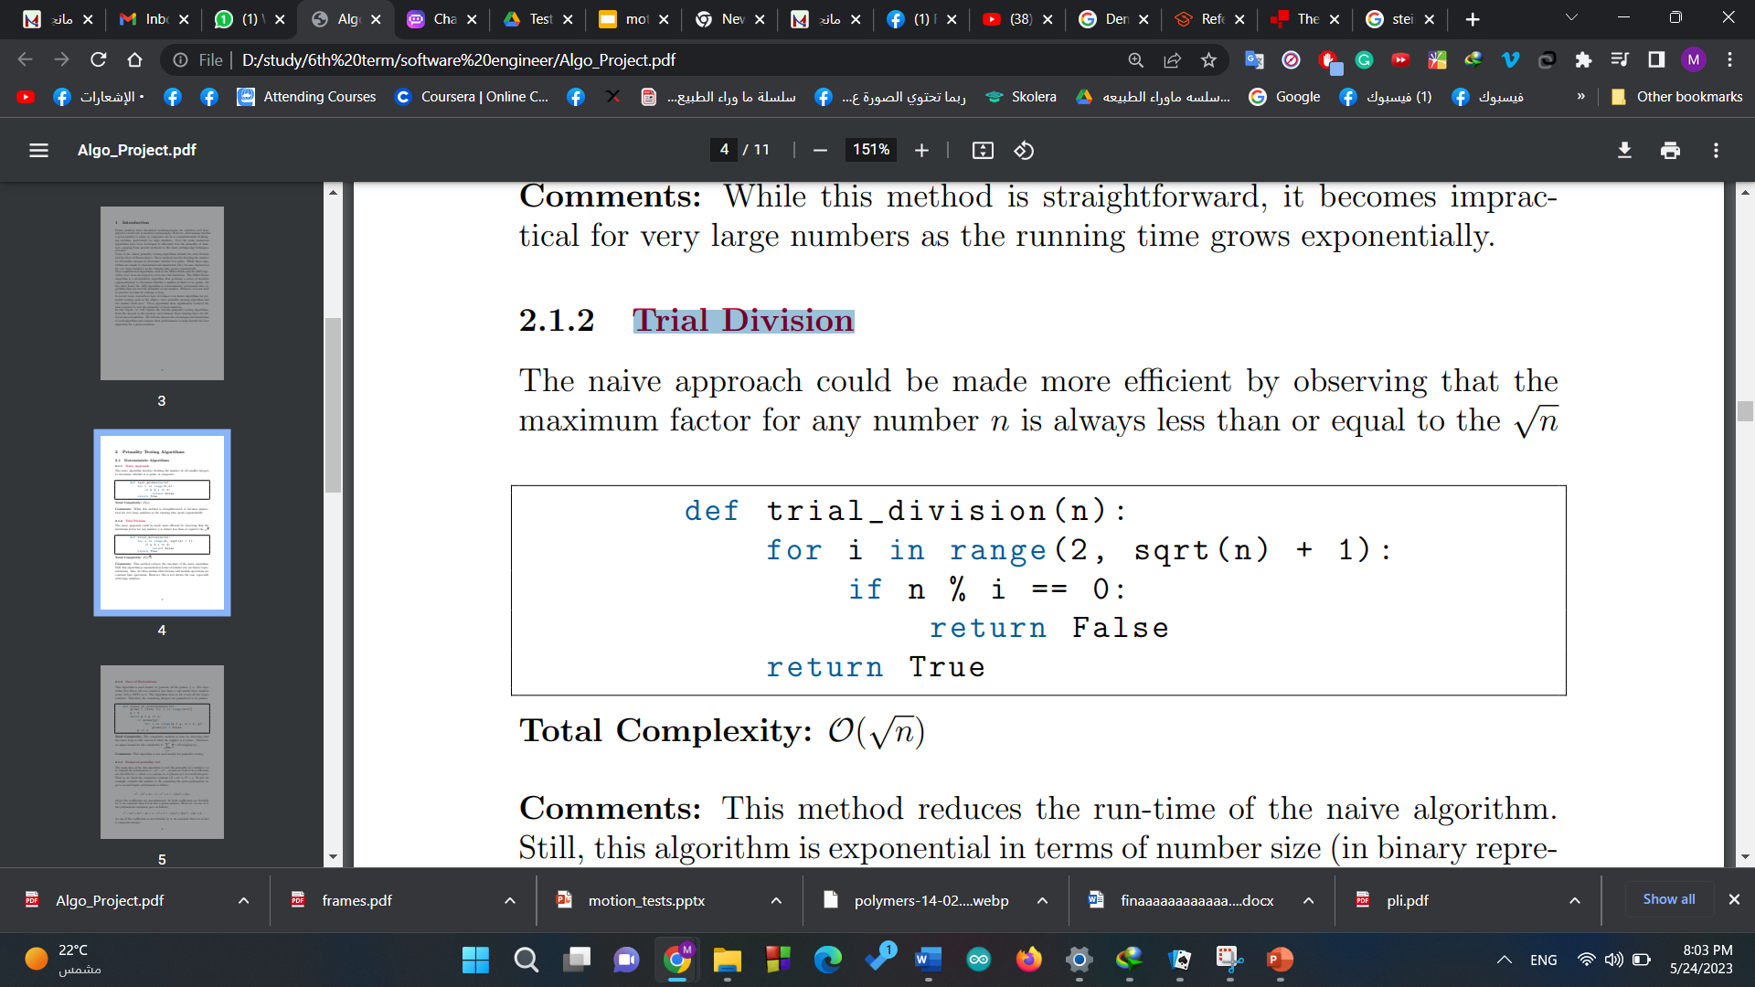
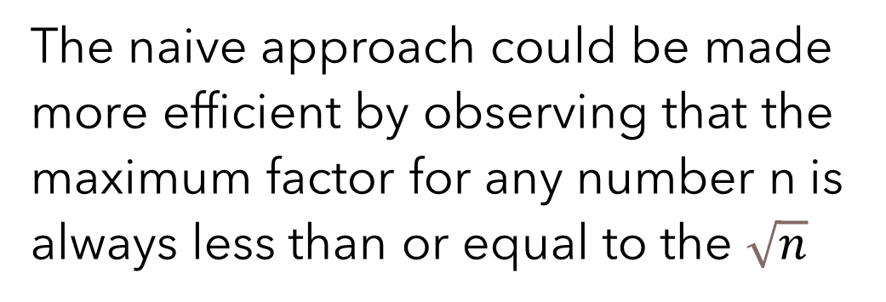
Trial Division
The naive approach could be made more efficient by observing that the maximum factor for any number n is always less than or equal to the $\sqrt{n}$

Slide 4
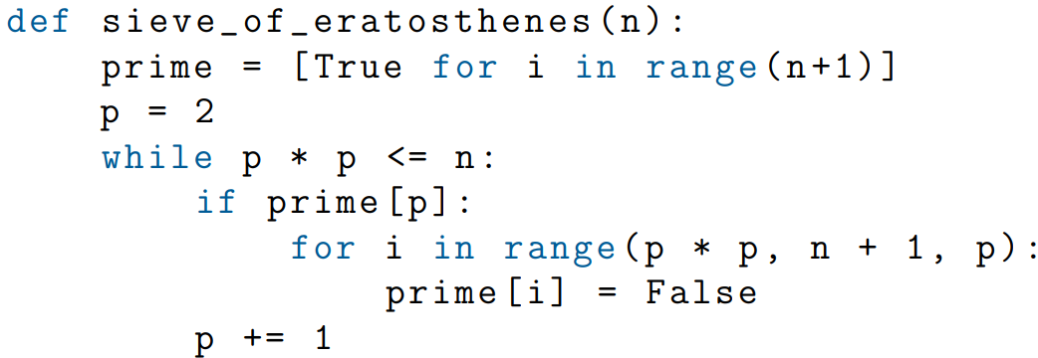
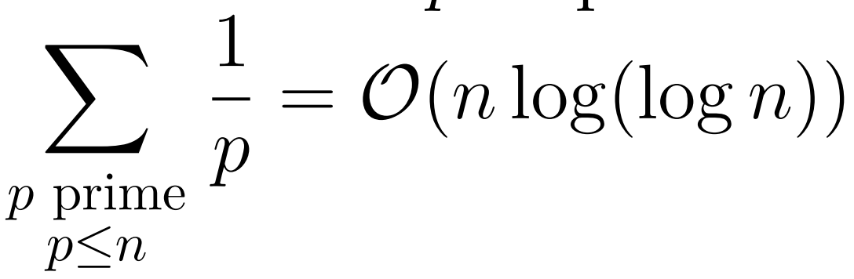

Sieve of Eratosthenes
This algorithm is used mainly to generate all the primes ≤ n. The algorithm first filters all even numbers less than n and marks their smallest prime factor (SPF) as 2. Therefore, the remaining integers are guaranteed to be primes.
$$n$$

Slide 5
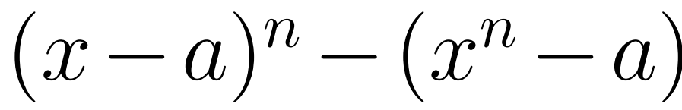
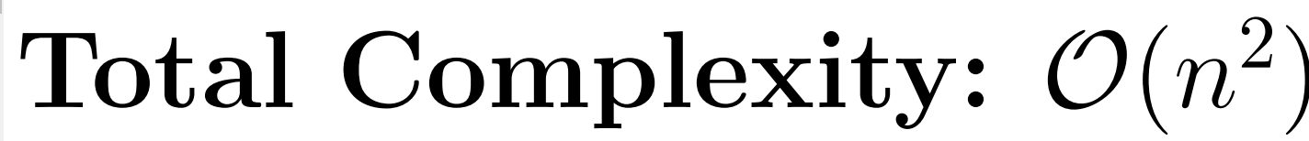
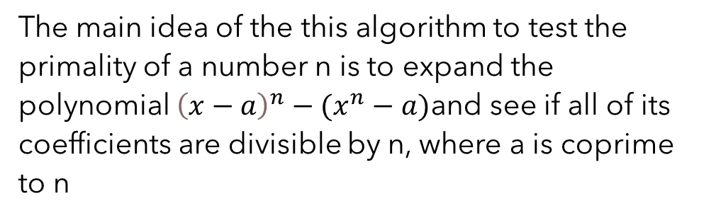
Foolproof primality test
The main idea of the this algorithm to test the primality of a number n is to expand the polynomial ${\left(x−a\right)}^{n}−(x^{n}−a)$and see if all of its coefficients are divisible by n, where a is coprime to n

Slide 6
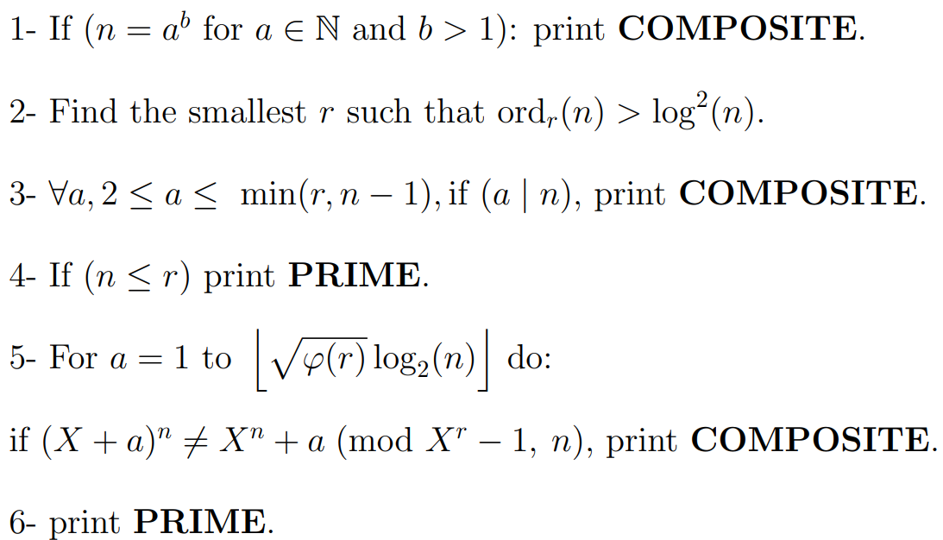
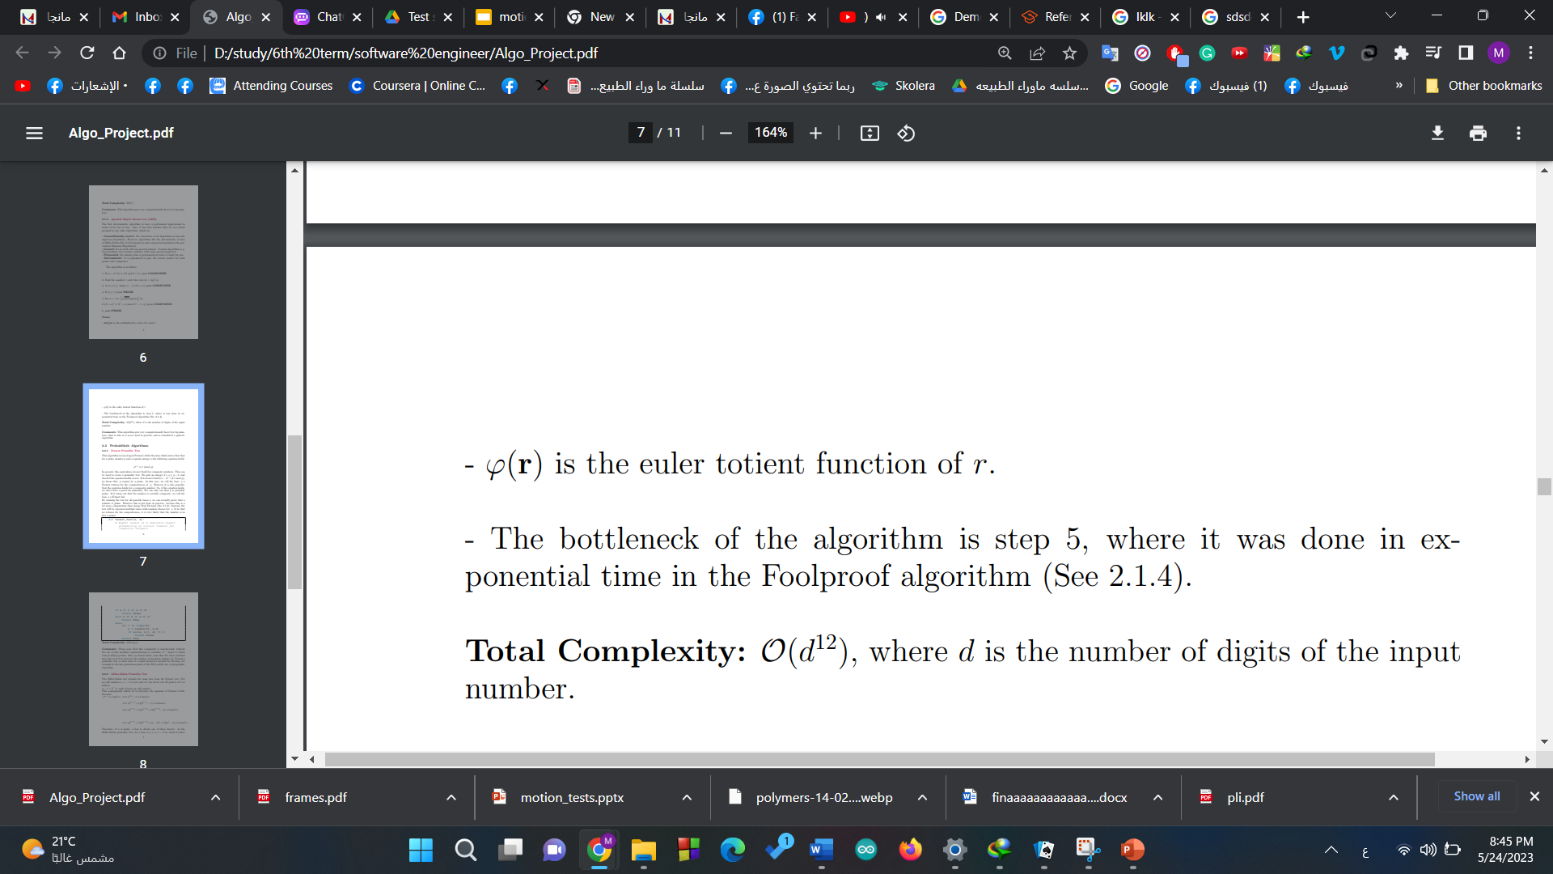
Agrawal–Kayal–Saxena test (AKS)
The first deterministic algorithm to have a polynomial upper bound in terms of its size in bits.
The bottleneck of the algorithm is step 5, where it was done in exponential time in the Foolproof algorithm
where d is the number of digits of the input number.

Slide 7
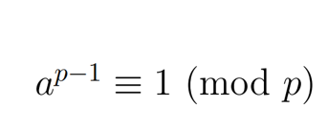

Fermat Primality Test
This algorithm is based upon Fermat’s little theorem which states that that for a prime number p and a coprime integer a the following equation holds:
In general, this equivalence doesn’t hold for composite numbers. This can be used to create a primality test. We pick an integer 2 ≤ a ≤ p − 2, and check if the equation holds or not.
where k is the number of iteration and n is the number being tested.

Slide 8
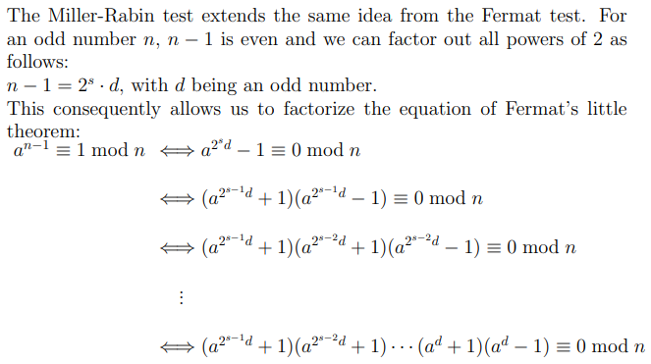
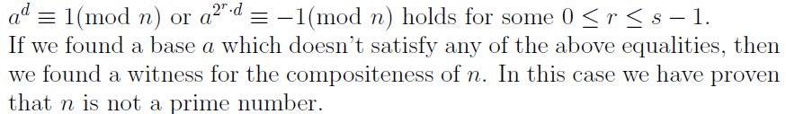
Miller-Rabin Primality Test
where k is the number of iteration and n is the number being tested.

Slide 9
Prime Properties
Twin primes: Twin primes are a pair of primes that has a prime gap of two. For example, both (17, 19) and (41, 43) are twin prime pairs.
Mersenne Primes: A mersenne prime is a prime p of the form 2x−1 for some positive integer x. Notably, if x is a composite integer, so is 2x − 1. Also, it is easy to prove that if 2p − 1 is prime, then p is prime.
Sophie-Germain primes: A prime number p is a Sophie-Germain prime if 2p − 1 is also a prime. Sophie-Germain primes have a wide-range of applications in cryptography and pseudo-random numbers generation.
Pythagorean primes: A prime p of the form 4x + 1 is called a pythagorean prime for a positive integer x. A pythagorean prime p appear as the hypotenuse in two pythagorean triplets as p and √p. For example, √5 is the hypotenuse for the triangle with side lengths of 1 and 2. Also, 5 is the hypotenuse of the triangle with side length of 3 and 4.

Slide 10
Results

Slide 11
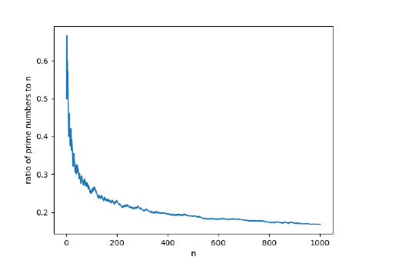
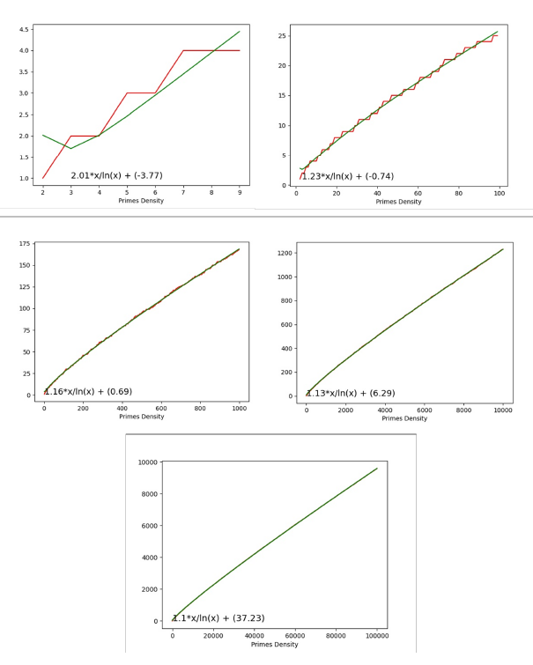
All primes

Slide 12
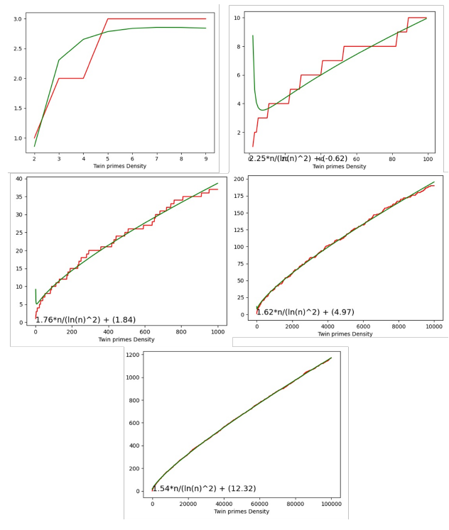
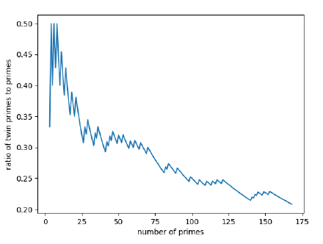
Twin primes

Slide 13
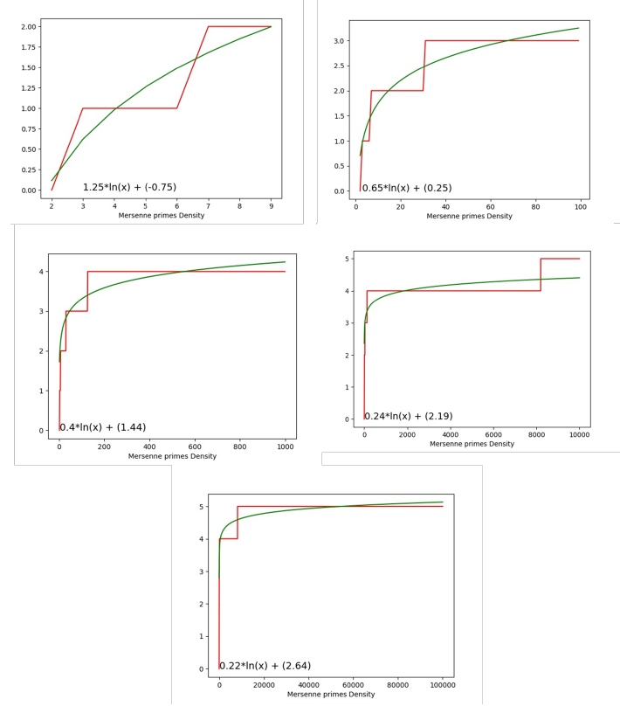
Mersenne Primes

Slide 14
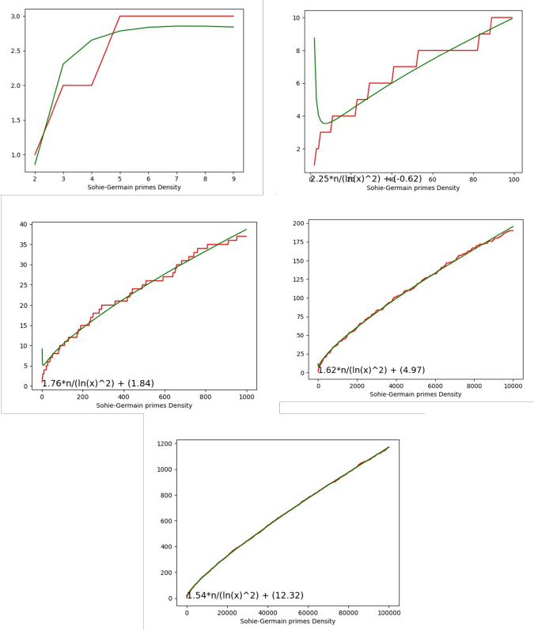
Germain Primes

Slide 15
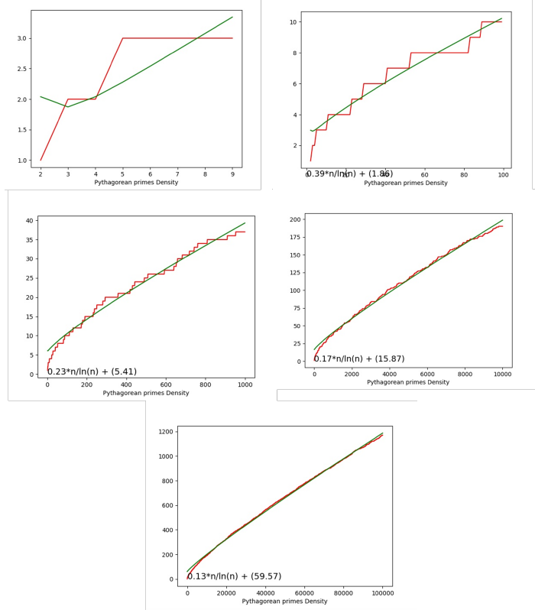
Pythagorean Primes

