Slide 1
Crazy Five Cards
Story Board
By Nobuhle , Kudzi , Peter

Slide 2
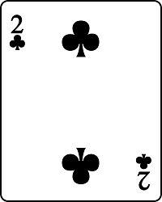
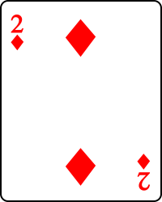
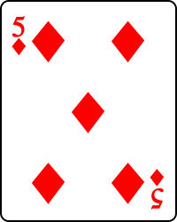
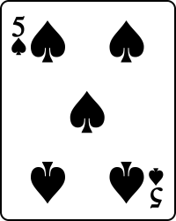
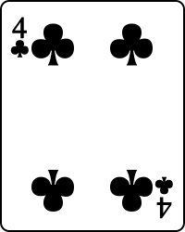
Start
Each Player is dealt Five cards

Slide 3



Then first move
The Player who starts first is required to pick from the deck then discard one card away to the played cards

Slide 4

Gameplay
The next Player then can either pick a card from the played or the Deck

Slide 5
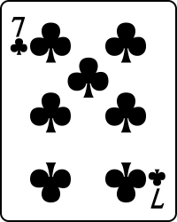
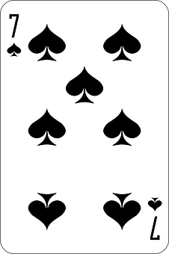
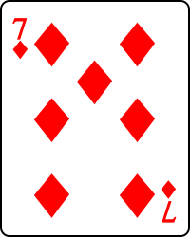
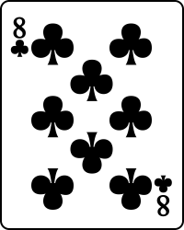
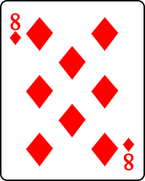
How to win
To win the game a player has to try and match 3 similar ranks and two similar ranks.
In this case it would have been a win.

Slide 6


The player could also win if they have 4 similar rank and an Ace or a ten
In this case it’s a win
OR

Slide 7
The other win is that the player could have 2 similar ranks, 3 similar ranks and an Ace or a 10.
This is another case of a win
OR

Slide 8
Lastly if you don’t follow the rules that the game tells you. You will end missing your turn and the next player will play.

