Slide 1
Does protected area connectivity moderate the efficacy of protection on tropical biodiversity
Evidence from a replication of Brodie et al. (2023)
Peter Kedron¹, Amy Frazier¹, Lei Song¹, Wenxin Yang¹
¹University of California Santa Barbara
peterkedron@ucsb.edu
2024 Annual Meeting of the American Association of Geographers | Honolulu, HI

Slide 2
30x30
Target 3 of the Kunming-Montreal Global Biodiversity Framework
Ensure and enable that by 2030 at least 30% of terrestrial and inland water areas, and of coastal and marine areas, especially areas of particular importance for biodiversity and ecosystem functions and services, are effectively conserved and managed through ecologically representative, well-connected and equitably governed systems of protected areas and other effective area-based conservation measures, …
Kedron et al.
Does PA Connectivity Moderate the Efficacy of Protection?
Original Analysis

Slide 3
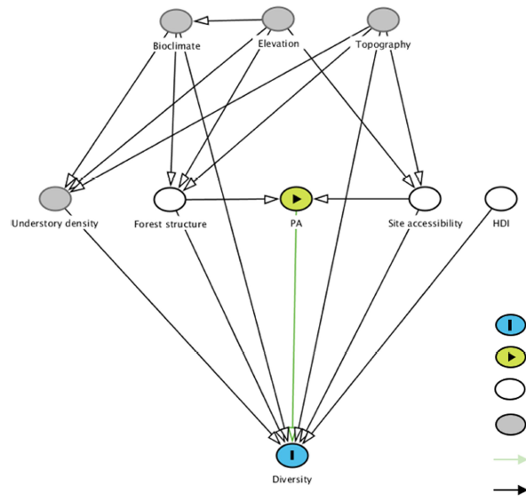
Brodie et al. (2023)
Analysis and key claims of the original study
Brodie et al. demonstrated the efficacy of terrestrial protected areas (PA) for conserving bird biodiversity while accounting for the confounding effects of 3D forest structure and accessibility.
Linear mixed-effects model with national-level random effects and exponential correlation structure based on covariance in pairwise distances among sites. Propensity score matching to deconfound effects of PA selection.
Predictors
PA Sample site inside/outside Protected Area
Forest Canopy height (habitat quality)
Access Circuit theory derived measure (hunting pressure)
HDI Human development index
Response
Diversity Functional Richness, Species Richness, Phylogenetic Diversity
ED Fig. 2 | Directed acyclic graph of bird and mammal diversity in relation to exposure variables and covariates
Kedron et al.
Does PA Connectivity Moderate the Efficacy of Protection?
Original Analysis

Slide 4
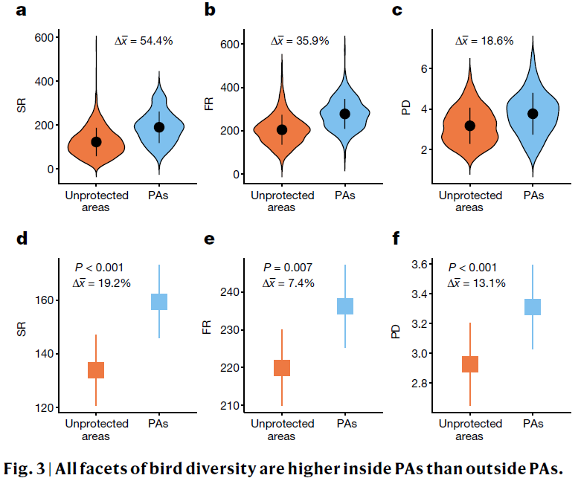
Brodie et al. (2023)
Analysis and key claims of the original study
Kedron et al.
Does PA Connectivity Moderate the Efficacy of Protection?
Original Analysis

Slide 5
30x30
Target 3 of the Kunming-Montreal Global Biodiversity Framework
Ensure and enable that by 2030 at least 30% of terrestrial and inland water areas, and of coastal and marine areas, especially areas of particular importance for biodiversity and ecosystem functions and services, are effectively conserved and managed through ecologically representative, well-connected and equitably governed systems of protected areas and other effective area-based conservation measures, …
Kedron et al.
Does PA Connectivity Moderate the Efficacy of Protection?
Original Analysis

Slide 6
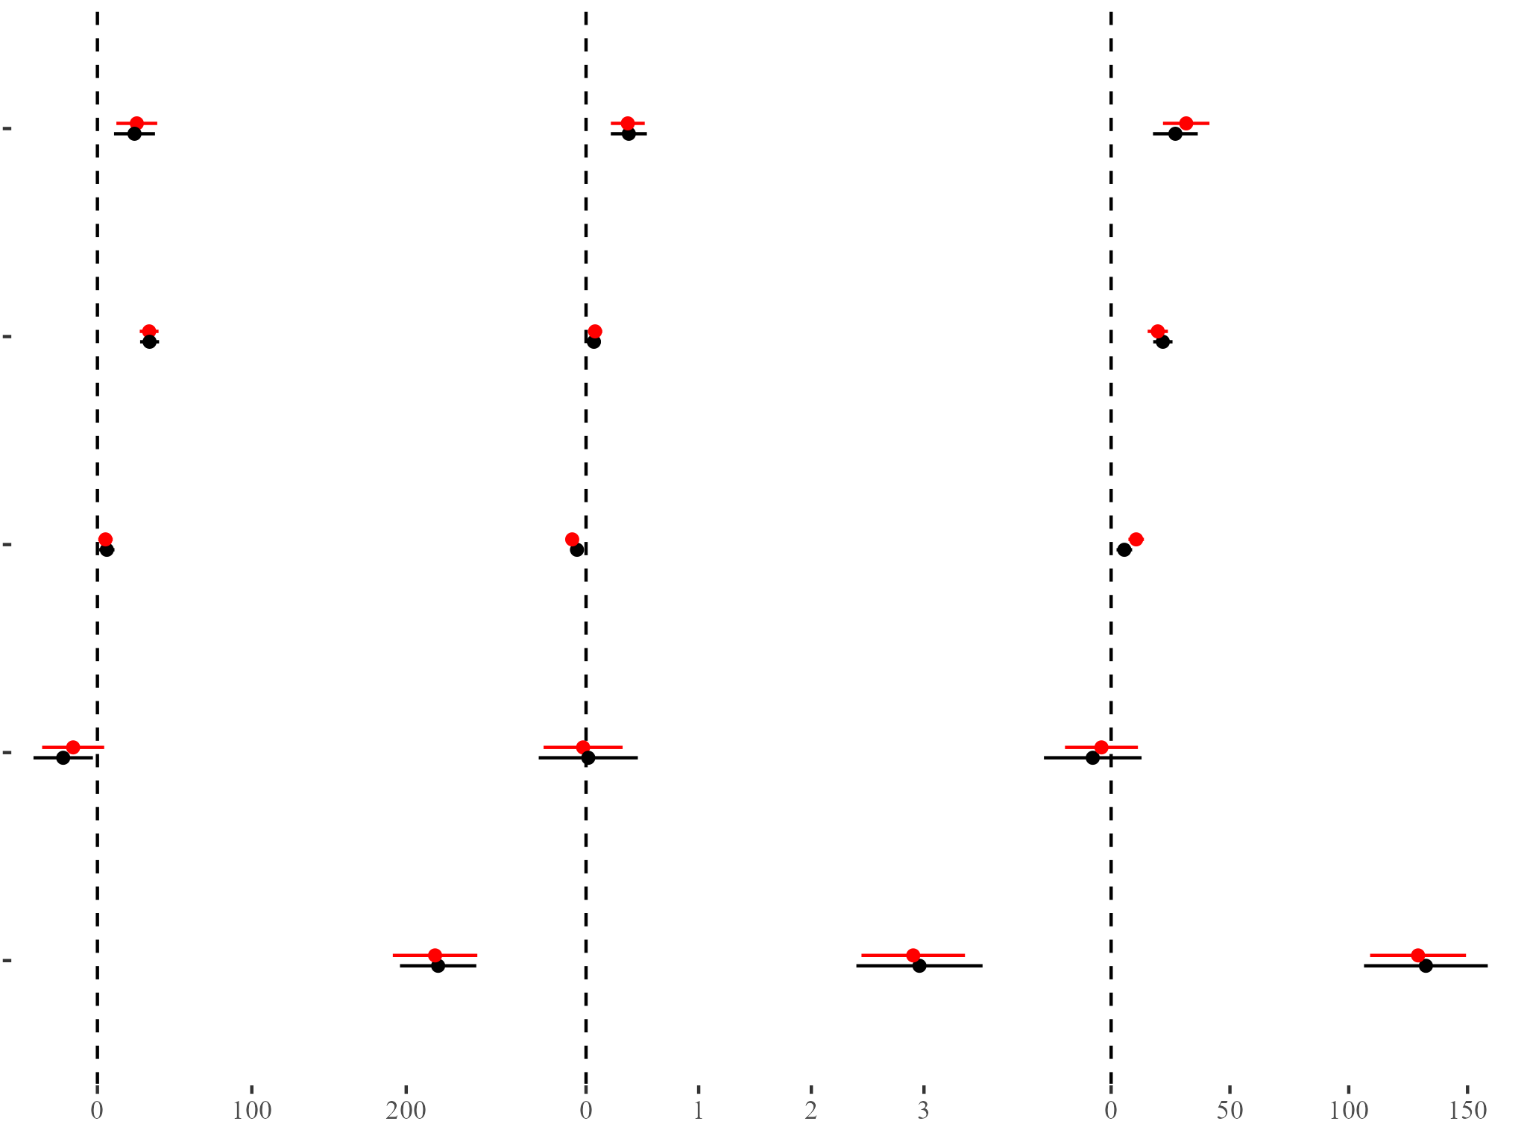
Computational Reproduction
Matching effect estimates observed across studies
Functional Richness
Phylogenetic Diversity
Species Richness
Reproduction
Protected Area
Brodie et al.
Forest Canopy Height
Site Accessibility
HDI
Intercept
Estimate of effect
Kedron et al.
Does PA Connectivity Moderate the Efficacy of Protection?
Computational Reproduction

Slide 7
Reproducibility Check
We identified a series of minor issues and areas of concern in the original analysis
Minor Concern
Omission
Construction
Spatial
Brodie et al. did not include HDI measures in the public data file
Procedures to construct GEDI predictors and response were not provided in public code
Information about projections and distance calculations was omitted
Moderate Concern
Spatial
Standardization
Leverage
Accounted for, but did not test for remaining spatial structure in model residuals
Brodie et al. centered variables on complete dataset, but regressed on subset
Removed outliers based on complete dataset, but regressed on subset
Kedron et al.
Does PA Connectivity Moderate the Efficacy of Protection?
Computational Reproduction

Slide 8

Replication Design
Does protected area connectivity moderate the efficacy of protection on tropical biodiversity?
Introducing connectivity as a predictor of diversity and a moderator of protected area efficacy
lme(Diversity ~ Brodie + conn + conn:PA,
random = list(~1 | country),
data = dat_matched,
weights = ~I(1/weights),
correlation = corExp(form = ~utm_east + utm_north, nugget = TRUE)
)
Connectivity
Kedron et al.
Does PA Connectivity Moderate the Efficacy of Protection?
Replication Attempt
Notes:
Theta is the median dispersal distance for a species, which give a 50% probability of dispersal at that distance
We tried four version of this calculation 2 vector, 2 raster. They produced highly correlated measures that did not alter the regression estimates

Slide 9
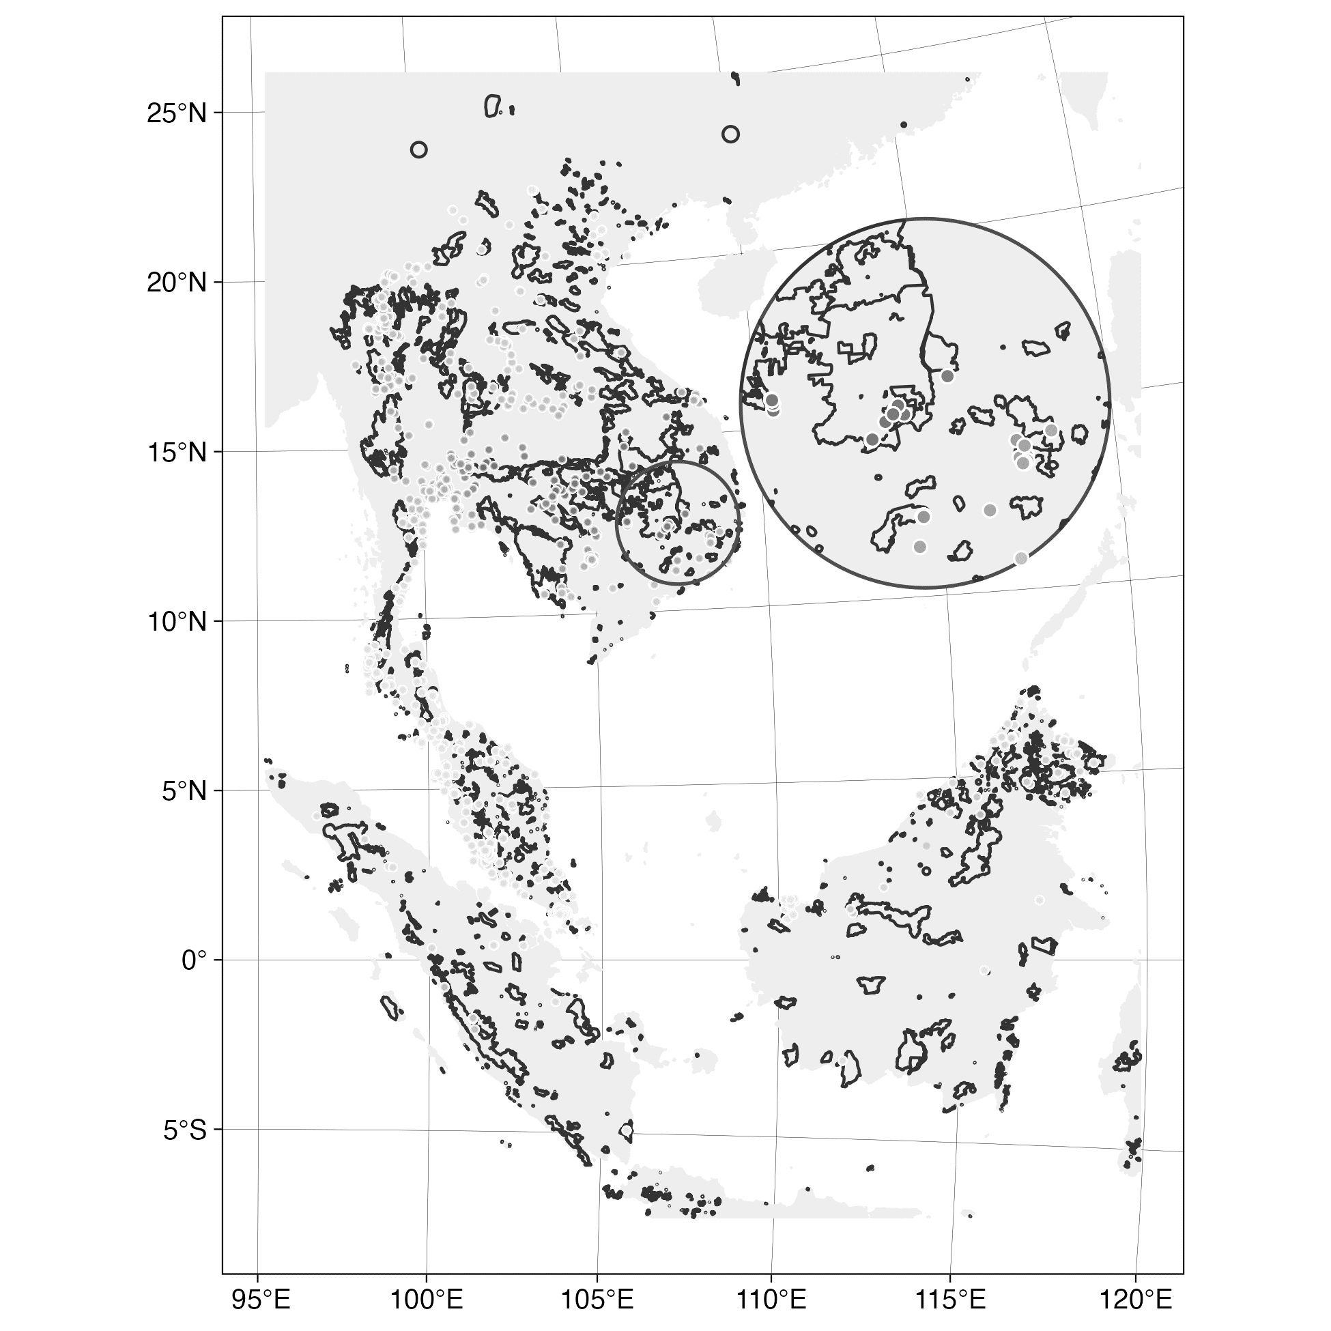
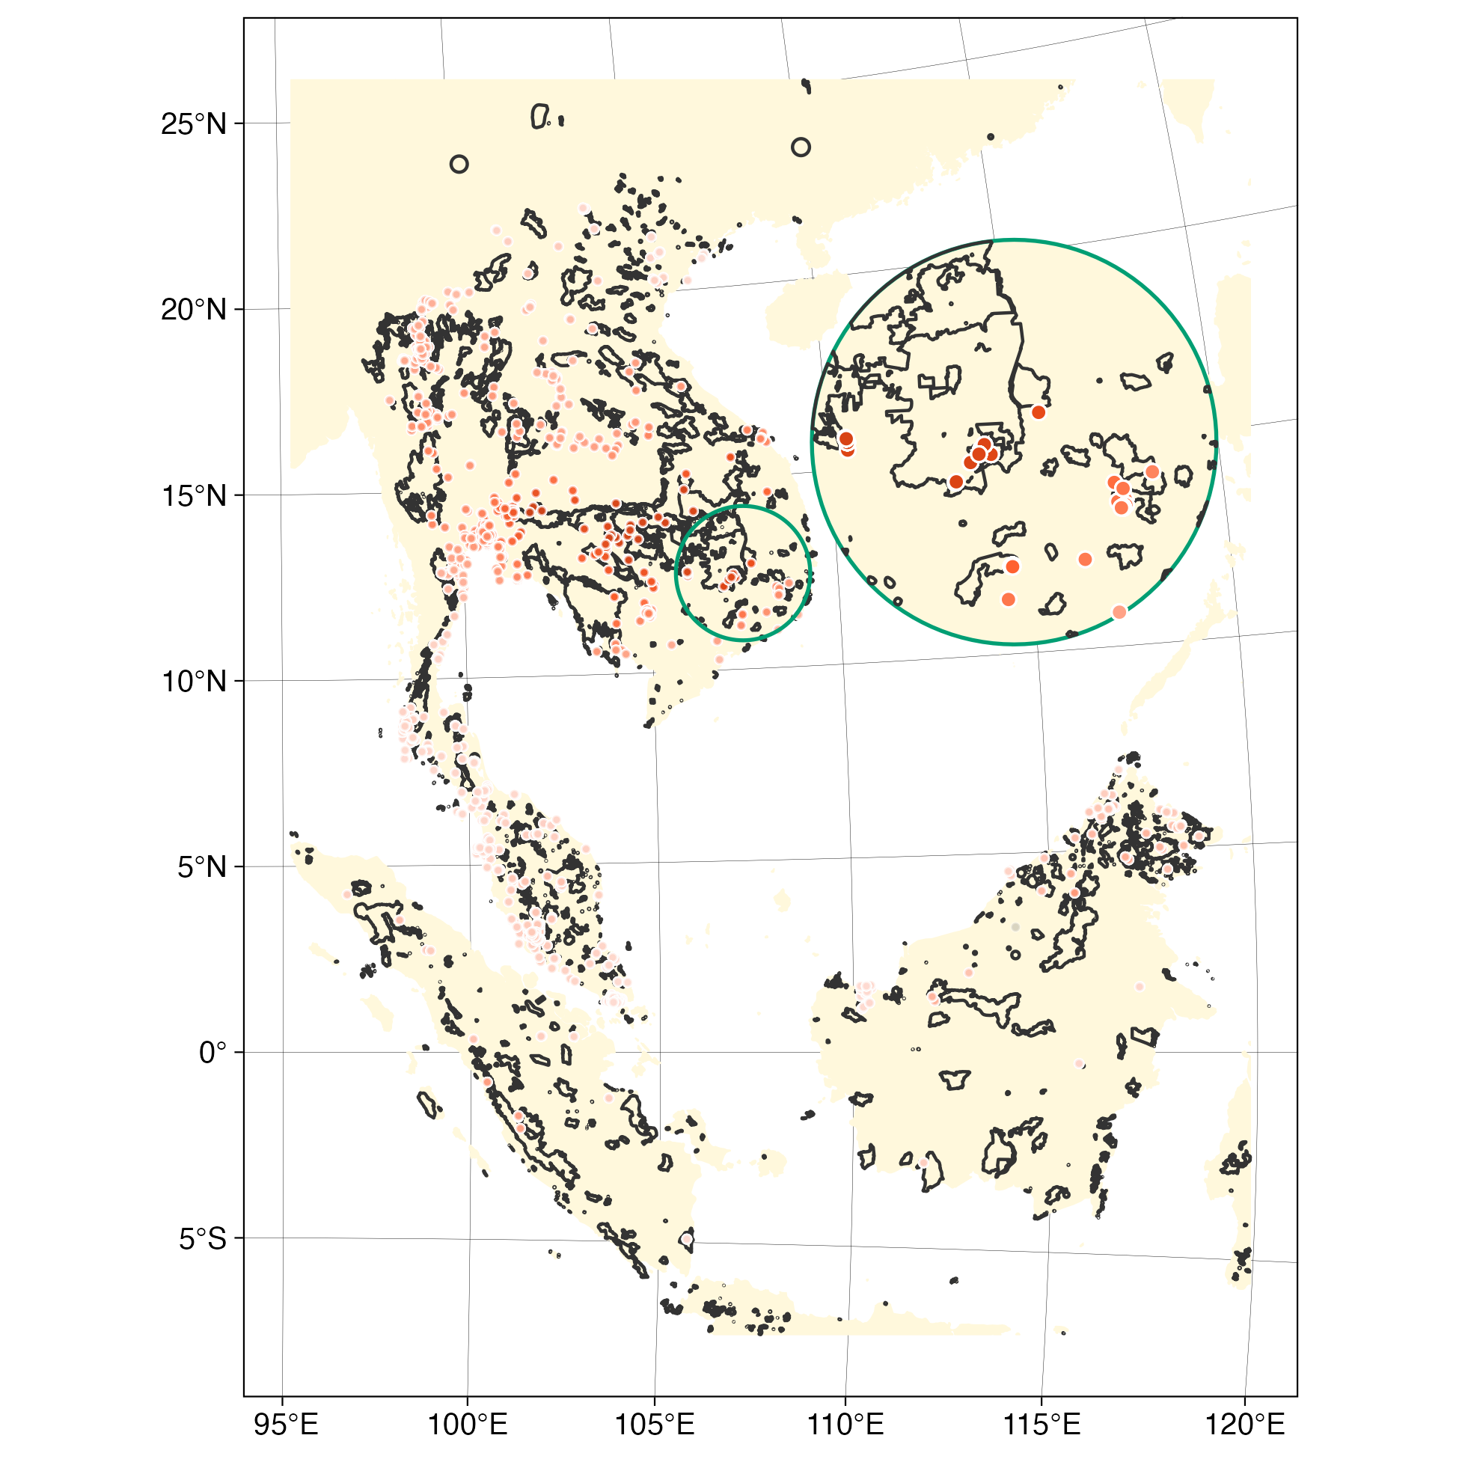
Replication Design
Does protected area connectivity moderate the efficacy of protection on tropical biodiversity?
Introducing connectivity as a predictor of diversity and a moderator of protected area efficacy
lme(Diversity ~ Brodie + conn + conn:PA,
random = list(~1 | country),
data = dat_matched,
weights = ~I(1/weights),
correlation = corExp(form = ~utm_east + utm_north, nugget = TRUE)
)
Kedron et al.
Does PA Connectivity Moderate the Efficacy of Protection?
Replication Attempt
Notes:
Theta is the median dispersal distance for a species, which give a 50% probability of dispersal at that distance
We tried four version of this calculation 2 vector, 2 raster. They produced highly correlated measures that did not alter the regression estimates

Slide 10
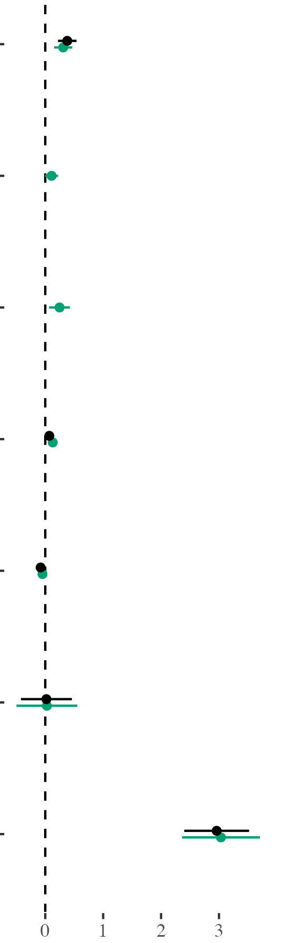
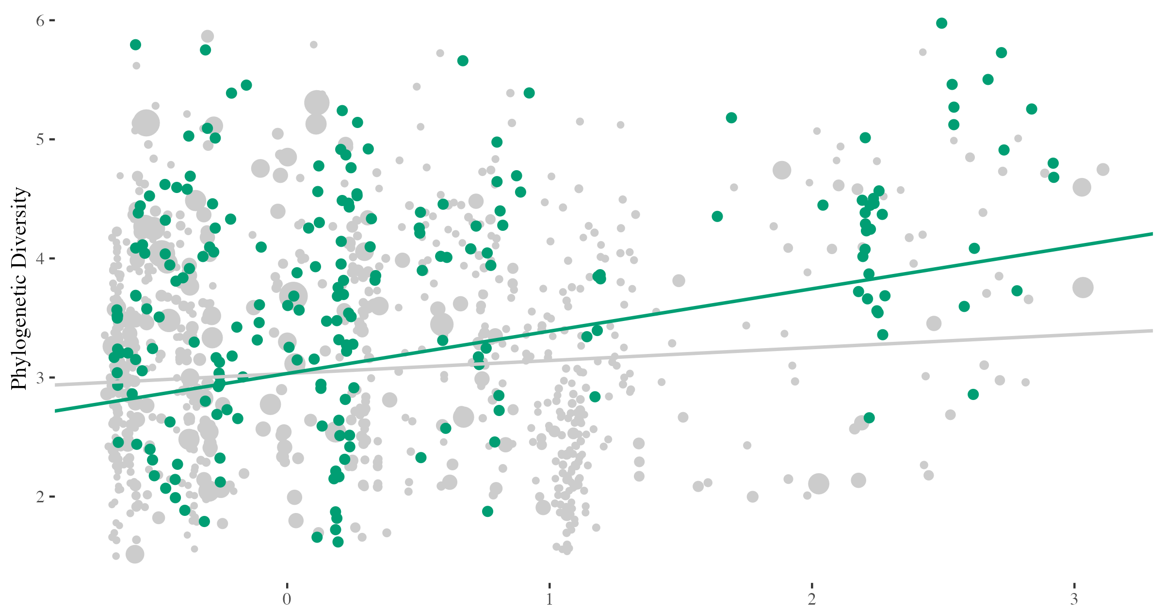
Connectivity Moderates PA Efficacy
On phylogenetic diversity, at a dispersal distance of 100km
Protected Area
Connectivity
PA | Connectivity
0.11 + 0.25
Forest Canopy Height
Site Accessibility
0.11
HDI
Protected
Intercept
Unprotected
Estimate of effect
Connectivity
Kedron et al.
Does PA Connectivity Moderate the Efficacy of Protection?
Replication Outcomes
Notes:
Lei, remind me of the scale of awf_ptg.z

Slide 11
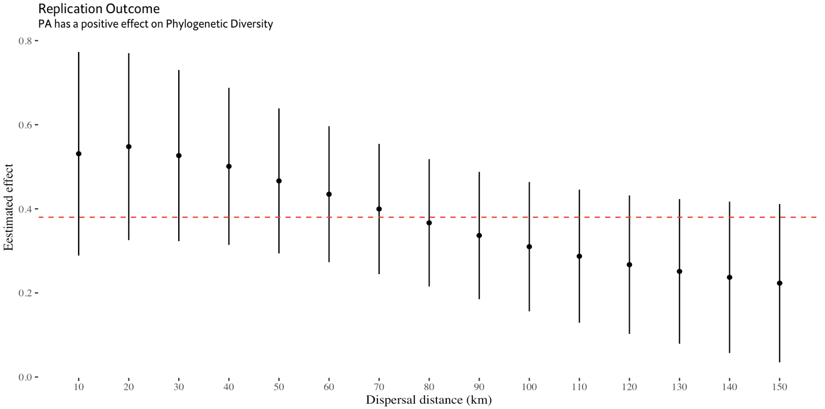
Robustness Check of PA Efficacy
PA efficacy has some sensitivity to dispersal distance selection, but statistically indistinguishable
Brodie et al.
Kedron et al.
Does PA Connectivity Moderate the Efficacy of Protection?
Replication Outcomes

Slide 12
Further Modifications
Conducting additional analyses before pre-print publication and submission
Primary Findings
Extension
Reproduction
Identified direct and moderating effects of connectivity, while preserving protective effect of PA conservation
Computationally reproduced effect estimates and supported conclusion and internal validity of Brodie et al.
Ongoing Work
Corrections
Spatial
Consistency
Check adjustments & extensions of original procedure (e.g., outliers, DAG)
Consider ways to address remaining spatial structure
Consistent positive direct and moderating effects of connectivity were only observed for phylogenetic diversity of birds
Kedron et al.
Does PA Connectivity Moderate the Efficacy of Protection?
Next Steps

Slide 13
Questions and Comments
The many paths we didn’t explore, the researcher degrees of freedom we used
Please contact me at peterkedron@ucsb.edu for the data and code used in this analysis. Our GitHub repository is currently under development and quite messy. However, we should have a clean repository (with messy development history tracked through version control) available soon along with a preprint summarizing our findings.
2024 Annual Meeting of the American Association of Geographers | Honolulu, HI

Slide 14
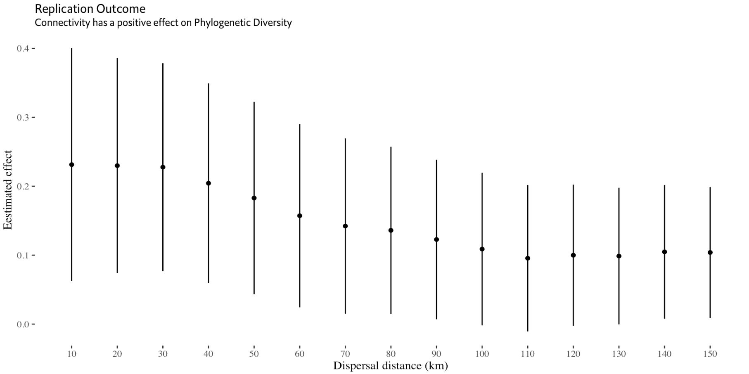
Robustness Check of PA Efficacy
PA efficacy has some sensitivity to dispersal distance selection, but statistically indistinguishable
No Effect
Kedron et al.
Does PA Connectivity Moderate the Efficacy of Protection?
Replication Outcomes

Slide 15
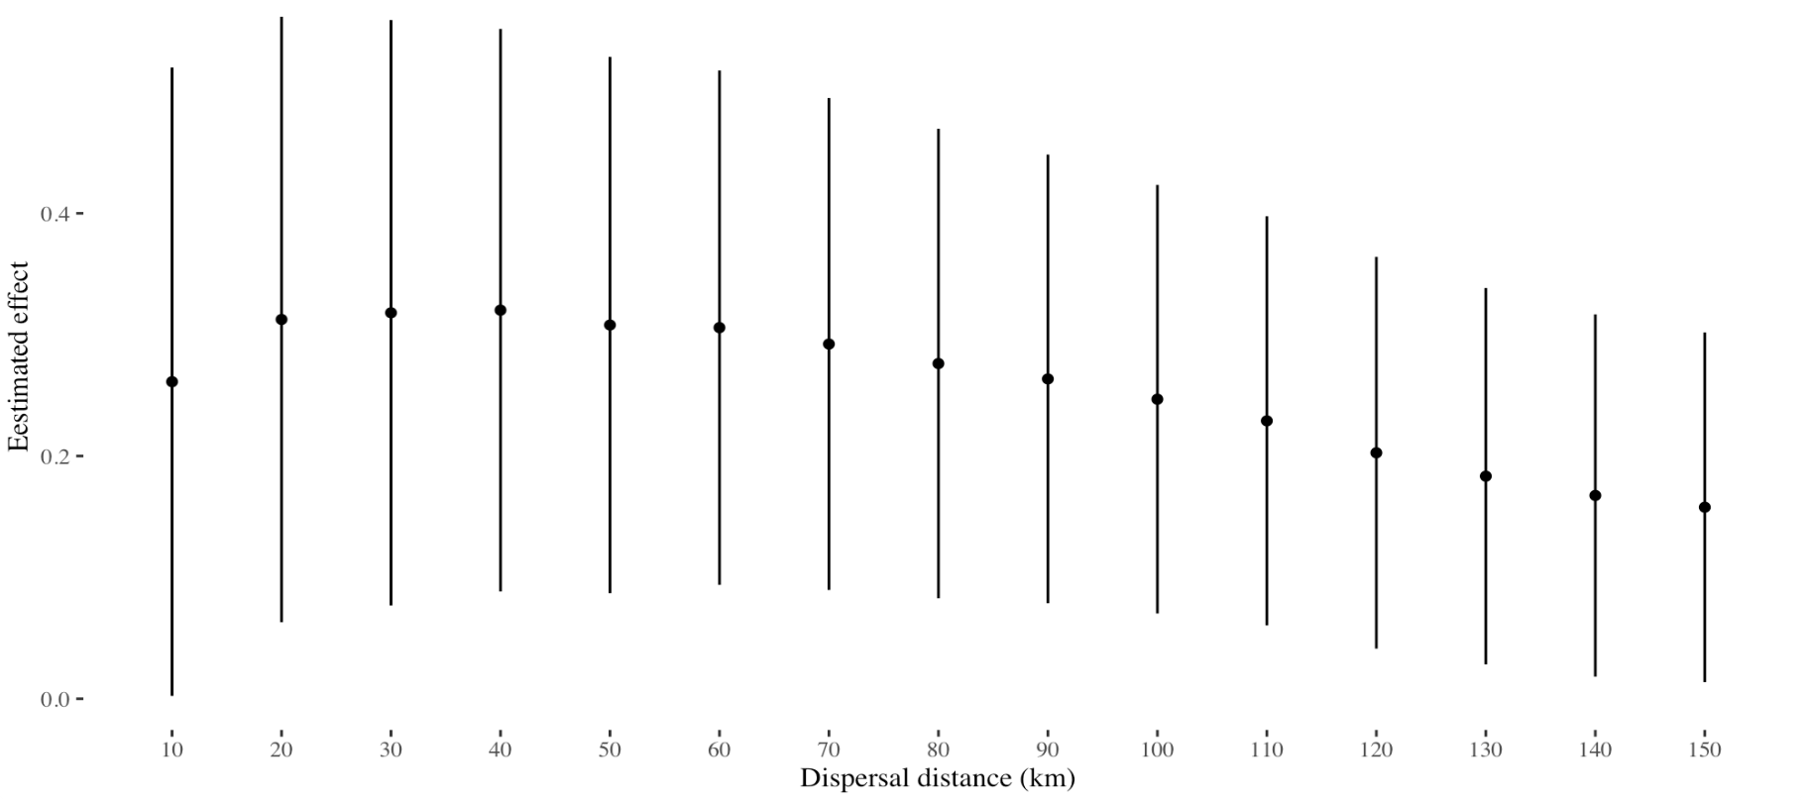
Robustness Check of PA Efficacy
PA efficacy has some sensitivity to dispersal distance selection, but statistically indistinguishable
No Effect
Kedron et al.
Does PA Connectivity Moderate the Efficacy of Protection?
Replication Outcomes

Slide 16
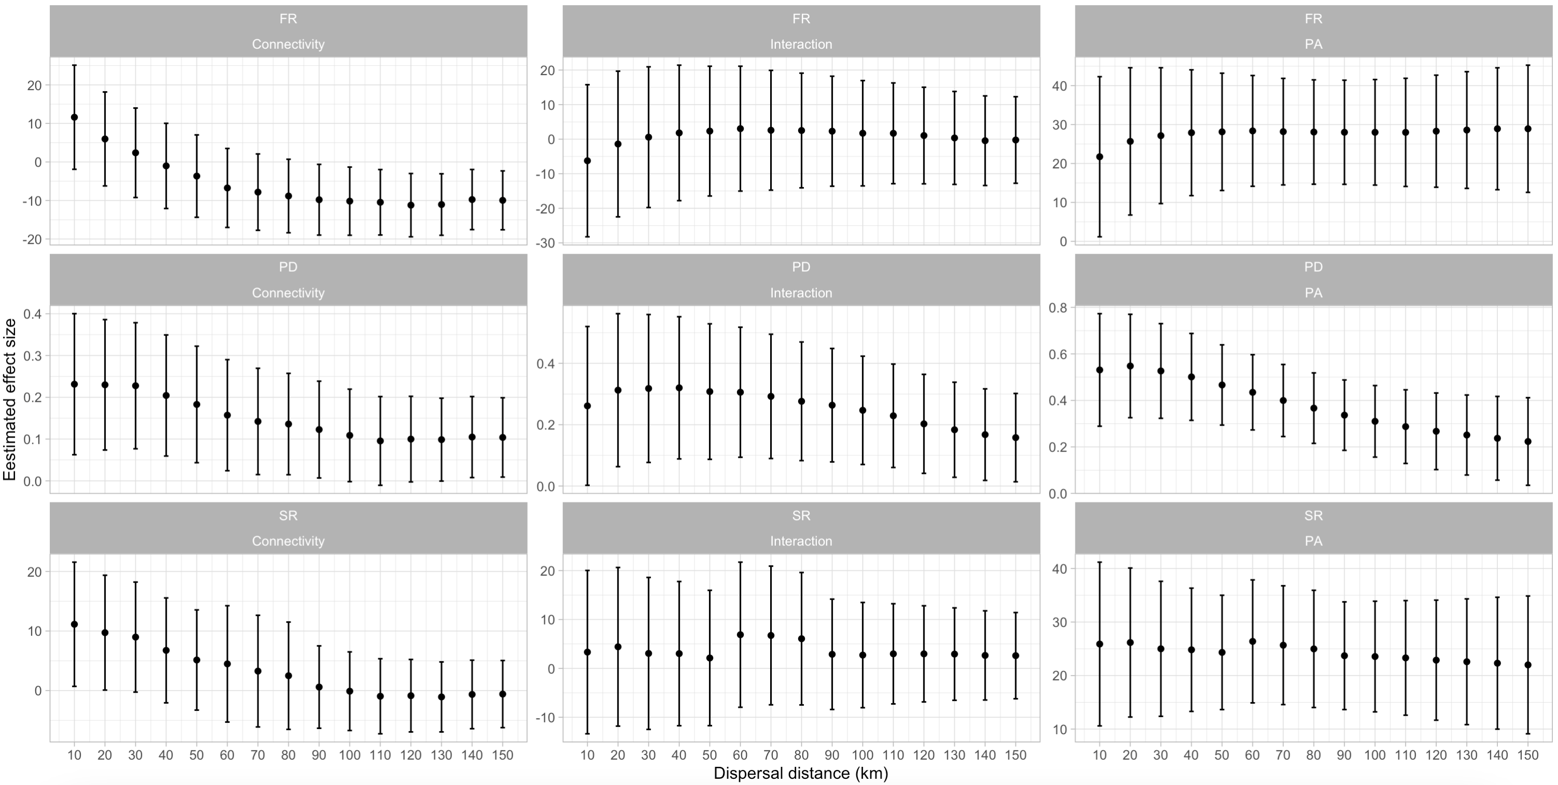
Further Robustness Checks
Inconsistency in effect estimates observed across dispersal distances for functional and species richness measures
Estimated Effects
Kedron et al.
Does PA Connectivity Moderate the Efficacy of Protection?
Next Steps

