Slide 1

How to create Google API project for web applications
powered by:

Slide 2
Login to the Google projects site
http://code.google.com/apis/console/

Slide 3
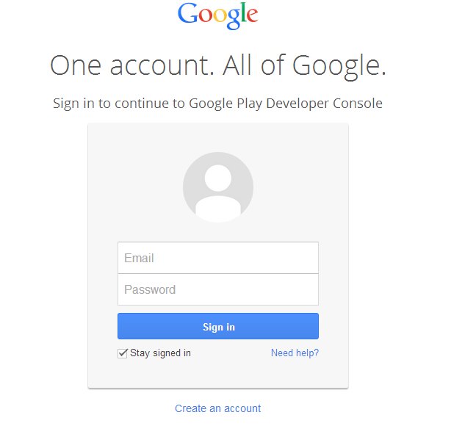
Login with your Google account

Slide 4
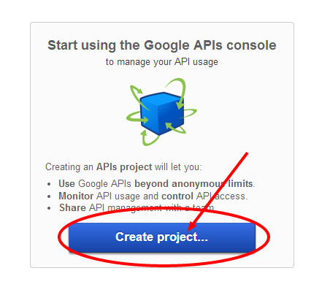
Hit the create project button to get started.

Slide 5
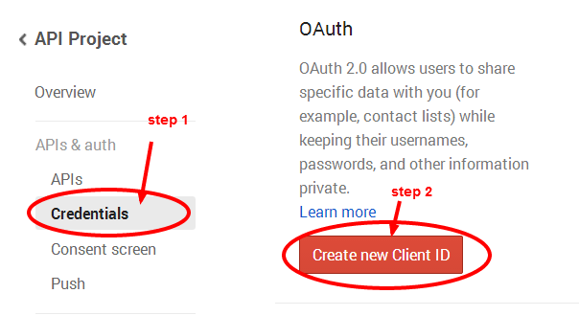
Click on Credentials, and then click on create new Client ID

Slide 6
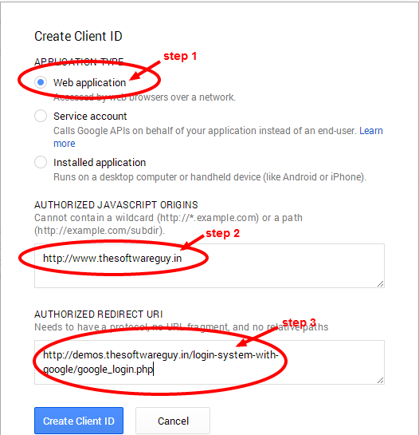
Select Web application, give your Site URL and redirect URL (must match with your php redirect URL or else it will give error).

Slide 7
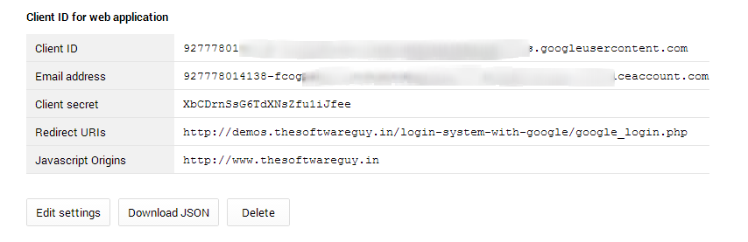
You will get the API credentials.

Slide 8
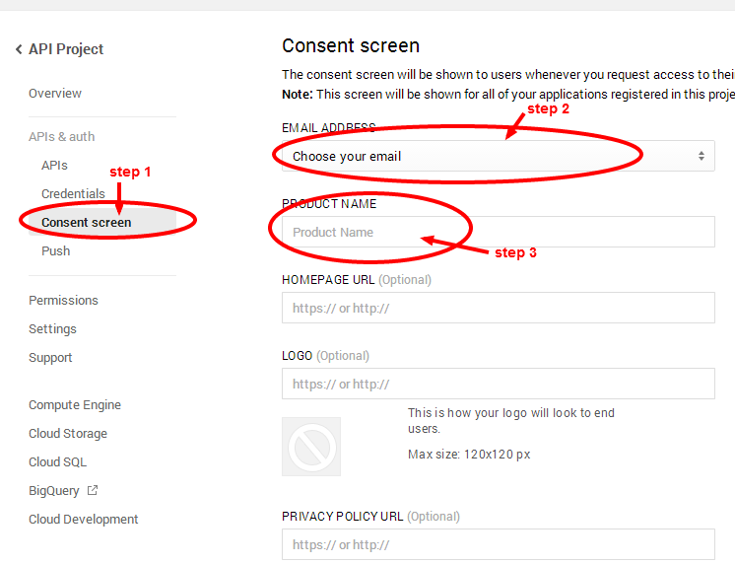
The final step is to enter your APP details. Click on Consent screen and fill up your email address and app name rest are optional.

Slide 9
Connect with us
website: www.thesoftwareguy.in
facebook: www.facebook.com/Thesoftwareguy7
twitter: www.twitter.com/thesoftwareguy7
google plus: www.plus.google.com/+ThesoftwareguyIn

