Slide 2
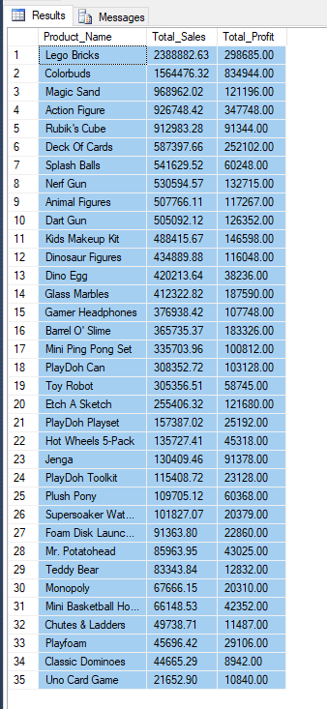
1. Production Performance Analysis Goal- Identify top-performing products based on total sales and profit.

Slide 3
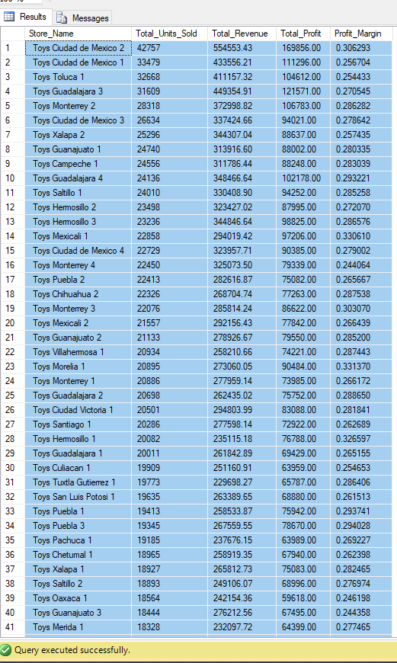
2. Store Performance Analysis Goal- Analyse sales performance for each store, including total revenue and profit margin

Slide 4
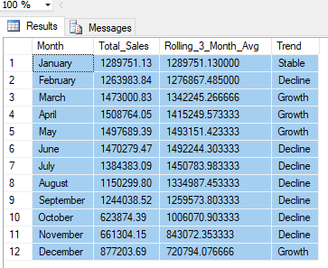
Complex Monthly Sales Trend Analysis: Goal- Examine monthly sales trends, considering the rolling 3-month average and identifying months with significant growth or decline.

Slide 5
Cumulative Distribution of Profit Margin: Goal- Calculate the cumulative distribution of profit margin for each product category, consider where products are having profit.

