Slide 1


AIRLINE RELIABILITY
DATA PIPELINE
From raw flight operations data to reliable airline, airport and route insights
Peter Blechert · Data Engineering · 04.09.2026

Slide 2
ABOUT ME & PRESENTATION FOCUS
PERSONAL CONTEXT
PRESENTATION QUESTION
Data Engineering final project
Focus: realistic, complete pipeline
25+ years of database experience
Career direction: Data Engineering
Degree: Dipl.-Kfm. (FH)
Preferred regions: NRW / Hamburg / Schleswig-Holstein · Remote
Contact: peter.blechert@web.de
How can monthly raw data become a reliable data product?
The next 15 minutes show the problem, the engineering solution and the proof that it works.

Slide 3
MOTIVATION & GOALS
Build a small but complete production-like pipeline.
real external source
monthly ingestion and partitioning
Bronze / Silver / Gold layers
Data Quality
Database model
Orchestration
Data consumption through dashboard

Slide 4
STAKEHOLDER PERSPECTIVE - CORPORATE TRAVEL
Get trusted, comparable reliability information.
Which airlines are reliable?
→ Carrier selection / benchmarking
Which airports concentrate problems?
→ Connection / disruption risk
Which routes are operationally robust?
→ Route selection / comparison

Slide 5
DATA SOURCE & DATA PROBLEM
Source: BTS - Bureau of Transportation Statistics (monthly On-Time Performance data)
https://www.transtats.bts.gov/
607,577
12
351
6,131
flight records · June 2026
airlines
airports
routes
WHAT THE SOURCE CONTAINS
WHAT IT DOESN'T
Flight date, airline, origin and destination airport
planned and actual times
delays, cancellations, diversions
delay causes and reference data
quality boundary
standardized schema
analytical model
business-ready reliability metrics
reproducible monthly processing

Slide 6
ENGINEERING QUESTION & ARCHITECTURE
How can monthly flight data be transformed into a reliable, reproducible analytics data product?
BTS
BRONZE
SILVER
POSTGRESQL
GOLD
STREAMLIT
source
→
preserve raw
→
validate
→
database model
→
metrics
→
consume
ZIP / CSV
ZIP / CSV
validated Parquet
Facts & Dimensions
Reliability Marts
Interactive Dashboard
Python & PySpark implement and process the data
Airflow orchestrates the process · Docker provides the reproducible runtime
The architecture is not a tool list - each layer answers a concrete requirement.

Slide 7
INGESTION & BRONZE - PRESERVE THE SOURCE
INGESTION
BRONZE
monthly available ZIP / CSV files
reference files for airlines and airports
routes derived from flights
download only when missing
year/month partitioning
traceability to source
repeatable monthly loads
clean separation from transformation logic
Raw ZIP / CSV remains unchanged.
Purpose: make the source reproducible before any analytical transformation happens.

Slide 8
SILVER & DATA QUALITY - CREATE TRUST
Silver is the quality boundary of the pipeline - not just another file format.
Schema
Types
Domain
required fields
date and numeric standardisation
airport code and route validation
Flags
Plausibility
cancelled, diverted, delay flags
distance and elapsed time
Result: standardized Parquet data that can safely enter the analytical model.
Parquet is a column-oriented format for efficient storage and fast analytical queries.

Slide 9
DATA MODEL & GOLD MARTS
dim_date
Gold Airline Reliability
dim_airline
fact_flight
Gold Airport Reliability
dim_airport
Gold Route Reliability
The star-schema model separates operational details…om business-level reliability metrics.
The star-schema model separates operational details from business-level reliability metrics.

Slide 10
AIRFLOW - FROM SCRIPTS TO PIPELINE
A pipeline is more than a sequence of scripts.
Scheduling
Dependencies
Retries
monthly runs
correct task order
temporary failures
Failure handling
Quality checks
Notification
stop downstream tasks
prevent bad data propagation
Email alerts on errors
▶ LIVE DEMO - AIRFLOW
Show DAG → task dependencies → retry / recovery → simulated failure

Slide 11
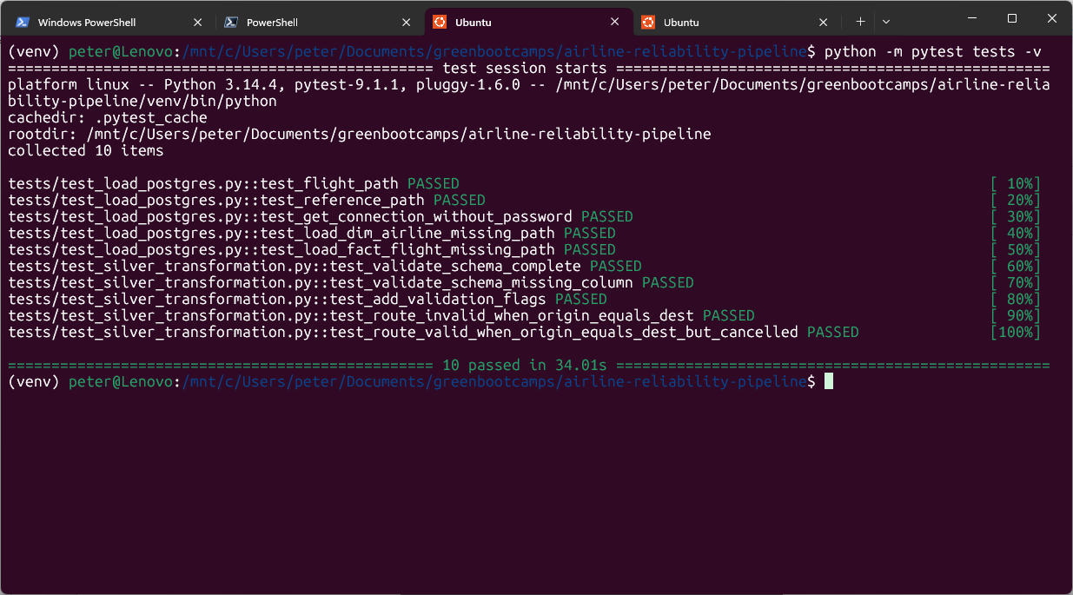
AUTOMATED TESTING – WHEN & WHY
Pytest validates critical code logic independently from the monthly Airflow data run.
WHAT IS TESTED?
schema validation
data-quality rules & route logic
Silver flight & reference path handling
controlled failure behaviour
WHEN SHOULD TESTS BE RUN?
after changes to transformation or loading code
before commit / release / presentation
After dependency or environment changes
Not simply because a new month arrives
Monthly Airflow quality checks validate new data – pytest validates the code when the code changes.
Current setup: pytest is started manually - it is not part of the Airflow DAG.

Slide 12
CONSUMPTION LAYER - RELIABILITY DASHBOARD
The Gold layer becomes an interactive decision layer - without exposing pipeline complexity.
AIRLINES
AIRPORTS
ROUTES
KPI comparison and development over time
departure & arrival reliability
with KPI and map
comparison, map and specific-route analysis
▶ OPEN LIVE DASHBOARD
Live demo: Airlines → Airports → Routes - selected interactions only

Slide 13
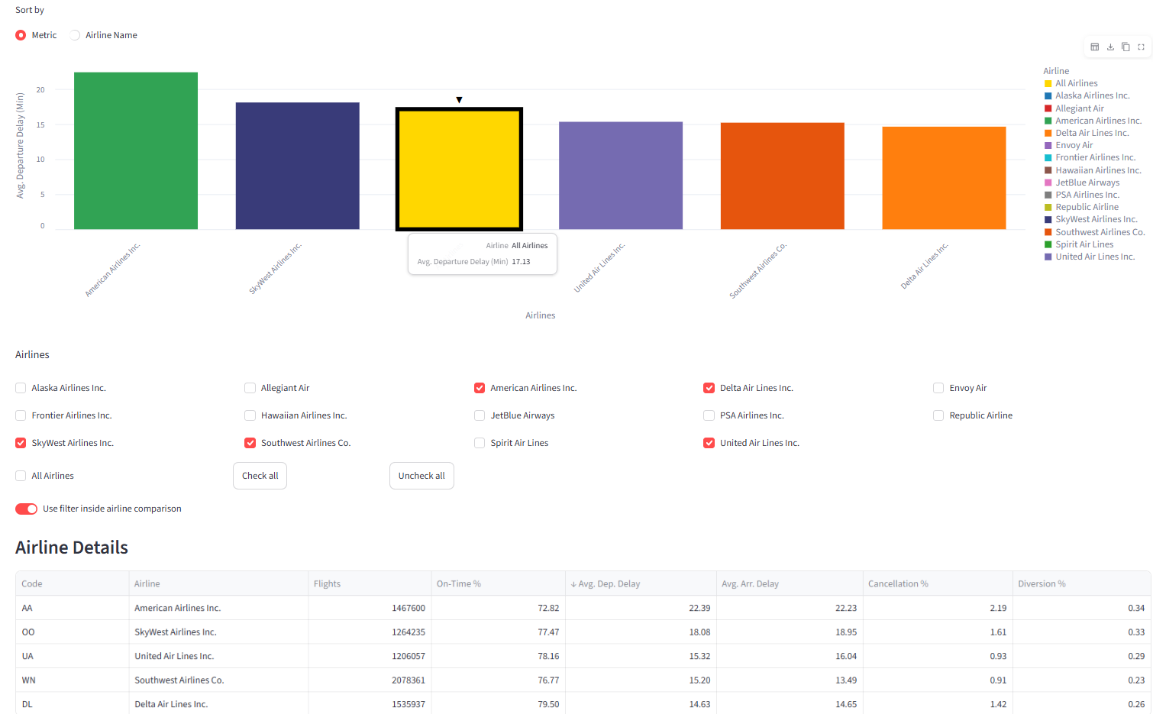
5 AIRLINES WITH THE MOST FLIGHTS 01/25-06/26 (PLUS
ALL AIRLINES), METRIC: AVG. DEPARTURE DELAY

Slide 14
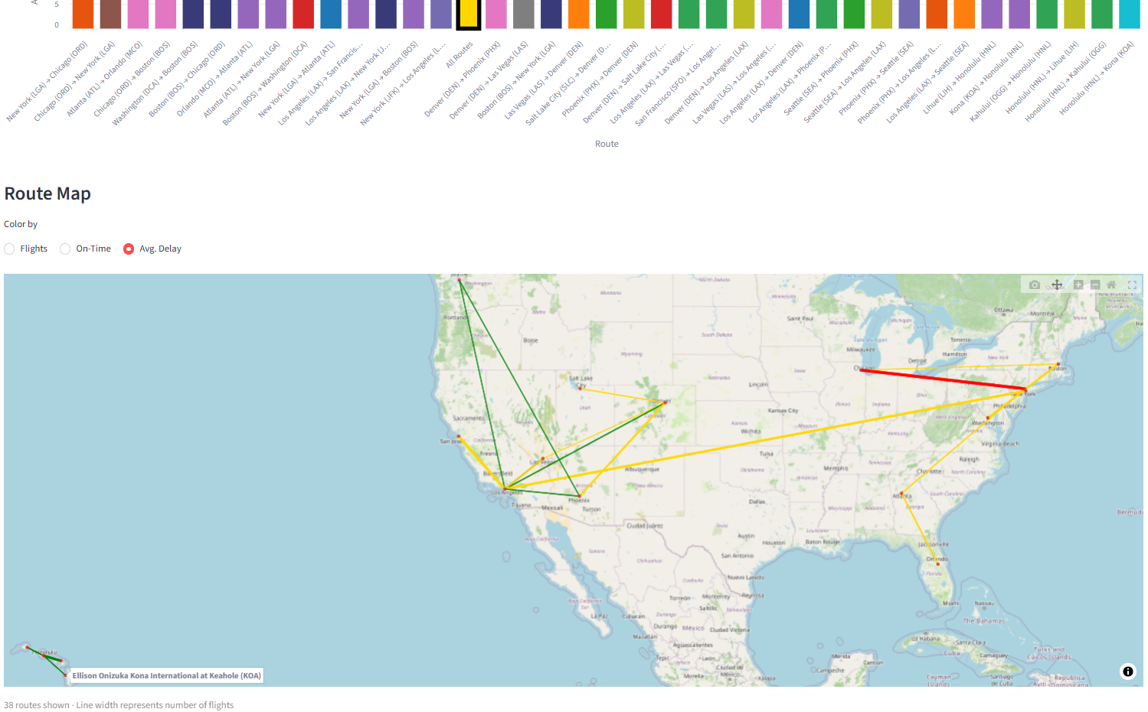
TOP 38 ROUTES (> 0.1% OF TOTAL TRAFFIC / ~10M FLIGHTS)
01/25 - 06/26, METRIC: AVG. ARRIVAL DELAY

Slide 15
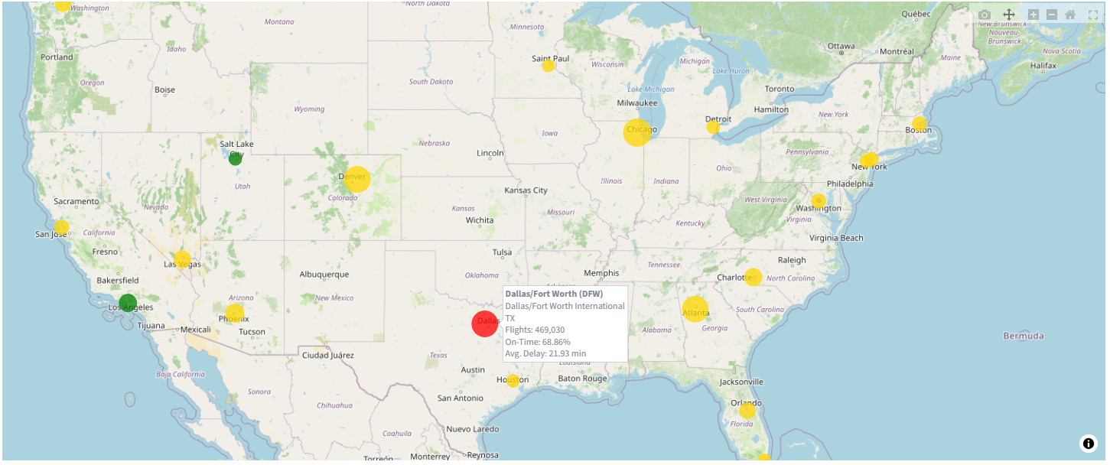
AIRPORTS WITH THE MOST FLIGHTS 01/25-06/26,
METRIC: ON-TIME

Slide 16
RESULTS & RECOMMENDATIONS
Results
Recommendations
Reliable monthly KPI basis
Identify areas for deeper analysis
Airline, airport and route comparison
Support decisions -
not replace them
The outcome enables data-driven decisions on airline, airport, and route reliability - without accessing raw files.

Slide 17
OUTLOOK
NEXT EVOLUTION
Why did delays happen?
Cloud deployment / managed storage
Monitoring and alerting
Delay and cancellation risk prediction
Descriptive → Diagnostic → Predictive
Reliable decisions require reliable data!

