Slide 1
Showrunner

Slide 2
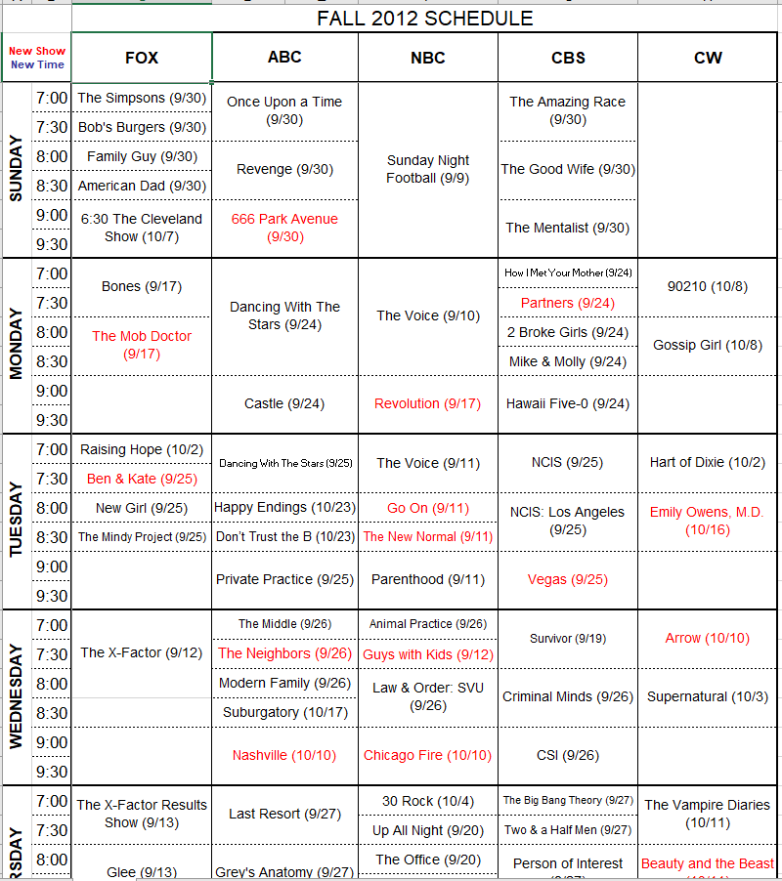

Slide 3
Watching TV has changed…what we watch, where we watch, how we watch.
Then…
And Now
Most shows on network or cable stations
New shows and seasons typically premiered in the fall or winter and were more predictable
More episodes per season meant most people had fewer shows they watched regularly
Content is everywhere…network, cable, streaming services
New shows and seasons premiere year-round with less regularity
Fewer episodes per seasons so people often watch more different shows

Slide 4
With so many viewing options, keeping track of your favorite shows can be a challenge.
How do you keep up with sporadic premiere dates for so many shows from a variety of providers?
How do you remember to check out that great show you heard about the other day?
How do you remember the name of that show you want to recommend to a coworker?

Slide 5
Showrunner is the answer…
Add shows to your Showrunner guide to quickly and easily keep up with your favorites
See premiere dates, renewal status and other key details all in one place
Sort your guide with preset sorting options or create your own using features like watch priorities, personal ratings, and genres.
Mark a season as “watched” to move it down the list until the next season premiere date becomes available

