Slide 1


Slide 2
Crystal cave is a 2d platformer game about a girl trapped in a cave. Go through the cave, and find your way out of it using different abilities, which you gain by collecting variuos crystals.

Slide 3
Functionality

Slide 4
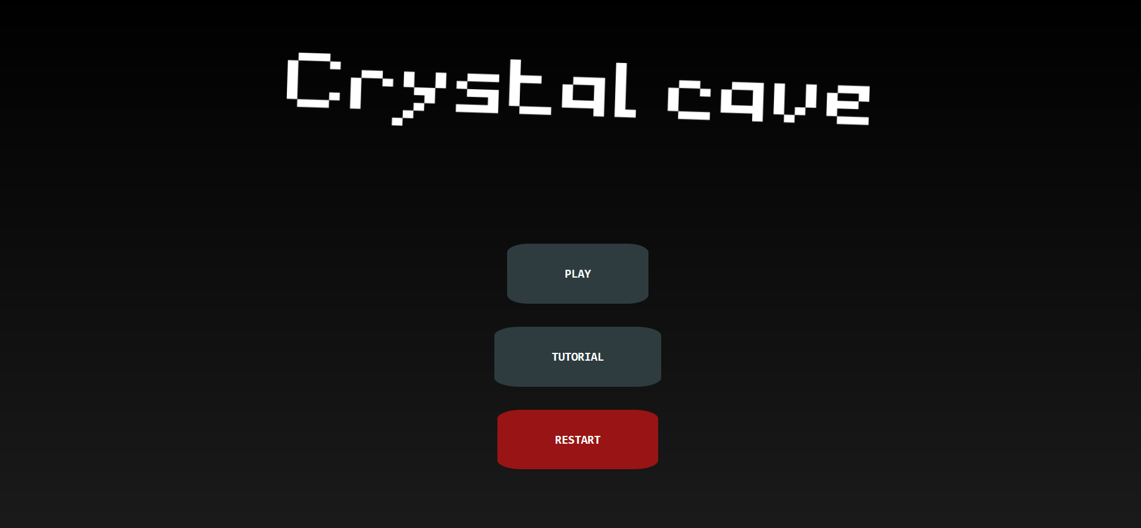
Main menu

Slide 5
From main menu you can:
1.Play the game;
2.See the tutorial;
3.Restart your save;

Slide 6
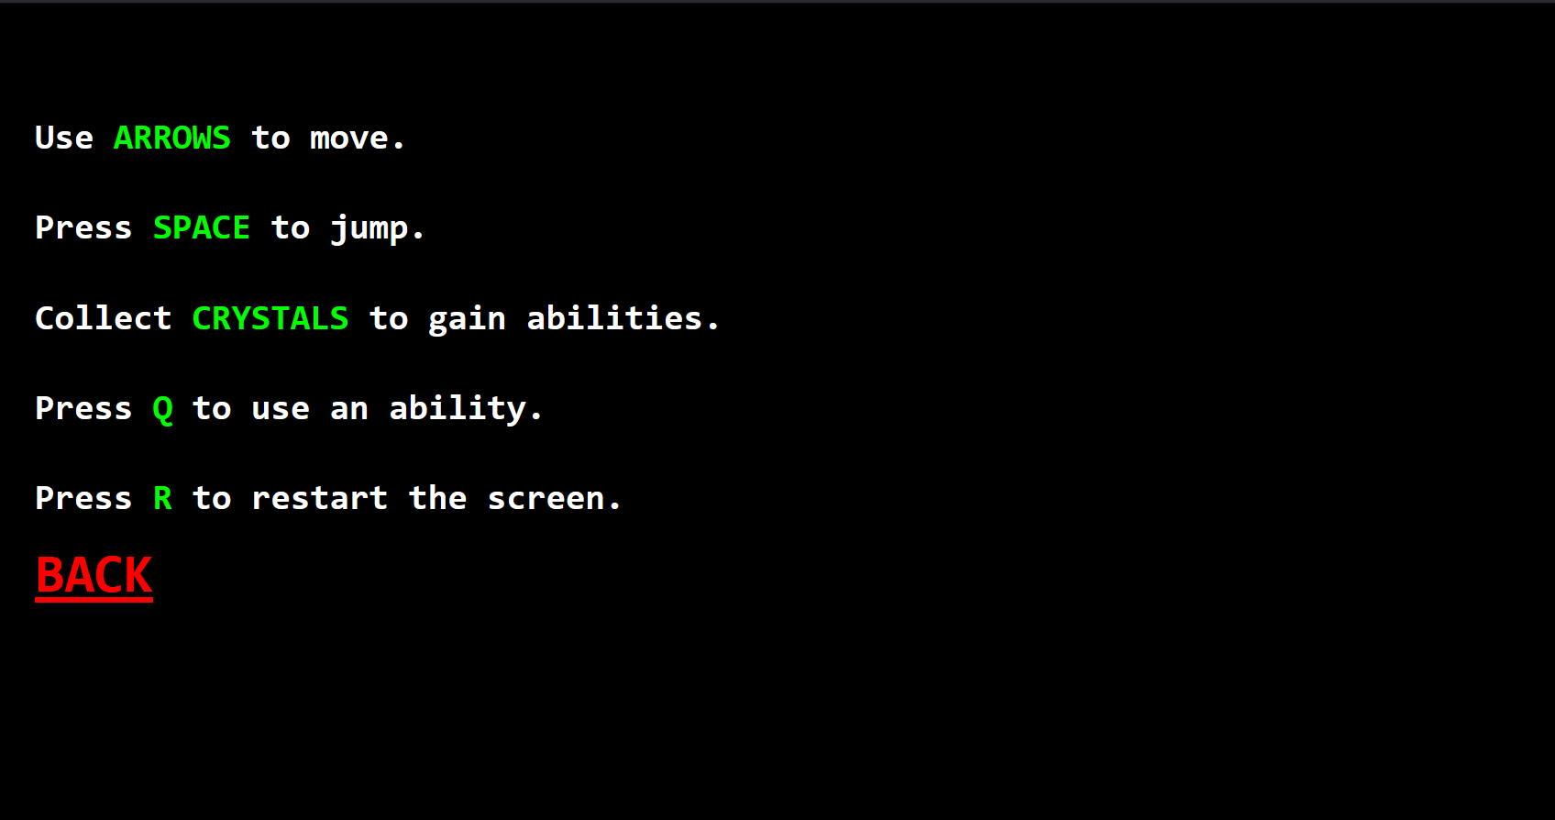
Tutorial

Slide 7

Restart button
By pressing the restart button you delete your save, so you will begin new game. In other words, you now start from the first room.

Slide 8
In-game functionality

Slide 9

By pressing the ‘PLAY’ button, you, obviously, start playing the game.

Slide 10
Mechanics
Player can:
Move by pressing arrows.
Jump by pressing space.
Use the ability(if he has one at the moment) by pressing Q.
Go to next by entering a door(when near door press W).
Restart the screen by pressing R.

Slide 11
Objects

Slide 12



Platforms
You can stand on them.

Slide 13

Spikes
They will kill you.

Slide 14


Crystals
Pick them up to gain abilities.

Slide 15

Doors
Go through them to go to next room.

Slide 16
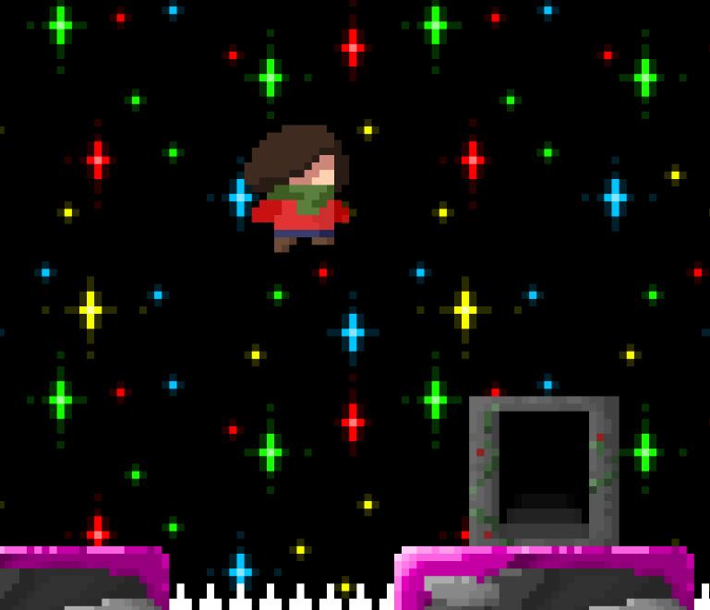
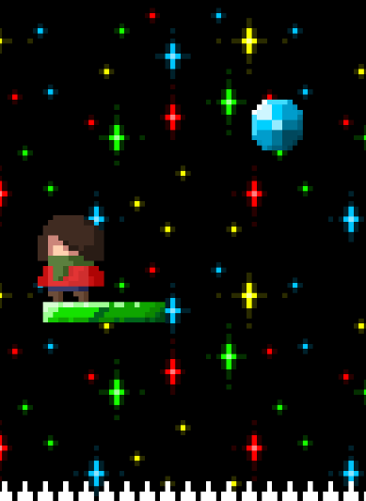
A couple of screenshots

Slide 17
Thanks for watching!

