Slide 1

Occupancy Grid Maps
2020년 12월 20일
우희도
hw527@cam.ac.uk

Slide 2
Learning Objectives
Define occupancy grid
Handling noisy data by using Bayesian updates
Issue with the Bayesian Probability Update
Present a solution utilizing log odds
Bayesian log odds update derivation
Examples

Slide 3
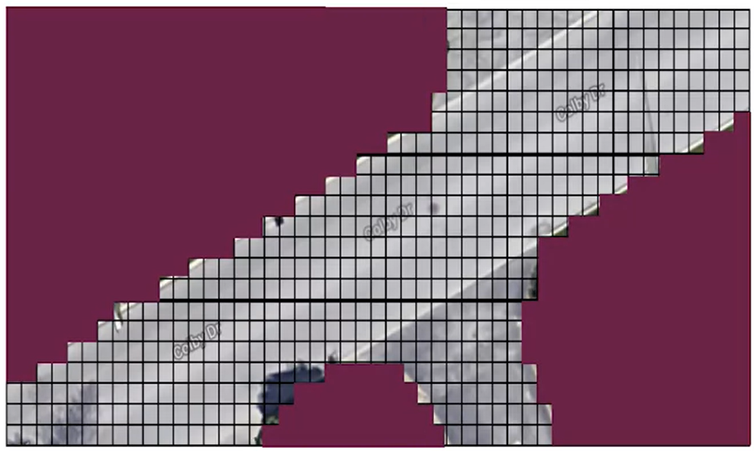
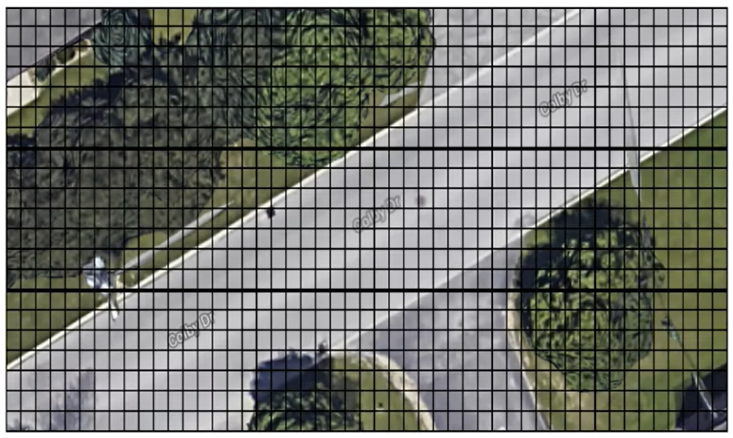

What is an occupancy grid?
Discretized fine grain grid map of space
Occupancy by static objects
Trees, buildings, curbs, walls
A belief map is built
Threshold of certainty will be
used to establish occupancy
Courtesy: Motion Planning for Self-Driving Cars, Probabilistic Robotics

Slide 4

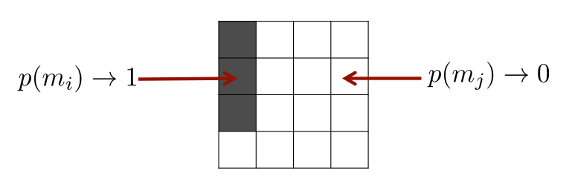

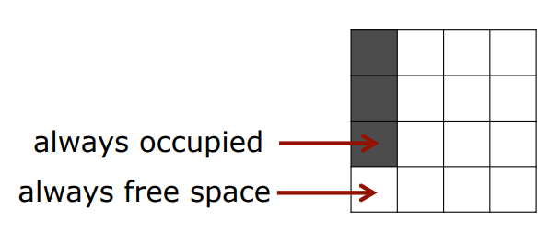
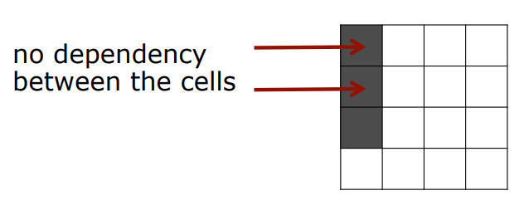
Assumptions
Either occupied or free
The world is static
Cells are independent of each other

Slide 5
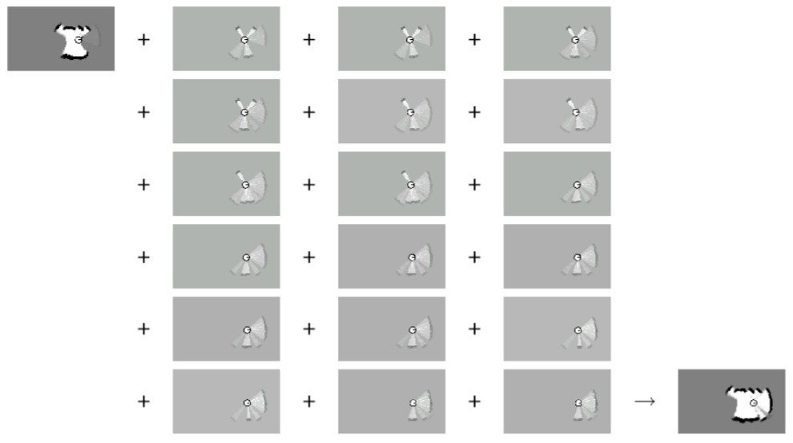
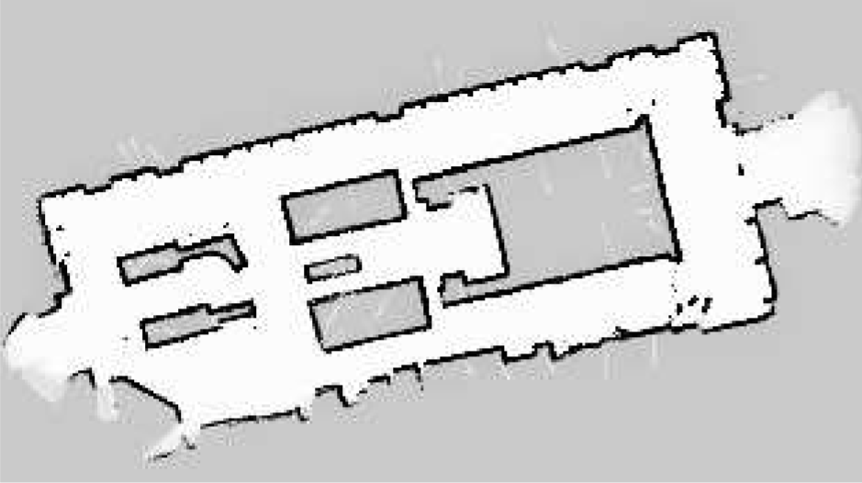


Handling noisy data by Bayesian Updates
To improve robustness multiple timesteps are used to produce the current map
Bayes’ theorem is applied at
each update step for each cell

Slide 6

Issue with the Standard Bayesian Update
Update a single unoccupied grid cell
Multiplication of numbers close to zero is hard for computers
An inefficient way to perform belief updates
Significant rounding errors of very small floating point numbers lead to instabilities
Store the log odds ratio rather than probability
0.000000008
0.000012
0.000638

Slide 7

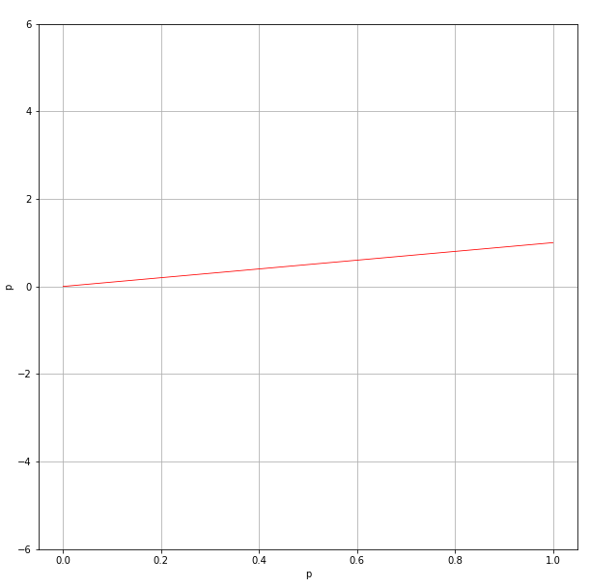
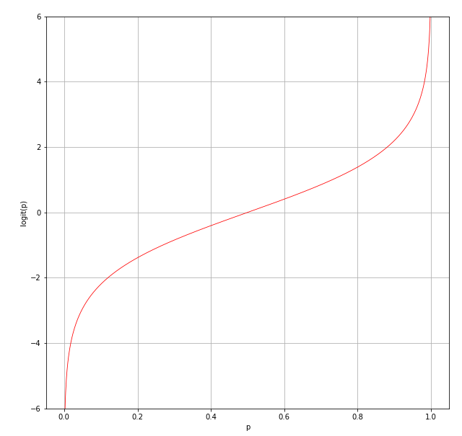


Logit Function

Slide 8


Bayesian Log Odds Single Cell Update Derivation

Slide 9



Bayesian Log Odds Single Cell Update Derivation

Slide 10

Bayesian Log Odds Single Cell Update Derivation

Slide 11

Bayesian Log Odds Single Cell Update Derivation

Slide 12



Bayesian Log Odds Single Cell Update Derivation

Slide 13
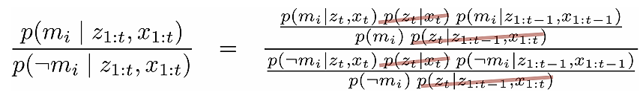
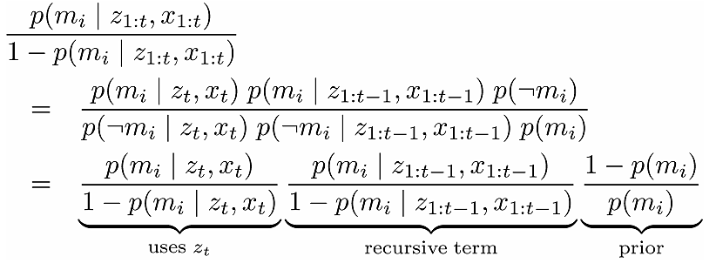
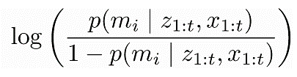
Bayesian Log Odds Single Cell Update Derivation

Slide 14

Bayesian Log Odds Single Cell Update Derivation

Slide 15
Bayesian Log Odds Single Cell Update Derivation
Inverse_Sensor_Model
Numerically Stable
Computationally Efficient

Slide 16
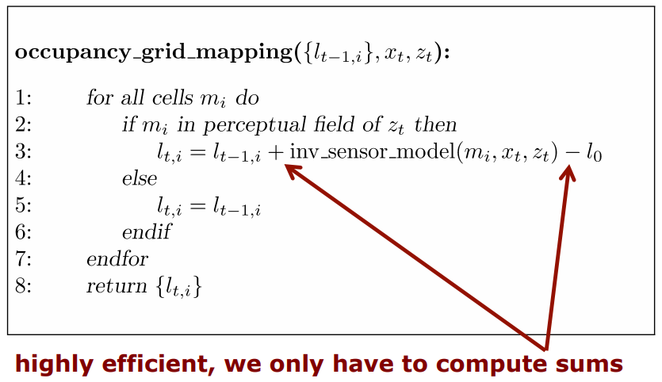
Bayesian Log Odds Single Cell Update Derivation

Slide 17


Inverse Measurement Model
So far we have only seen the following measurement model:
But…
Bresenham’s Line Algorithm (Ray Tracing)

Slide 18
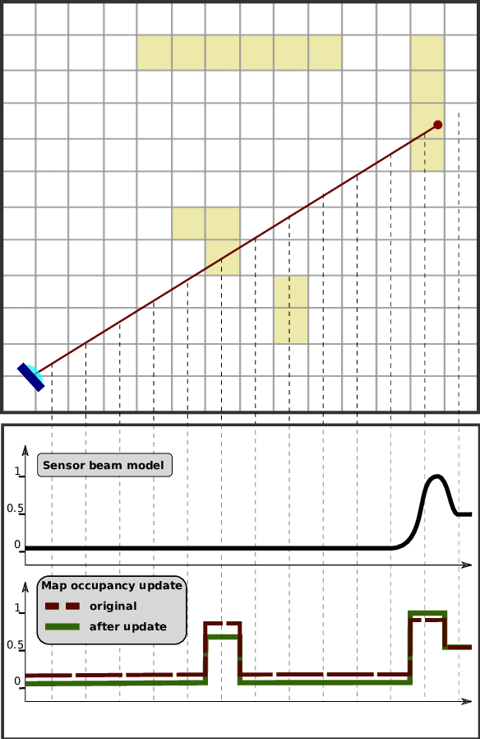
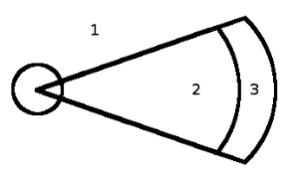
Inverse Measurement Model
For LIDARs:
Courtesy: Probabilistic Robotics, Henrik Andreasson

Slide 19
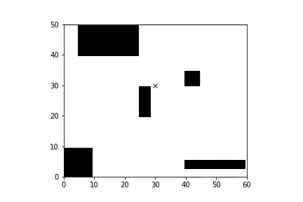
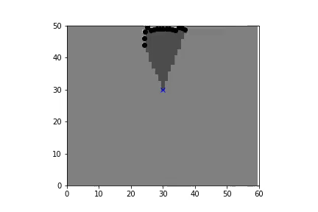
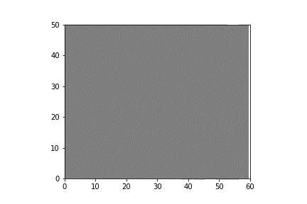
Jupyter Notebook Example
Ground Truth
Sensor Model
Belief Map

Slide 20
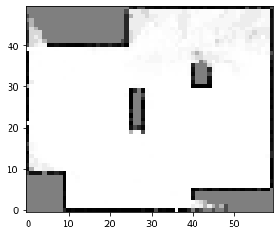
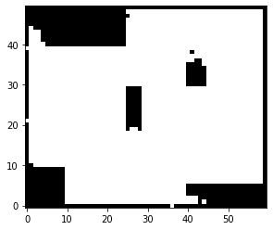
Jupyter Notebook Example
Threshold Filter
Belief Map
Binary Occupancy Grid

Slide 21
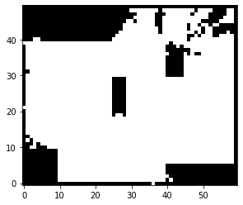

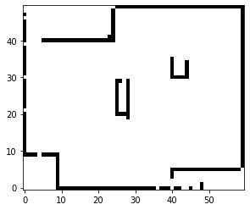
Jupyter Notebook Example
Threshold = 0.05
Threshold = 0.15
Threshold = 0.20
Threshold = 0.50

Slide 22
References
Cyrill Stachniss, 2020, “Occupancy Grid Maps” [YouTube]
Steven Waslander et al., “Motion Planning for Self-Driving Cars”, University of Toronto [Coursera]
Sebastian Thrun et al., “Probabilistic Robotics, Chapter 9”
Alex Styler, 2012, “Statistical Techniques in Robotics, Lecture 5” [Carnegie Mellon]

Slide 23

Thank you!
facebook.com/groups/slamkr/

