Slide 1

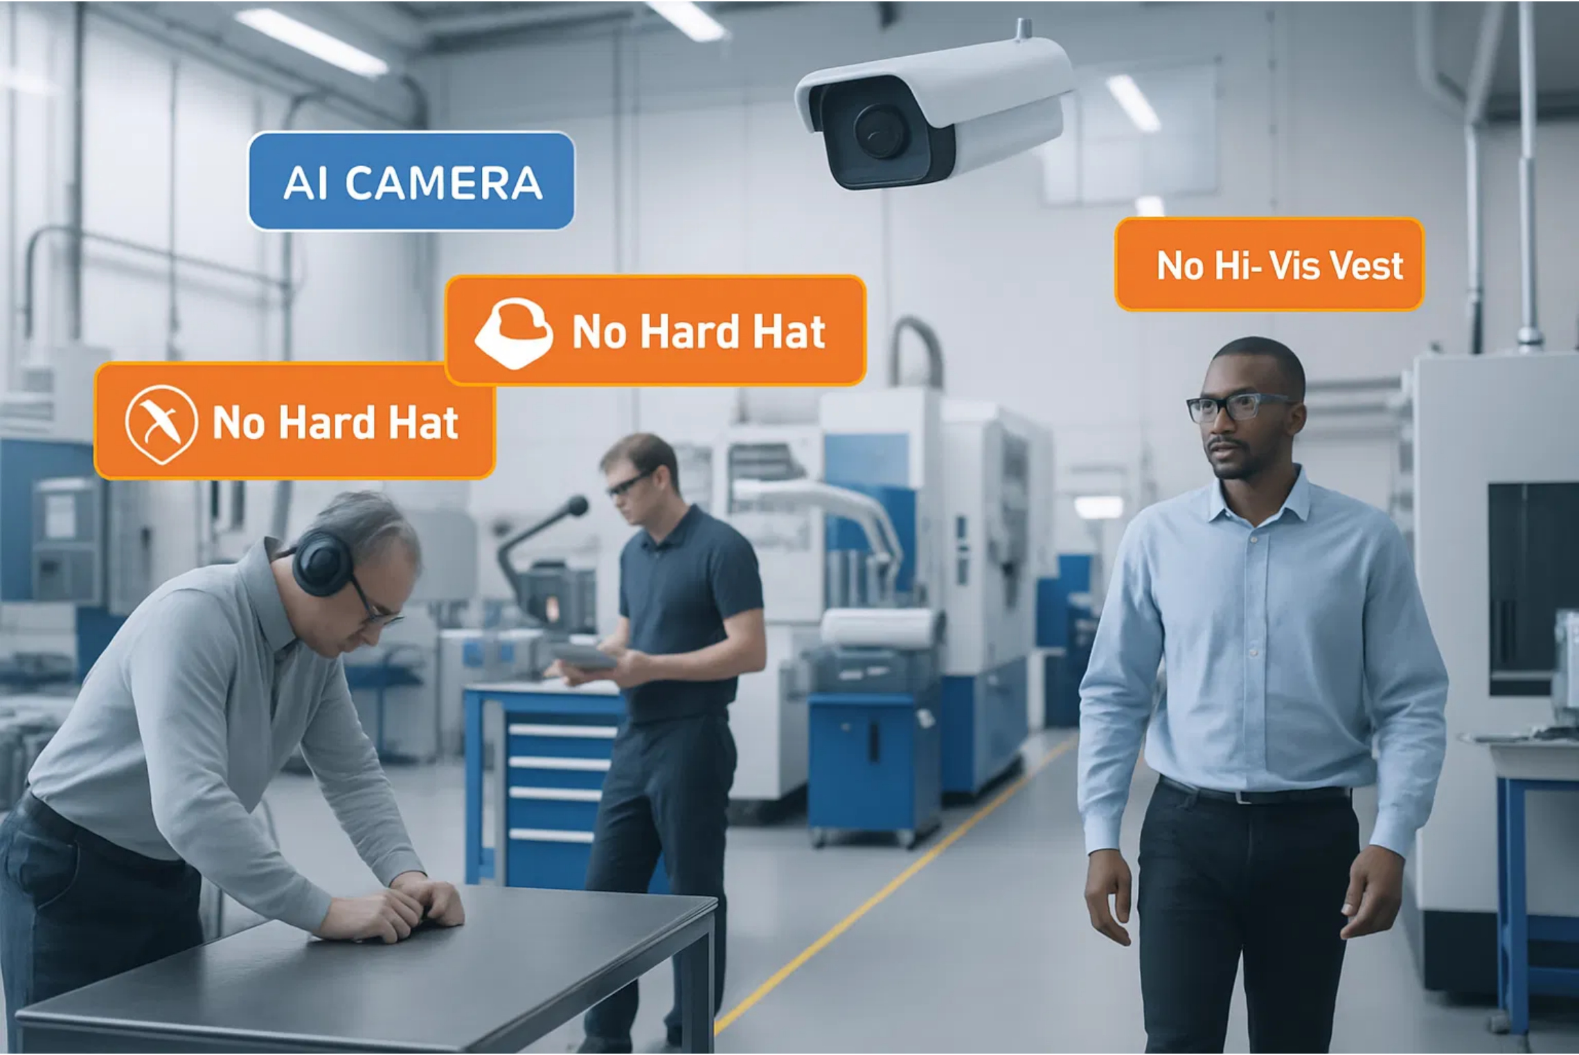
AI Safety Agent MVP for SMBs
Leveraging NVIDIA's Video Search and Summarization Blueprint
June 2025

Slide 2


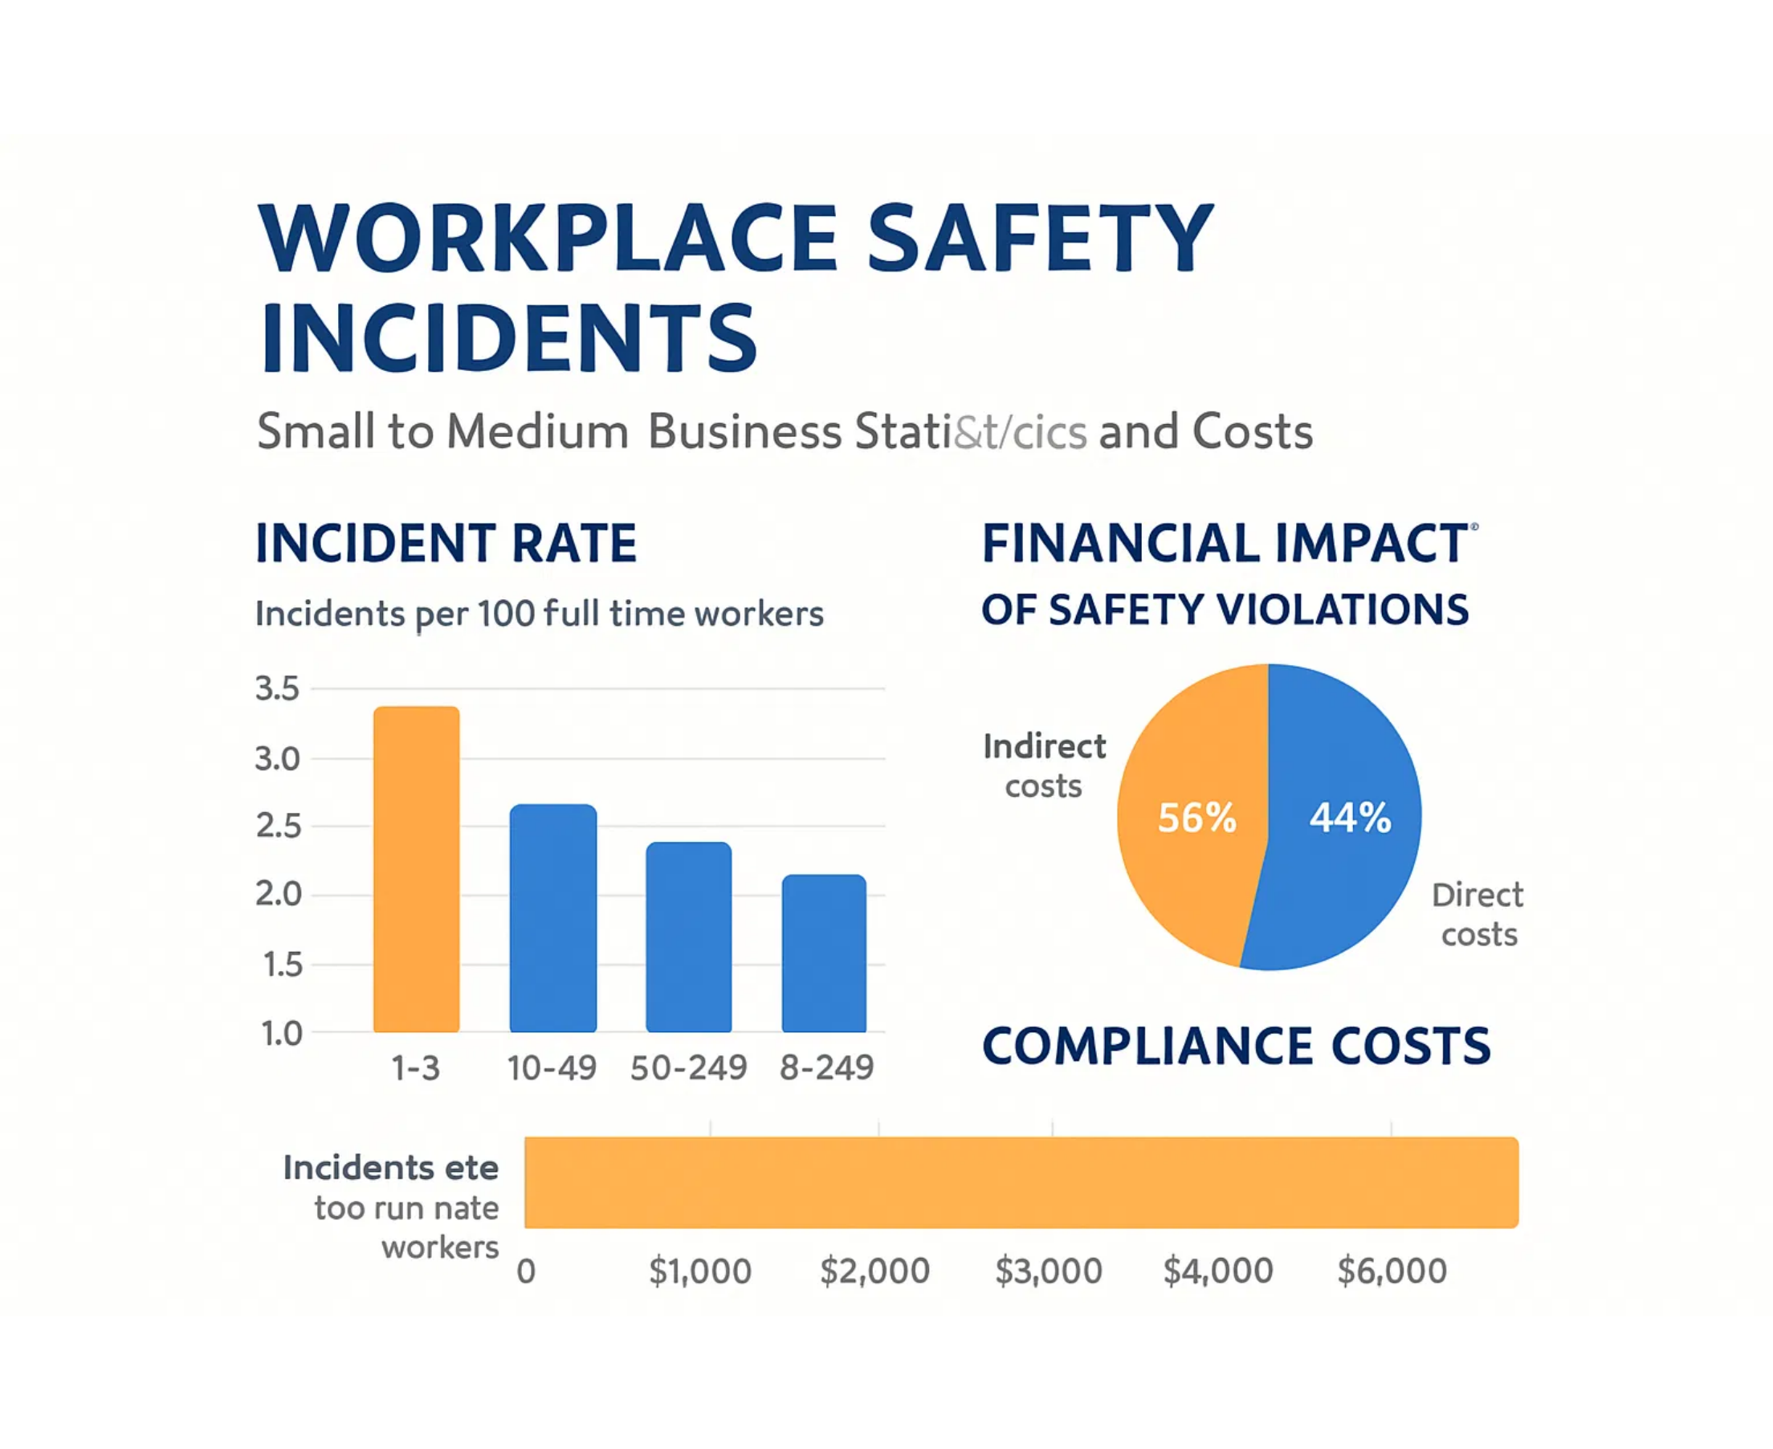




Problem Statement
in workplace safety monitoring
SMBs face
significant challenges
and prone to human error
Manual monitoring is
resource-intensive
Compliance documentation creates
administrative burden
and preventive measures
Limited data for
pattern recognition
and productivity losses
Safety incidents lead to
significant costs
AI Safety Agent MVP

Slide 3
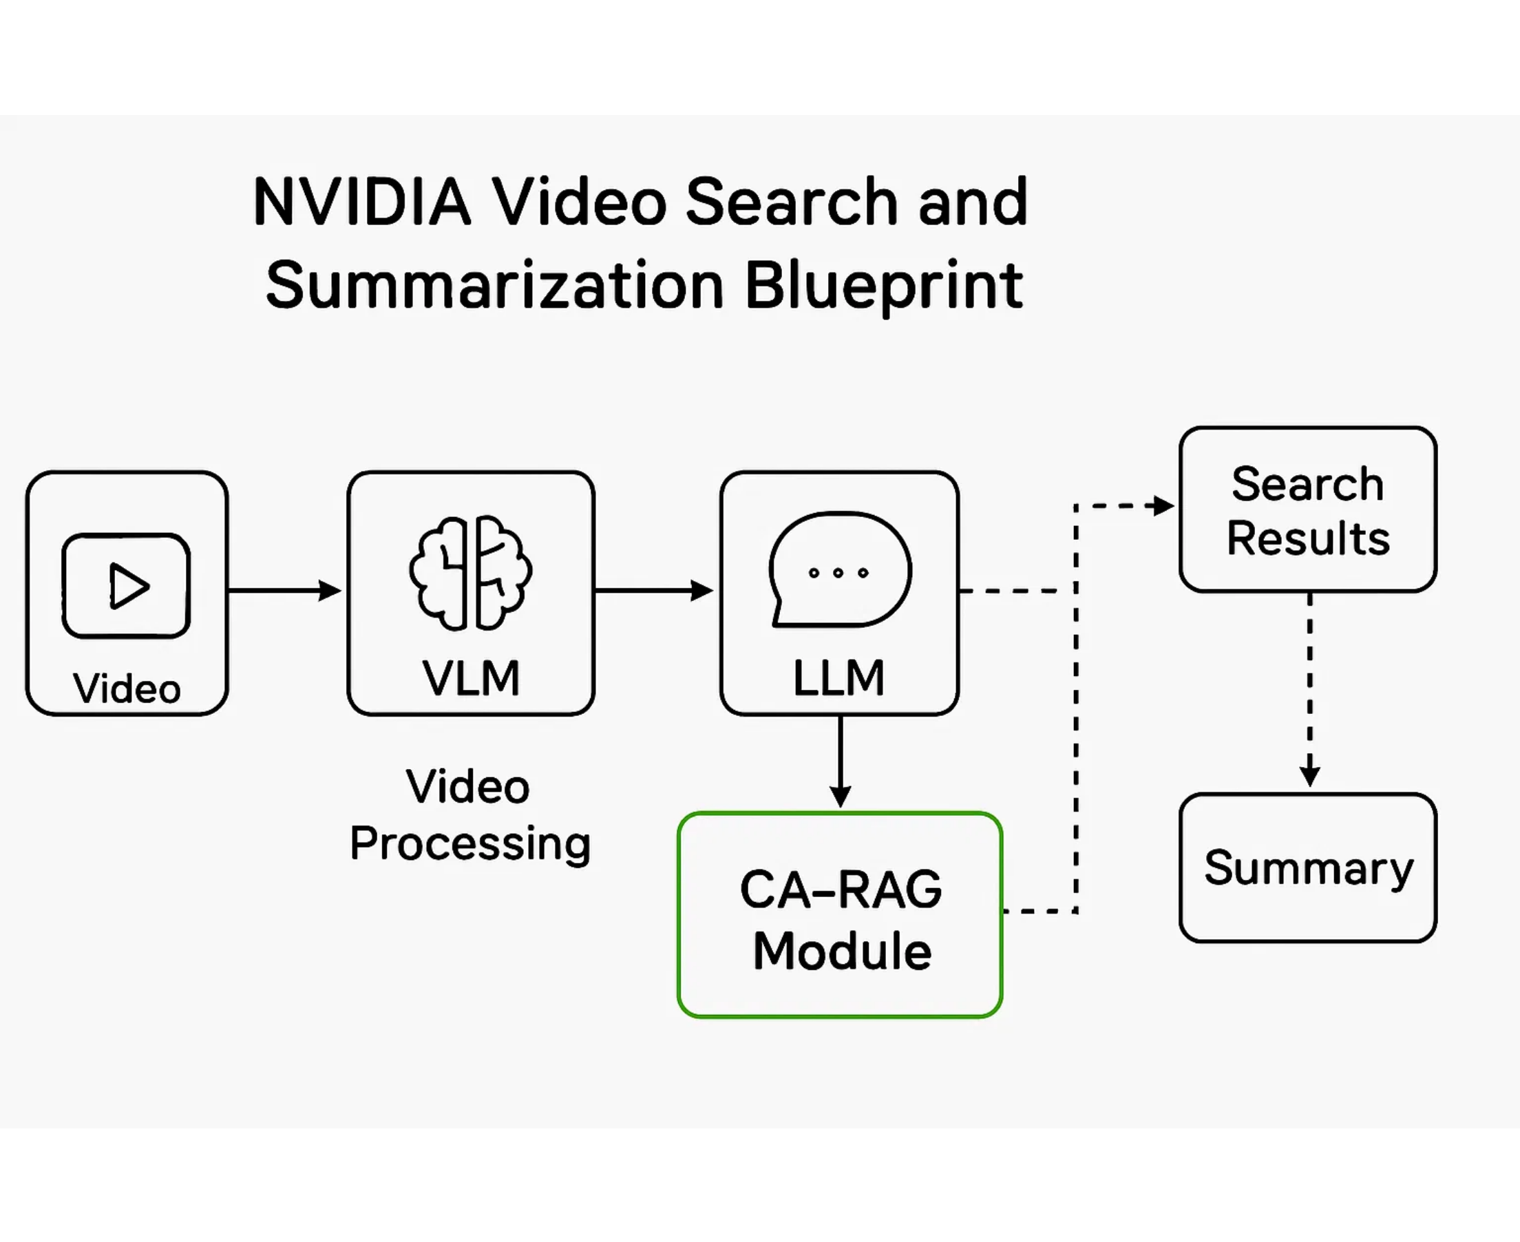




NVIDIA Blueprint Overview
NVIDIA's video search and summarization blueprint provides a powerful foundation for AI safety applications
Key Technologies
Vision Language Models (VLMs)
Large Language Models (LLMs)
Context-Aware RAG
NVIDIA NIM Microservices
Designed for
efficient analysis
and
summarization
of large video volumes
AI Safety Agent MVP

Slide 4
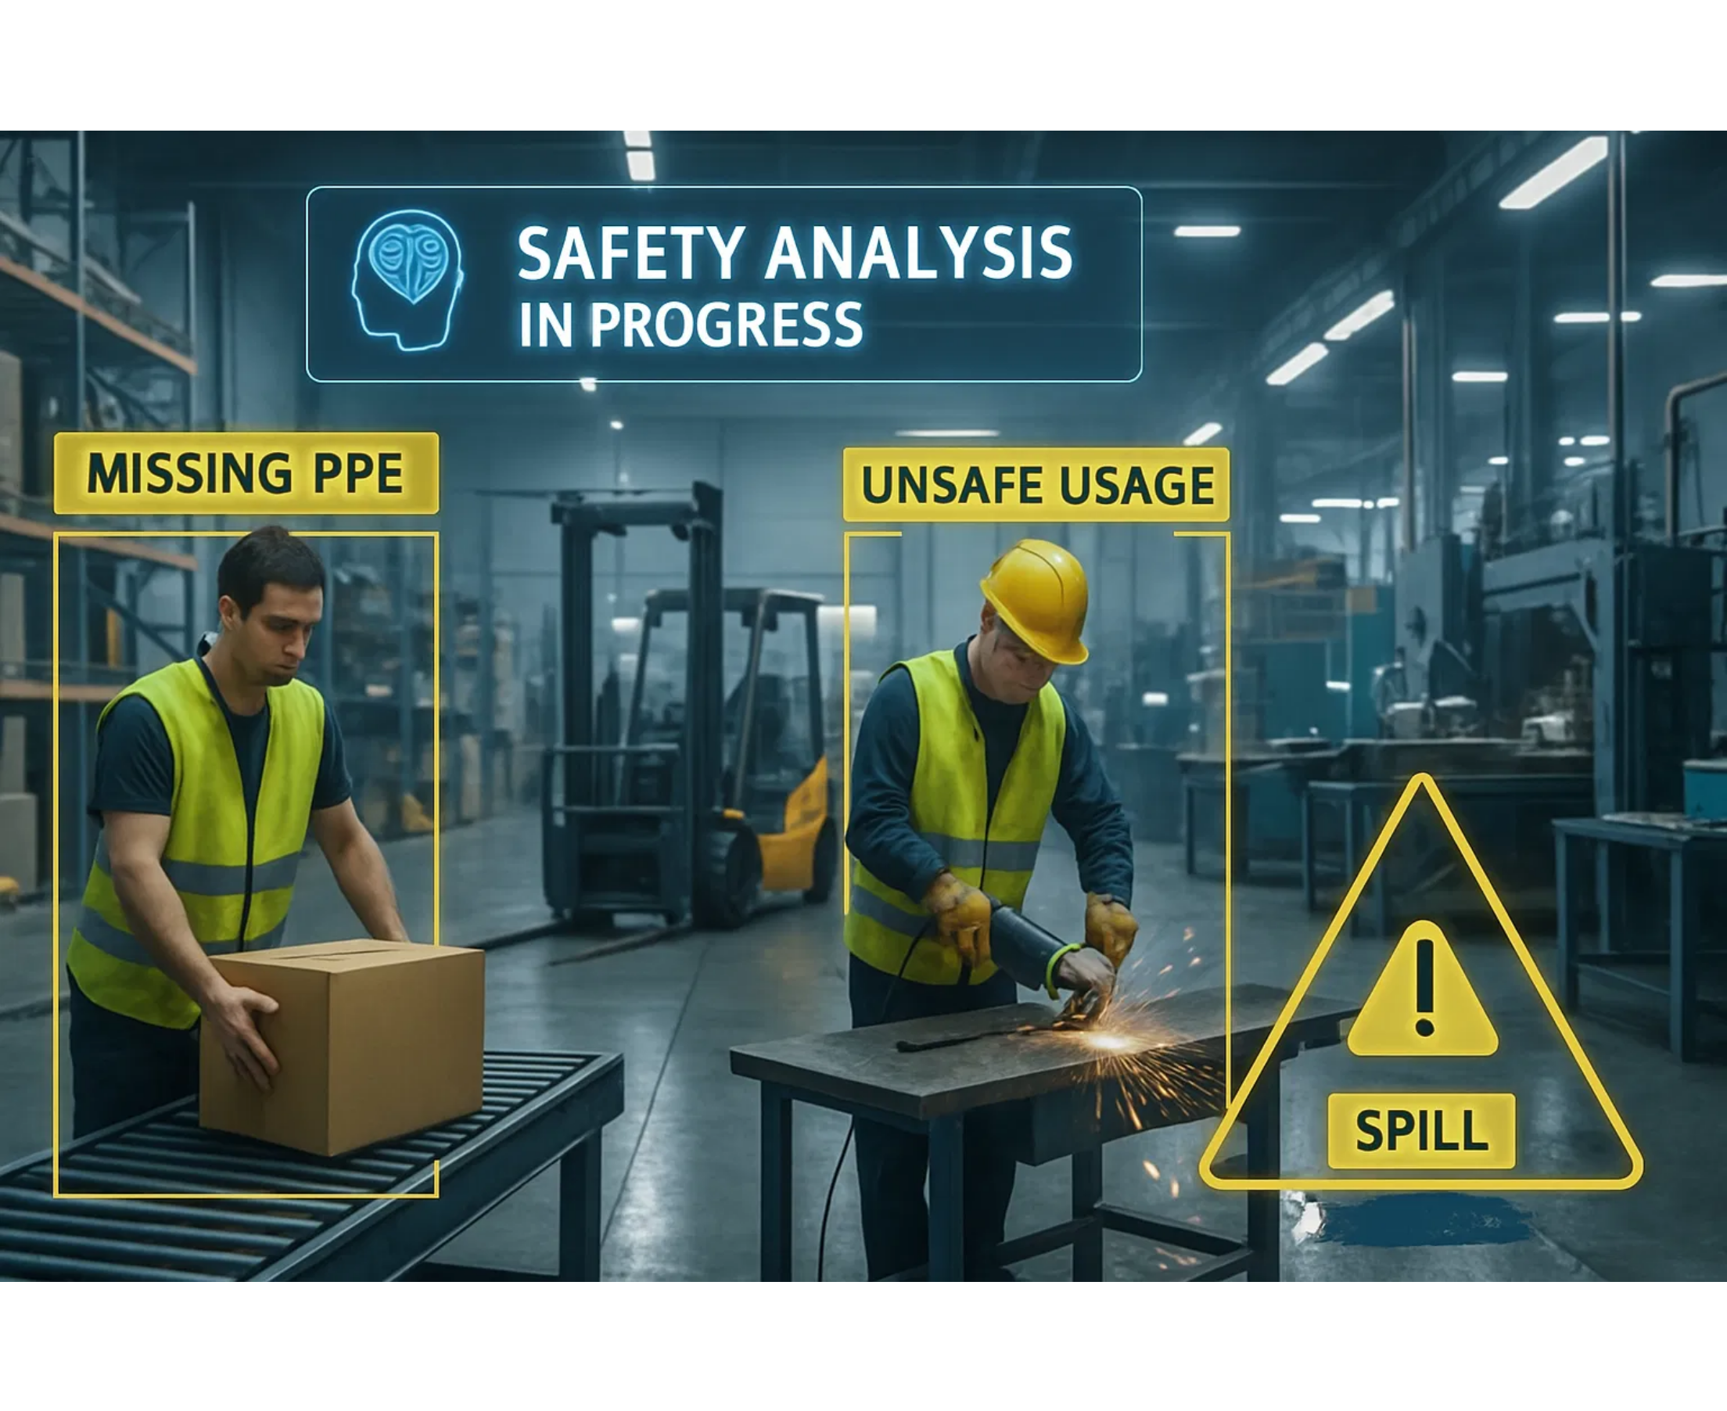
AI Safety Agent Concept
Transforming the NVIDIA blueprint into a specialized
for small to medium businesses
AI safety monitoring solution
Proactive
Continuous
Identifies hazards before incidents occur
24/7 monitoring without fatigue
Adaptive
Scalable
Learns from patterns over time
Grows with business needs
AI Safety Agent MVP

Slide 5

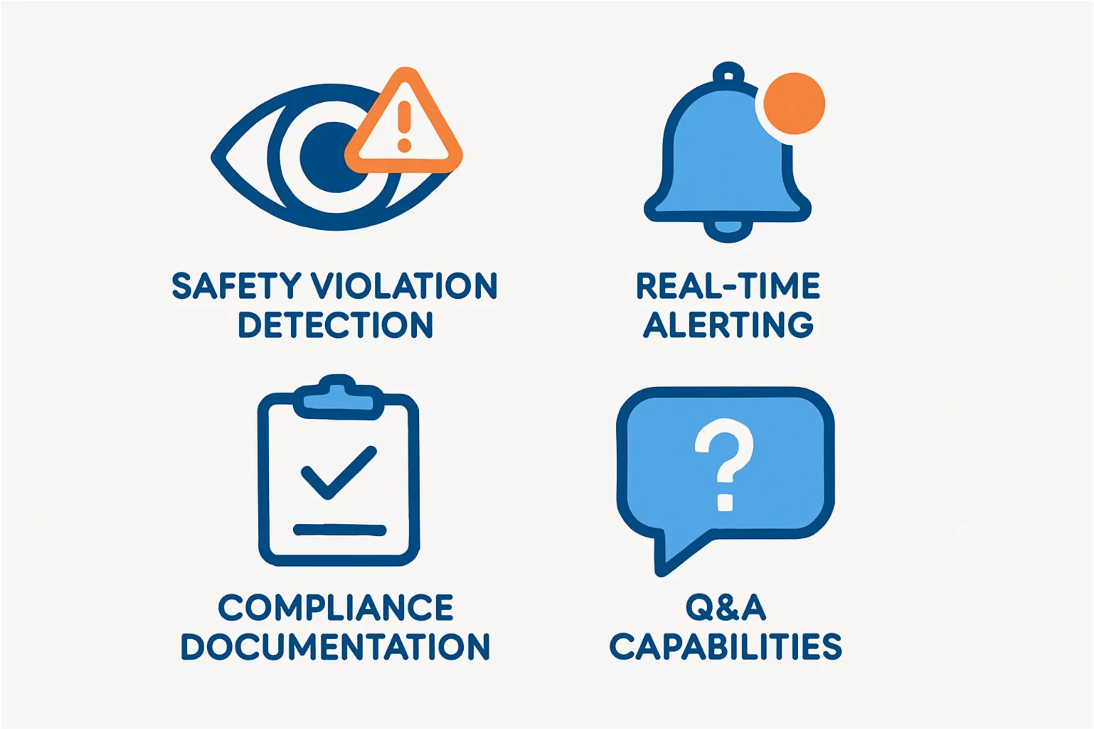


Core Features
The AI Safety Agent MVP delivers four essential capabilities for workplace safety
Identifies OSHA violations in real-time
Notifies appropriate personnel immediately
Generates required safety documentation
Answers questions about safety status
AI Safety Agent MVP

Slide 6

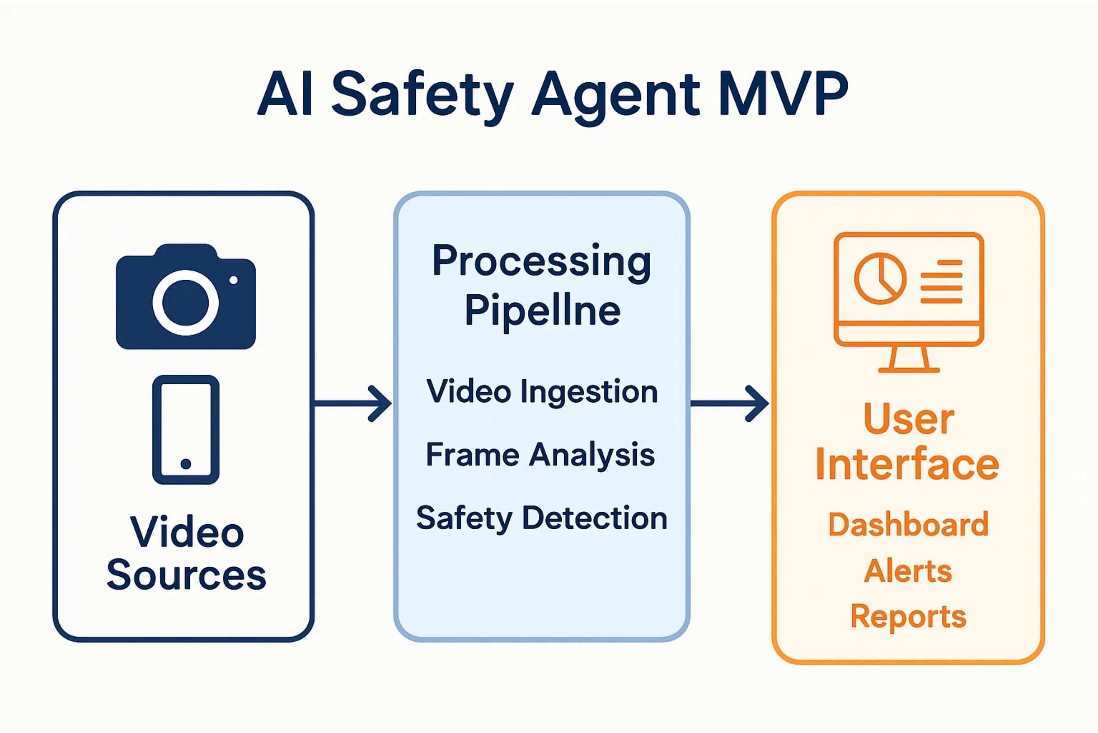
MVP Architecture
Simplified architecture designed specifically for small to medium businesses
Video Sources
Processing Pipeline
User Interface
Security cameras
Video ingestion
Safety dashboard
Mobile uploads
Frame analysis
Incident alerts
Archived footage
Safety detection
Compliance reports
AI Safety Agent MVP

Slide 7

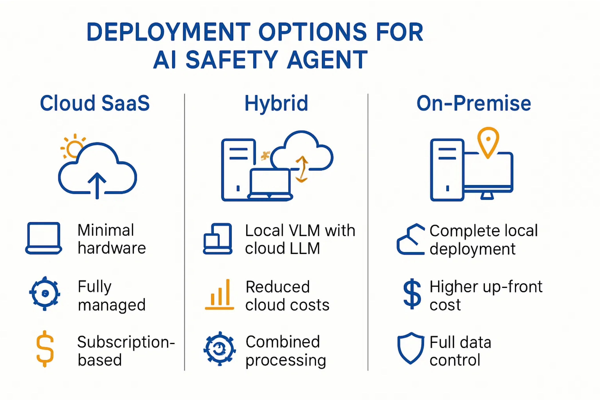
Deployment Options
Flexible deployment models to accommodate different SMB resources and needs
Cloud SaaS
Hybrid
On-Premise
Ideal for businesses with minimal IT infrastructure
Balanced approach for businesses with some hardware resources
Complete control for businesses with existing GPU infrastructure
AI Safety Agent MVP

Slide 8
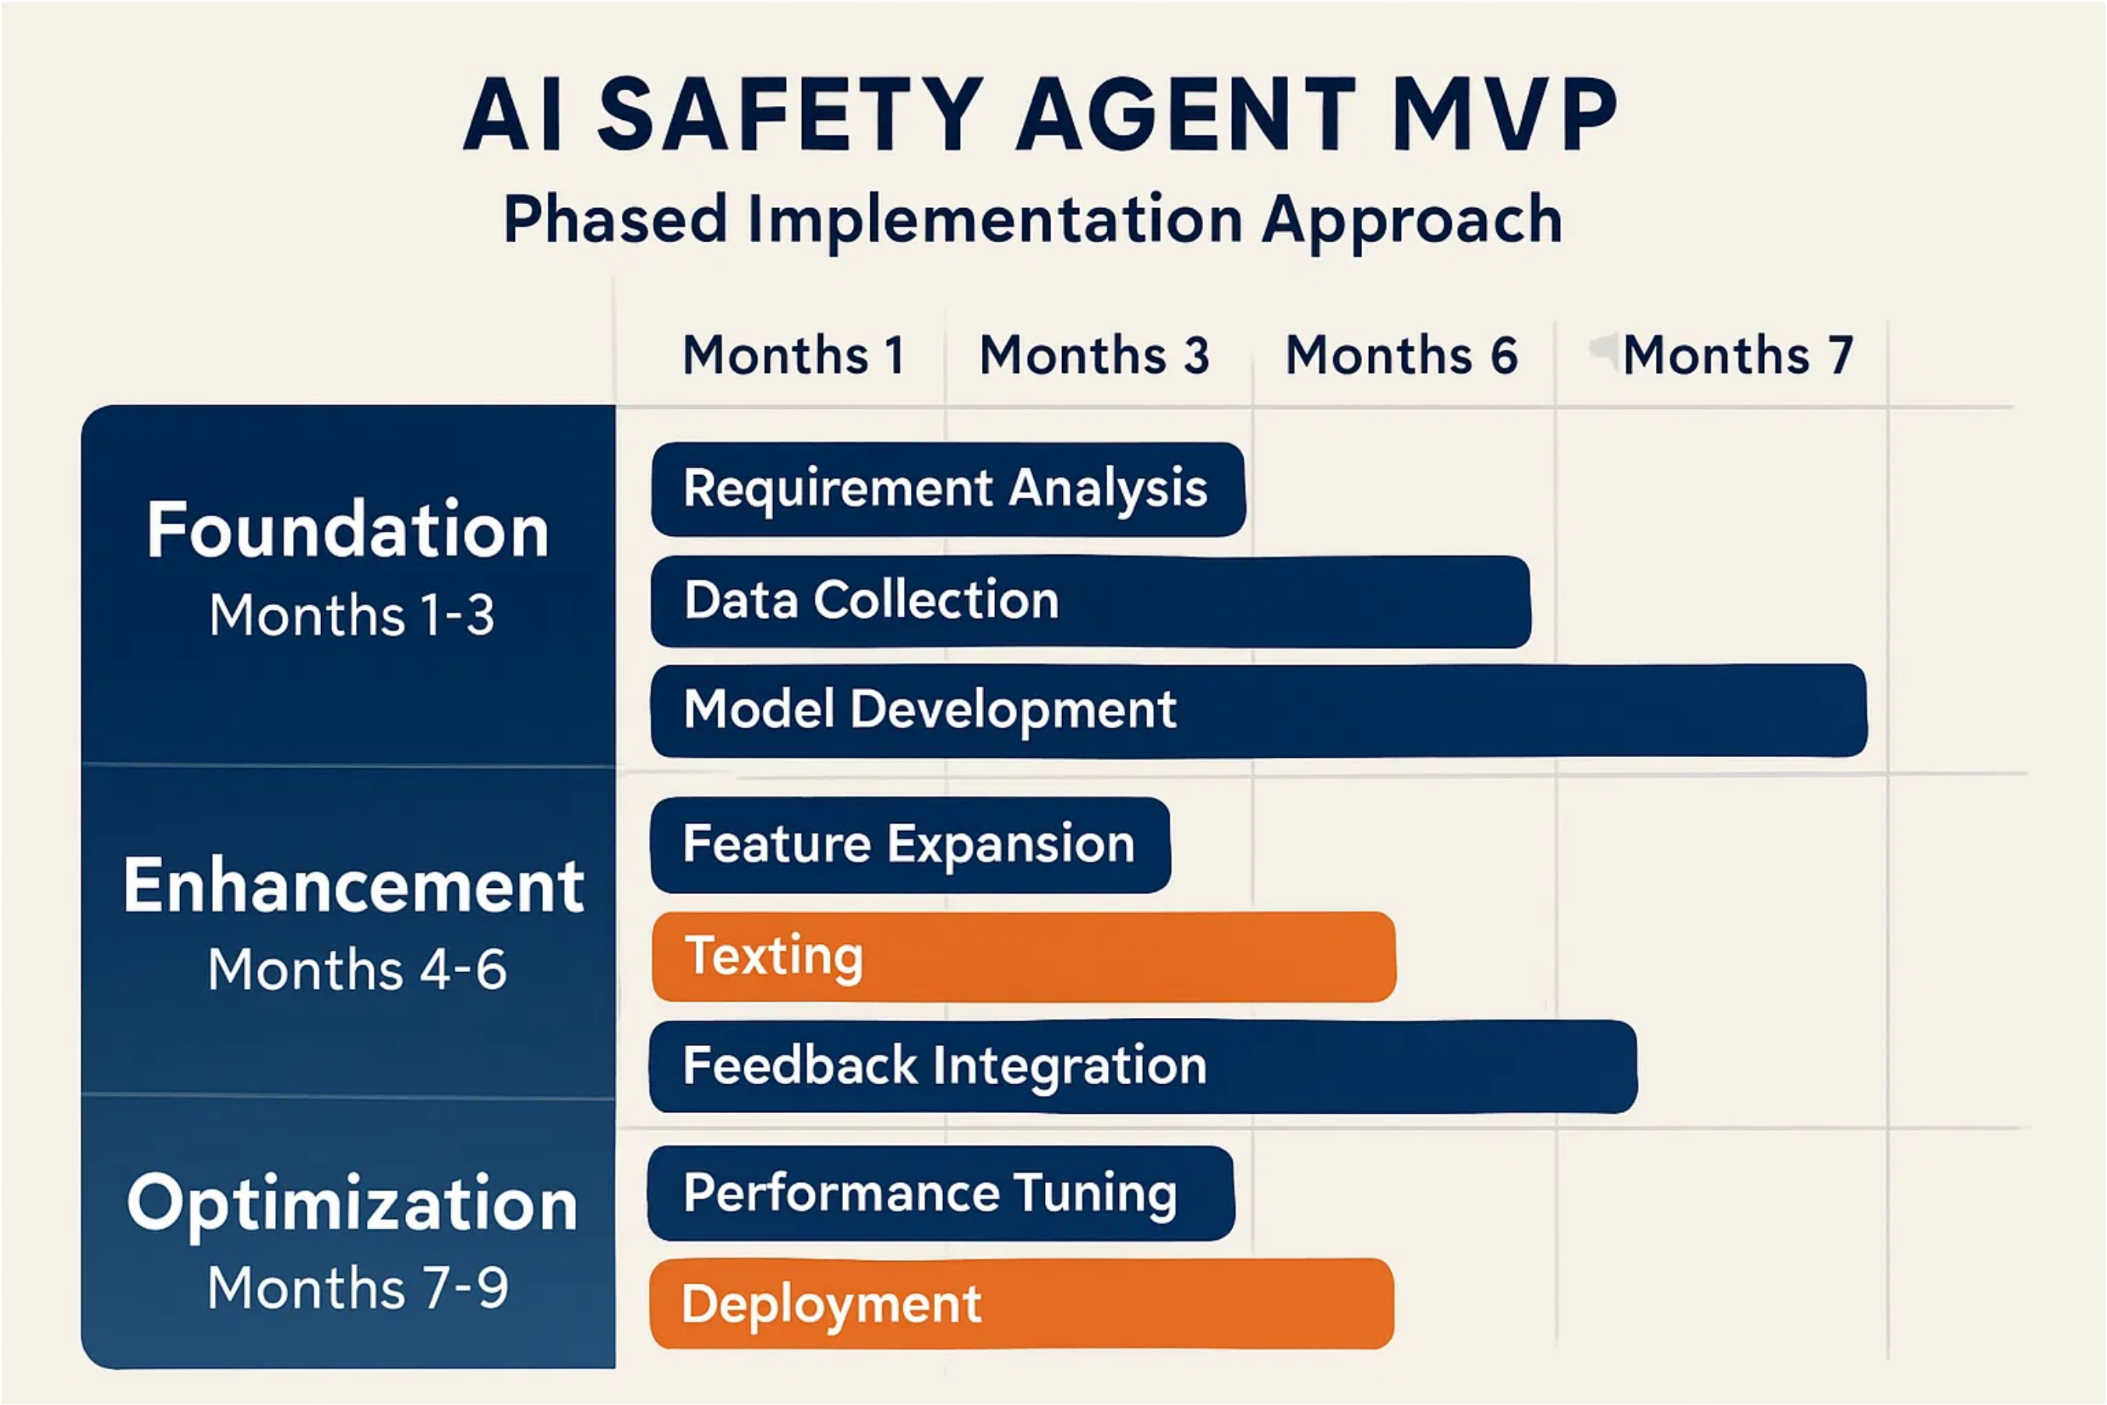
Implementation Roadmap
Phased approach to implementation ensures manageable deployment and clear milestones
Foundation
Enhancement
Optimization
Core architecture setup and initial deployment package
Feature expansion and integration capabilities
Performance improvements and advanced analytics
AI Safety Agent MVP

Slide 9
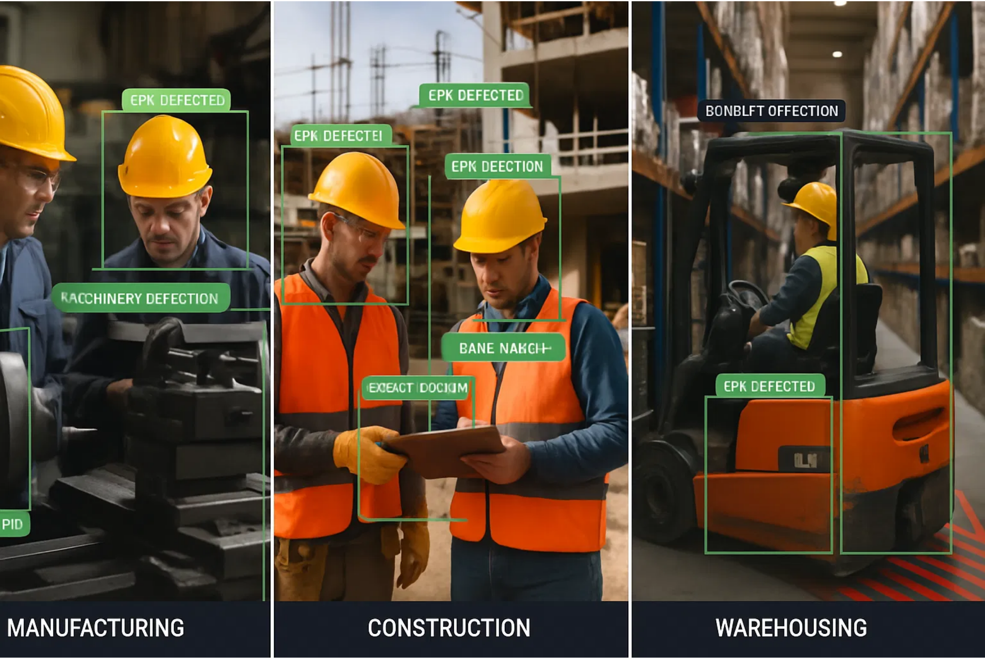
Industry Applications
The AI Safety Agent MVP addresses specific safety needs across multiple industries
Manufacturing
Construction
Warehousing
PPE compliance monitoring
Fall protection monitoring
Forklift operation safety
Machinery safety zones
Site access control
Loading dock monitoring
Process adherence
Equipment operation safety
Storage compliance
AI Safety Agent MVP

Slide 10
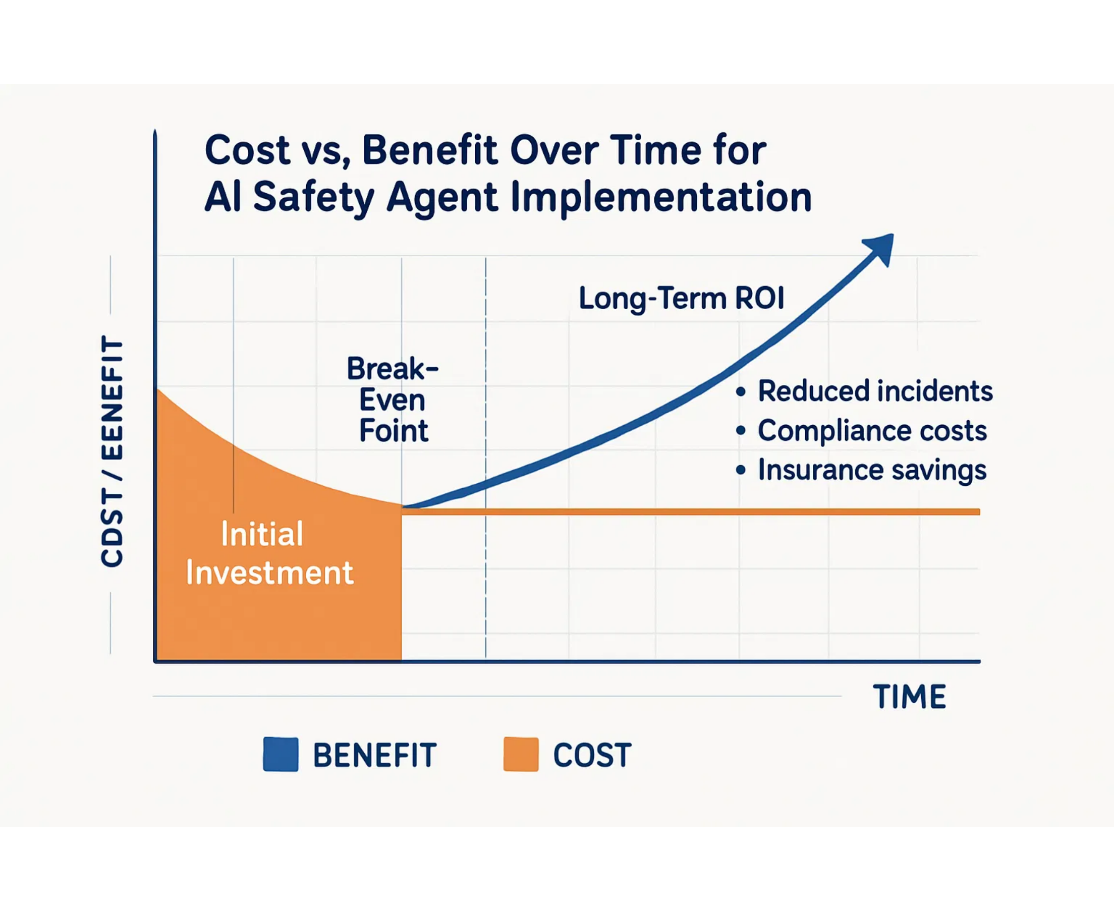




ROI & Benefits
Implementation of the AI Safety Agent delivers
measurable returns
for small to medium businesses
20-30% reduction
in workplace safety incidents within 3-6 months
5-15% reduction
in insurance premiums over 12-24 months
40-60% reduction
in compliance penalties and associated costs
10-20% improvement
in operational efficiency for safety management
AI Safety Agent MVP

Slide 11

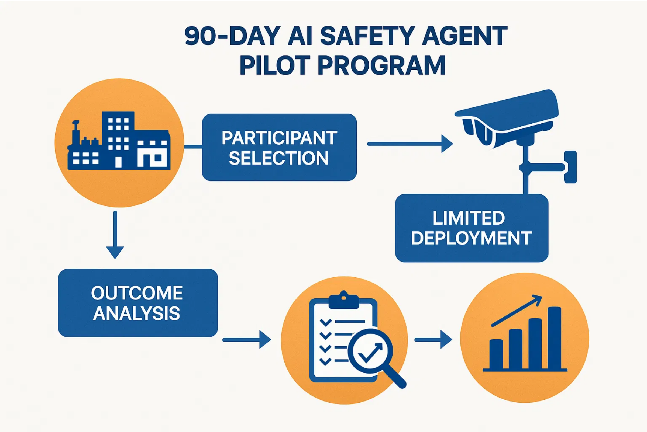




Pilot Program
Structured 90-day pilot program to validate effectiveness and gather real-world feedback
Participant Selection:
3-5 businesses across 2-3 target industries
Limited Deployment:
3-5 cameras in highest-risk areas
Success Metrics:
Detection accuracy, response time, user satisfaction
Outcome:
Case studies and testimonials for market launch
AI Safety Agent MVP

Slide 12
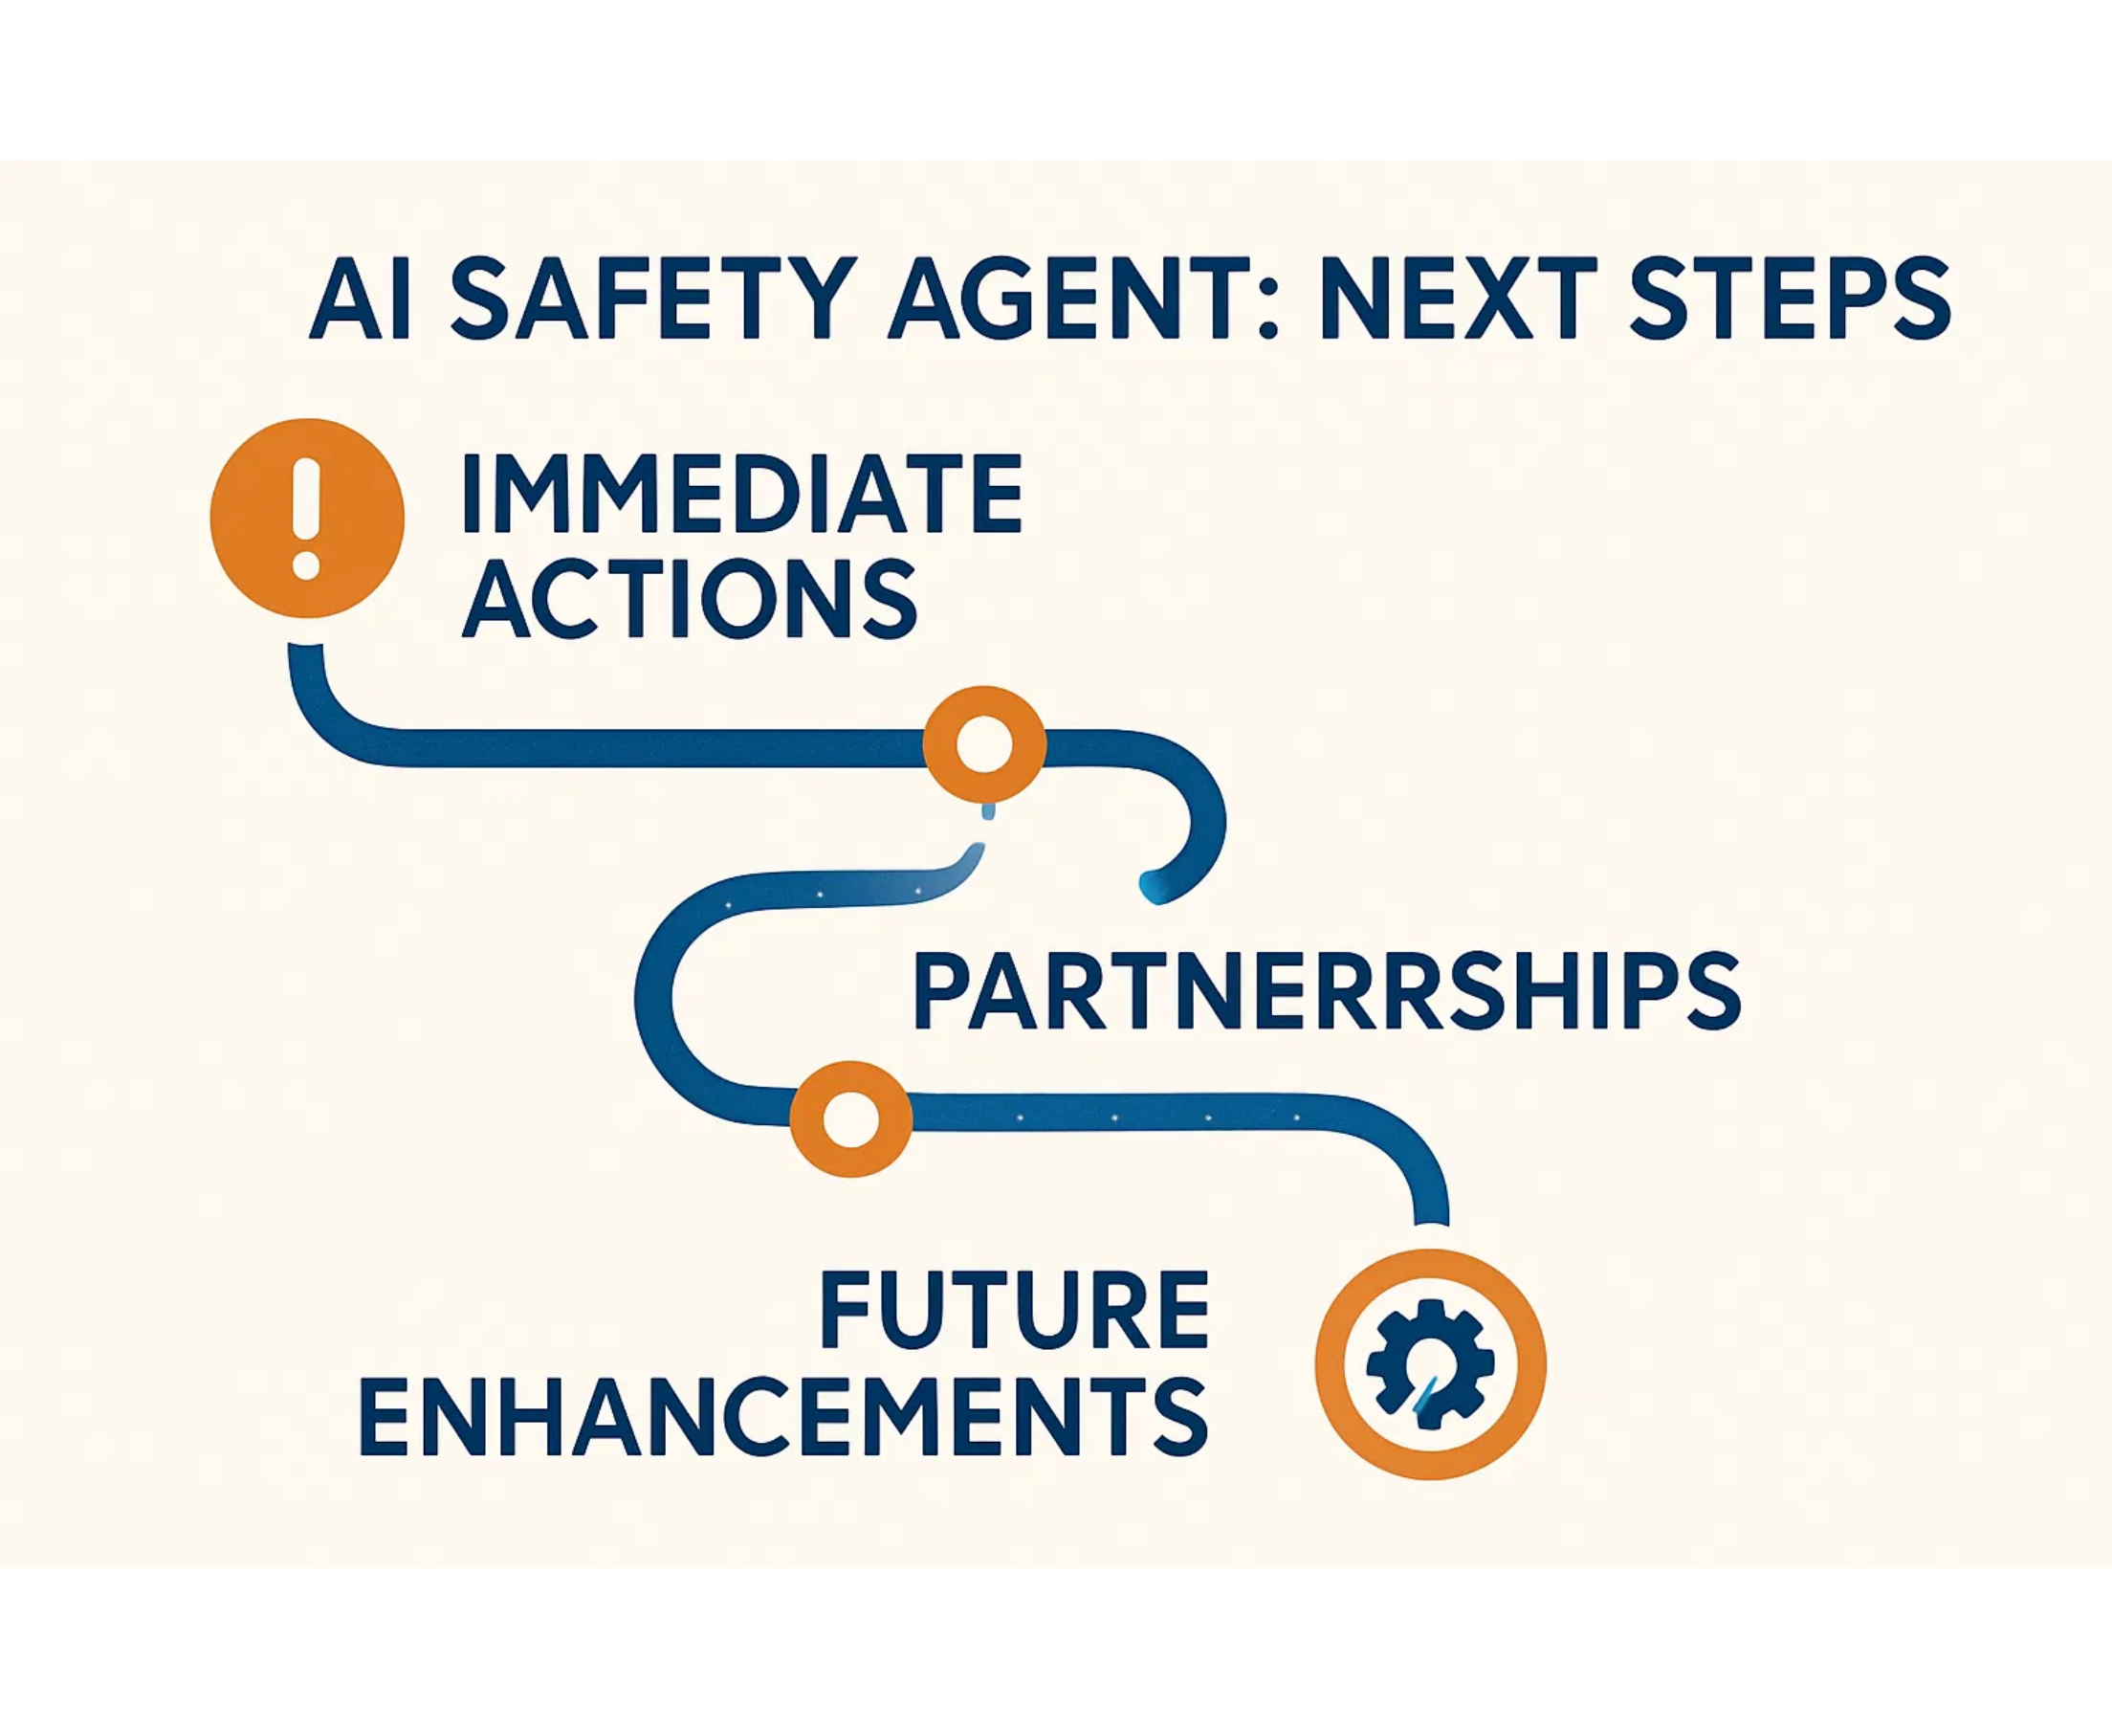




Next Steps
Clear path forward to implement the AI Safety Agent MVP for your business
Immediate:
Select deployment model and identify high-risk monitoring areas
Partnerships:
Engage with MSPs, security integrators, and safety consultants
Timeline:
90-day pilot followed by phased implementation
Future:
Custom model training and multi-site coordination
AI Safety Agent MVP

