Slide 1
Predicting cryptic binding sites
one residue at a time, from the unbound structure alone
Zero-shot TabICLv2 · 117 apo-only features · CryptoBench
No training. No fine-tuning. No holo structure at prediction time.

Slide 2
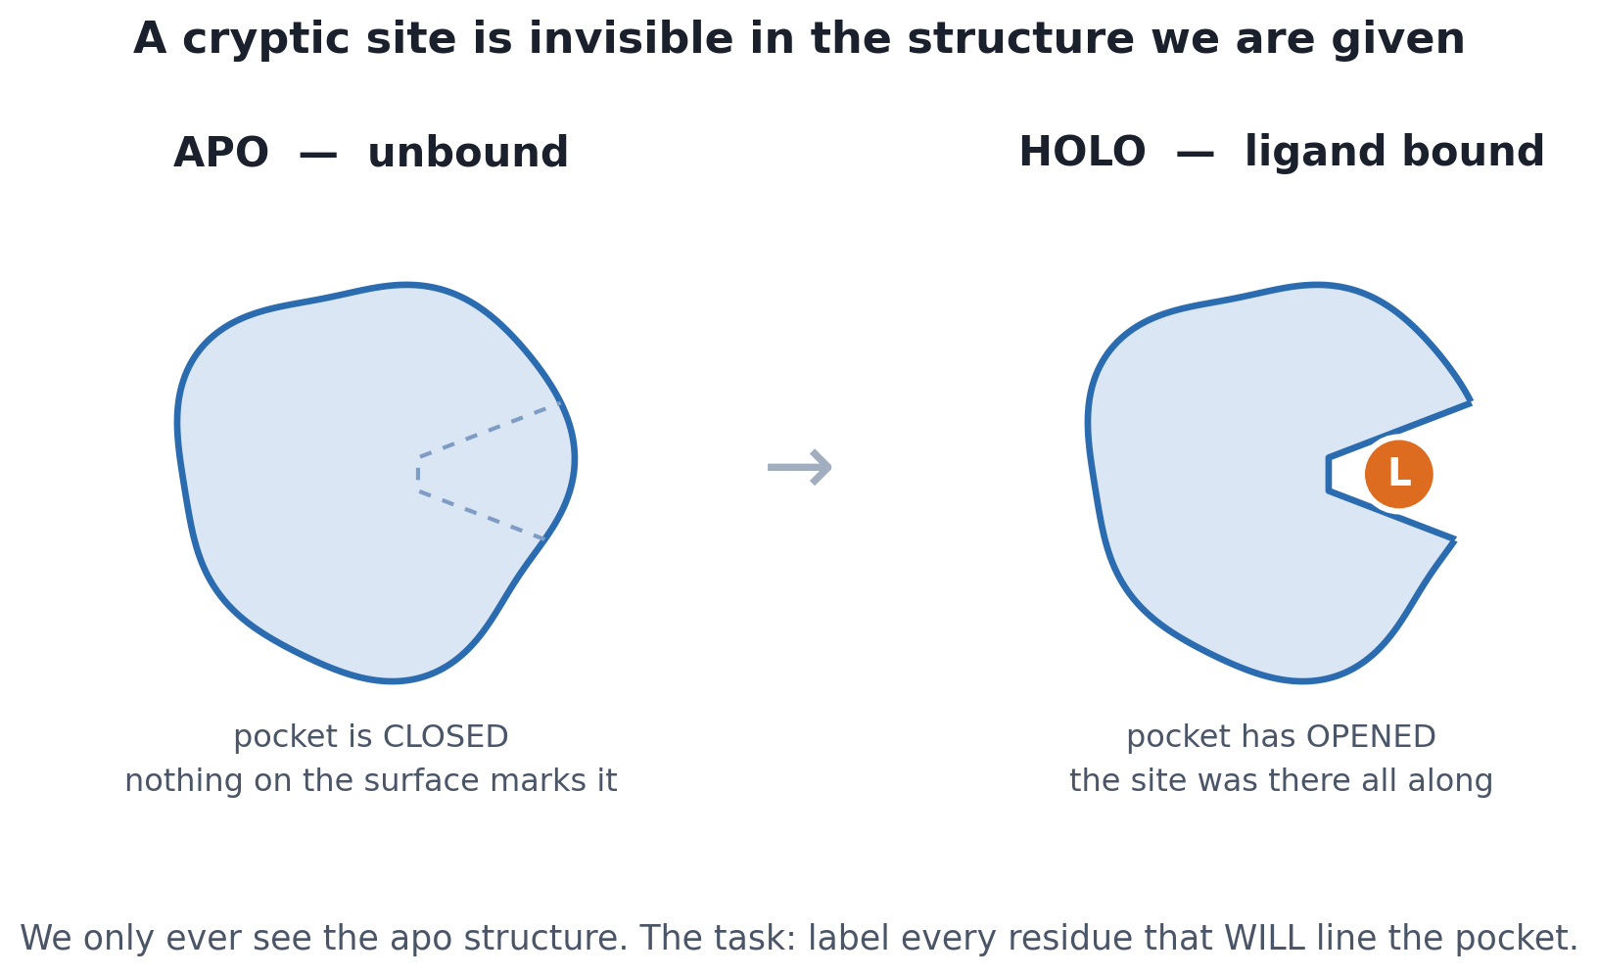
The problem
Most druggable pockets do not exist in the structure you can crystallise.

Slide 3
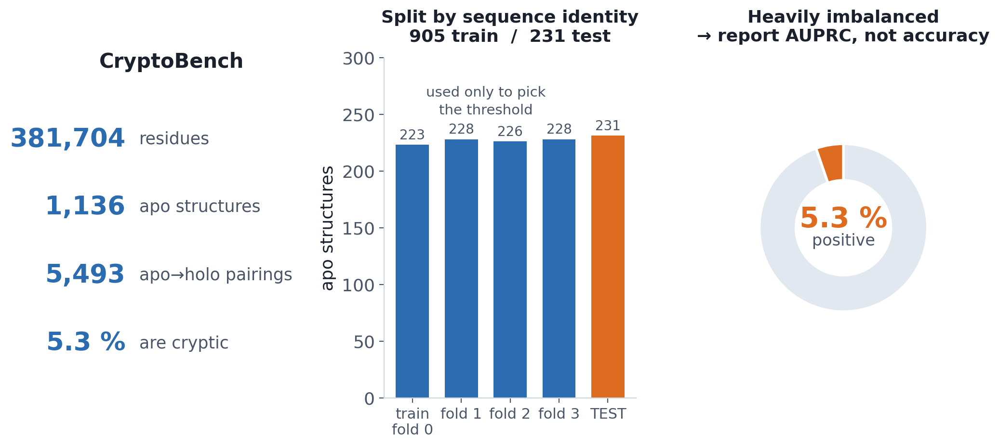
The dataset: CryptoBench
The largest curated set of cryptic sites — built from PDB apo/holo pairs, labelled per residue.
A residue is POSITIVE if it lines the ligand pocket in ANY holo partner of that apo structure — the union over all 5,493 pairings, not just the first.

Slide 4
CryptoBench's rules for testing
Four constraints. Break any one and the number stops meaning anything.
1. Split by sequence identity, never at random.
Homologues would otherwise sit on both sides. We use CryptoBench's own shipped folds — we never make our own split.
2. A protein is the unit. All of its residues stay together.
Residues within one structure are correlated; splitting inside a protein leaks.
3. Score per structure, then average the scores.
Not pooled over all 76,753 residues — that would let big proteins dominate. This is CryptoBench's own Protein.py convention.
4. Nothing derived from the holo structure may become a feature.
A cryptic site is DEFINED by the apo→holo change, so any holo-derived column reconstructs the label. A test fails the build on one.
The decision threshold is chosen on training folds and frozen before the test set is touched. Each published method sets its own (pLM-NN 0.95, PocketMiner 0.7, P2Rank none).

Slide 5
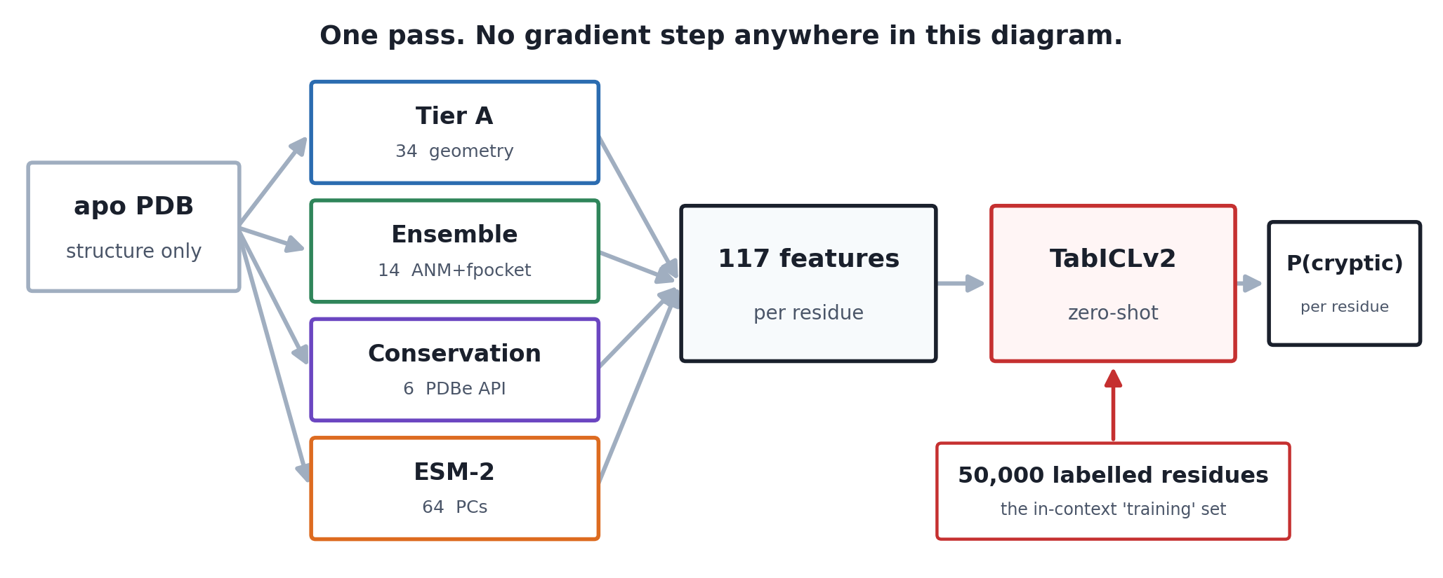
The pipeline
One apo PDB file in, one probability per residue out.
Steps run once, offline, and are cached: the ensemble and ESM stages are the expensive ones (Modal GPU/CPU); Tier A and conservation are cheap.

Slide 6
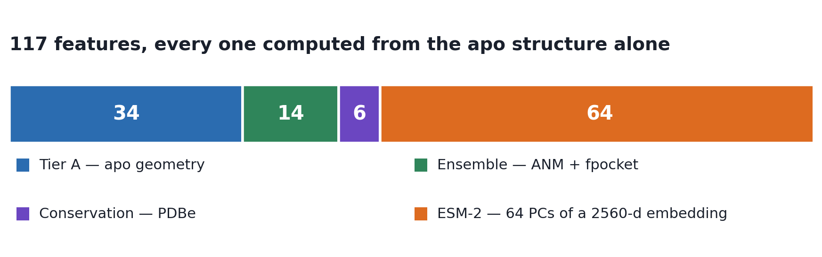
117 features
Four independent sources of evidence about one residue.
source | n | what it measures | how it is extracted
Tier A — geometry | 34 | is this residue in a pocket-like place? | computed locally from the apo PDB (gemmi + scipy)
Ensemble — pockets | 14 | does a pocket OPEN when the protein moves? | ANM normal modes → 24 conformations → fpocket on each
Conservation | 6 | is evolution protecting this position? | PDBe Graph API — the same source CryptoBench used
ESM-2 | 64 | what does a language model make of the sequence? | esm2_t36_3B → 2560-d → PCA to 64, fit on train only
Every one of the 117 is computable from the apo structure alone. That invariant is what makes the result honest, and a test enforces it.

Slide 7
Tier A · 34 geometric features
Cheap, local, and the backbone of the model.
Shape and exposure
sasa · rsa · depth_to_surface · protrusion · convexity · half-sphere exposure (up/down)
Packing and neighbourhood
packing · n_neighbors at 4 Å / 6 Å / 8 Å
Chemistry, flexibility, position
residue type · Kyte–Doolittle hydropathy · formal charge · B-factor and its z-score · secondary structure · φ/ψ · position along the chain
Plus an 8 Å neighbourhood mean of 12 of them
CryptoSite found the “…of neighbours” variants rank near the top: a residue's environment carries as much signal as the residue itself.
Definitions are taken verbatim from CryptoSite where it gives a formula (packing, n_neighbors, depth_to_surface); where it only cites prior work, we use a named documented proxy and say so.

Slide 8
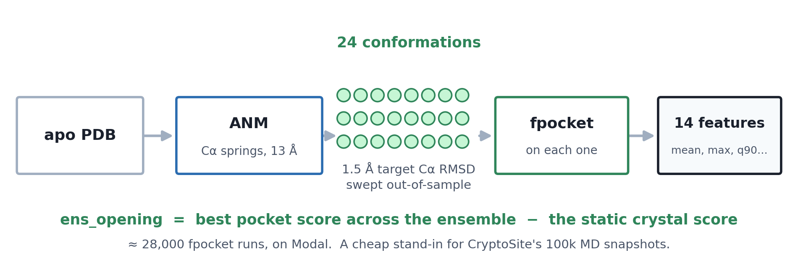
Ensemble features · 14
The one idea that is specific to crypticity: make the protein move.
A cryptic site is closed in the crystal and opens under thermal motion, so scoring a single static structure cannot see it. ANM gives the low-frequency collective modes from the Cα contact map alone — no MD. The trade is real: it will not find a site that needs a side-chain flip or a loop to cross a barrier.

Slide 9
Conservation · 6
Evolution has already labelled the functional sites for us.
Align a protein against its homologues. A column that never varies is doing something the organism cannot afford to change — and functional sites are under exactly that selection.
cons_score · cons_entropy · cons_prob_self + the 8 Å neighbourhood mean of each
Source: the PDBe Graph API, which serves precomputed per-residue conservation. The CryptoBench authors used the same API to analyse their own dataset, so the numbers are consistent with the benchmark rather than a different pipeline's.
It returns full per-amino-acid probability distributions, so we compute proper Shannon entropy — CryptoSite's actual definition — rather than a binned integer grade.
Coverage 1,136 / 1,136 structures. Median join match rate 1.000. ~2,300 API calls.
The strongest individual features in the project: cons_prob_self_nb8 reaches 0.673 AUC on its own.

Slide 10
ESM-2 · 64
The same protein language model the published benchmark uses.
facebook/esm2_t36_3B_UR50D → 2,560 dimensions per residue
We embed the observed residues of one chain, in order, as a single string. Chains longer than 1,022 tokens are chunked with a 256-residue overlap, and only the middle of each chunk is kept, so every embedding had real context on both sides.
2,560 raw dimensions would swamp 54 hand-built features and blow past TabICL's context budget, so they are reduced by PCA to 64 components — fit on TRAIN ROWS ONLY, then applied to test.
Bookkeeping is the part that goes wrong silently.
159 residues share an (apo_id, chain, seq_id) key with another — insertion codes, where two residues are numbered 52A and 52B. The residue key now carries the insertion code everywhere, and all three feature merges join on that four-part key under a 1:1 assertion.
Gains shrink but do not stop: 16 → 32 components adds +0.023 AUPRC, 32 → 64 adds +0.007 — the last step is the smallest.

Slide 11
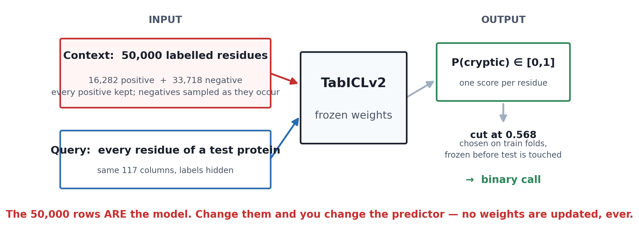
What TabICLv2 actually does
It is a tabular foundation model. There is no training step.

Slide 12
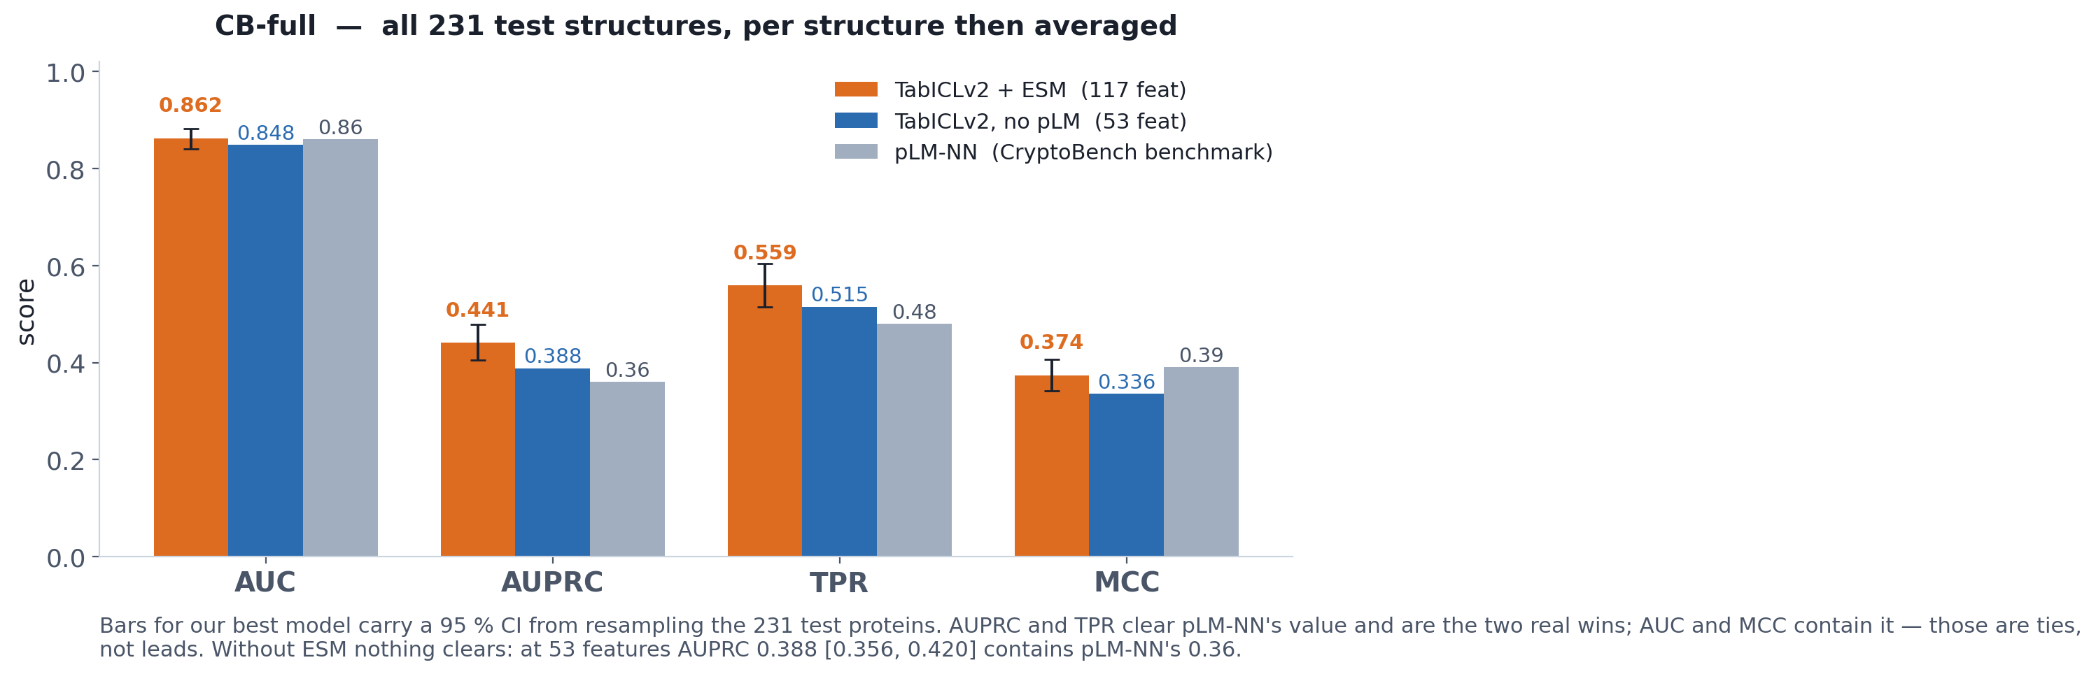
Results
Against the published CryptoBench benchmark, on the same test split.
Only the ESM row clears pLM-NN, and only on AUPRC and TPR. At 53 features AUPRC 0.388 [0.356, 0.420] contains their 0.36 — a tie. AUC and MCC are ties even with ESM.

Slide 13
The other methods on CryptoBench
Only CB-full is a like-for-like comparison with us.
Method | Subset | AUC | AUPRC | TPR | FPR | MCC | F1 (wtd)
TabICLv2 + ESM (this work) | CB-full | 0.862 | 0.441 | 0.559 | 0.071 | 0.374 | 0.912
TabICLv2, no pLM (this work) | CB-full | 0.848 | 0.388 | 0.515 | 0.073 | 0.336 | 0.906
pLM-NN (benchmark) | CB-full | 0.86 | 0.36 | 0.48 | 0.05 | 0.39 | 0.92
TabICLv2 + ESM (this work) | CB-P2RANK-apo | 0.861 | 0.469 | 0.569 | 0.068 | 0.392 | 0.914
pLM-NN | CB-P2RANK-apo | 0.88 | 0.42 | 0.51 | 0.04 | 0.43 | 0.93
P2Rank | CB-P2RANK-apo | 0.81 | 0.21 | 0.62 | 0.14 | 0.27 | 0.81
pLM-NN | CB-PM | 0.88 | 0.43 | 0.52 | 0.04 | 0.44 | 0.93
PocketMiner | CB-PM | 0.76 | 0.19 | 0.51 | 0.16 | 0.22 | 0.78
The subsets are not interchangeable.
CB-P2RANK-apo is the 184 single-chain test structures P2Rank could run on — we reconstruct it from the shipped dataset. CB-PM is defined by which 60 structures PocketMiner failed on, which is a property of that tool's run, not of the data, so it cannot be reconstructed.
Quote AUPRC, not F1. At 5 % prevalence a weighted F1 is governed by the 95 % of residues that are trivially negative — every pLM-based row sits at 0.92–0.93.

Slide 14
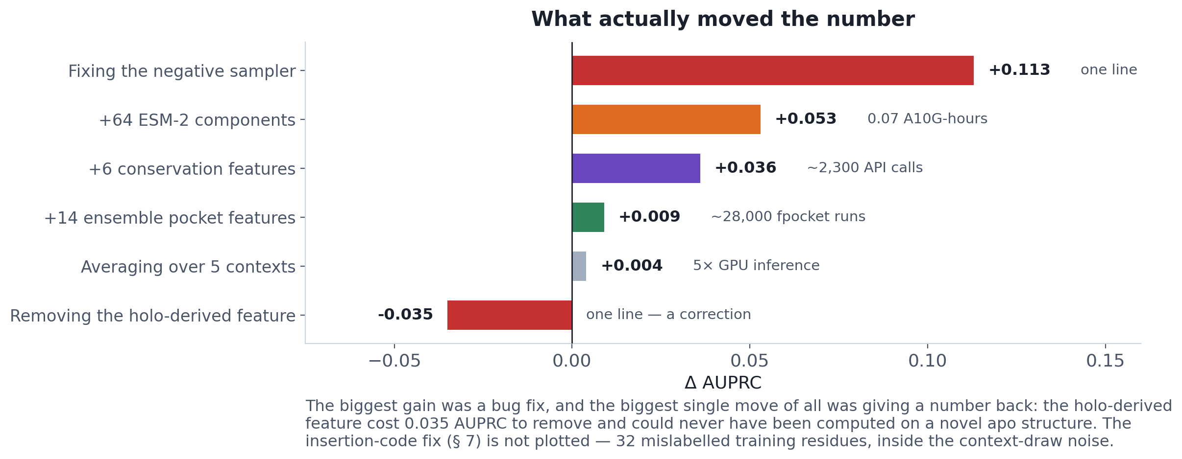
What actually moved the number
Ranked by ΔAUPRC, the honest summary at 5 % prevalence.
A separate bug — a missing altLoc column, which shifted every field in the PDB writer — was worth +0.144 AUPRC on the ensemble features alone. fpocket parses positionally, so it still ran and still reported pockets; it simply typed the atoms wrongly.

Slide 15
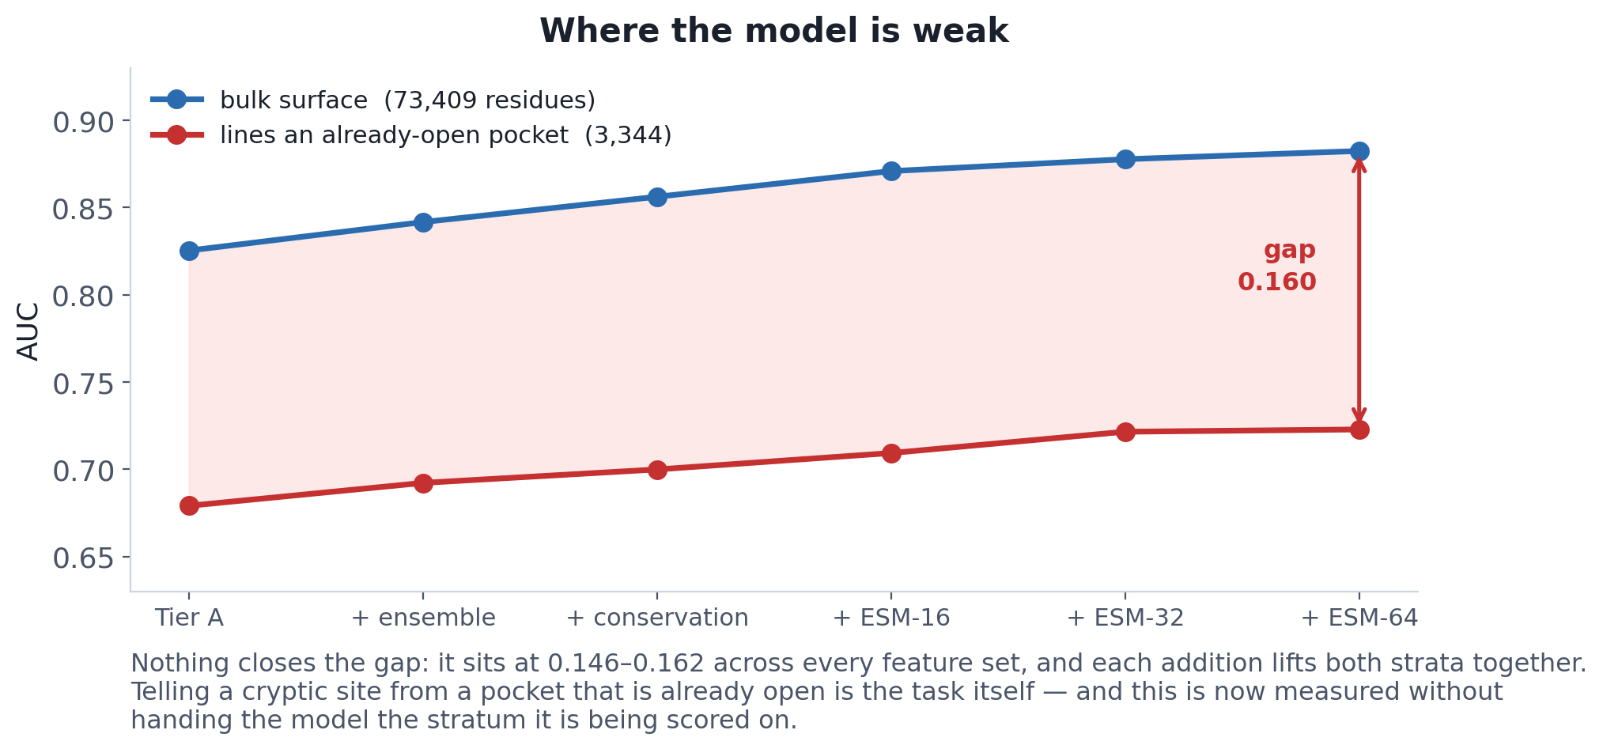
Where the model is weak
One stratum resists everything we have tried.
Every addition lifts BOTH strata by about the same amount, so the gap never closes: ESM buys +0.023 on this stratum against +0.026 on the bulk, and no single addition moves the gap by more than 2 sd of the context-draw noise. What separates these two classes appears to be a property of MOTION, not of sequence or of static shape.

Slide 16
Where it stands
Settled
0.862 AUC / 0.441 AUPRC on CB-full, zero-shot, from apo structure alone. AUPRC and TPR beat pLM-NN by margins that survive resampling the 231 test proteins. AUC and MCC are ties, and FPR and weighted F1 are losses — we run hotter than their operating point.
Measured, not assumed
Two separate uncertainties are quantified: test-set sampling (95 % CIs, 10,000 bootstrap resamples) and the 50k context draw (12 seeds on Modal). Together they set a noise floor — differences below ~0.008 AUPRC are not real.
Pending
External validation on CryptoSite's 14 held-out apo/holo pairs. The evaluation set is built (4,278 residues, 5.9 % positive, zero overlap with CryptoBench); scoring is not yet run.
Open
The hard stratum at 0.723 AUC against 0.882 on the bulk surface. Telling a cryptic site from a pocket that is already open is the discrimination the task is actually about.

