Slide 1

Factory OPTIMIZATION 101
Turning Factory Profit into a
Solvable Optimization Problem
From LP & MIP intuition to your first factory dispatch model in docplex
Quant / Trading Analytics · 2026
Notes:
Opening: today has one goal — to show that deciding when a battery charges, discharges and trades is a mathematical optimization problem, and one we can solve with off-the-shelf tools (docplex). No optimization background needed; we start from zero.

Slide 2




AGENDA
Today's roadmap: four steps
1
2
3
4
What is an optimization problem?
Battery = the same problem
Implement with docplex
LP and MIP
Variables, objective, constraints — the three parts
Build intuition with a tiny furniture-factory example
Map charge/discharge decisions onto the same three parts
Translate every constraint into code, line by line
2
Notes:
Roadmap: first pin down what 'optimization problem' actually means; then use an example that has nothing to do with batteries to understand LP and MIP; third, the key mental leap — battery arbitrage is the same problem in different clothes; finally, translate the maths into Python with docplex.

Slide 3



PART 1 · FOUNDATIONS
Every optimization problem has three parts
Decision variables
Objective
Constraints
What we control
The scoreboard
The rules
Real-world rules the decisions must obey.
e.g. limited wood; limited battery capacity.
The numbers we get to choose.
e.g. how many tables to build; how much to charge each hour.
One number measuring 'how good', to maximise or minimise.
e.g. max profit, min cost.
In one sentence: among all choices that satisfy the constraints, find the one with the best objective. The solver does the finding — our job is to state the problem clearly.
3
Notes:
The three parts: decision variables are the knobs in our hands; the objective is the scoreboard; constraints are the rules of the game. Modelling means translating business language into these three things — then the solver does the dirty work. This is the single most important mental model of the talk.

Slide 4
PART 1 · FOUNDATIONS
LP: Linear Programming
What does "linear" mean?
Objective is a linear combination of variables
All constraints are linear equalities / inequalities
Variables are continuous — 7.5 or 3.14 are fine
Why everyone loves LP
Extremely fast — millions of variables are fine
Solution is globally optimal, no local optima
Mature solvers out of the box: CPLEX, Gurobi, CBC…
STANDARD FORM
max c₁x₁ + c₂x₂ + … + cₙxₙ
s.t.
a₁₁x₁ + … + a₁ₙxₙ ≤ b₁
a₂₁x₁ + … + a₂ₙxₙ ≤ b₂
…
xᵢ ≥ 0
First-order terms only — no x², x·y or log(x)
4
Notes:
LP: objective and constraints are all linear, variables continuous. The payoff: fast, stable, globally optimal. Don't memorise the standard form — just remember its shape: first-order terms only. Later we can check that every line of the battery model has exactly this shape.

Slide 5


PART 1 · EXAMPLE
A toy example: what should the factory make?
THE SAME, IN MATHS
Business language
vars: x = tables, y = chairs
max 300x + 200y
s.t. 4x + 2y ≤ 40 (wood)
2x + 3y ≤ 30 (labour)
x, y ≥ 0
Table: £300 profit, 4 wood, 2 labour
Chair: £200 profit, 2 wood, 3 labour
Wood available ≤ 40, labour ≤ 30
Q: how many of each to maximise profit?
5
Notes:
Deliberately battery-free example to keep the cognitive load low. Left: what the boss says. Right: the same sentences in maths — two variables, one profit objective, two resource constraints. Note the *translation act* itself, business rule → equation, line by line. That's exactly what we'll do to the battery.

Slide 6
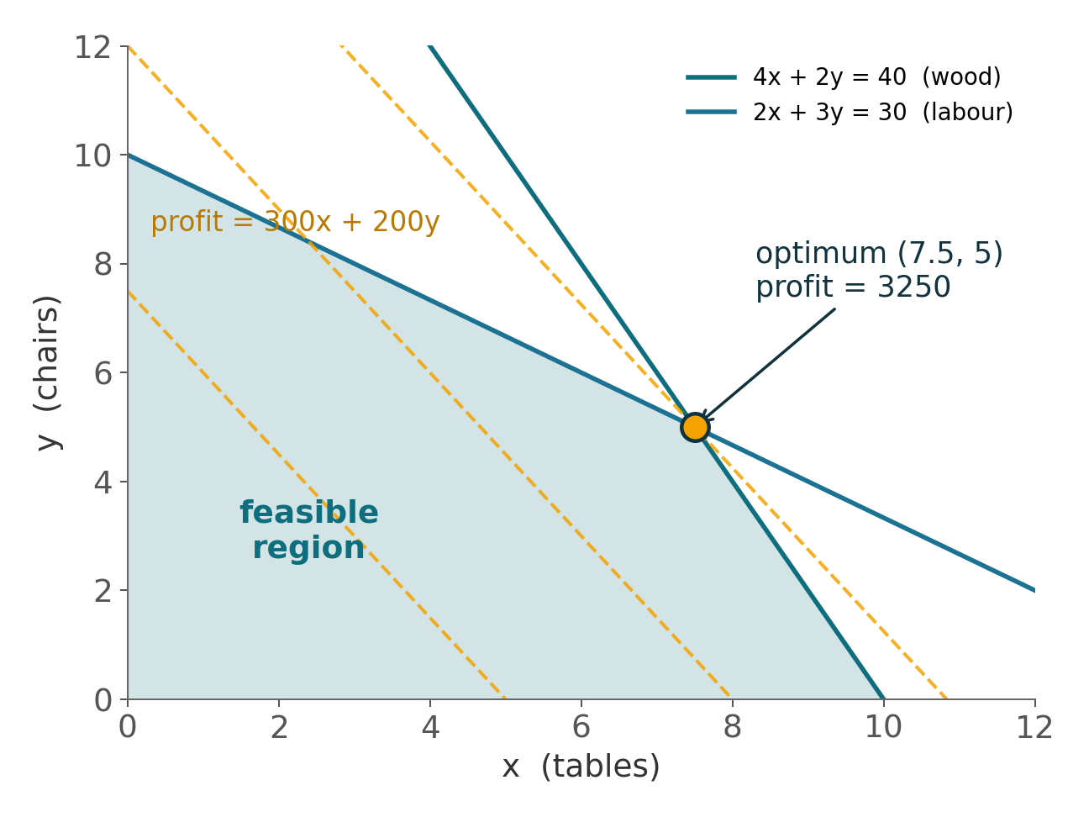



PART 1 · EXAMPLE
Geometric intuition: the optimum sits on a corner
Shaded area = feasible region
Every (x, y) that satisfies all constraints. More constraints → smaller region.
Dashed lines = iso-profit
Push them up-right for more profit — until you can't push any further.
Optimum at a vertex
An LP optimum always sits on a corner point — this is why solvers are so fast.
6
Notes:
With two variables we can draw it. Shaded = feasible region; yellow dashed lines are iso-profit lines — slide them outwards until they leave the region, landing on a corner: (7.5, 5), profit 3250. Key fact: LP optima live on vertices; the simplex method hops between them cleverly. But wait — 7.5 tables? That plants the question for the next slides.

Slide 7
PART 1 · FOUNDATIONS
MIP: when variables can't take "half"
MIP = Mixed-Integer Programming
Still linear objective & constraints — but some variables are restricted to integers or 0/1.
Integer variables
Binary variables
The price
x ∈ {0, 1, 2, …}
y ∈ {0, 1}
Harder to solve
Quantities must be whole:
you can't build 7.5 tables.
Yes/no switch decisions:
unit on or off? charge or discharge?
Combinatorial explosion; branch & bound prunes it, but large models slow down.
The key power: binary variables express logic — either/or, if…then, fixed start-up costs. Pure LP simply cannot do this.
7
Notes:
MIP changes one thing: some variables must be integer or 0/1. Don't underestimate it — binaries let us express logic inside a linear framework: on/off, do/don't, either/or. The battery's 'no simultaneous charge & discharge' will need exactly this. The price: solving becomes NP-hard, so use binaries sparingly.

Slide 8
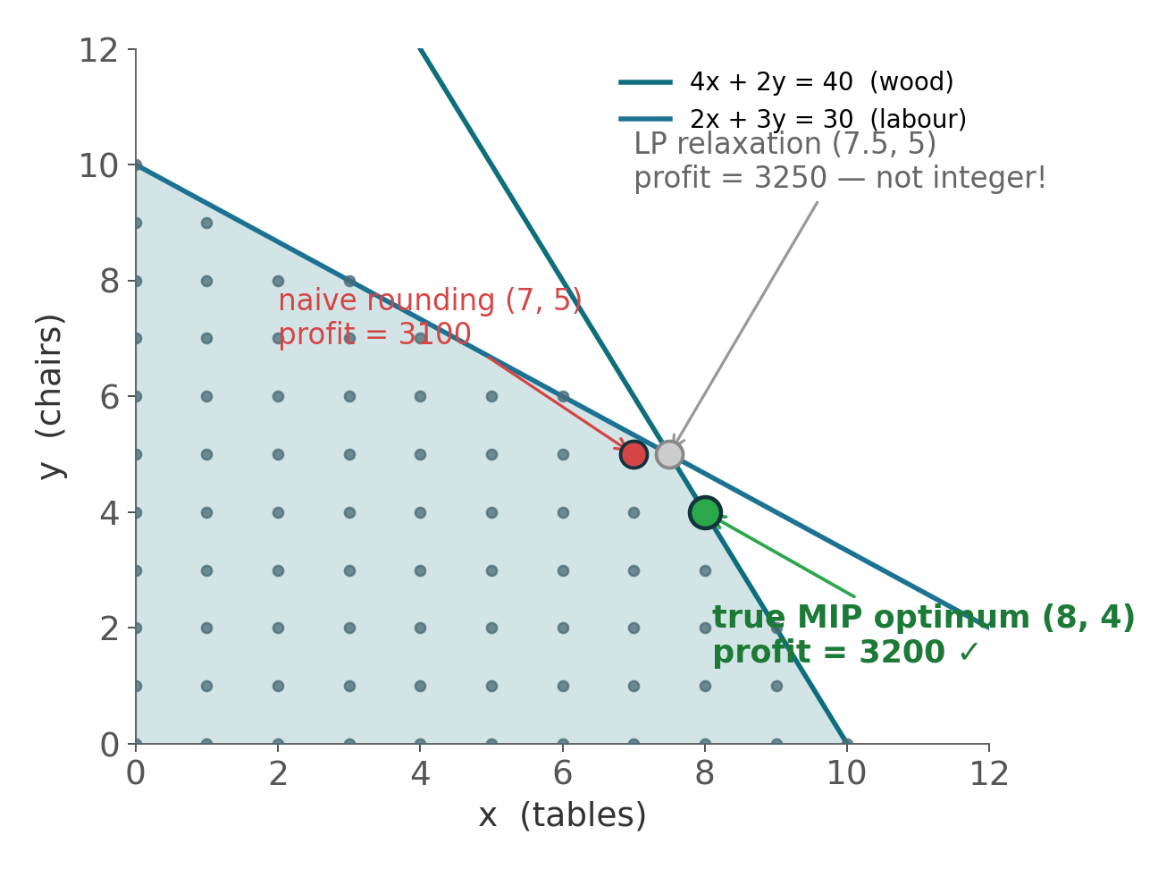
PART 1 · EXAMPLE
Why can't we just round the LP solution?
LP optimum: (7.5, 5) → £3250
Rounded: (7, 5) → £3100
MIP optimum:(8, 4) → £3200
The integer optimum need not sit next to the LP optimum — and rounding can even be infeasible.
Conclusion: integrality belongs inside the model — let the MIP solver handle it.
8
Notes:
A tempting shortcut: solve the LP, then round. On the chart: grey dot is the LP optimum (7.5,5); rounding to (7,5) gives only 3100; the true integer optimum is (8,4) at 3200 — nowhere near the LP point. Worse, rounding can be infeasible. So integrality goes into the model, and branch & bound deals with it. That completes our LP/MIP intuition.

Slide 9


PART 2
Battery arbitrage
is the same problem
CHARGE
BUY LOW
DISCHARGE
SELL HIGH
Buy energy when it's cheap, store it, sell when it's expensive.
"How do I trade profitably?" = "maximise a linear objective under constraints".
Notes:
Now the key mental leap. A storage battery makes money in a plain way: buy low, sell high. It sounds like a trading problem — but look again: hourly charge/discharge volumes are decision variables; total revenue is the objective; the battery's physical spec is the constraint set. Structurally identical to the furniture factory — just 24 hours × a few variables per hour.

Slide 10
PART 2 · MODELLING
Fitting the battery onto the same skeleton
 | Furniture factory | Battery (24-hour day-ahead arbitrage)
Variables | x tables, y chairs | hourly charge cₜ, discharge dₜ, state of charge SoCₜ
Objective | max 300x + 200y | max Σₜ pₜ · (dₜ − cₜ) — sales revenue minus purchase cost
Constraints | wood ≤ 40, labour ≤ 30 | power limits, capacity bounds, energy balance, no simultaneous charge & discharge…
The only new ingredient: time. The same variables repeat for t = 1…24, and the hours are linked together by energy balance.
10
Notes:
Row by row: variables — the factory has 2 numbers, the battery has 3 per hour (charge, discharge, SoC), 72 in total; objective — both are linear revenue expressions, price p_t times net energy sold; constraints — resource limits become the battery's physical spec. The single qualitative change is time: hours are chained by the energy-balance equation. Nothing else is new.

Slide 11
PART 2 · TRANSLATION
Translating constraints (1/2): physics → linear
Power limit
"the inverter is rated at 5 MW"
0 ≤ cₜ ≤ 5, 0 ≤ dₜ ≤ 5
Capacity bounds
"10 MWh pack — never over/under-charge"
0 ≤ SoCₜ ≤ 10
Energy balance
"this hour's energy = last hour's + in − out"
SoCₜ = SoCₜ₋₁ + η·cₜ − dₜ/η
Start = end
"be back at today's level by tomorrow's open"
SoC₂₄ = SoC₀
η ≈ 0.9 round-trip efficiency per leg: store 1 MWh, only 0.9 arrives; a full round trip loses ~19%.
11
Notes:
Fixed format: business language on the left, maths on the right. Power limits are just variable bounds; capacity limits are SoC bounds; the crucial one is energy balance — it chains adjacent hours and is the backbone equation of the model. Efficiency η makes each round trip cost ~19%, so the model won't churn energy pointlessly. Finally start = end, so the strategy is a sustainable day, not emptying the battery for a one-day P&L. Note: every line is linear — so far this is still an LP.

Slide 12


PART 2 · TRANSLATION
Translating constraints (2/2): where MIP begins
The problem
The binary-switch trick
Introduce yₜ ∈ {0,1} (1 = charging mode)
cₜ ≤ 5 · yₜ
dₜ ≤ 5 · (1 − yₜ)
yₜ=1 squeezes discharge to 0; yₜ=0 squeezes charge to 0. Two linear rows + one switch = the logic "either/or".
"Never charge and discharge in the same hour."
This is logic (either/or), not a quantity — no continuous linear expression can state it.
cₜ · dₜ = 0 ? ✗ nonlinear — rejected by LP and MIP alike.
This is the moment our model turns from an LP into a MIP.
12
Notes:
Everything so far was LP. But 'no simultaneous charge & discharge' is a logical constraint: the product form is nonlinear and can't go in. Classic trick: add a 0/1 switch y_t and wire it into the power limits with two linear inequalities — flip the switch to charging and the discharge limit collapses to zero, and vice versa. One binary + two linear rows = one piece of logic. At this moment the model officially becomes a MIP — which is why we covered MIP in part 1.

Slide 13
PART 3 · CODE
docplex (1/2): declare the model & variables
from docplex.mp.model import Model
m = Model(name="battery_arbitrage")
T = range(24) # 24 hours
# continuous vars: lb/ub ARE the power & capacity constraints
c = m.continuous_var_list(T, lb=0, ub=5, name="charge")
d = m.continuous_var_list(T, lb=0, ub=5, name="discharge")
soc = m.continuous_var_list(T, lb=0, ub=10, name="soc")
# binary vars: the charge/discharge mode switch — MIP starts here
y = m.binary_var_list(T, name="is_charging")
The correspondence: every symbol in the maths = one array of variables in code; the bound constraints are written for free at declaration time.
13
Notes:
Down to code. docplex is IBM CPLEX's Python modelling API — designed so the code reads like the maths. Step 1: create a Model. Step 2: declare variables. continuous_var_list creates 24 continuous variables at once, and its lb/ub arguments knock out the power-limit and capacity constraints as a side effect. binary_var_list creates the 24 switches — the highlighted line is the line where the model becomes a MIP.

Slide 14
PART 3 · CODE
docplex (2/2): constraints, objective, solve
for t in T:
m.add_constraint(c[t] <= 5 * y[t]) # charging switch
m.add_constraint(d[t] <= 5 * (1 - y[t])) # discharging switch
prev = 5 if t == 0 else soc[t-1] # initial SoC = 5 MWh
m.add_constraint(soc[t] == prev + 0.9*c[t] - d[t]/0.9) # balance
m.add_constraint(soc[23] == 5) # start = end
m.maximize(m.sum(price[t] * (d[t] - c[t]) for t in T))
sol = m.solve()
print(sol.objective_value) # → 753.0 (£)
Translation complete: each equation on the previous slides ↔ one add_constraint here, one to one; solving takes a single m.solve().
14
Notes:
Second block: inside the loop, the two switch constraints and the energy balance (highlighted — literally the backbone equation from slide 11); outside the loop, start = end; the objective is Σ p_t(d_t−c_t) verbatim; then m.solve(). Compare with the maths on the previous slides: not a single line here is new knowledge — it's mechanical translation. This instance solves to £753; next slide shows what it actually did.

