Slide 1






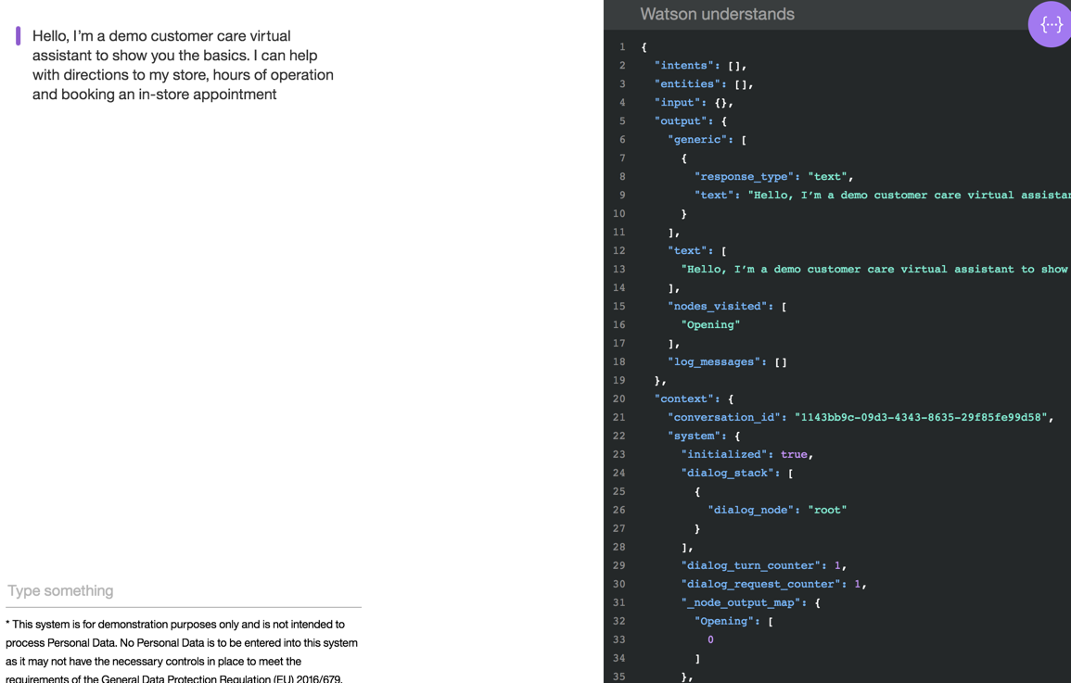

Browser
IBM Cloud
load
Cloud Foundry
Node.js Buildpack
Alias Cloudant
Cloudant
WebApp
Server
load
WebApp
Cloud Foundry
Node.js Buildpack
Alias Assistent
Assistent
Server

Slide 2
Browser
IBM Cloud
Load_WebApp
Cloud Foundry
Node.js Buildpack
Any WebApp
Server
Call REST
Load WebApp
Cloud Foundry
Node.js Buildpack
Simple-forward-server
Call REST
load
Cloud Foundry
Node.js Buildpack
Alias Cloudant
Cloudant
Node-RED WebApp
Node-RED Server

