Slide 1
Indiana Bones
Working Title

Slide 2
Planned content
General Idea/Story
Interaction
Gameplay obstacles
Puzzles
Level design

Slide 3
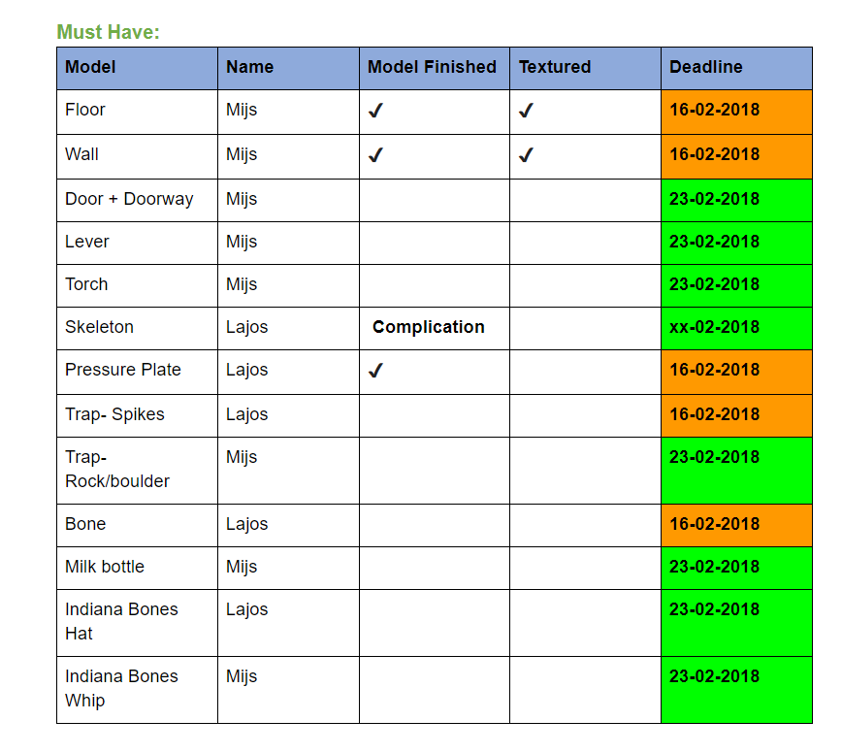
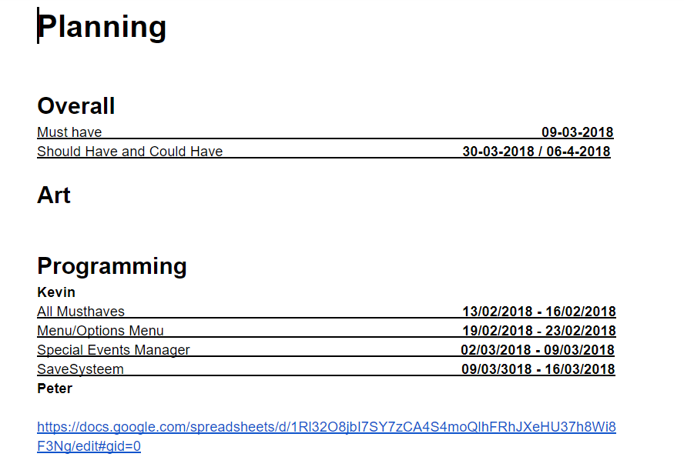
Game Design Document
- https://docs.google.com/document/d/1hf-na7bdCFSeHHdtGF03CiWVjSxiEsswhKHYJB8Af14/edit?ts=5a79b809

Slide 4
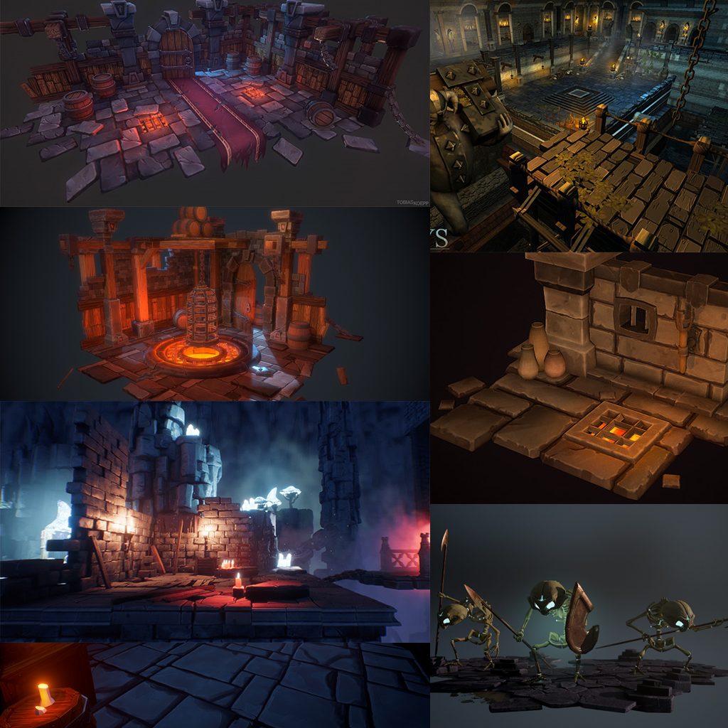
Art
Mood
Style
Lettertype
Character
Envirment
GUI

Slide 5
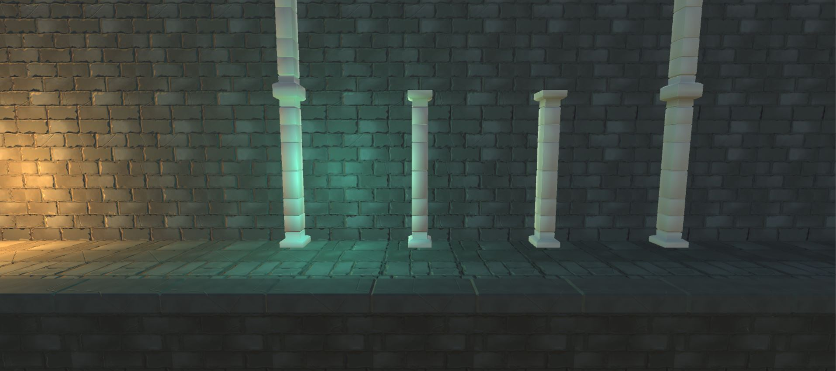
Completed Art
Wall
Ground
Foreground
Pillar

Slide 6
Programming
Camara
Controls
Enemies
Player abilities
Level desing
GUI

Slide 7
CurrentMechanics
Trap Systeem
Camera Systeem
BasicPuzzle

Slide 8
The end
Demo gameplay

