Slide 1
IndianaBones

Slide 2
GamePlay
General Idea/Story
Interaction
Gameplay obstacles
Puzzles
Level design

Slide 3
Gdd
https://docs.google.com/document/d/1hf-na7bdCFSeHHdtGF03CiWVjSxiEsswhKHYJB8Af14/edit?ts=5a79b809

Slide 4
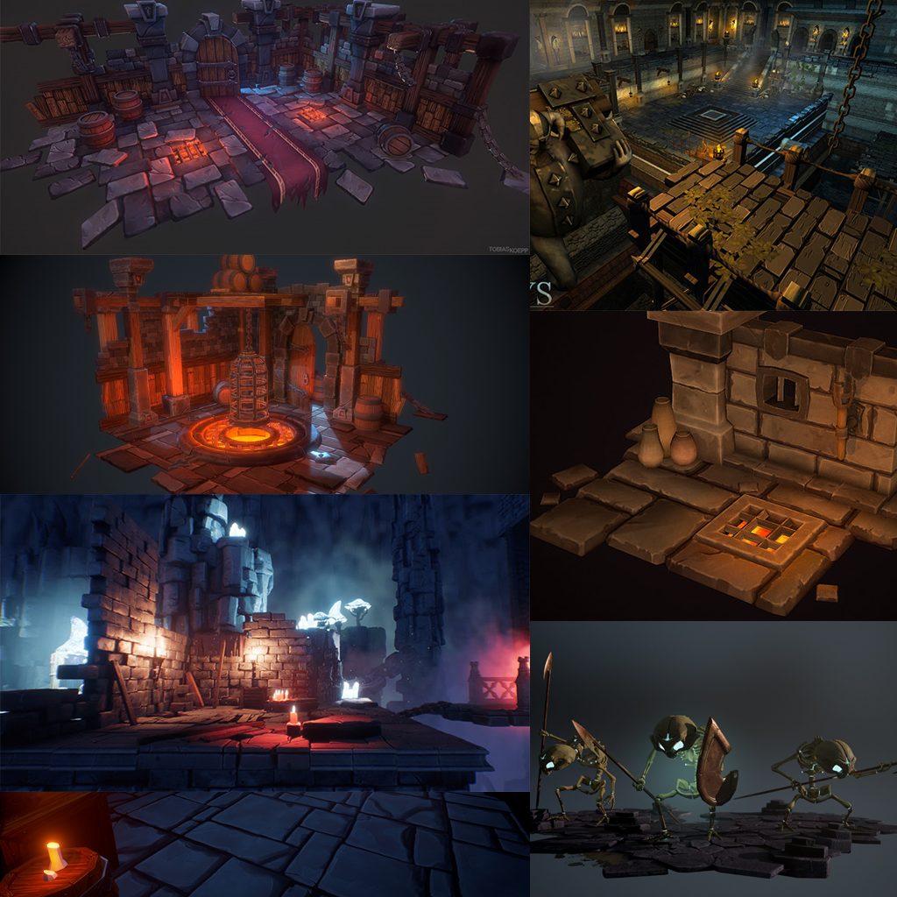
Art
Mood
Style
Lettertype

Slide 5
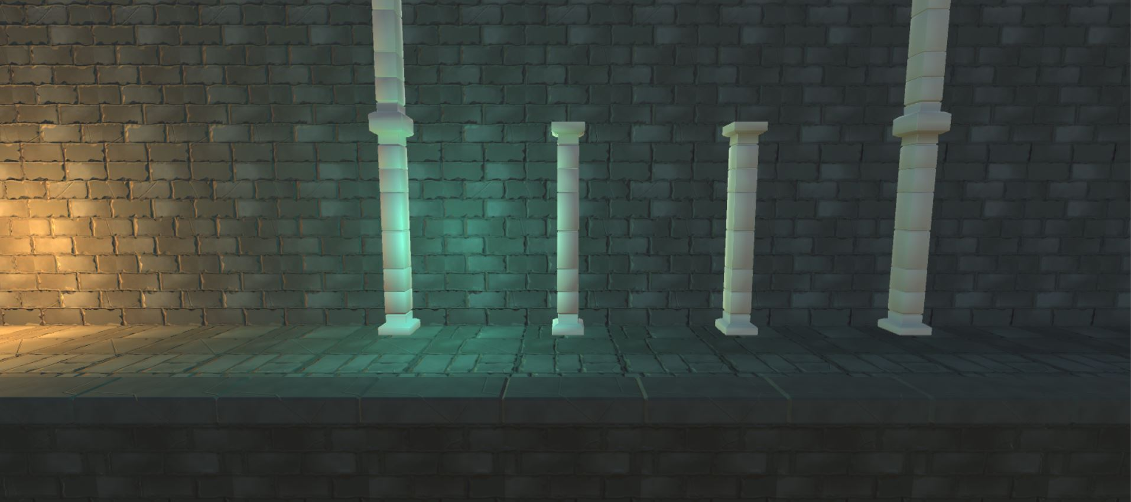
al ready done
wall
Ground
For ground
pillar

Slide 6
Al ready done programing
…

Slide 7

The end

