Slide 1
IndianaBones

Slide 2
GamePlay
General Idea/Story
Interaction
Gameplay obstakels
Puzzles
Level design

Slide 3
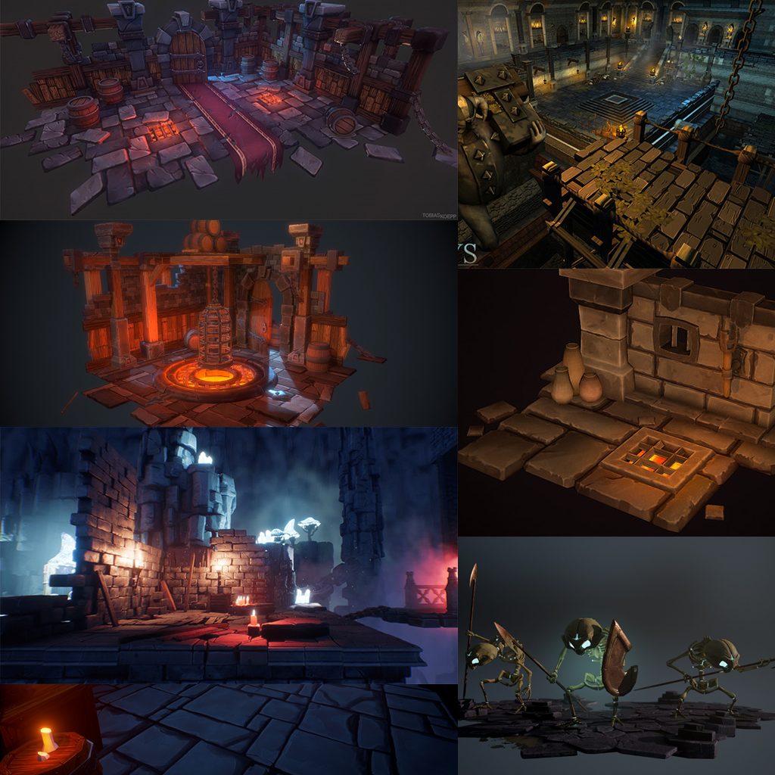
Art
Mood
Style
Lettertype

