Slide 1
Indiana Bones
Working Title

Slide 2
Gameplay
General Idea/Story
Interaction
Gameplay obstacles
Puzzles
World creation

Slide 3
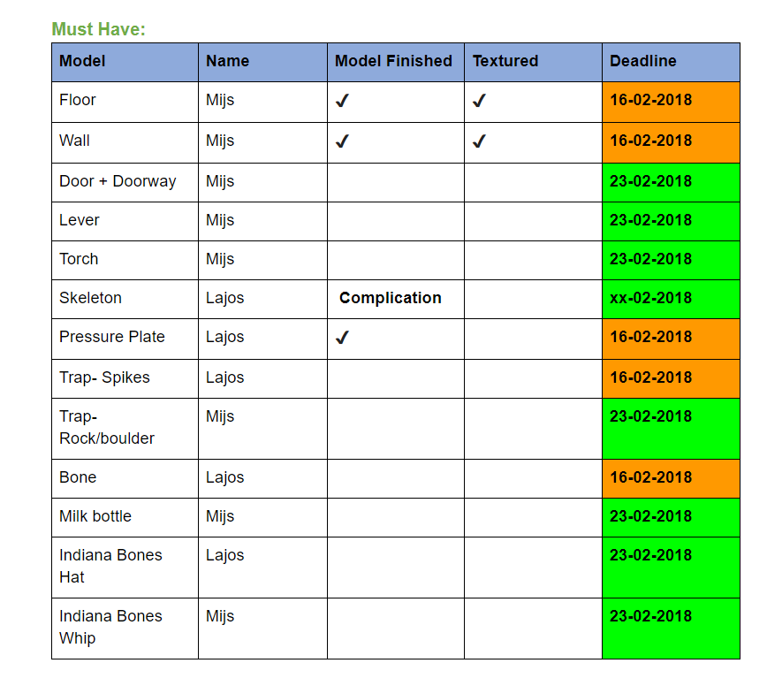
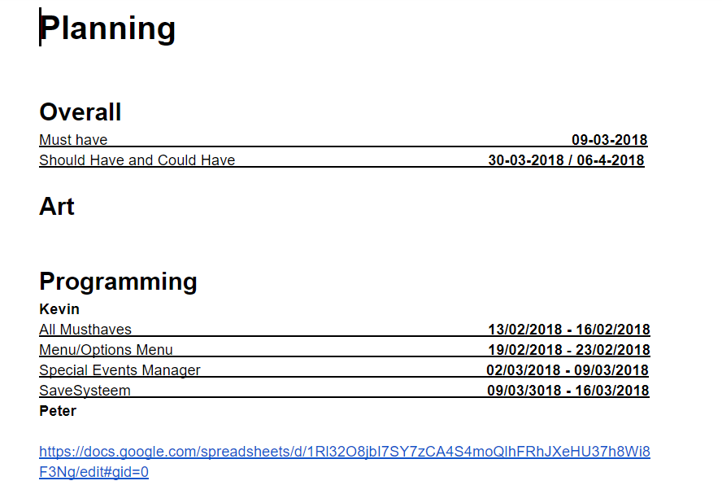
Game Design Document
- https://docs.google.com/document/d/1hf-na7bdCFSeHHdtGF03CiWVjSxiEsswhKHYJB8Af14/edit?ts=5a79b809

Slide 4
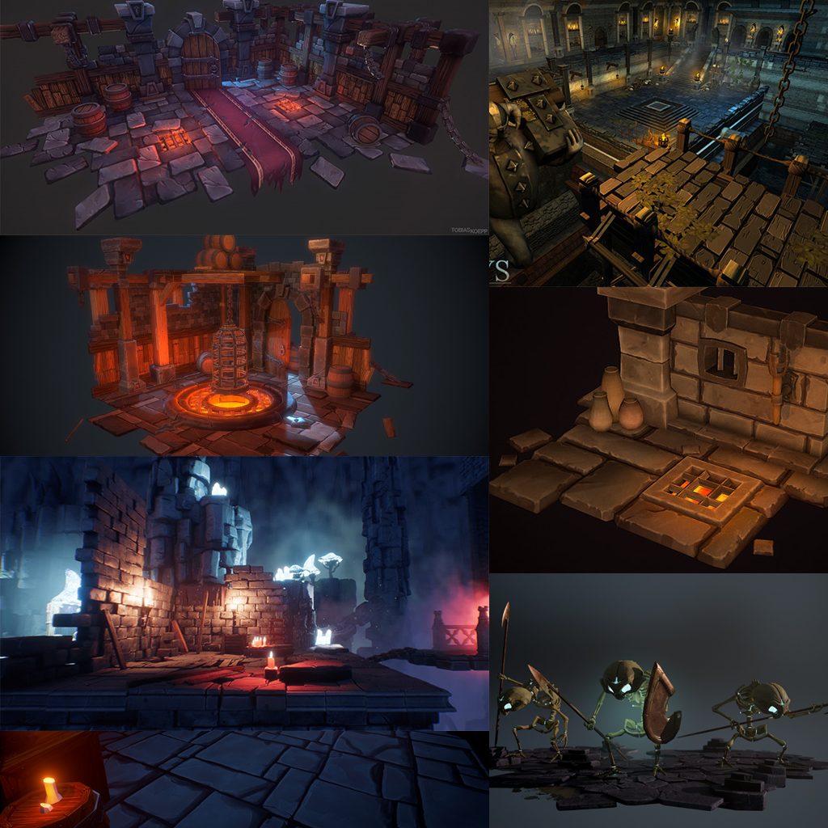
Art
Mood
Style
Lettertype
Character
Envirment
GUI

Slide 5
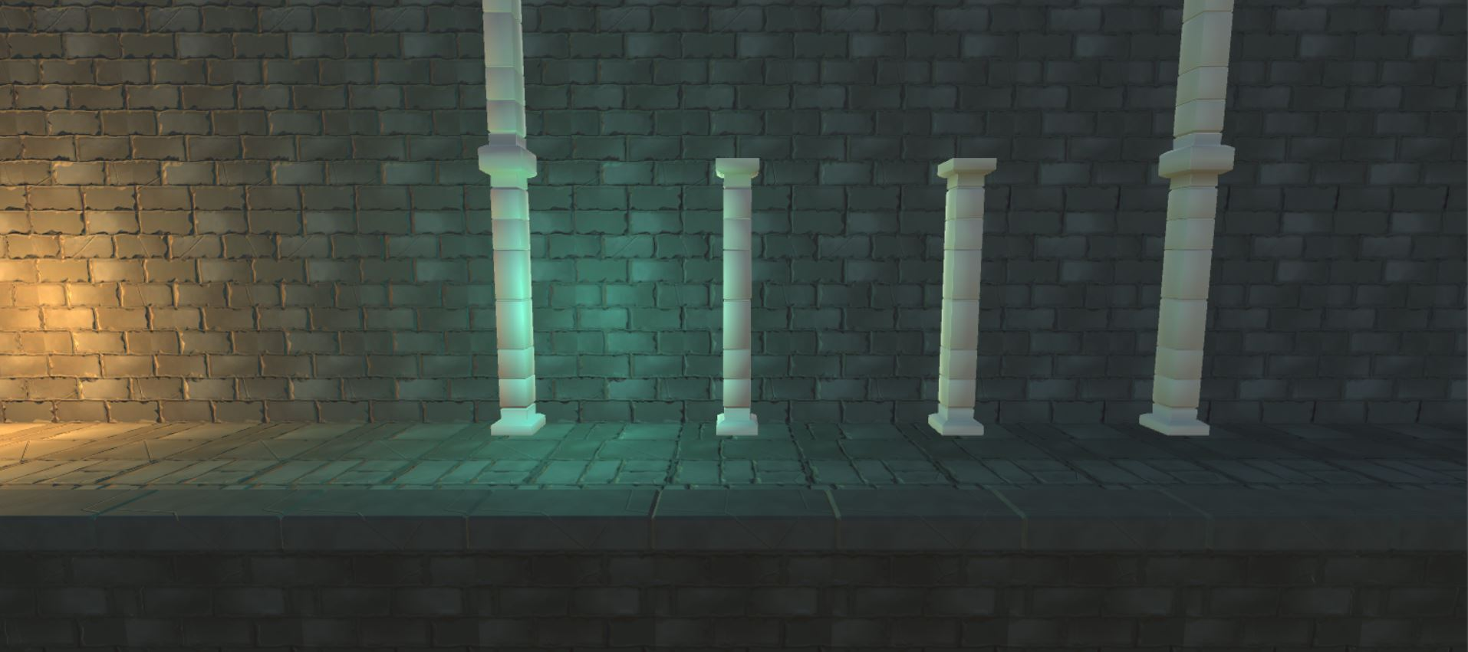
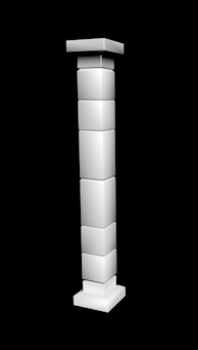
Current Graphics
Art
Level Design
Camera View

Slide 6
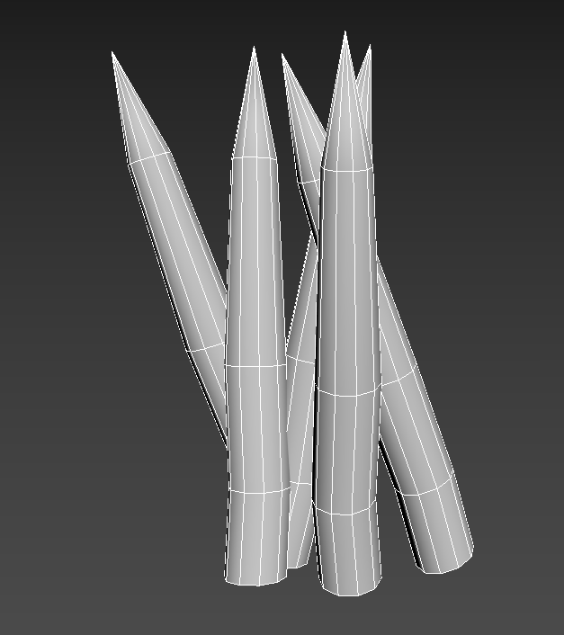
Technical
Camera
Controls
Traps
Player abilities
GUI

Slide 7
The end
Demo gameplay

