Slide 1


Development of a simulative environment for a teleoperation task using an Haptic Device
Faculty of Information Engineering, Computer Science and Statistics
M.Sc. in Artificial Intelligence and Robotics
AA 2015-2016
Professors:
Marilena Vendittelli
Alessandro De Luca
Presenters:
Aloise Irvin, Colosi Mirco, Gigli Andrea

Slide 2
Outline
Goal
Introduction and Motivations
Devices: Geomagic Touch & Kuka LWR 4+
Coupling and clutching
Kuka Cartesian control
Teleoperation principles
Soft tissue model
The simulation software
Simulations and results
Conclusions

Slide 3
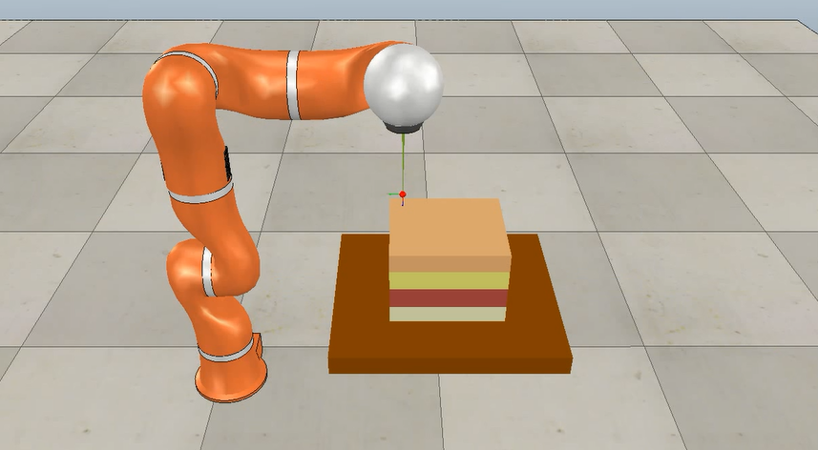
Goal
Realization of a simulative framework for:
Teleoperation task between real haptic device and virtual robot;
Needle insertion task;
Computation of haptic feedback.

Slide 4
Introduction and motivations
Teleoperation = remote control
Master in the local site, Slave in the remote site
Motivation: command robot in far, dangerous, small/big environments
Requirements: quality of technologies, communication channels, teleoperation schemes
Telesurgery improves surgeon’s technical abilities (precision, dexterity, safety)
Needle insertion: definition and applications
Simulated needle insertion: cheap and safe
Simulation requires needle-tissue model of interaction

Slide 5
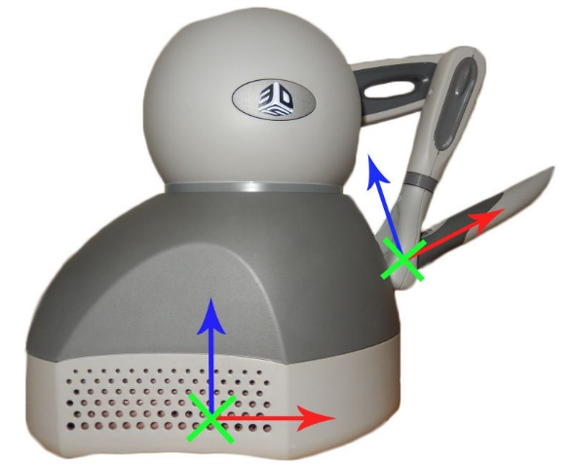
Devices: Geomagic Touch
Geomagic Touch by 3D Systems (previously Phantom Omni by SensAble Technologies)
6 joints: first 3 actuated, others 3 passive spherical wrist
Small dimensions, limited workspace 160 w x 120 h x 70 d mm
Maximum exertable linear force = 3.3N
2 buttons
Ethernet connectivity
Compatible with OpenHaptics Toolkit (3D Systems) and CHAI3D libraries.

Slide 6
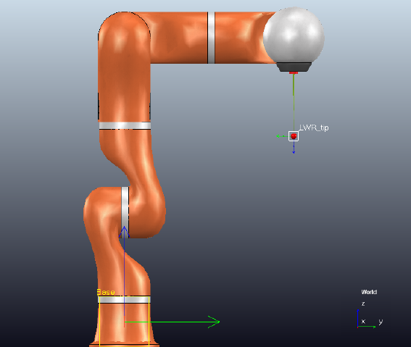
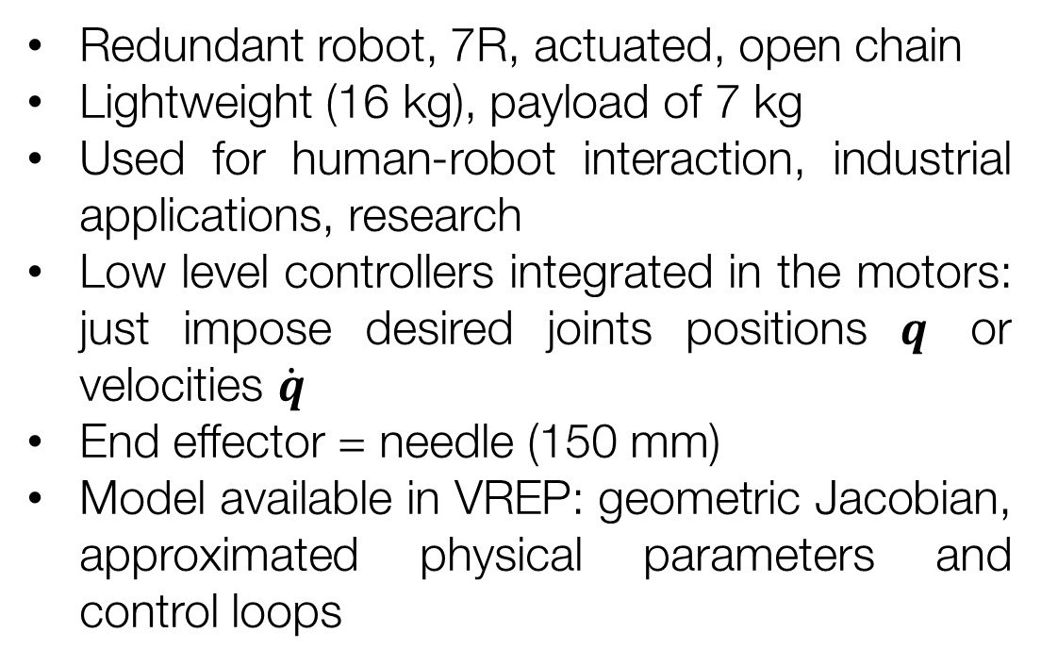
Devices: Kuka Lwr 4+ (aka kuka lbr 4+)
Redundant robot, 7R, actuated, open chain
Lightweight (16 kg), payload of 7 kg
Used for human-robot interaction, industrial applications, research
Low level controllers integrated in the motors: just impose desired joints positions $q$ or velocities $\dot{q}$
End effector = needle (150 mm)
Model available in VREP: geometric Jacobian, approximated physical parameters and control loops

