Slide 1


Development of a simulative environment for a teleoperation task using an Haptic Device
Faculty of Information Engineering, Computer Science and Statistics
M.Sc. in Artificial Intelligence and Robotics
AA 2015-2016
Professor:
Marilena Vendittelli
Alessandro De Luca
Presenter:
Aloise Irvin, Colosi Mirco, Gigli Andrea

Slide 2
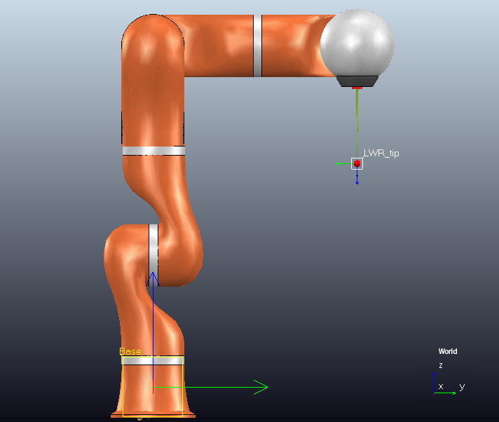
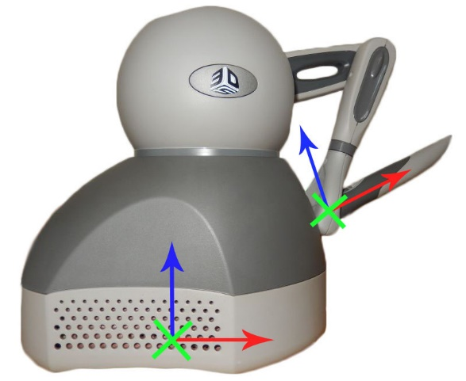
Master-slave frame mismatch
The frames of Geomagic Touch’s end effector and KUKA’s tool-tip do not coincide, so to guarantee coherent movements of the slave it is necessary to align them.
Fixed Offset between the frames
The $x$- axis of Geomagic’s pencil has to coincide to the $z$- axis of the KUKA’s tool-tip. This fixed rotational offset must always be added to have a intuitive teleoperation.

Slide 3
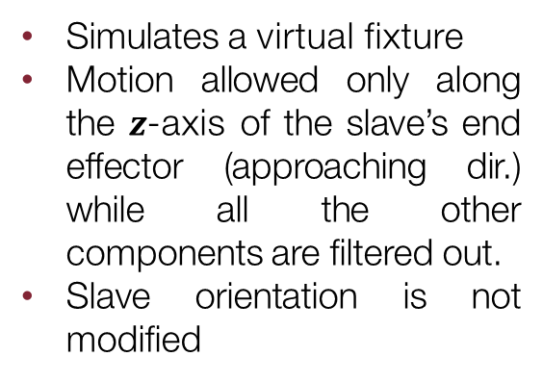
Workspace extension (1)
The first thing to underline is that master and slave do not have the same workspaces. A clutching mechanism is required to extend Geomagic limited workspace. This is done using the 3 buttons on the device.
Button 1
Button 2
Button 3
Fully releases the clutch between master and slave
Slave position is modified
Slave orientation is modified
Partially releases the clutch between master and slave
Slave position is not modified
Slave orientation is modified
Simulates a virtual fixture
Motion allowed only along the $z$-axis of the slave’s end effector (approaching dir.) while all the other components are filtered out.
Slave orientation is not modified

Slide 4
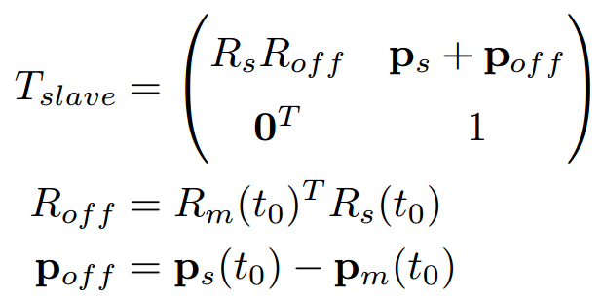
Workspace extension (2)
The software has to evaluate the offset between the current pose of slave’s end effector and the current master pose every time the user switches button.
In this way it is possible to command correctly and in a more intuitive way the slave through the haptic device. Slave position is not modified
If no button is pressed the slave will not move, allowing the user to rearrange the master pose to be more comfortable for the task, or to achieve distant points inside the slave’s workspace.

Slide 5
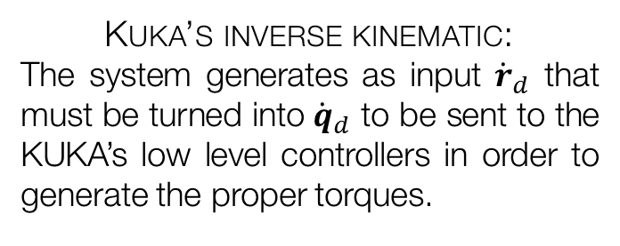
Teleoperation task
The aim of the project is use the Geomagic Touch (master) to simulate the teleoperation of a KUKA LWR 4+ (slave).
At each time-step, given the right desired pose ${(p_{d} φ_{d})}^{T}$, the robot has to converge to it and a force feedback must be returned through the haptic device. Two main problems to be solved:
Kuka’s inverse kinematic:
The system generates as input ${\dot{r}}_{d}$ that must be turned into ${\dot{q}}_{d}$ to be sent to the KUKA’s low level controllers in order to generate the proper torques.
Teleoperation schemes:
Three possible schemes have been developed in order to verify which one is more suited to a needle insertion task.
The system has been used to perform a needle insertion task, perforating a synthetic tissue modelled in the scene.

Slide 6
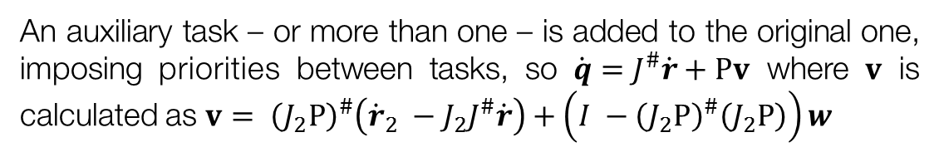
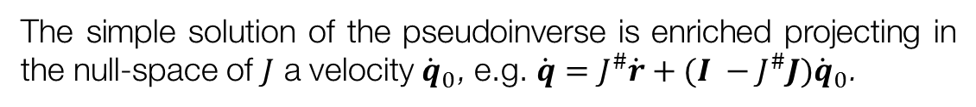
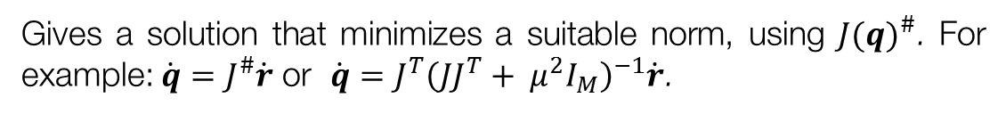
Kuka lwr 4+ inverse kinematics (1)
Inverse kinematics of a redundant manipulator can be solved using different approaches.
Starting from $\dot{r}=J(q)\dot{q}$
Jacobian-based Methods
Gives a solution that minimizes a suitable norm, using ${J(q)}^{\#}$. For example: $\dot{q}=J^{\#}\dot{r}$ or $\dot{q}=J^{T}{\left(JJ^{T}+ μ^{2}I_{M}\right)}^{−1}\dot{r}$.
Null-space Methods
The simple solution of the pseudoinverse is enriched projecting in the null-space of $J$ a velocity ${\dot{q}}_{0}$, e.g. $\dot{q}=J^{\#}\dot{r}+(I −J^{\#}J){\dot{q}}_{0}$.
An auxiliary task – or more than one – is added to the original one, imposing priorities between tasks, so $\dot{q}=J^{\#}\dot{r}+Pv$ where $v$ is calculated as $v= {\left(J_{2}P\right)}^{\#}\left({\dot{r}}_{2} −J_{2}J^{\#}\dot{r}\right)+\left(I −{\left(J_{2}P\right)}^{\#}\left(J_{2}P\right)\right)w$
Task augmentation Methods
In the system in analysis has been used a null-space based method to evaluate the right $\dot{q}$ that we provide as inputs of the KUKA low-level controllers.

Slide 7


Kuka lwr 4+ inverse kinematics (2)
In order to achieve smooth movements of the slave robot, it has been decided to discard the default VREP’s IK group and to implement the following custom null-space-based IK.
$$\dot{q}=J^{\#}{\dot{r}}_{d}+(I −J^{\#}J){\dot{q}}_{0}$$
$${\dot{q}}_{0}= q_{start} −q$$
${\dot{r}}_{d}= \left({v_{d} \atop ω_{d}}\right)+ K_{p}e_{cartesian}=\left({v_{d} \atop ω_{d}}\right)+ K_{p}\left({p_{d}−p \atop T_{xyz}\left(φ\right)[φ_{d}− φ]}\right)$
Where $v_{d}$ and $ω_{d}$ are the references, while the term $e_{cartesian}$ is necessary to force the convergence of KUKA’s end-effector to the desired pose.

Slide 8
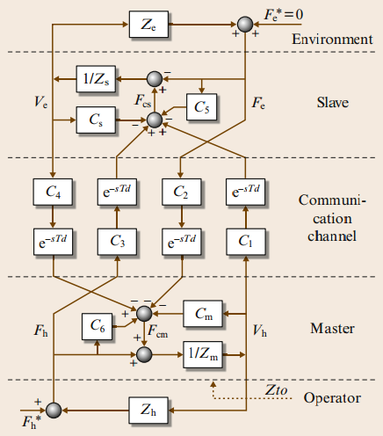




Teleoperation schemes (1)
Once that the system is able to generate desired pose references and that the slave is able to converge to them, a force feedback must be returned to the haptic device.
User
Master Velocities
$$F_{MC}$$
$$v_{m}/p_{m}$$
Teleoperation
Scheme
Inverse Kinematics
Environ.
$$F_{ext}$$
$$v_{s}/p_{s}$$
Slave Motion
Slave Velocity
Slave Torques

Slide 9

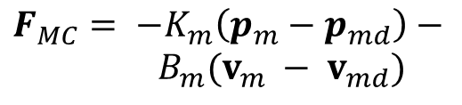
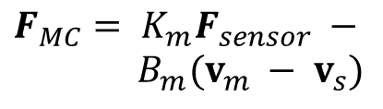
Teleoperation schemes (2)
The system developed allow the user to choose between 3 teleoperation schemes:
Position – Force/Position
Position - Position
Position - Force
Very popular among the schemes.
It allows to feel the robot while moving and the external forces.
Simple and stable method: master and slave try to track each other.
User feels only the friction and inertia in the slave robot.
Gives a more clear sense of the environment.
The user feels only the external forces that act on the slave robot.
$$F_{MC}= K_{m}F_{sensor} −$$
$B_{m}(v_{m} − v_{s})$
$$F_{MC}= {−K}_{m}\left(p_{m}−p_{md}\right)−$$
$B_{m}(v_{m} − v_{md})$
$$F_{MC}= K_{m}F_{sensor}$$

Slide 10
Teleoperation: filtering velocities
CHAI3D synchronizes Geomagic’s HL and VREP simulation loop, but velocity measures remain noisy: filtering is needed in order to generate smooth force feedbacks.
A low pass filter has been developed and used to filter the velocity measures used in the calculation of $F_{MC}$.
Weighted Average of velocity buffer
Actual Low-Pass Filter

Slide 11
Synthetic tissue (1)
In order to perform the needle penetration it has been designed in VREP a model of a generic stratified biological tissue.
4 Layers stacked to compose the Tissue:
Skin
Fat
Muscle
Bone
Analytical model used to design the tissue response to penetration. Viscoelastic force generated during insertion; force generated by:
Springs
Dampers
Initially the layer deforms itself, due to its elasticity: the force exerted on the needle is described by a spring model.
Reached the maximum deformation, perforation happens: from now on, the force is only due to viscous friction.

Slide 12
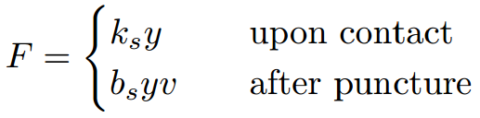
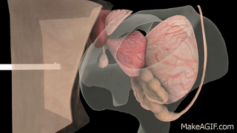
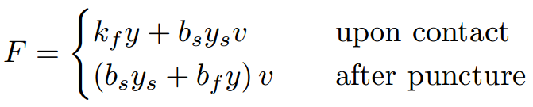
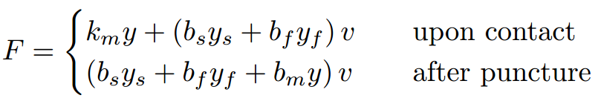
Synthetic tissue (2)
Each layer has different physical parameters to generate a more realistic effect during the execution of the task.
Skin
Fat
Muscle
Bone
Since VREP is not good in managing contacts between objects, it has been done an approximation to determine the fracture point: each layer will be perforated when a certain depth is reached – indicated through the parameter called perforation depth.

