Slide 1
AWS Getting Start
Introduction
雲端暨架構服務部

Slide 2
關於 AWS
In 2006, Amazon Web Services (AWS) began offering IT infrastructure services to businesses in the form of web services.
In 2011, AWS released over 80 significant services and features; in 2012, nearly 160; in 2013, 280, in 2014, 516, and in 2015, AWS launched 722.
Today, Amazon Web Services provides a highly reliable, scalable, low-cost infrastructure platform in the cloud that powers hundreds of thousands of businesses in 190 countries around the world.

Slide 3
AWS global infrastructure
AWS 雲端在全球 16 個 region 運作 42 個 Availability Zones ，且在公佈的計劃中將再增加八個 Availability Zones 和 Regions。
Availability Zones ?
Regions ?
Edge Locations ?

Slide 4
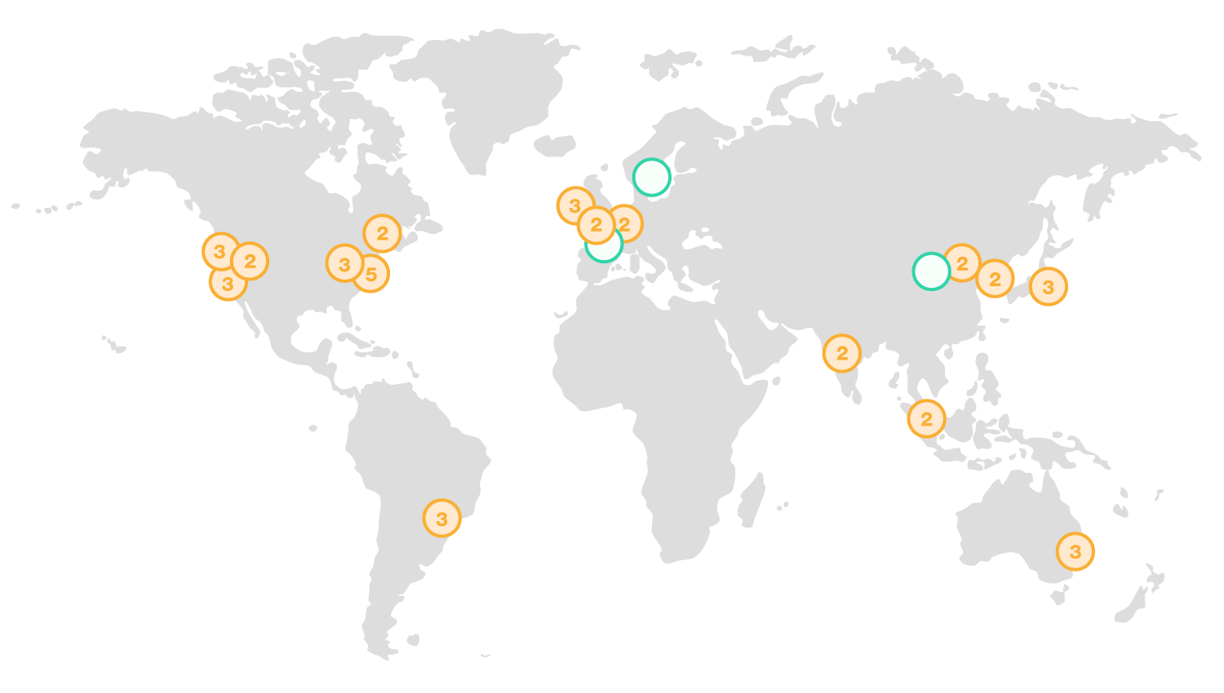
AWS global infrastructure

Slide 5
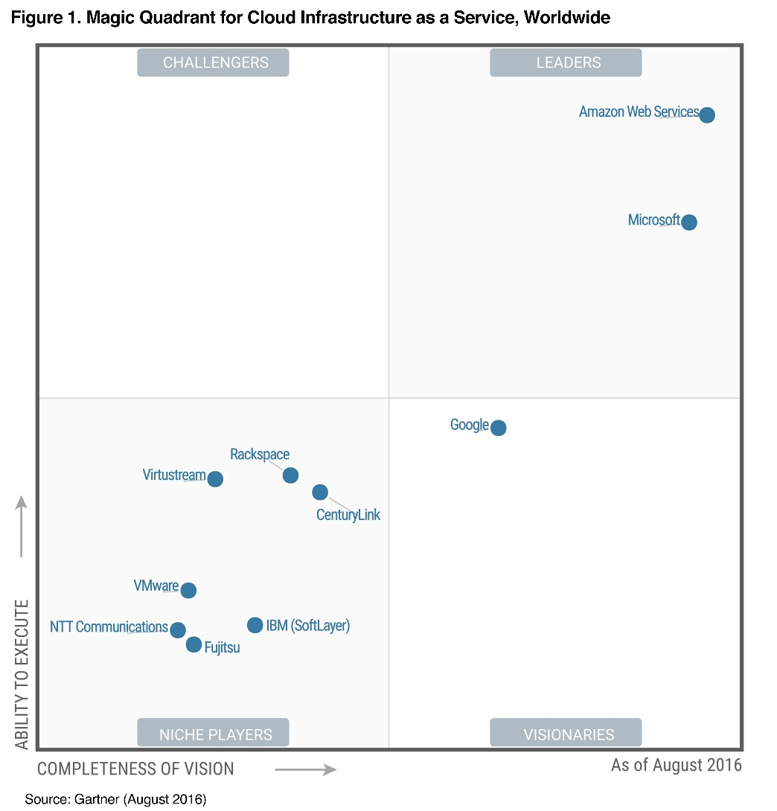
Why we choose AWS

Slide 6
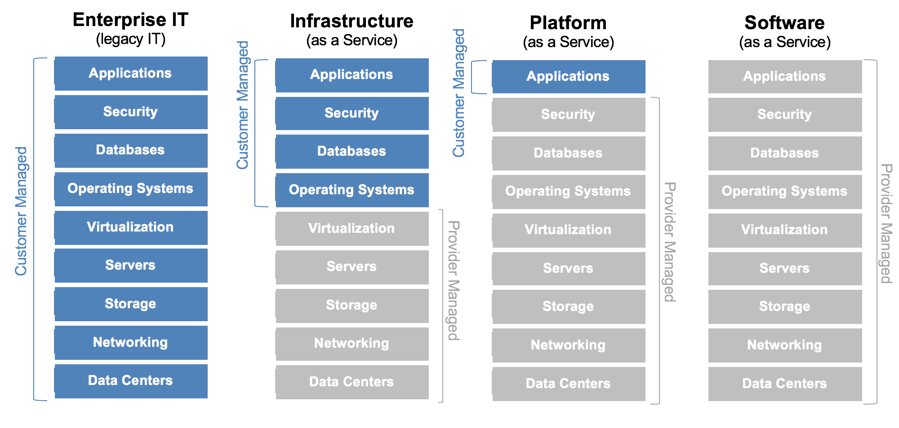
Iaas & Paas & Saas

Slide 7
Cloud Computing
Cloud Computing 利用網際網路搭配按用量付費定價，透過雲端服務平台隨需交付運算能力、資料庫儲存、應用程式及其他 IT 資源。

Slide 8
Business Benefits of Cloud
Almost zero upfront infrastructure investment
Just-in-time Infrastructure
More efficient resource utilization
Usage-based costing
Reduced time to market

Slide 9
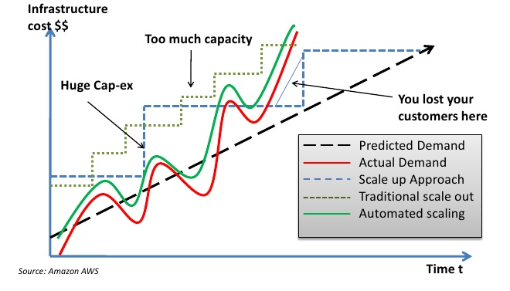
Traditional VS. Cloud Scaling

Slide 10
Technical Benefits of Cloud
Automation - "Scriptable infrastructure“
Auto-scaling
Proactive Scaling
More Efficient Development lifecycle
Improved Testability
Disaster Recovery and Business Continuity
"Overflow" the traffic to the cloud

Slide 11
Products overview

Slide 12
What is free tier
The AWS Free Tier includes services with a free tier available for 12 months following your AWS sign-up date, as well as additional service offers that do not automatically expire at the end of your 12 month AWS Free Tier term.
https://aws.amazon.com/free/

Slide 13
Create AWS account
Create AWS root account
Create IAM user

Slide 14
Security credentials
Account/Password/MFA
Access key ID/Secret access key
Key Pair

Slide 15
Q & A
Introduction
雲端暨架構服務部

