Slide 1
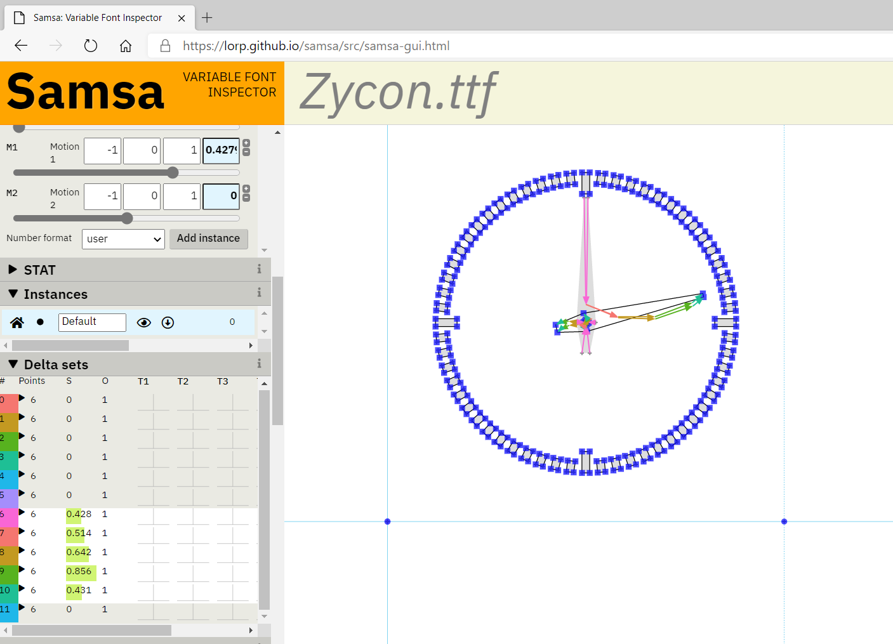
Combined deltas from multiple delta sets
Scalars for intermediate delta sets

Slide 2
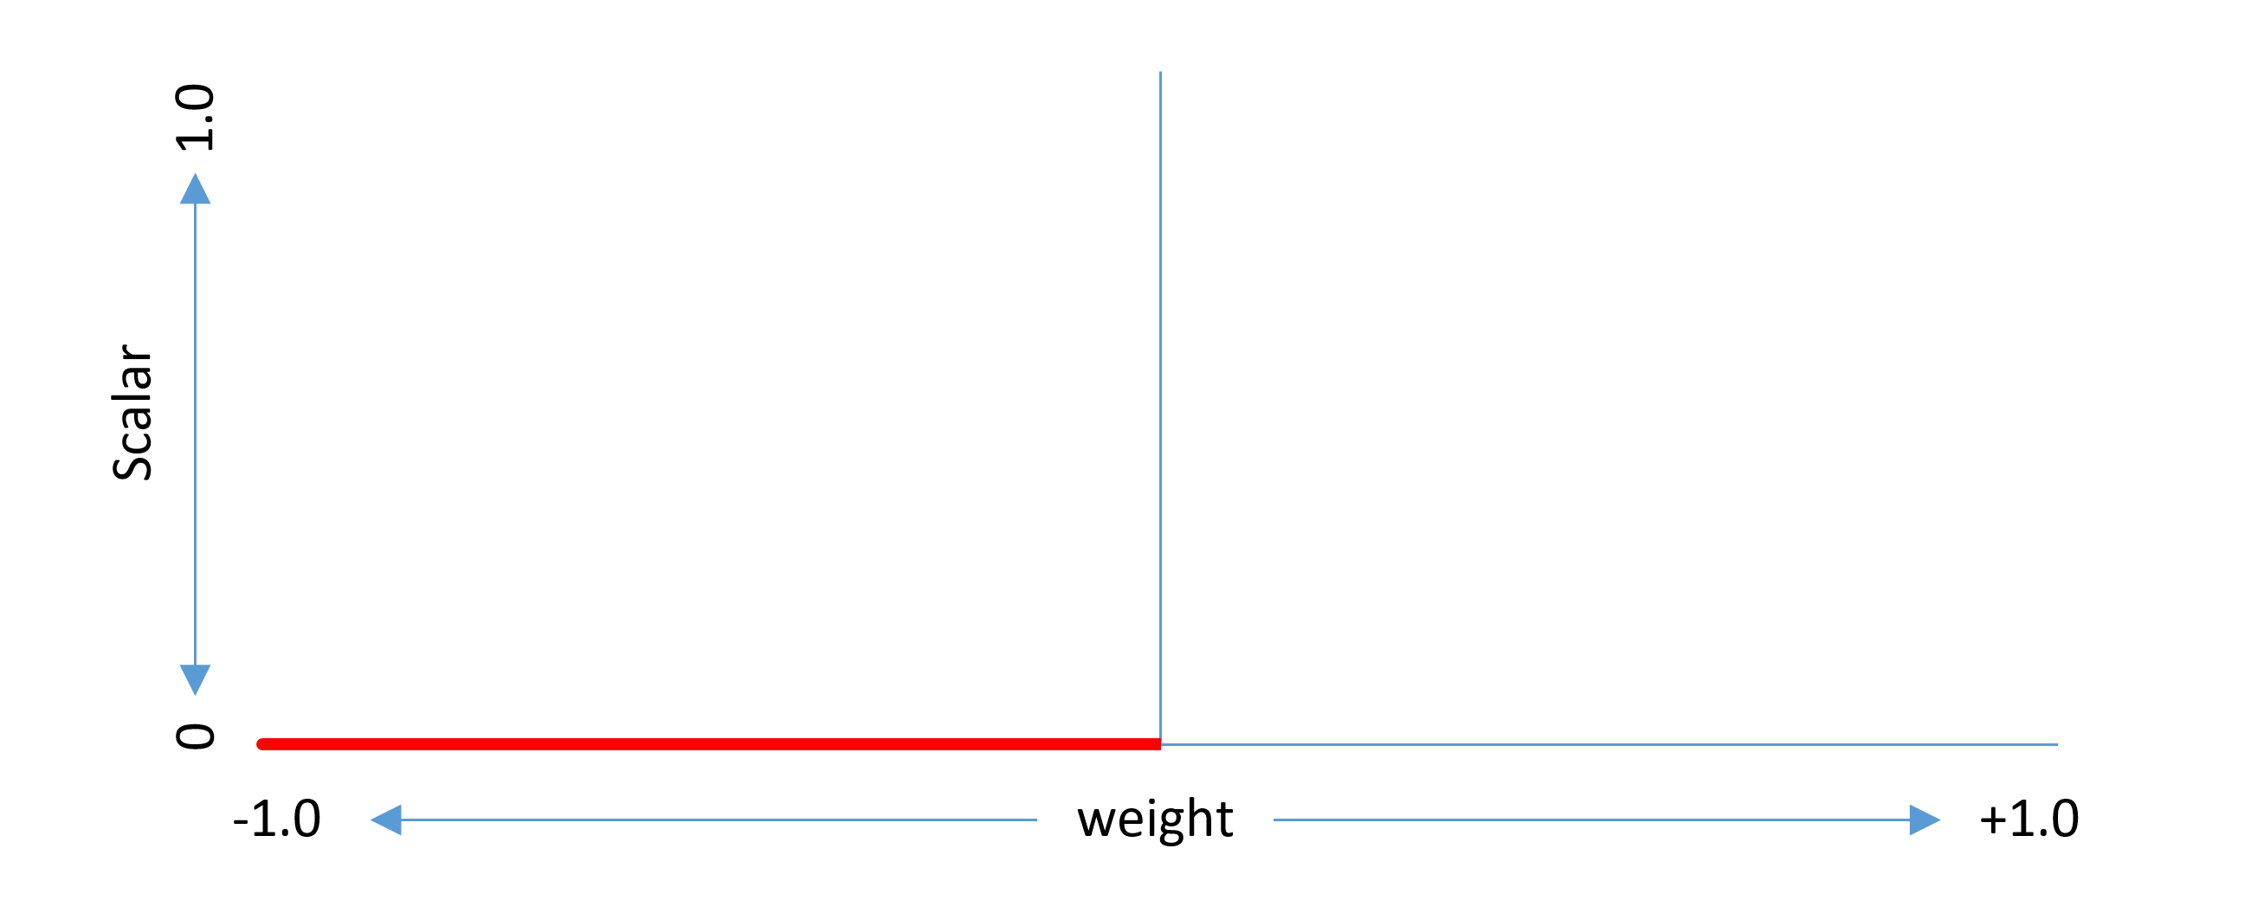

Slide 3
p_{max}
δ
δ′
y = x²
p_{default}

Slide 4
p_{max}
δ
δ₃ — region (1,1)
p_{default}
δ₁ — region (1,0)

Slide 5
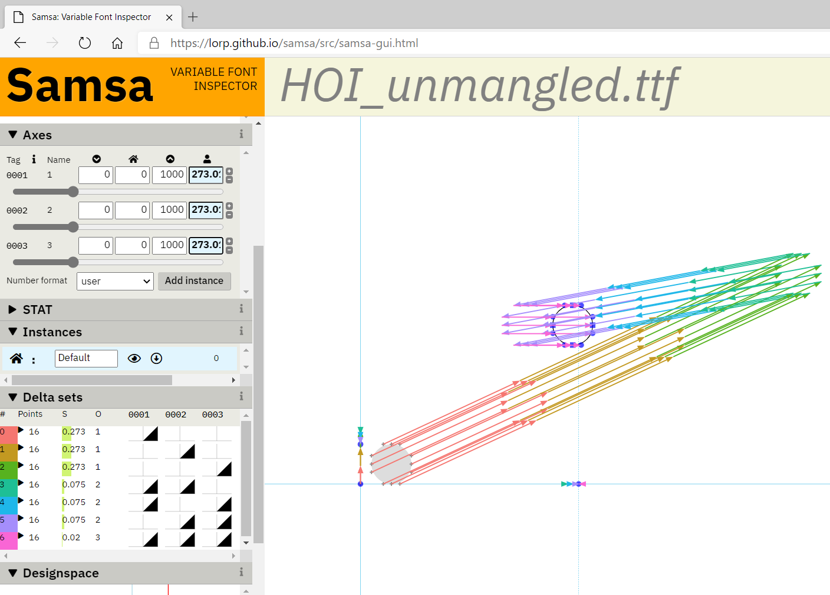
Separate deltas, always in equal
proportions: could be combined
Axis scalars for same order terms
always have the same value

