Slide 1



🥳
👩‍🏫
🛎

Slide 2
Layer 1
Layer 0 (bottom)
Layer 2 (top)

Slide 3

Extended with starting color
Defined interval
Extended with ending color

Slide 4
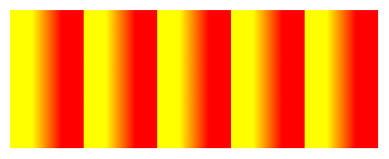
Repeated intervals
Defined interval
Repeated intervals

Slide 5
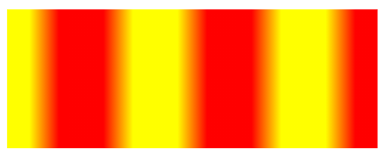
Repeated intervals
Defined interval
Repeated intervals

Slide 6

Pad with starting color
Defined interval
Pad with ending color

Slide 7
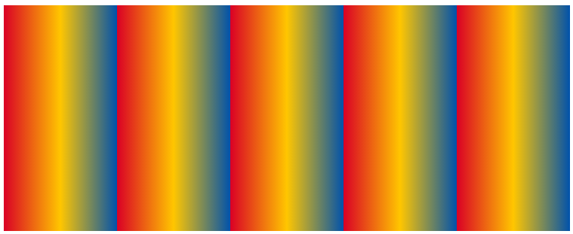
Repeated intervals
Defined interval
Repeated intervals

Slide 8
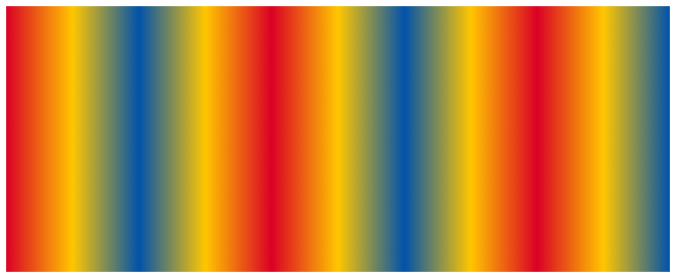
Reflected intervals
Defined interval
Reflected intervals

Slide 9
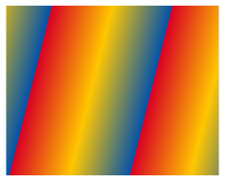
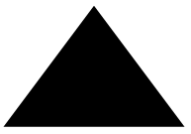
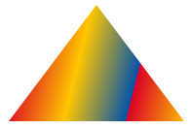
PaintGlyph
PaintLinearGradient
glyphID: 270
Color glyph data:
Color glyph presentation:

Slide 10


PaintGlyph
PaintGlyph
PaintLinearGradient
glyphID: 258
glyphID: 270
Color glyph data:
Color glyph presentation:

Slide 11

PaintTransformed
PaintGlyph
PaintLinearGradient
Transformation: rotate 30°
glyphID: 270
Color glyph data:
Color glyph presentation:
Screenshot @130 % / display @125%

Slide 12

PaintTransformed
PaintGlyph
PaintTransform
PaintLinearGradient
Transformation: rotate 30°
glyphID: 270
Transformation: mirror in y-axis
Color glyph data:
Color glyph presentation:
Screenshot @130 % / display @125%

Slide 13


PaintGlyph @ 0x0f980a
PaintSolid @ 0x0fa14
glyphID: 308
Color glyph data:
Component presentation:

Slide 14

PaintRotate
PaintGlyph @ 0x0f980a
PaintSolid
glyphID: 308
Color glyph data:
Transformation: rotate -30°
Color glyph presentation:

Slide 15

PaintRotate
PaintGlyph @ 0x0f980a
PaintSolid
glyphID: 308
Color glyph data:
Transformation: rotate -60°
Color glyph presentation:

Slide 16
BaseGlyphRecords
LayerRecords array
Color glyphs
glyphID:713
🥳
glyphID:527
👩‍🏫
⋮
🛎
glyphID:486
2
glyphID, paletteIndex
1
glyphID, paletteIndex
0
glyphID, paletteIndex
Screenshot @130 % / display @125%

Slide 17
Paint table
LayerV1List table
paintOffsets array
Paint table
PaintColrLayers
Offset: 0x16A0
Root of paint sub-graph
numLayers, firstLayerIndex
Offset: 0x148E
Offset: 0x13EA
Offset: 0x0C9E
Offset: 0x0C9E
Paint table
PaintColrLayers
Root of paint sub-graph
numLayers, firstLayerIndex
PaintColrLayers
⋮
Paint table
numLayers, firstLayerIndex
2
Offset: 0x04B2
Root of paint sub-graph
1
Offset: 0x03D6
0
Offset: 0x03A0
Screenshot @130 % / display @125%

Slide 18





LayerV1List table
paintOffsets array
PaintGlyph
PaintSolid
glyphID: 1653
BaseGlyphV1Record
PaintColrLayers
alpha: 0.2
glyphID: 253 paintOffset
numLayers, firstLayerIndex
Offset: 0x148E
Offset: 0x13EA
PaintGlyph
PaintRadialGradient
glyphID: 1654
Screenshot @130 % / display @125%

Slide 19
PaintGlyph
PaintLinearGradient
BaseGlyphV1Record
glyphID: 270
glyphID: 1198 paintOffset
Screenshot @130 % / display @125%

Slide 20




PaintGlyph
PaintSolid
LayerV1List table
PaintComposite
glyphID: 1182
paintOffsets array
sourcePaintOffset
backdropPaintOffset
⋮
Mode: source out
PaintGlyph
PaintSolid
Offset: 0x2116
glyphID: 573
Offset: 0x20CA
⋮
PaintGlyph
PaintSolid
glyphID: 573
Screenshot @130 % / display @125%

Slide 22
Paint @ 0x0f814
Root of color glyph for U+1F55B
Paint @ 0x0f846
PaintRotate @ 0x0f950
PaintGlyph @ 0x0f980
PaintSolid @ 0x0fa14
Root of color glyph for U+1F550
glyphID: 308
Transformation: rotate -30°
Paint @ 0x0f872
PaintRotate @ 0x0f968
Root of color glyph for U+1F551
Transformation: rotate -60°
Screenshot @130 % / display @125%

Slide 23
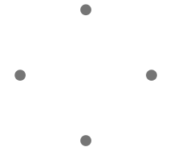

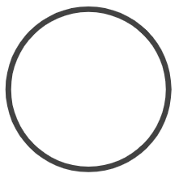

LayerV1List table
paintOffsets array
⋮
Offset: 0x18E0
Offset: 0x1926
Offset: 0x1954
Offset: 0x198A
⋮
Screenshot @130 % / display @125%

Slide 24

LayerV1List table
paintOffsets array
Offset: 0x18E0
Offset: 0x1926
Offset: 0x1954
Offset: 0x198A
U+1F550
PaintColrLayers
numLayers: 3 firstLayerIndex: 87
Offset: 0x26CC
Root of graph:
Offset: 0x26B8
PaintColrLayers
Offset: 0x26A2
numLayers: 4 firstLayerIndex: 251
Screenshot @130 % / display @125%

Slide 25
Root of graph:
LayerV1List table
paintOffsets array
BaseGlyphV1Record
PaintColrLayers
Offset: 0x18E0
glyphID: 63163 paintOffset
numLayers: 4 firstLayerIndex: 251
Offset: 0x1926
Offset: 0x1954
Offset: 0x198A
U+1F550
BaseGlyphV1Record
PaintColrLayers
glyphID: 3542 paintOffset
numLayers: 3 firstLayerIndex: 87
Offset: 0x26CC
Offset: 0x26B8
PaintColrGlyph
Offset: 0x26A2
glyphID: 63163
Screenshot @130 % / display @125%

Slide 26

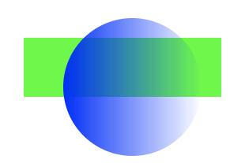
PaintLinearGradient
LayerV1List table
PaintComposite
alpha 1 to alpha 0
paintOffsets array
sourcePaintOffset
backdropPaintOffset
⋮
Mode: source in
PaintGlyph
PaintSolid
Offset: 0x23AA
glyphID: 573
Offset: 0x20CA
⋮
PaintGlyph
PaintSolid
glyphID: 573
Screenshot @130 % / display @125%

