Slide 1
Database
Peter

Slide 2
Account related Features
Sign up aka register
Sign in aka log in
Sign out
Reset password

Slide 3
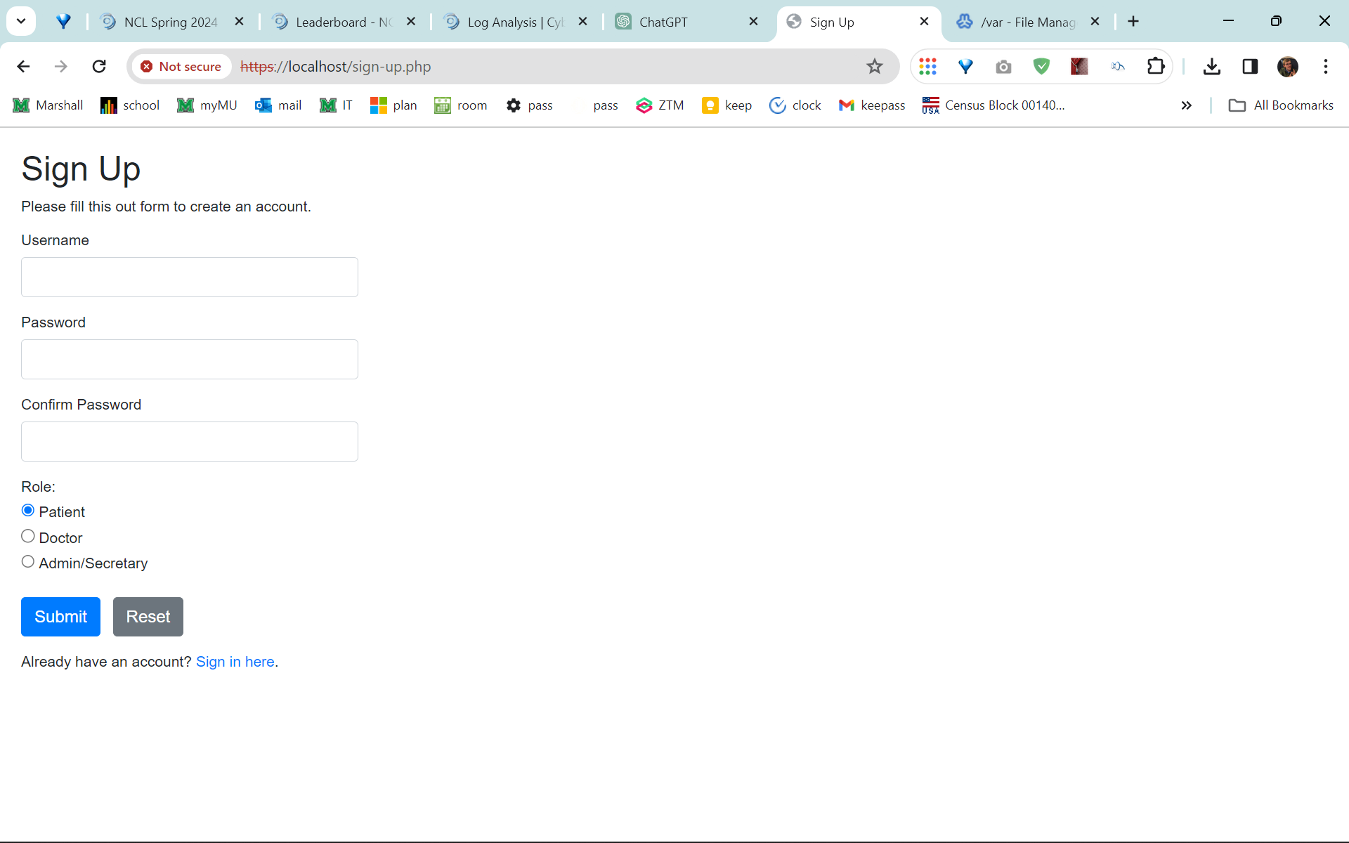
Sign up

Slide 4
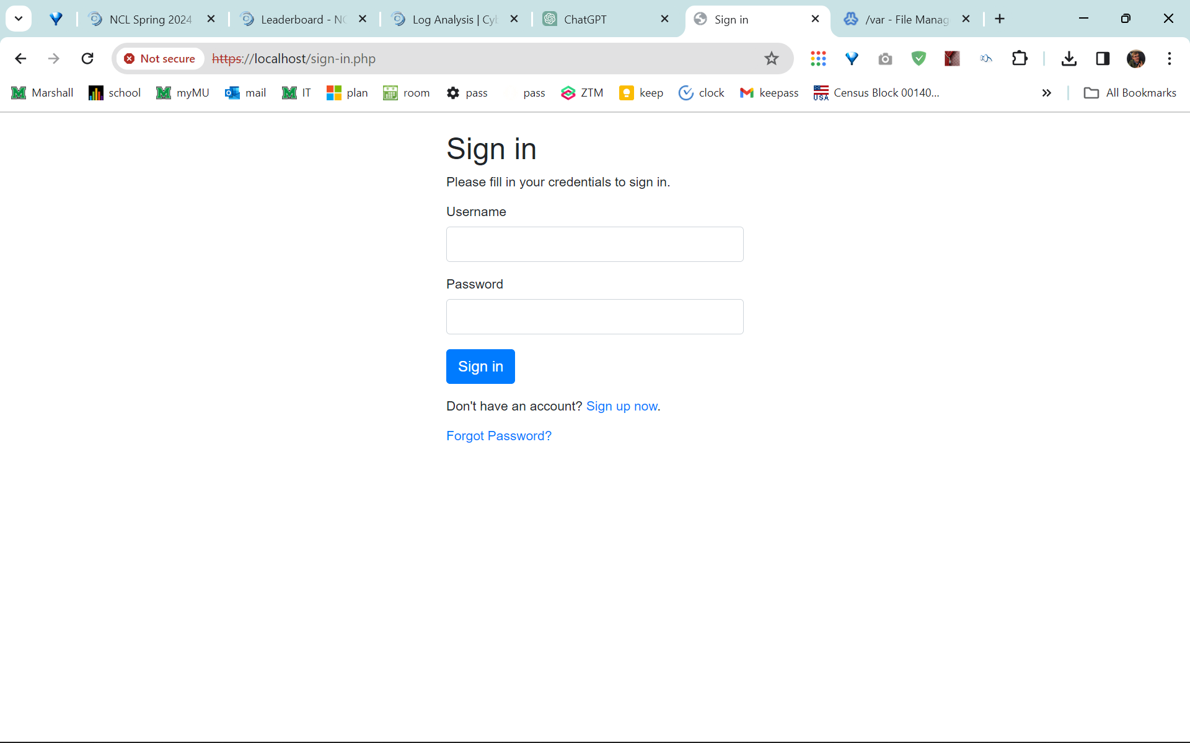
Sign in

