Slide 1
Database
Peter

Slide 2
Account related Features
Sign up aka register
Sign in aka log in
Sign out
Reset password

Slide 3
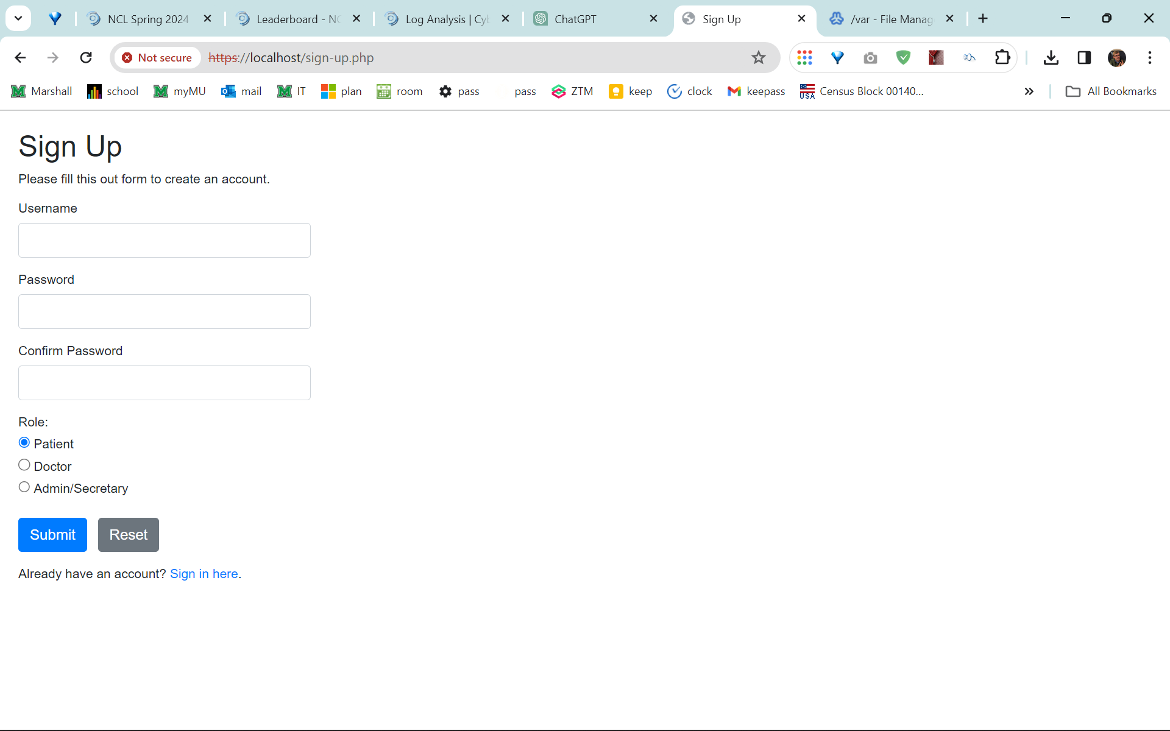
Sign up

Slide 4
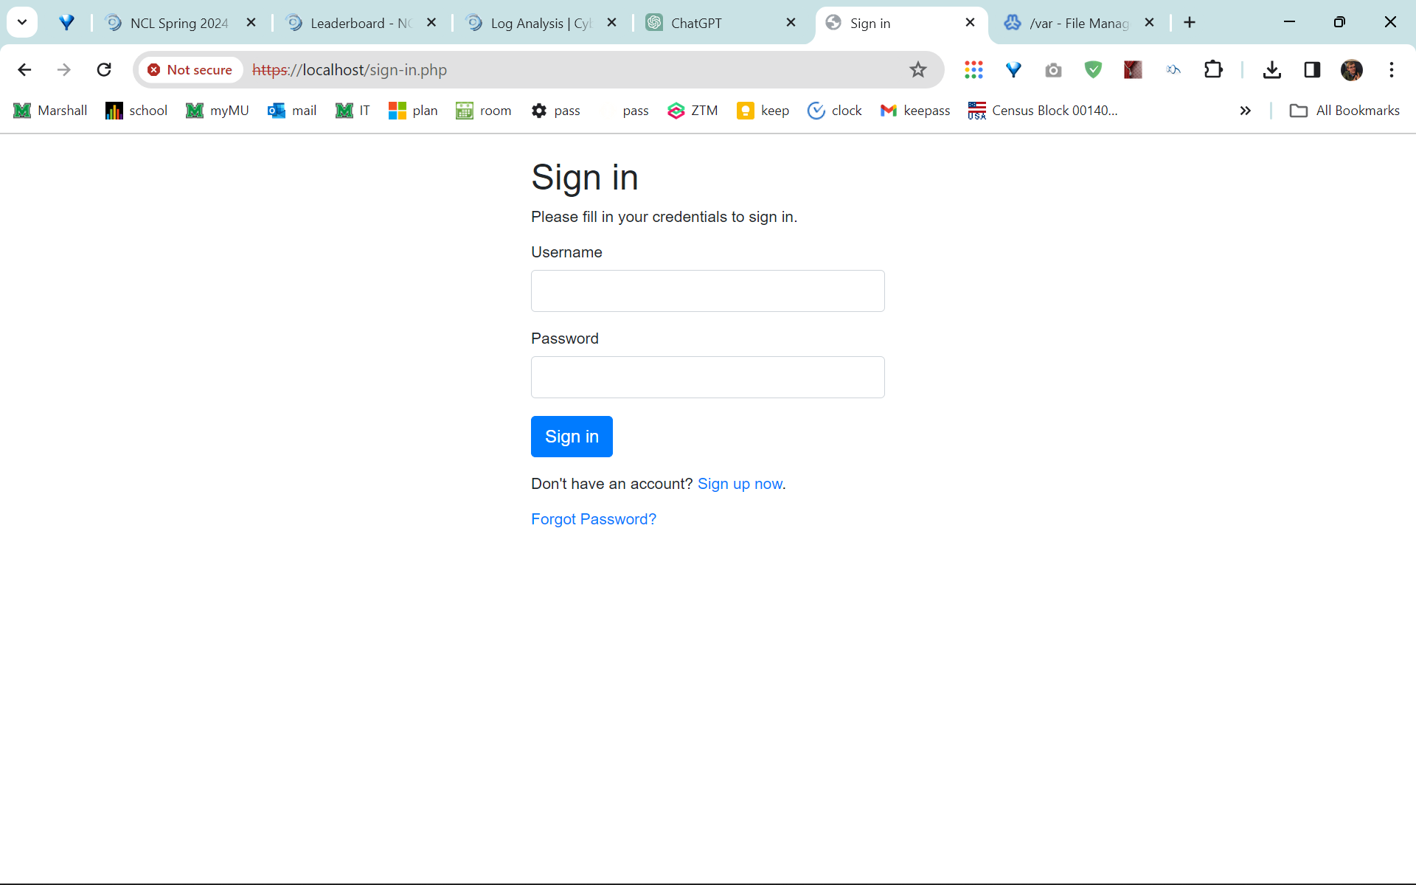
Sign in

Slide 5
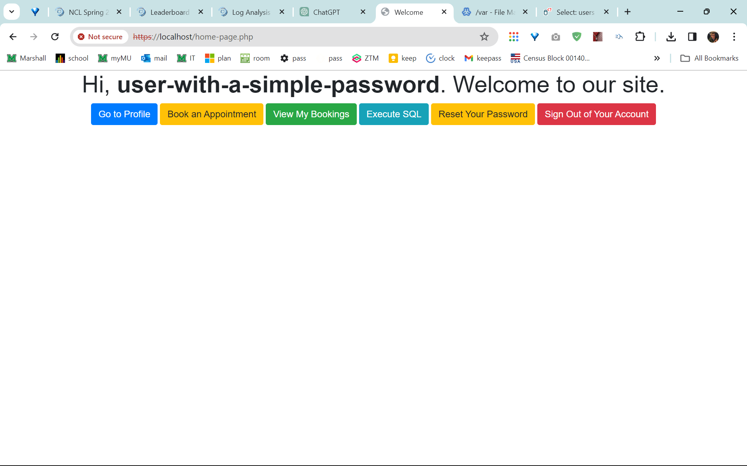
Home page

Slide 6
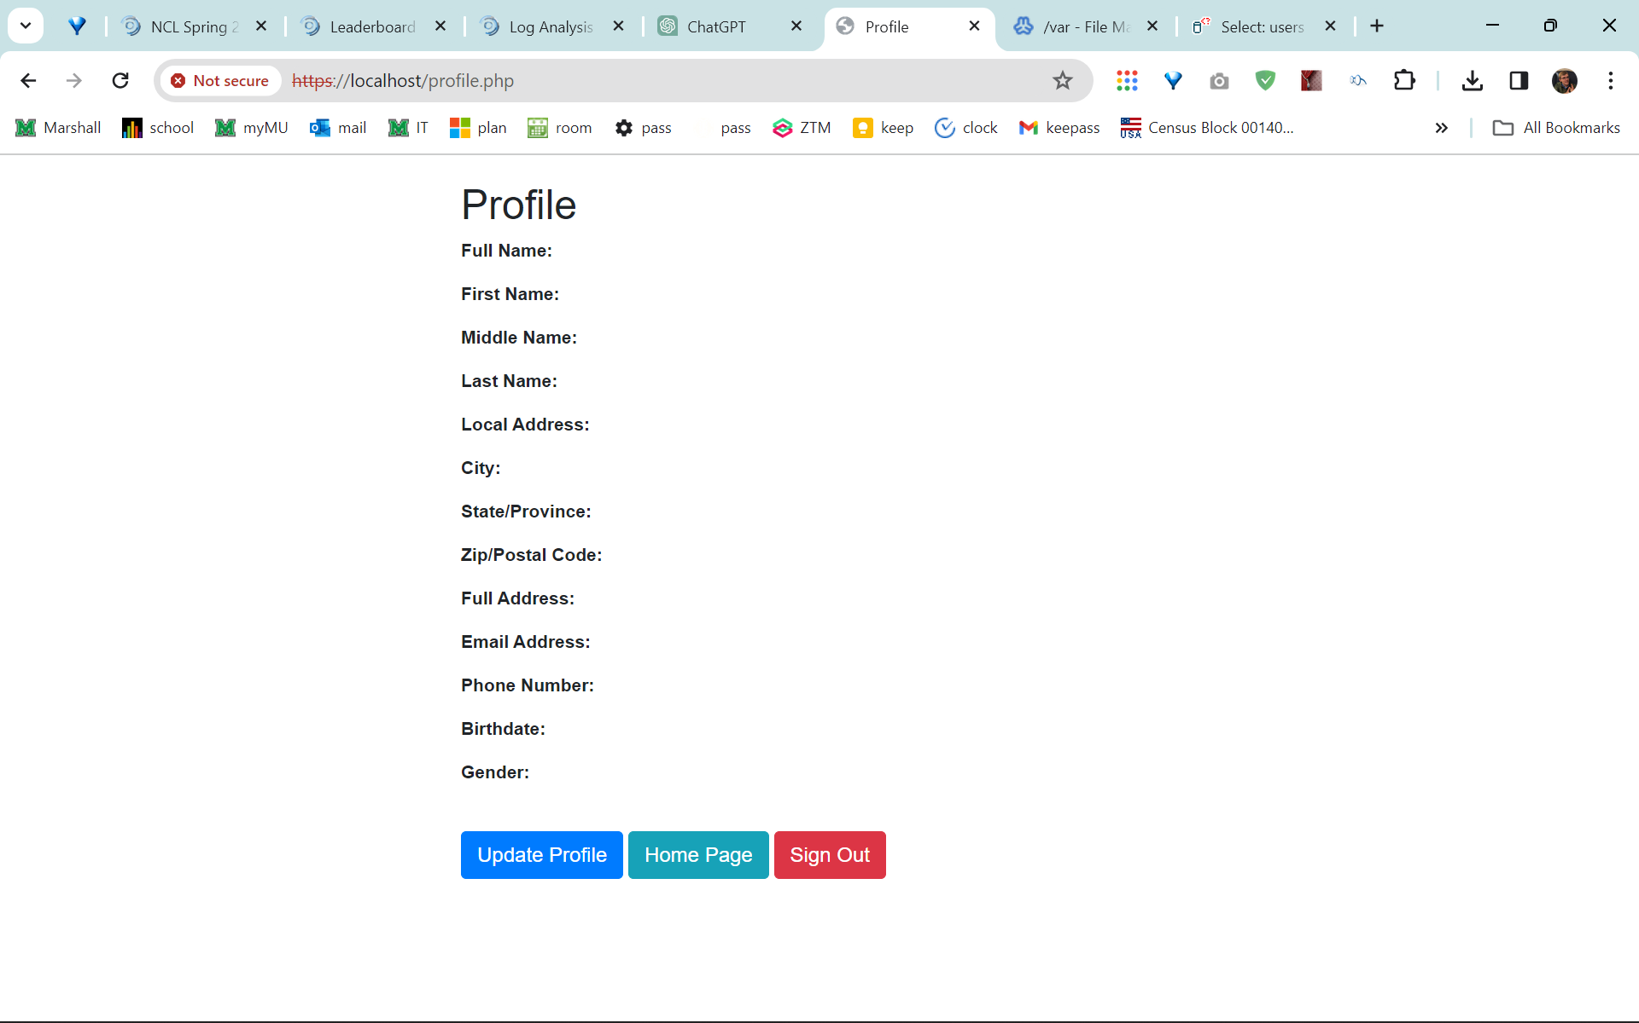
Profile page

Slide 7
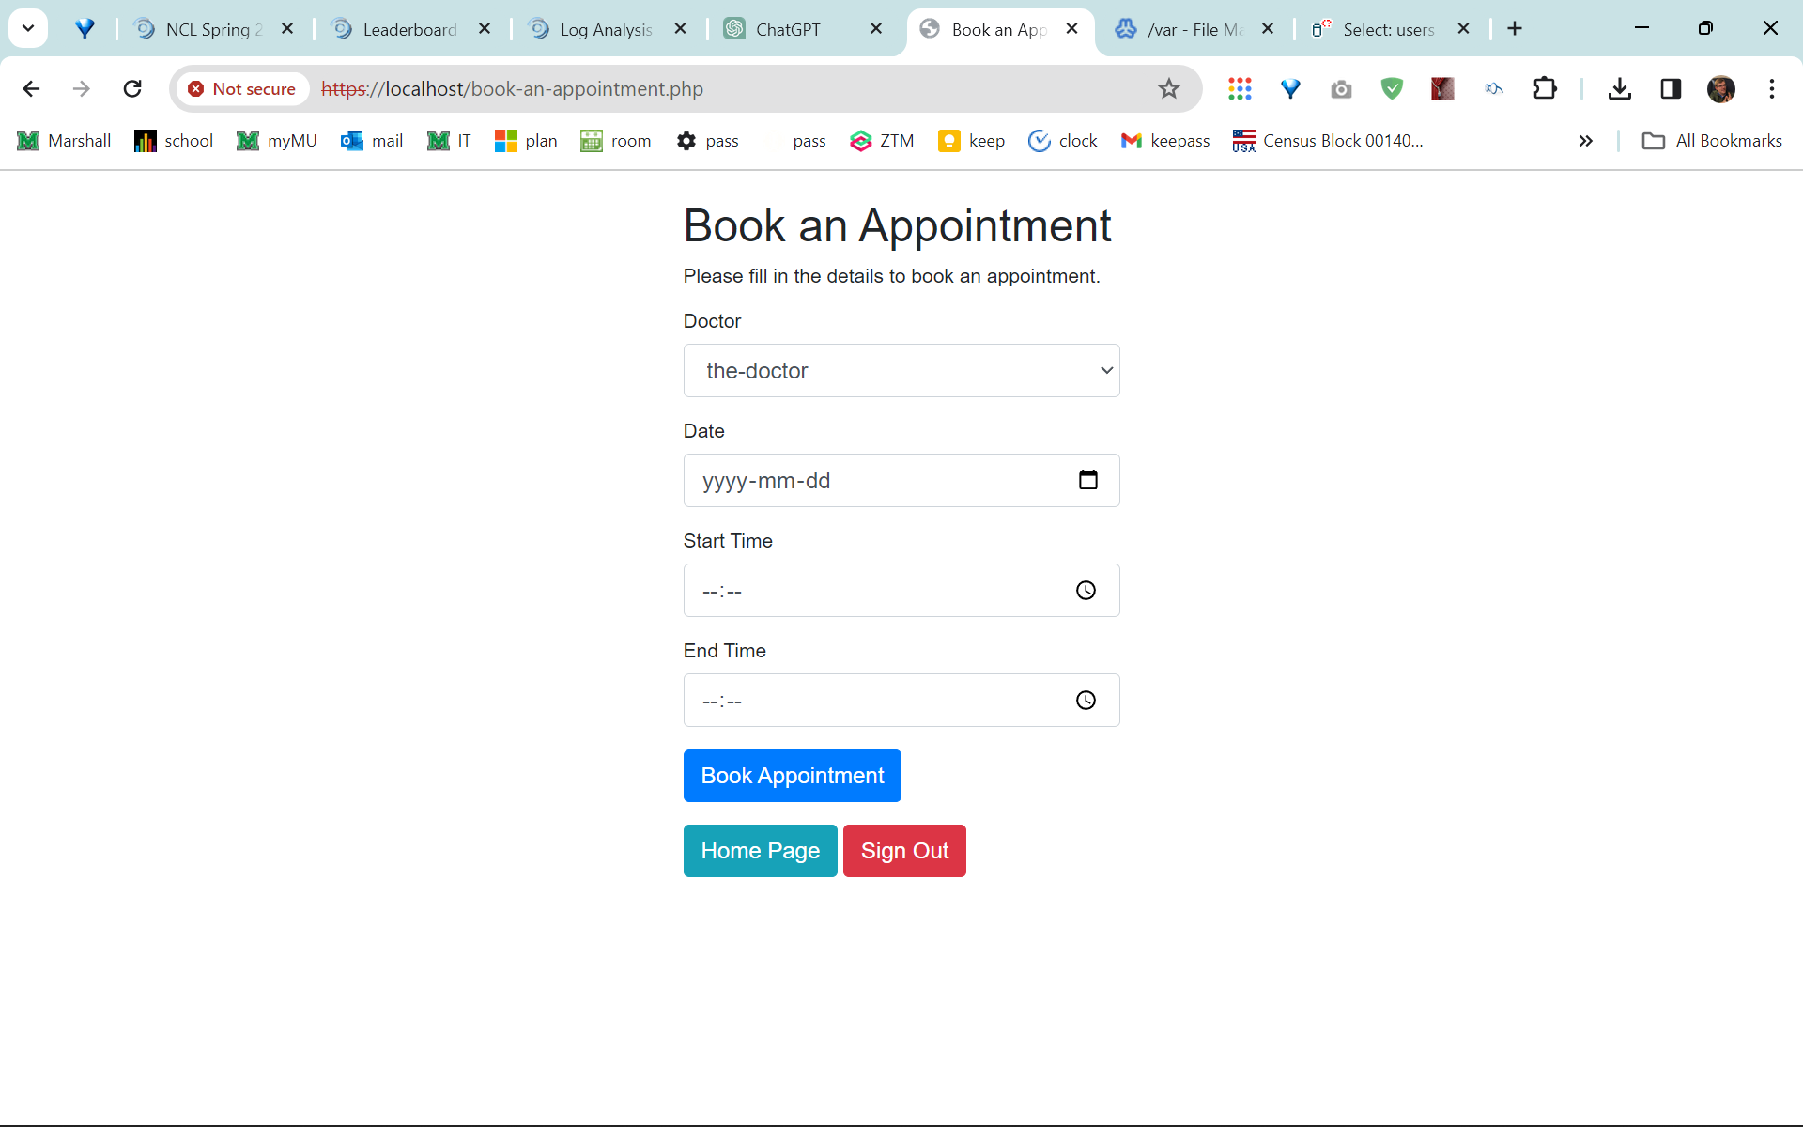
Book an appointment

Slide 8
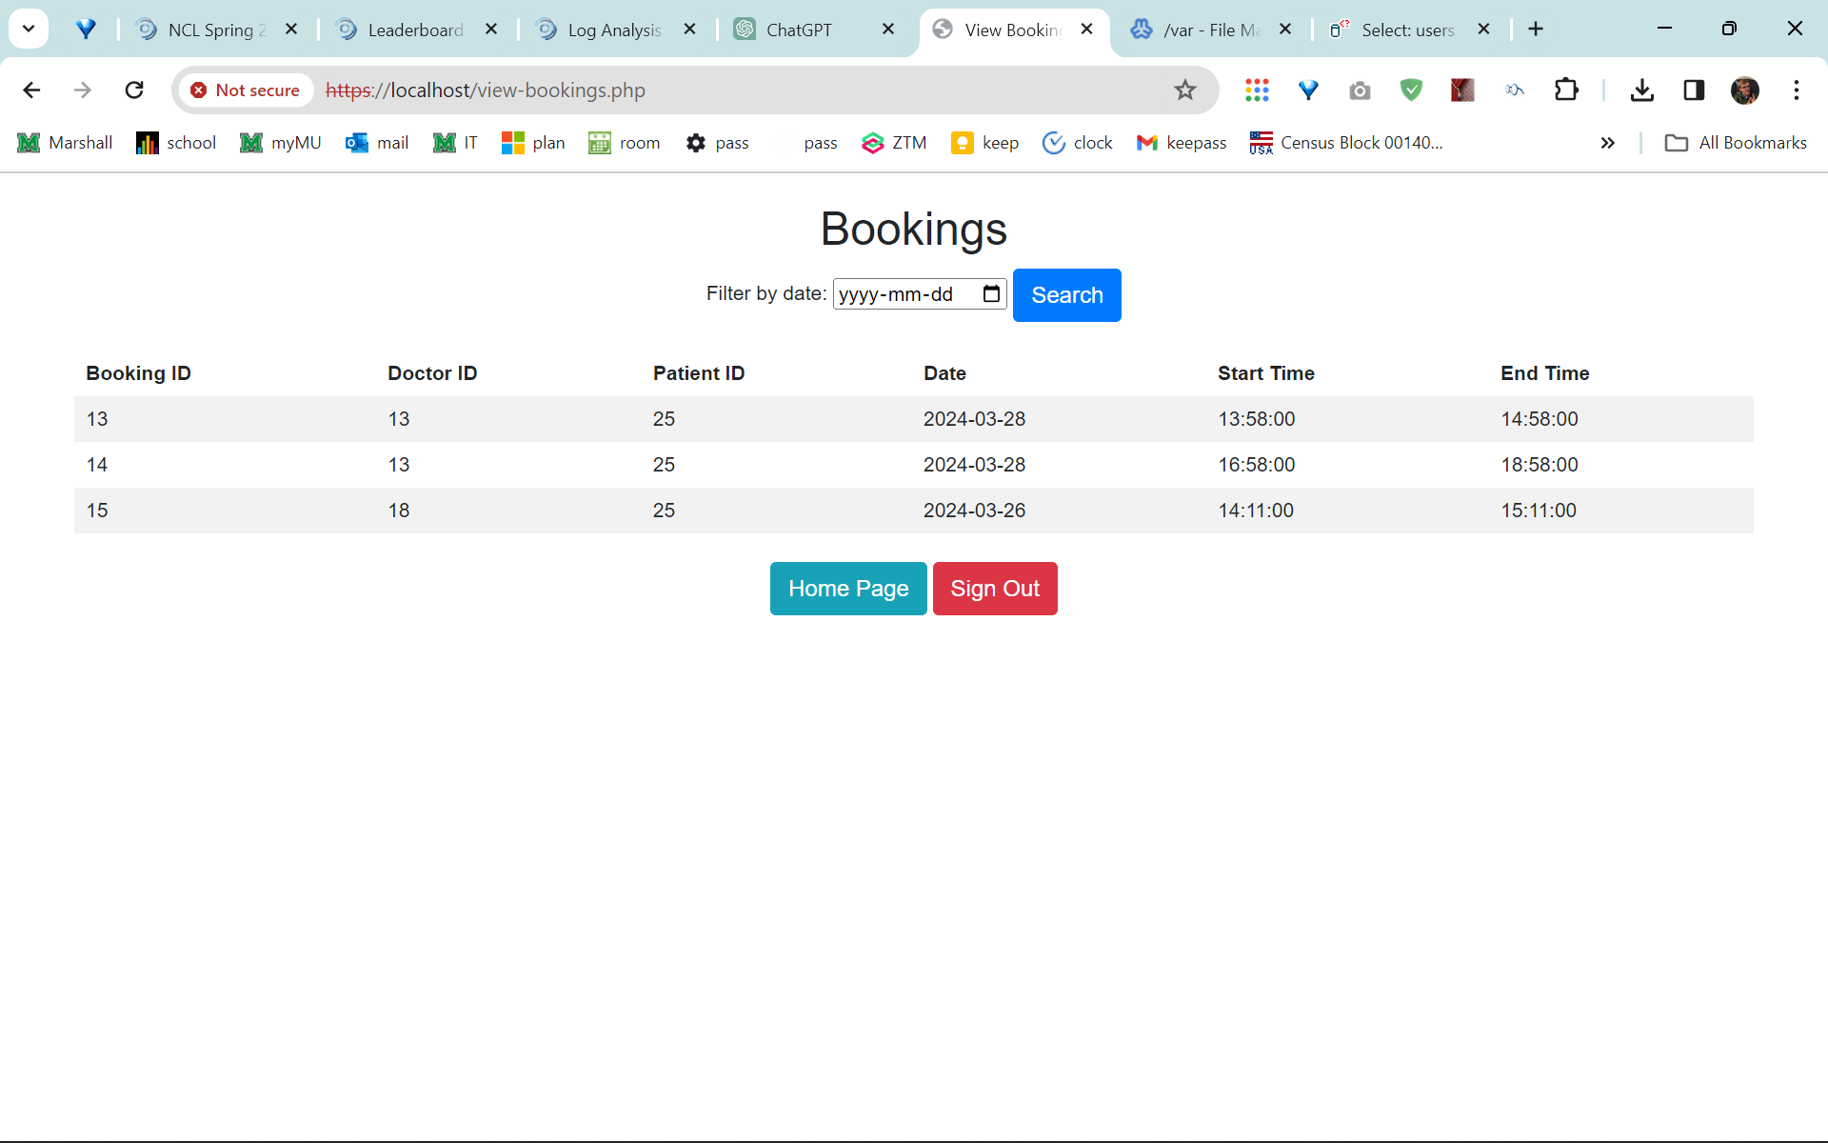
View my bookings for a patient

Slide 9
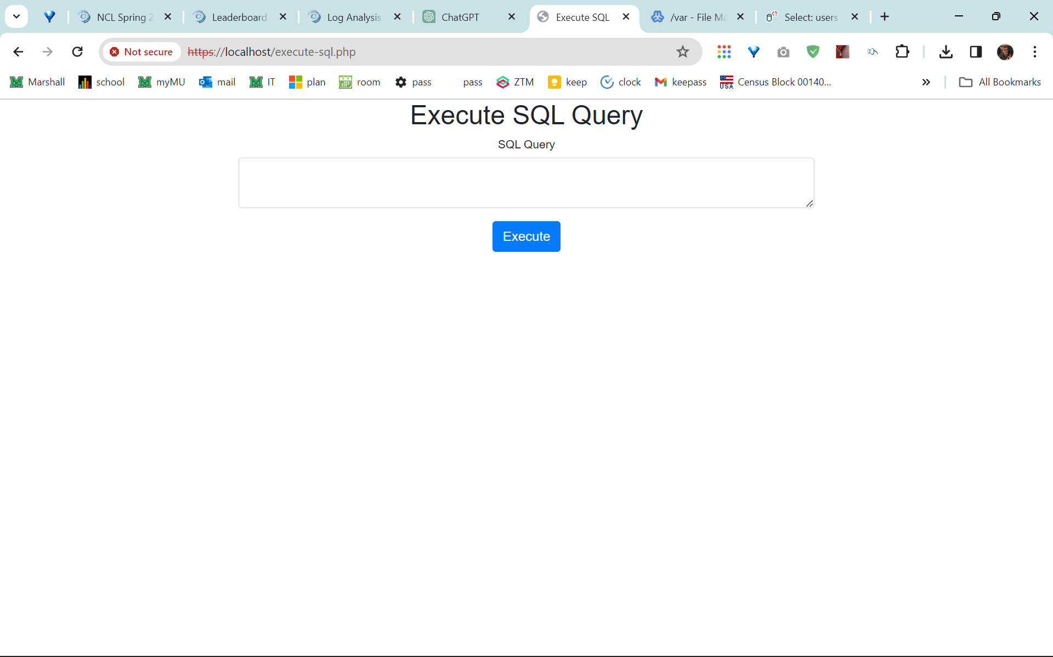
Execute SQL query

Slide 10
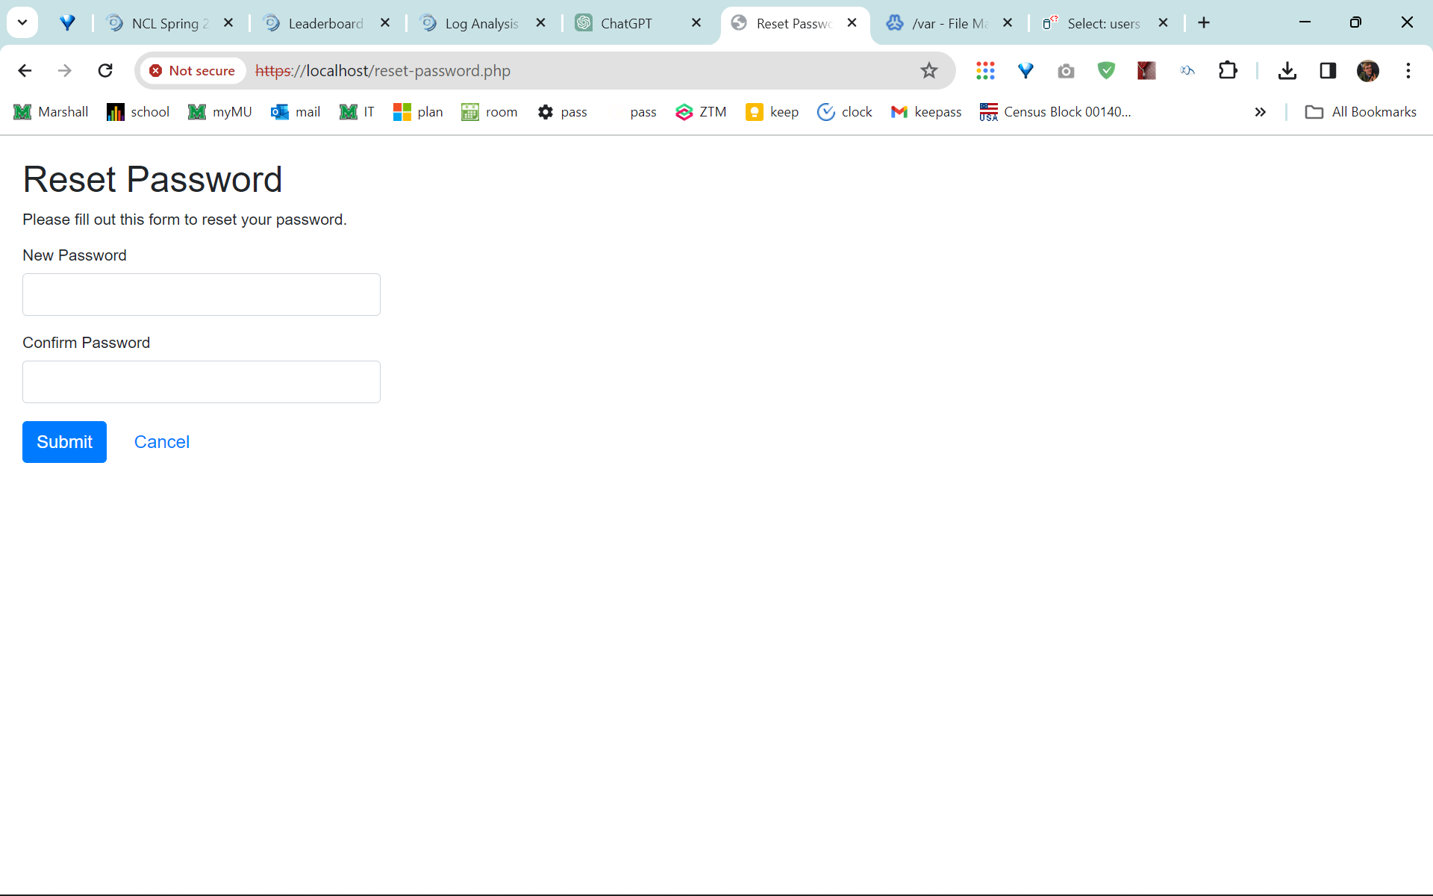
Reset your password

Slide 11
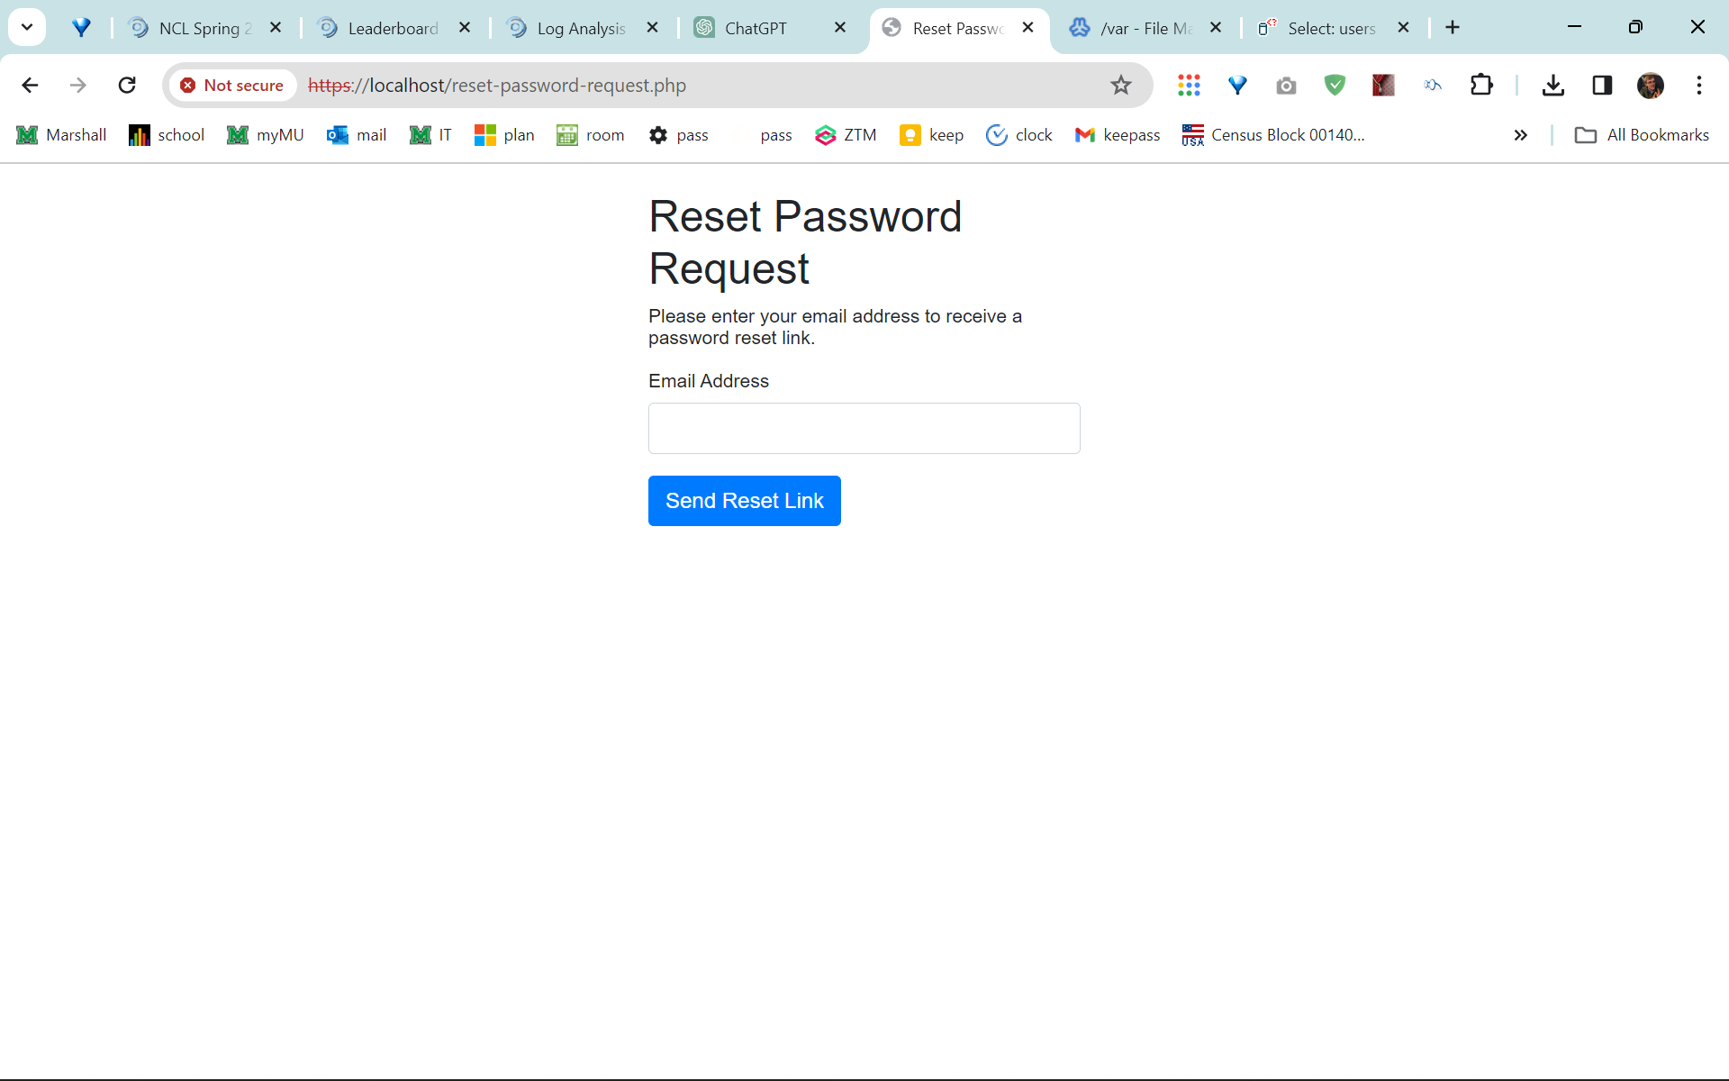
Email Reset
This does not work. I tried to make it send an email but I didn’t get an email.

Slide 12
Other notes…
If anything else needs to be said or written or added it goes here.
Notes go here.

