Slide 1
main app = App() app.mainloop()
class App(tk.TK): model = Model(‚peter.dirnhofer@t-online) view = View(self) controller=Controller(model, view) view.set_controller(controller)
class Controller(): def __init__(self, model , view): self.view=view self.model=model
class View((ttk.Frame): def __init__(self, parent) Implemet views … def set_controler(self, controler): self.controler=controler
class Model: def __init__(self, myprop): self.myprop=myprop @property def myrop(self): return self.__myprop
https://www.pythontutorial.net/tkinter/tkinter-mvc/

Slide 2
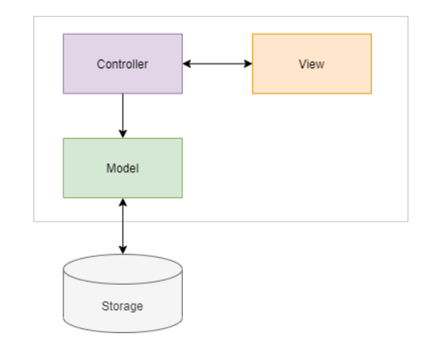
cls.view_reference.close() | reset
cls.view_reference.display_comports(available_ports) | comselect
cls.view_reference.frame_select_com_off() | comselect
cls.view_reference.frame_select_com_on() | comselect
cls.view_reference.lbox_parameter.delete(0, tk.END) | parameter
cls.view_reference.queue_available.set(len) | espdata
cls.view_reference.text_com_state.set(f'Connecting {cls._actport} ...') | stateoben
cls.view_reference.text_status.set(cls._statemachine_state) | stateunten
https://www.pythontutorial.net/tkinter/tkinter-mvc/

