Slide 1

AI: Should We Be Doing This?

Slide 2
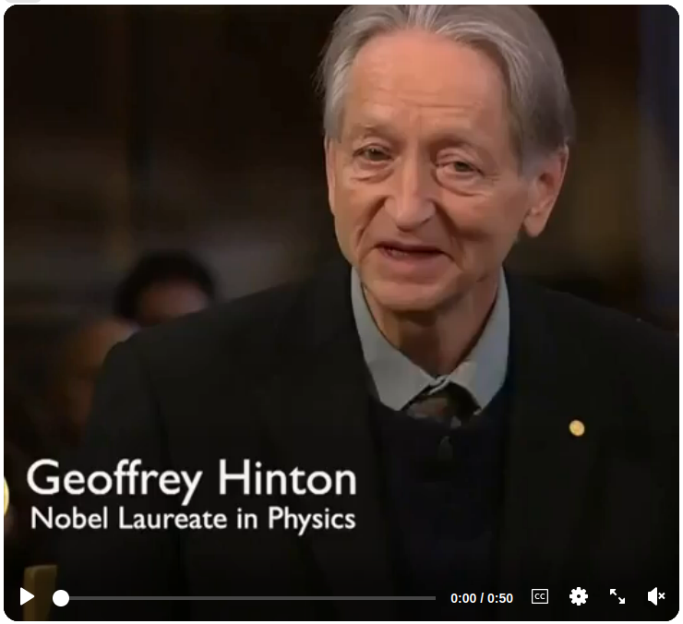

Slide 3
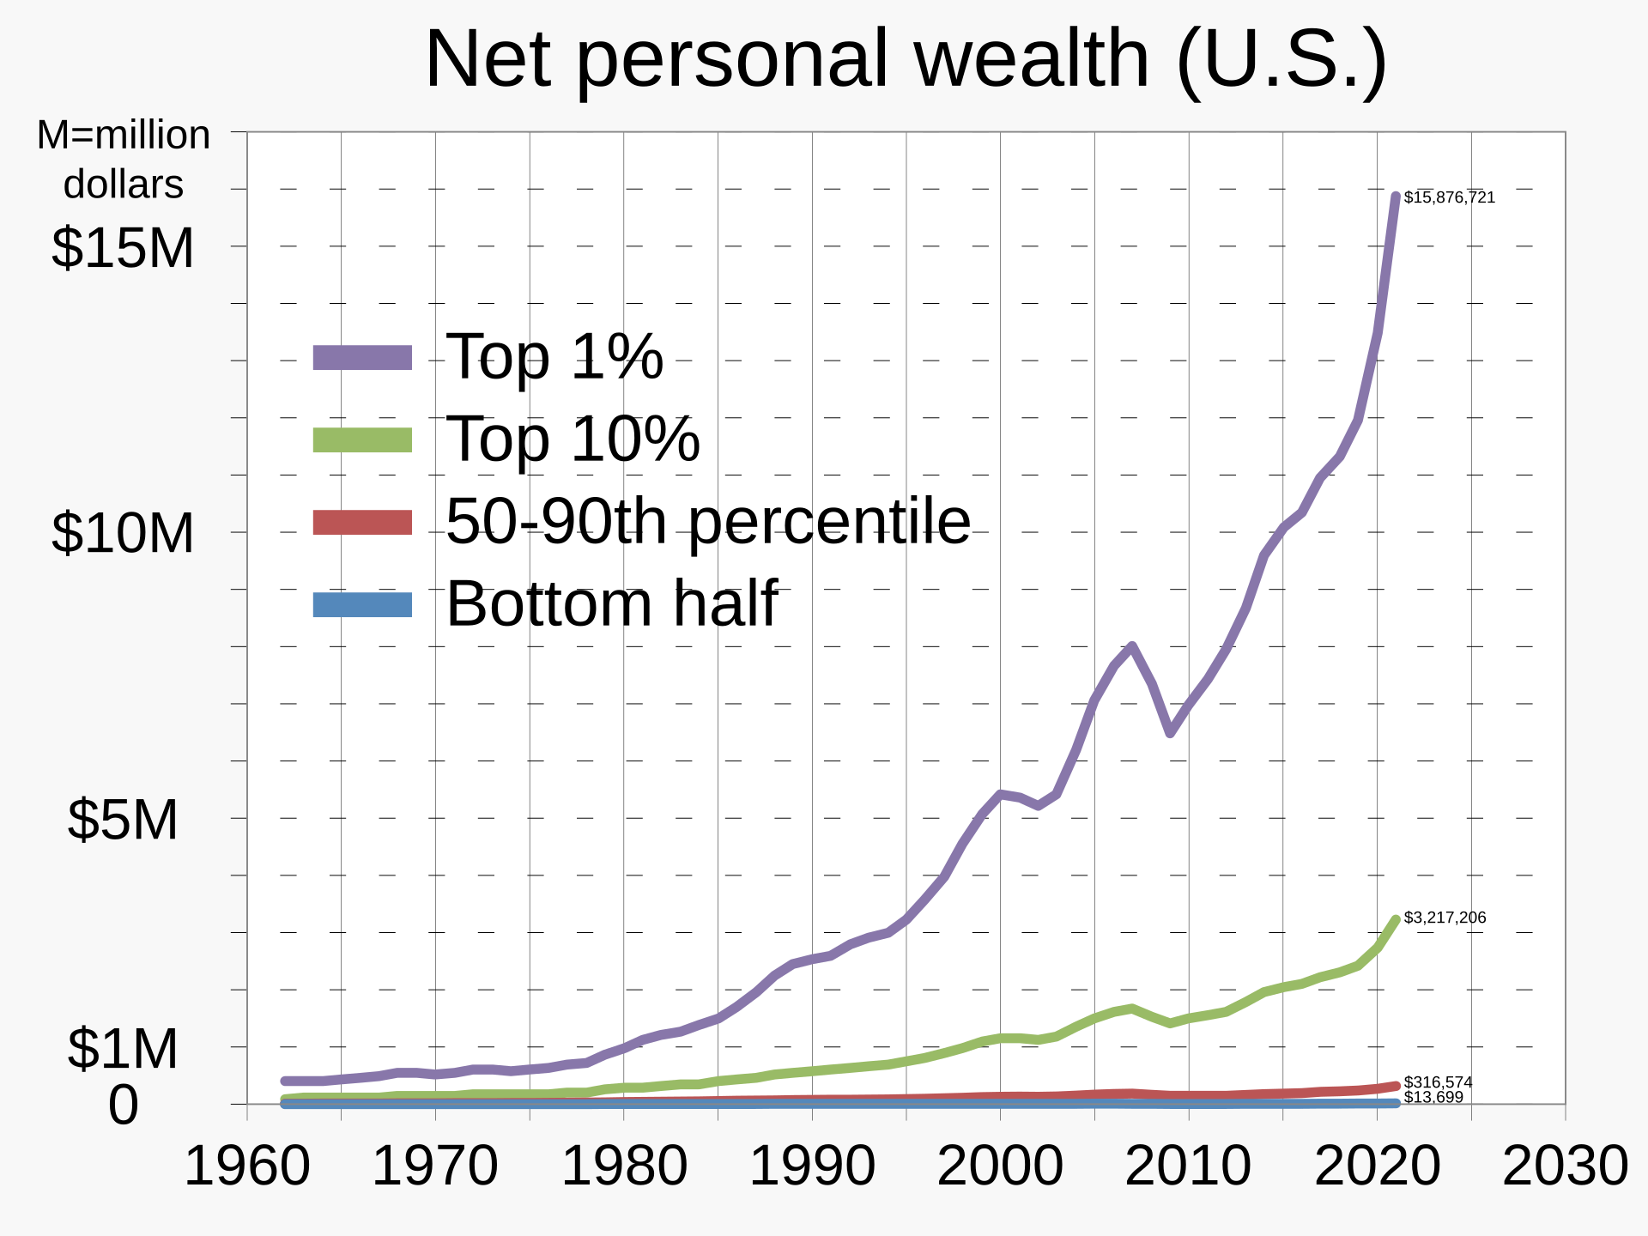

Slide 4
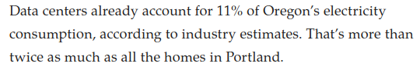
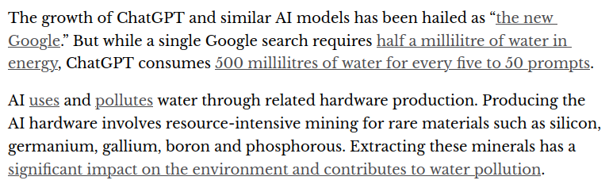

Slide 5
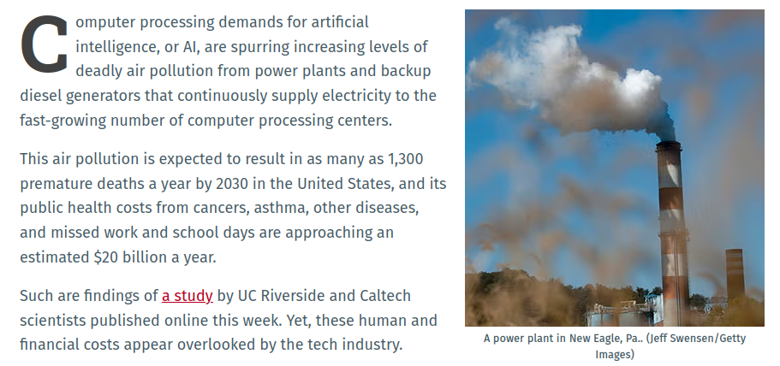

Slide 6
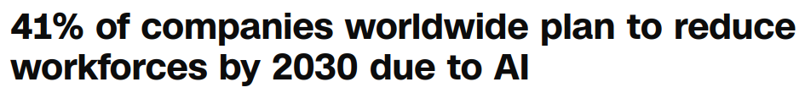

Slide 7
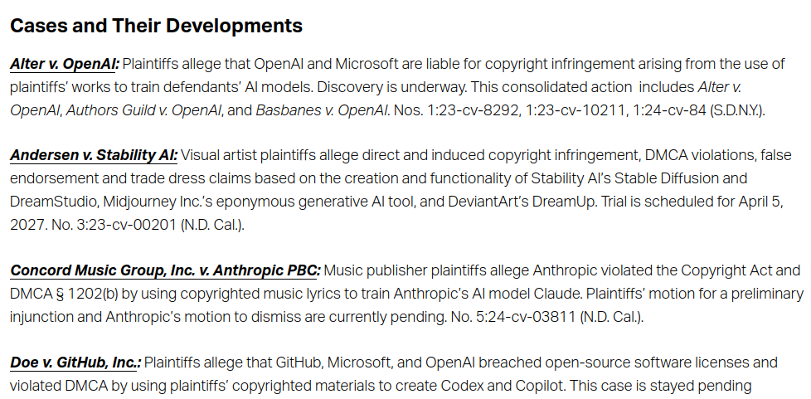

Slide 8
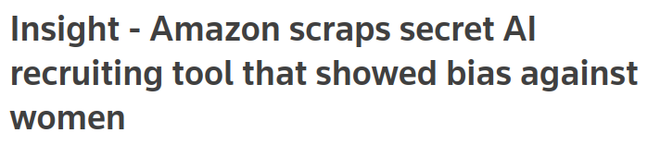

Slide 9
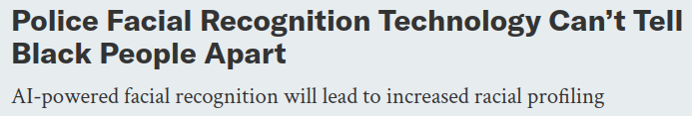

Slide 10
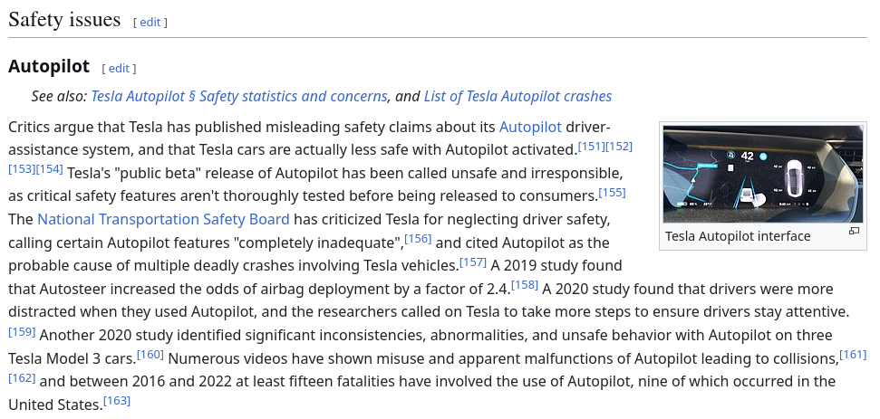

Slide 11
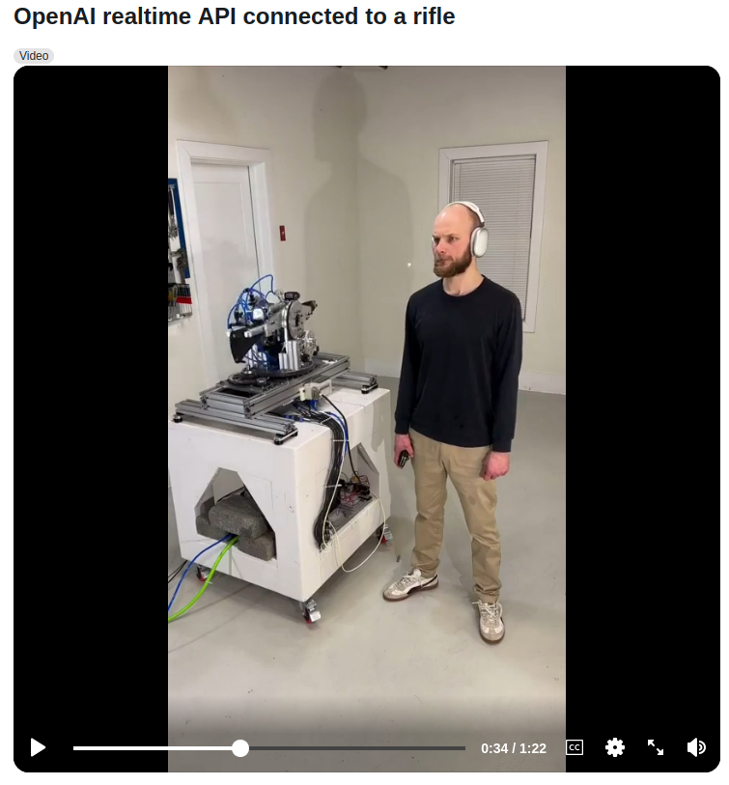

Slide 12
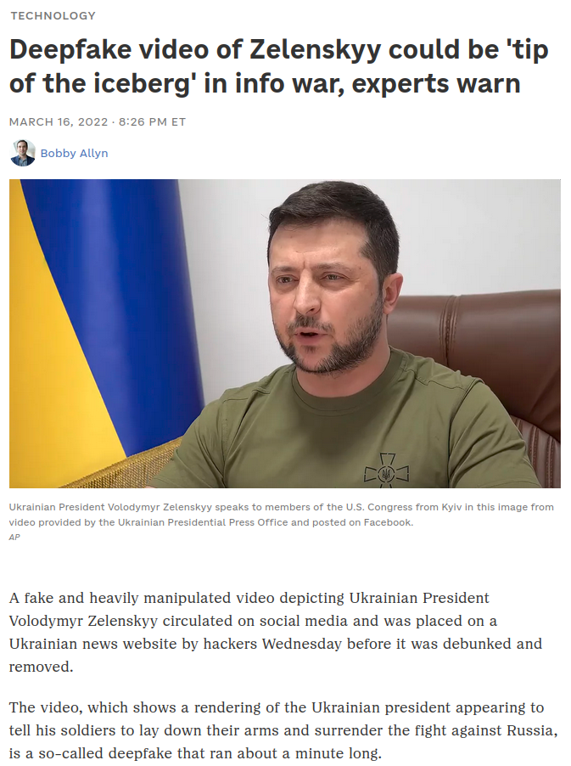

Slide 13
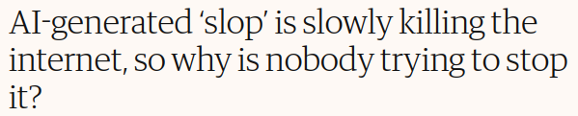

Slide 14
On the other hand...

Slide 15
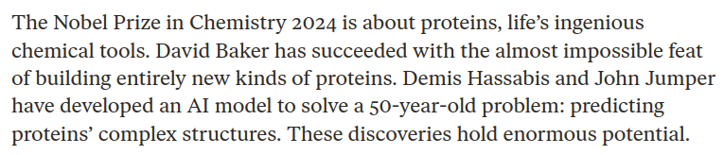

Slide 16
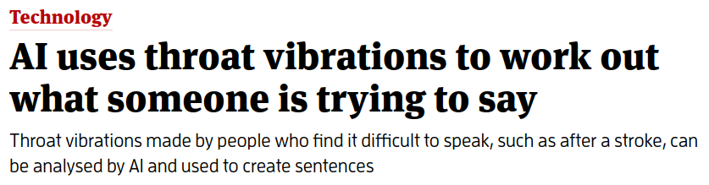

Slide 17
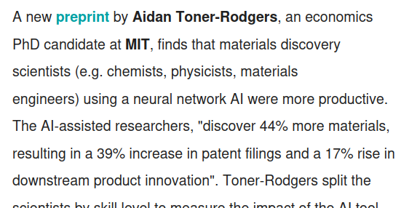

Slide 18
Automatic Translation

Slide 19
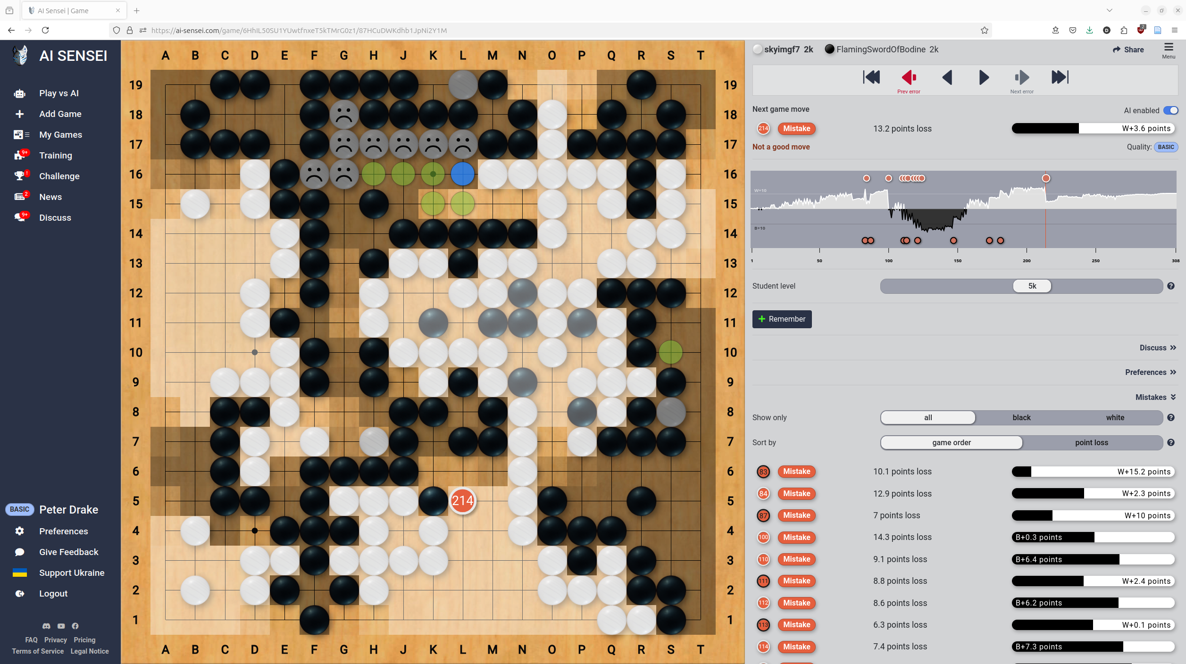

Slide 20
Other beneficial uses
Transportation network design
Spam filtering
Speech recognition
Fraud detection
Image search
Accessibility
Robotic assistants
Industrial efficiency
NPCs and opponents in games

Slide 21
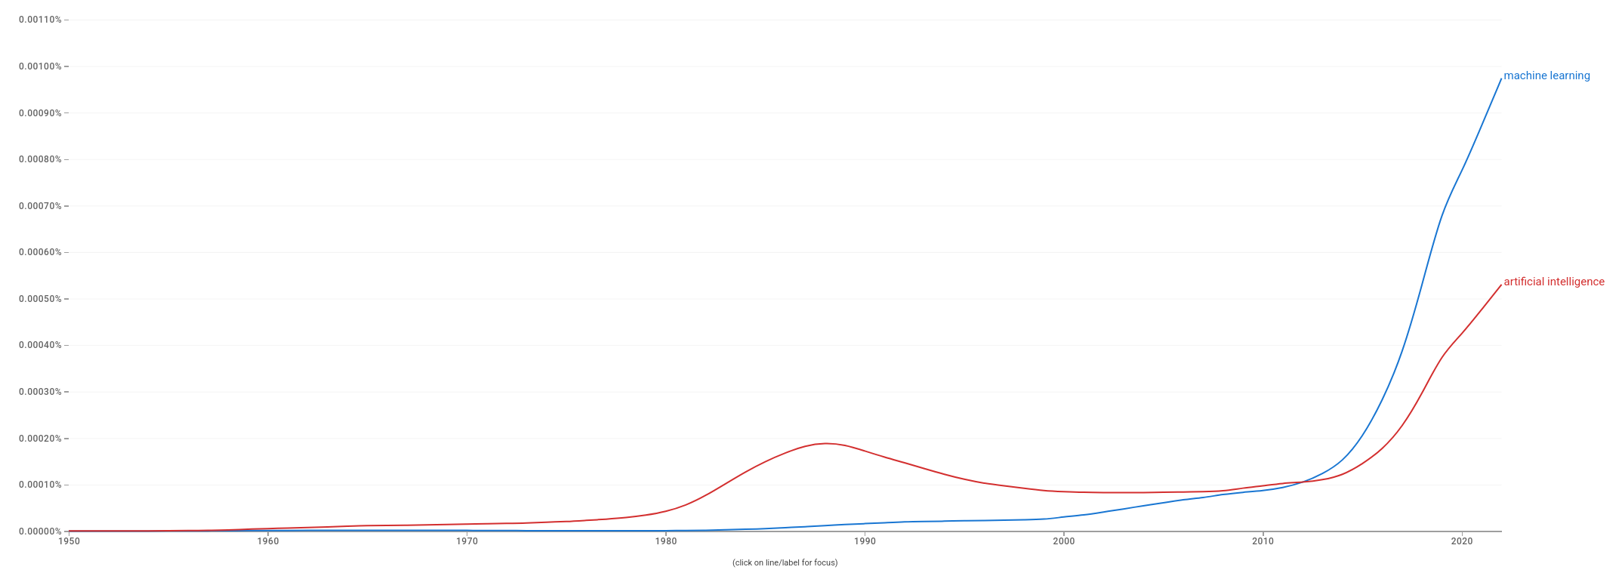
AI (or something called AI) has arrived

Slide 22
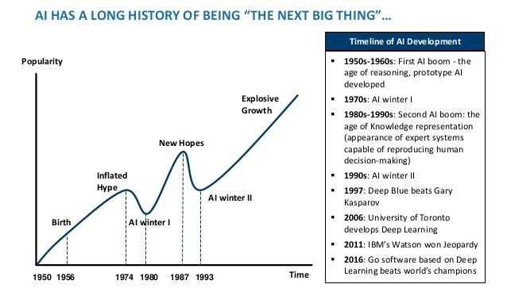
Is it here to stay?

Slide 23
Discussion
What can AI do or not do?
What should AI do or not do?

