Slide 1
AGGREGATION OF MULTIPLE DATA SOURCES FOR INTEGRATED EQUITY MARKET ANALYSIS
Southern Methodist university
Master of science in data science Program
MSDS 7330 File Organization and Database Management-group Project
Daniel Serna, Peter flaming, brandon de la houssaye, james vasquez

Slide 2
Why?
Ron Chernow: “One of the very nice things about investing in the stock market is that you learn about all different aspects of the economy. It's your window into a very large world.”
What if we flipped the script?
What if we used the very large world as a window into the stock market?
What if we gathered and organized previously overlooked information into a sustainable database that enabled this view?

Slide 3
abstract
In this paper, we present a means of gathering disparate information from multiple, publicly available information sources in a reproducible format for subsequent organization into a relational database schema. The information being gathered (into a database schema) is centered around equity market output (i.e., stock pricing). The authors observe that the equity markets are influenced by a myriad of factors, and it is only once proper empirical analysis is performed on these factors that we can better understand the equity market response (to external stimuli). It is therefore endeavored by the authors to make the information available (within a database structure) so such subsequent analyses may be performed. The authors began the analysis by first considering which publicly available information to gather; then gathering the information; and finally structuring it in a relational database schema.

Slide 4
Introduction
Purpose:
Explore possible external stimuli that can be used for better understanding of the equity market with future analysis and new predictive models.
Gather disparate information from multiple, publicly available sources in a reproducible format for subsequent organization into a relational database schema.
Goal:
Design a new approach to equity market analysis utilizing the relational database model design with MySQL-Workbench
Perform visual analysis in BI tools (Spotfire).
Notes:
Today’s stock analysis tools lack the ability to expand overlooked relationships to external data sets outside of the market place.
The aggregation of political climates, major national events, natural disasters, and the emergence of social media data into an integrated relational model is key to a new equity market analysis approach.

Slide 5
tutorial
Step 1. Define the entities that will act as external stimuli for the equity market analysis, and create each entity as a table with their specific relationship roles in MySQL-Workbench.
Societal stimuli
Natural stimuli
Equity market data
Political Climates
Republican Party
Democratic Party
National Events
Disasters
Hurricanes
Floods
Fires
Tornados
FEMA relief
Subsidies
Options Selected
American Outdoor
General Electric
Home Depot
Kroger
Microsoft
Ruger
Walmart

Slide 6
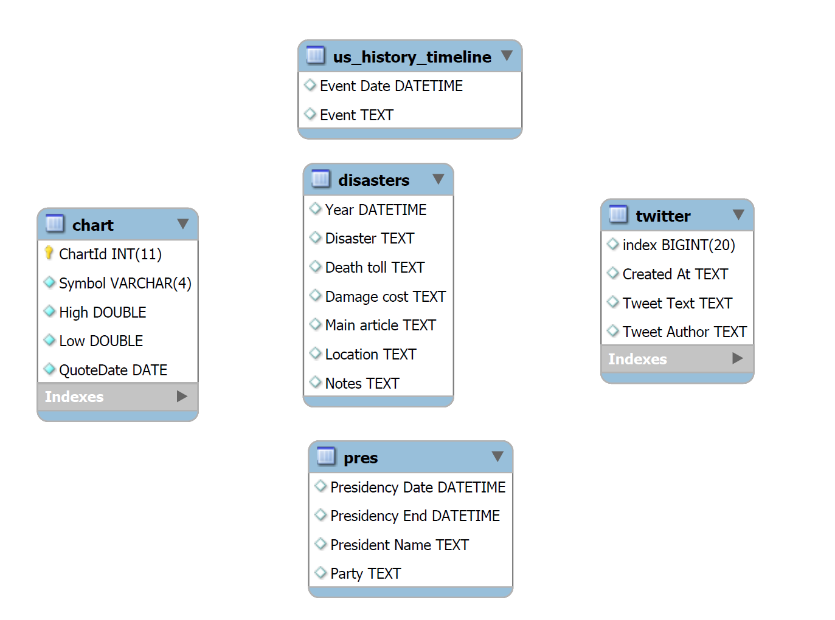
tutorial
Step 2. Create the E-R Model for the equity market analysis with the entities chosen in step 1.

Slide 7
tutorial
Step 3. Gather the data for the equity market analysis using Python3.x via Jupyter Notebook and C#
Python3.x Libraries and Packages used:
Pandas
Requests
BeautifulSoup
SQLAlchemy
C# libraries used:
RestSharp
Newtonsoft.Json
MySql.Data

Slide 8
tutorial
Step 4. Visualize the data for the equity market analysis using Spotfire.
Access the database (populated in step 3) using Spotfire.
Plot the data as a time-series.
Explore the plotted external stimuli with respect to the equity market data.
Note any positive and negative trends that encompass the external stimuli.
These noted areas of interest should be explored in further detail as possible predictors for a new equity market model.

Slide 9
Data sets: publicly available sources
In particular, the following websites were utilized to scrape data:
Political Climate Data
https://en.wikipedia.org/wiki/List_of_Presidents_of_the_United_State
National Events Data
https://en.wikipedia.org/wiki/Timeline_of_United_States_history
Natural Disaster Data
https://en.wikipedia.org/wiki/List_of_natural_disasters_in_the_United_States
Equity Market Data
https://api.iextrading.com

Slide 10

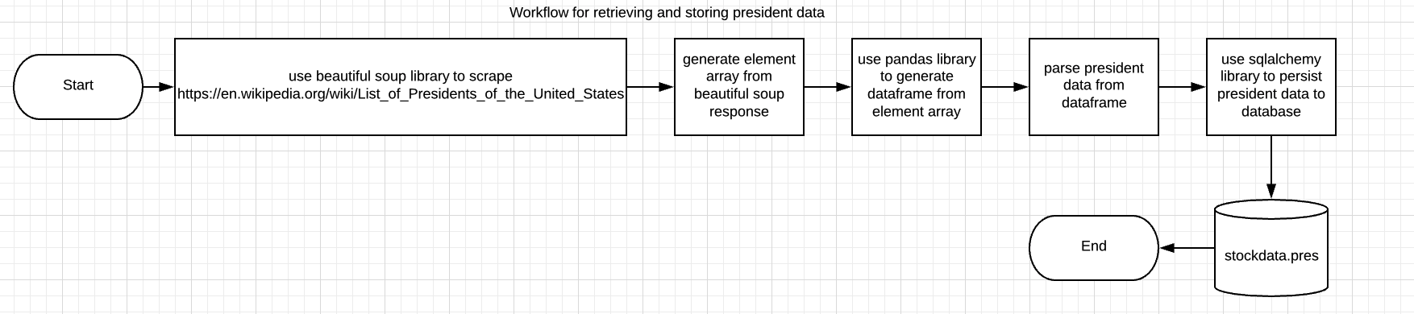
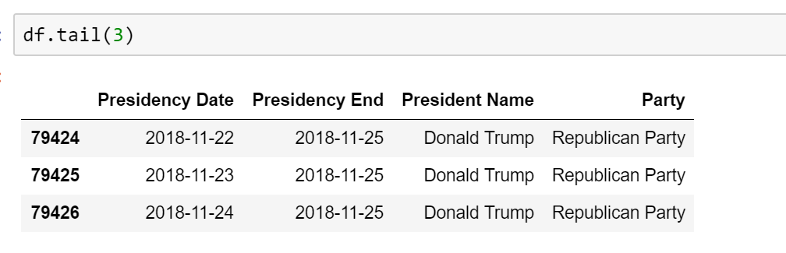
Data sets: Political climate data
Political Climate Data
https://en.wikipedia.org/wiki/List_of_Presidents_of_the_United_State

Slide 11
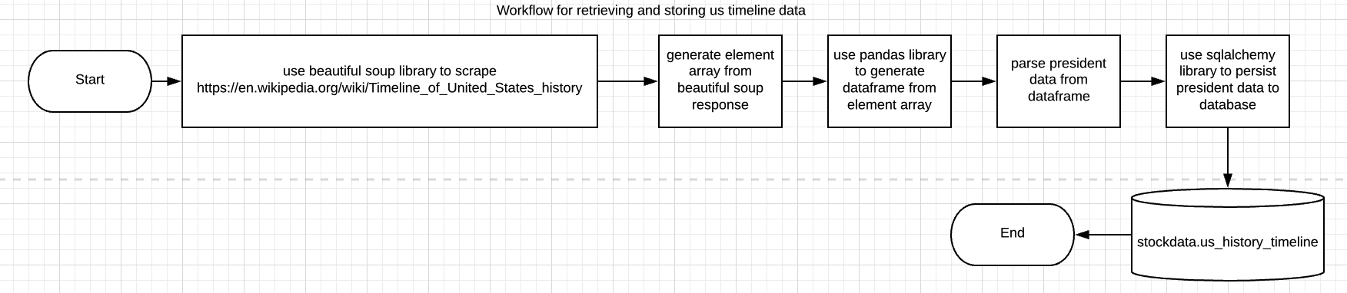
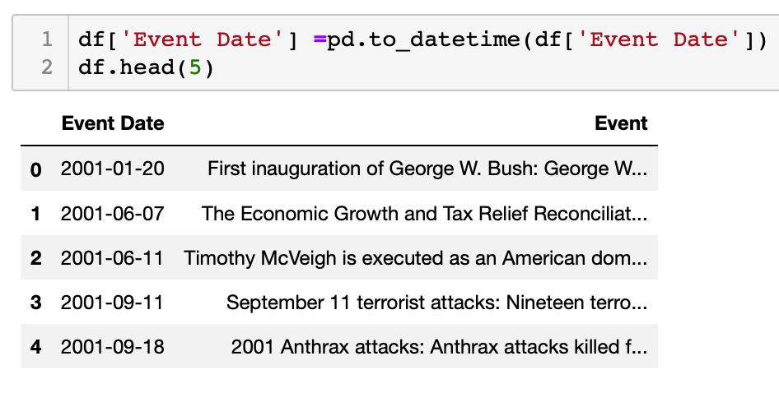
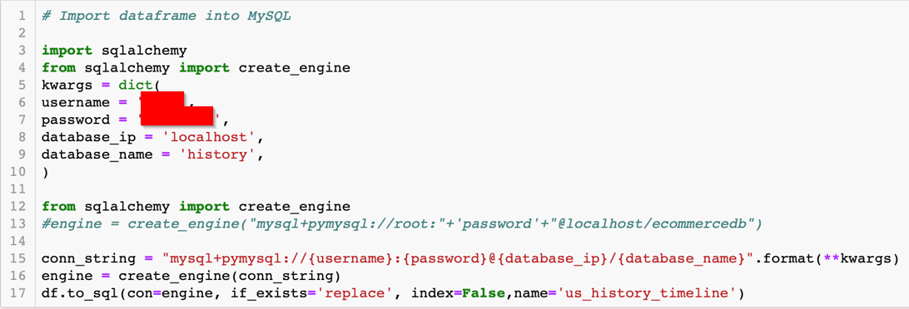
Data sets: National events data
National Events Data
https://en.wikipedia.org/wiki/Timeline_of_United_States_history

Slide 12
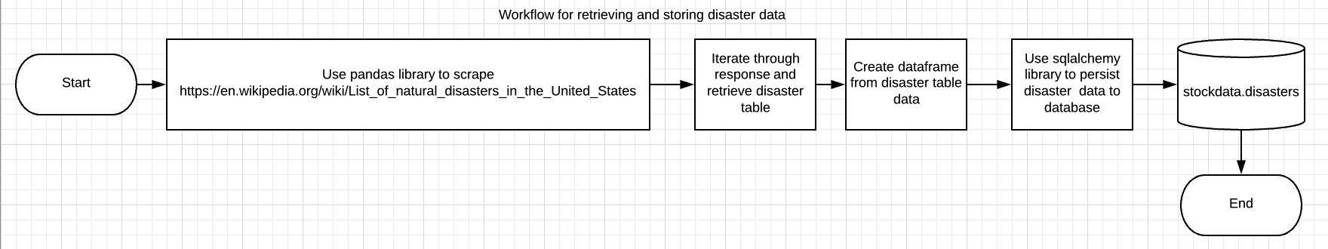
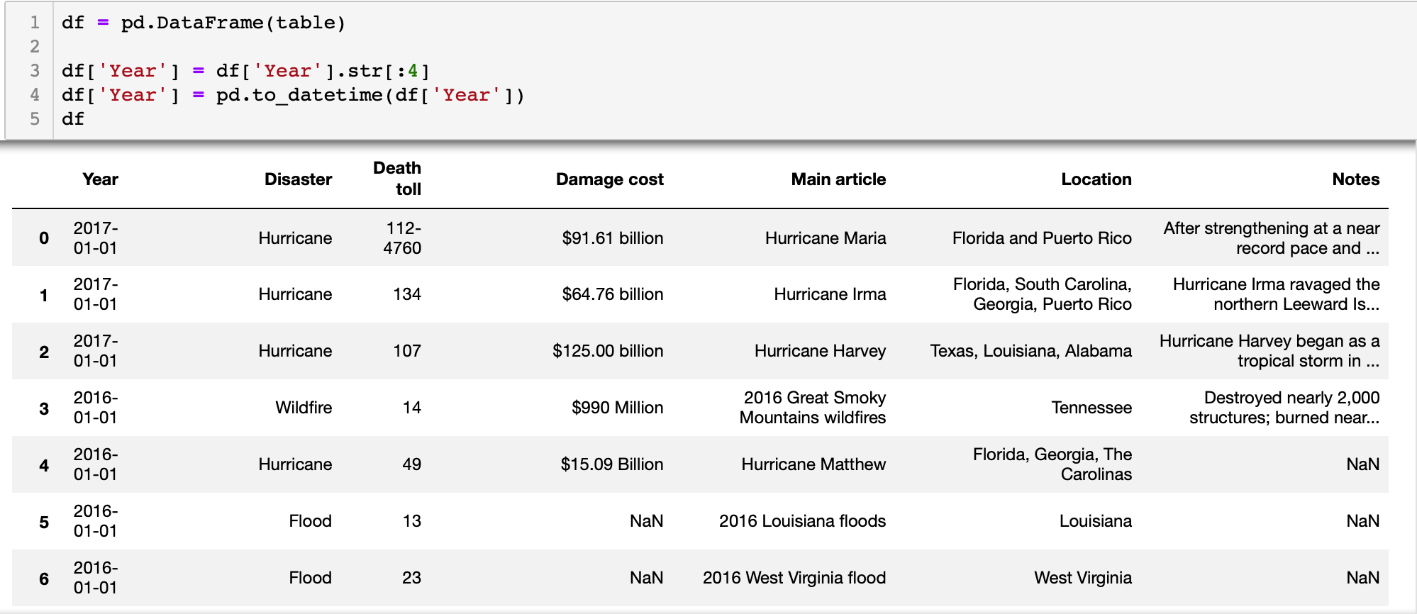
Data sets: Natural disasters Data
Natural Disaster Data
https://en.wikipedia.org/wiki/List_of_natural_disasters_in_the_United_States

Slide 13
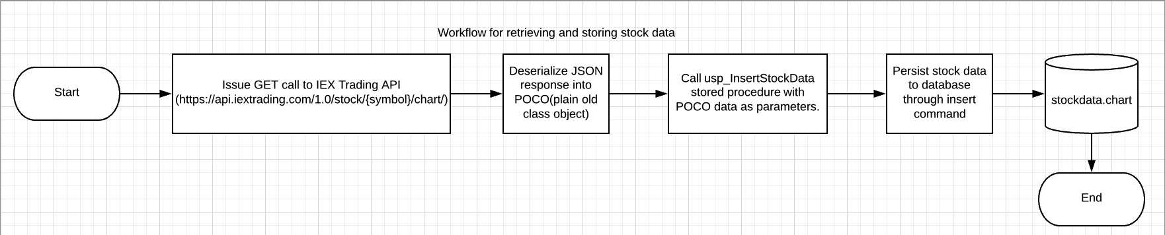
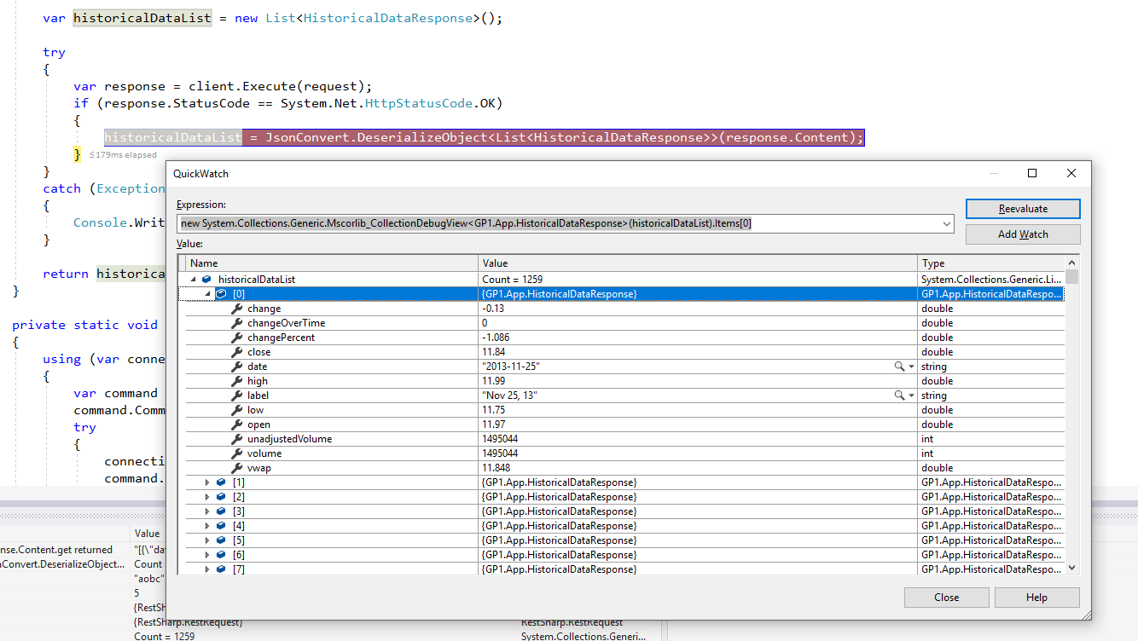
Data sets: equity market Data
Equity Market Data
https://api.iextrading.com

Slide 14
Results: IDEAL Relational Database design
Equity Market
Political Climate
National Events
Natural Disasters
Date
Many-Many Relationships
Many-Many Relationships
Many-Many Relationships
Many-Many Relationships

Slide 15
Results: end state database design__________
Practical Requirements:
Ability to support quick data refreshes.
Resiliency to rapidly changing code.
Easy analysis by Spotfire business intelligence tool.
End State Design:
Flat, independent tables.
Stored procedures as abstraction layers.

Slide 16
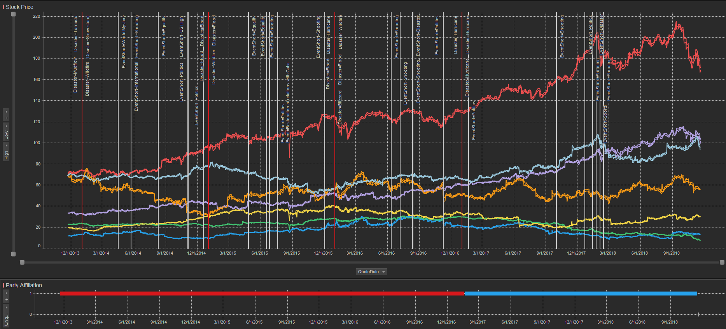
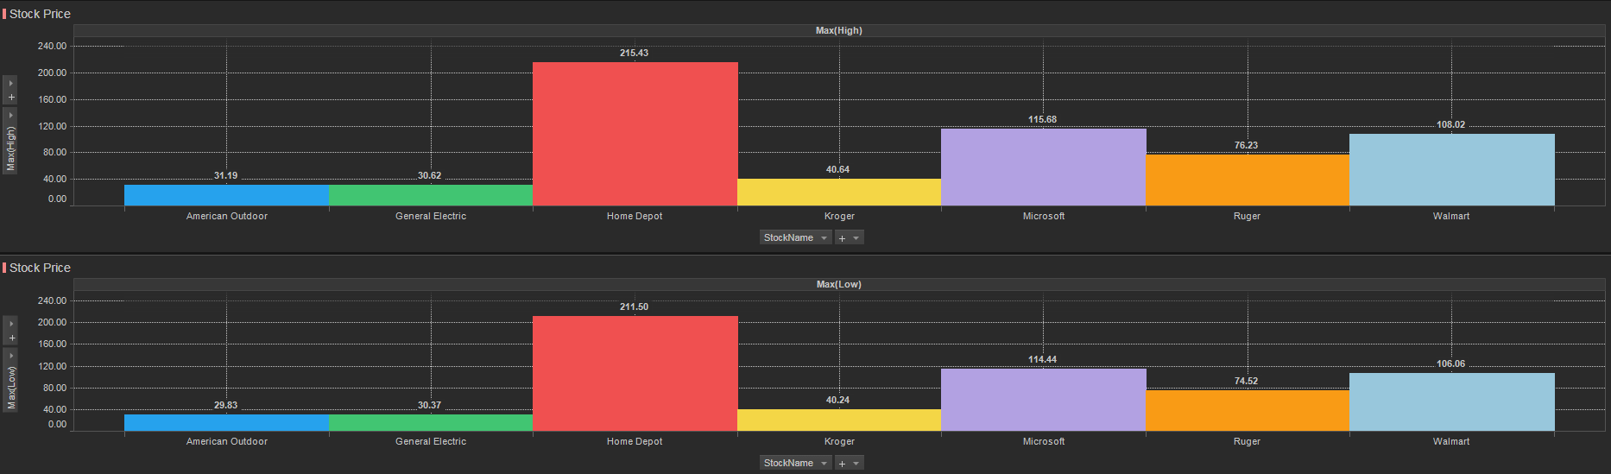
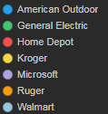
analysis: a new equity market analysis approach

Slide 17
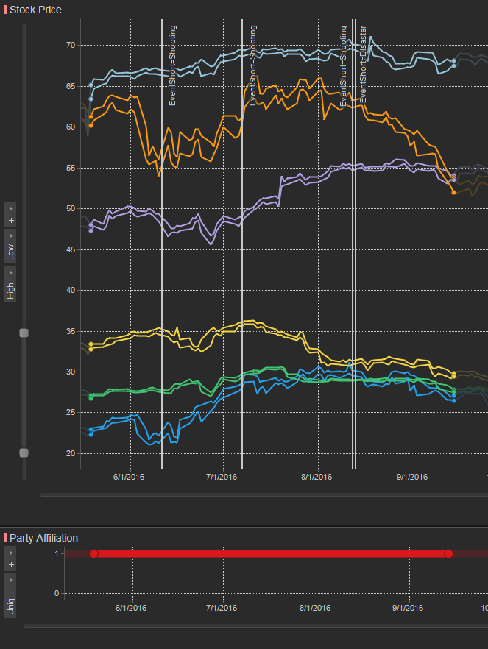
analysis: a new equity market analysis approach
Louisiana Floods
Dallas officer shot and killed
Orlando shooting
Milwaukie Riots

Slide 18
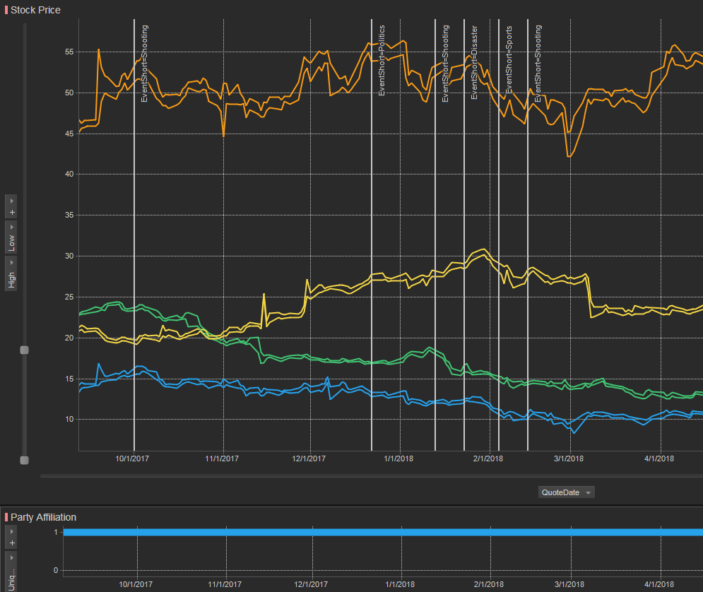
analysis: a new equity market analysis approach
Eagles win Super Bowl
Alaska Earthquake
Hawaii Fake Missile
Tax Cuts
Parkland shooting
Correlation does not imply causation
Vegas shooting

Slide 19

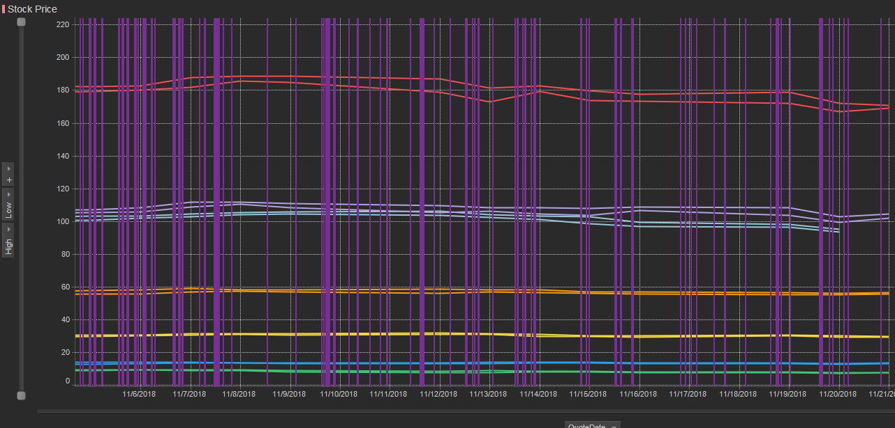
analysis: a new equity market analysis approach
Adding tweets to the model
Example used @realDonaldTrump

Slide 20

ethics
As a result, in performing this analysis, the authors focus on the gathering of information and data that would only be available to all market participants.
In doing so, the authors avail themselves of any ethical concerns associated with providing an unfair trading advantage within the market of interest.
https://rapidbi.com/rapidbi-daily-business-cartoon-149/

Slide 21
Conclusions
There is a market up-tick for gun manufactures immediately after shooting event.
After natural disasters, hardware stores have a long running up-tick.
Too many data points for twitter data for effective equity analysis.

Slide 22
Future work
Potential use of statistical sampling (NLP) or clustering for twitter analysis.
Investigate utilizing NoSQL database.
Automate data refreshes.
Ability to pull more than five years historical stock data
Categorize tweets for easier analysis

Slide 23
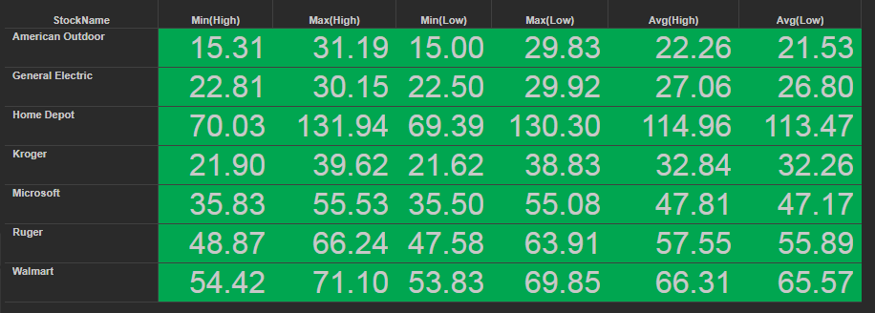
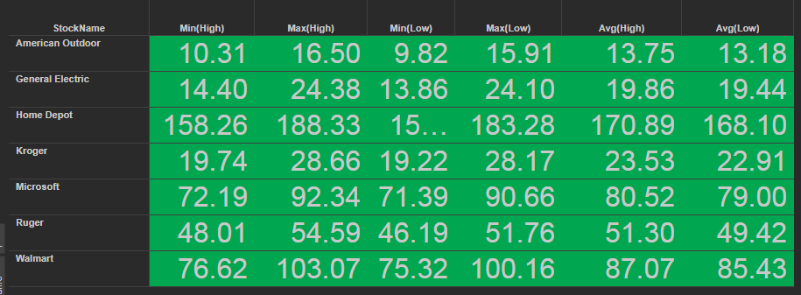
Back up slides
Shooting during Democratic Presidency – Shootings 6
American Outdoor stock has dropped quite a bit during Trump presidency, but Ruger seems to stay consistent between party affiliation
Ruger is a much larger company then American Outdoor. Possible reason for withstanding better stock prices.
Shooting during Republican Presidency – Shootings 2

Slide 24
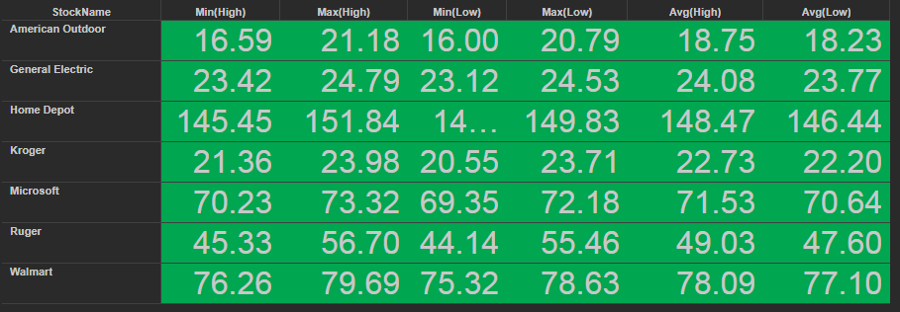
Back up slides
2017 Hurricane Harvey
HARVEY

