Slide 1
Turkish Van
Stephen Aldred
Noelle Alston
Peter Gatira
Bhoj Raj Pandey
CMSC 447: Software Engineering I
Dr. Nick Allgood
May 02, 2024

Slide 2

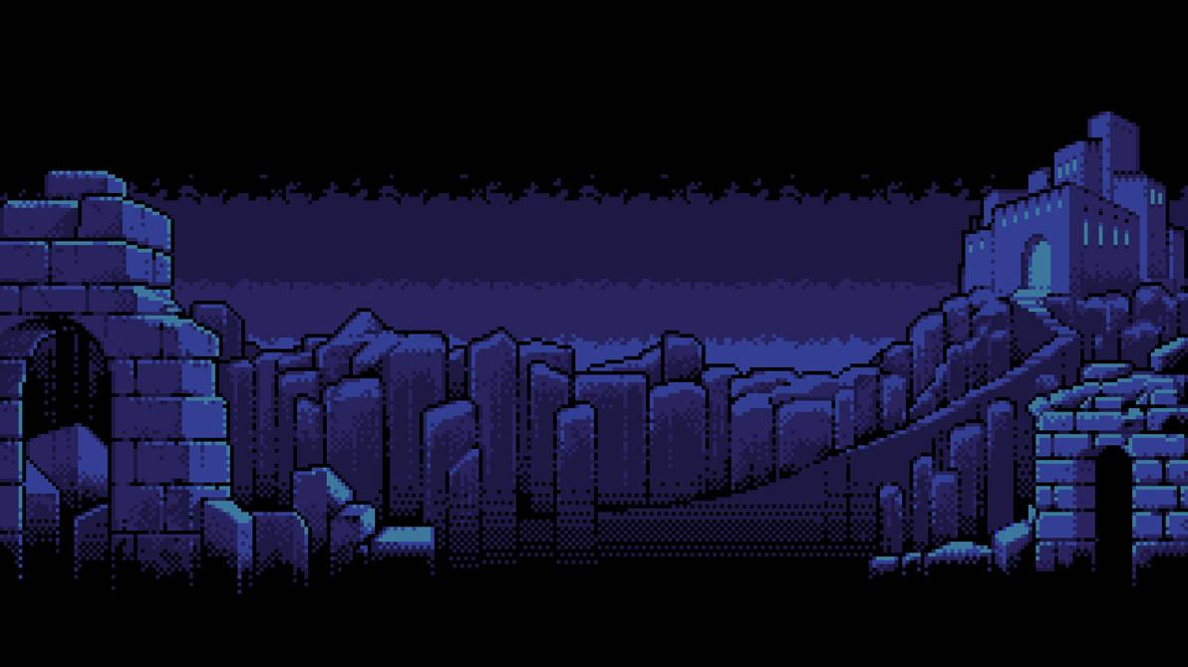
Turkish Van Presents

Slide 3
What is Dark Ascent?
Main Gameplay
Dark Ascent is a turn-based strategy game, using a combat system inspired by games like Final Fantasy, Persona, and Pokémon.
Each level has the player go against an assortment of enemies, using the moves that they learned (or were given initially) and the items in their inventory to defeat them.
When the player wins, they are rewarded with gold, new moves from enemies they haven’t defeated before, and can move on to the next level (or “floor” of the tower).
How well a player does is determined by their Kill-Death ratio. How many enemies they defeat, and how many times their player character has fallen in combat.
Extra Features
A shop in which the player can buy items and permanent upgrades to aid them in their journey.
After beating the preset levels in the game, the player will be able to continue playing through randomized encounters.

Slide 4
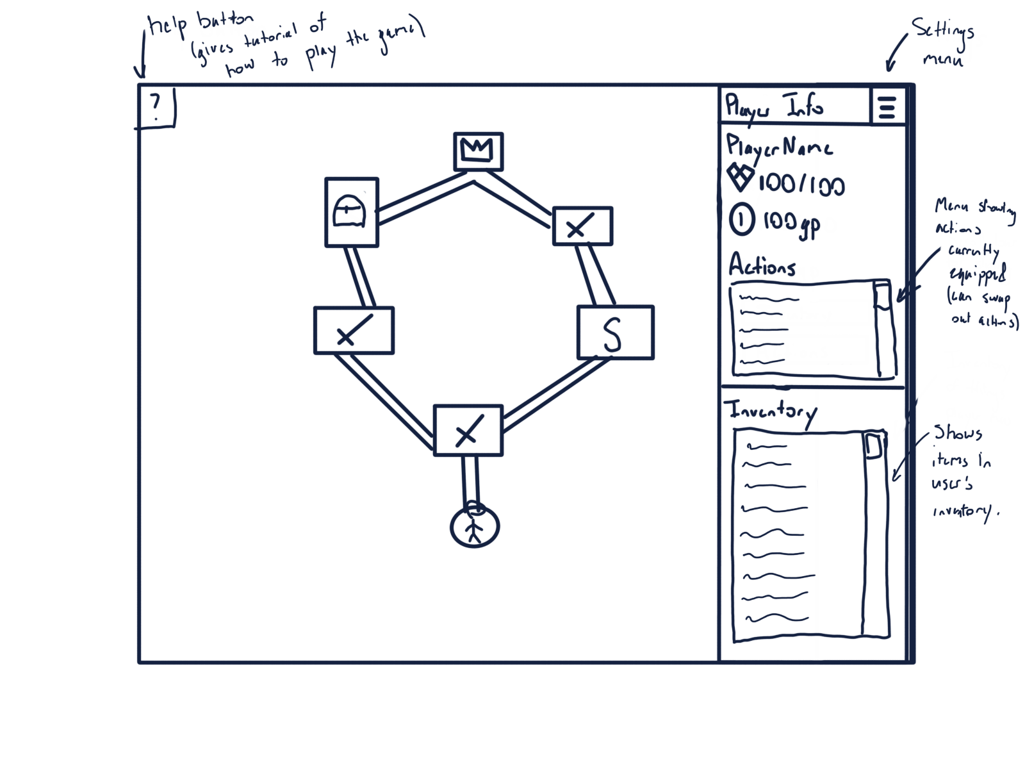
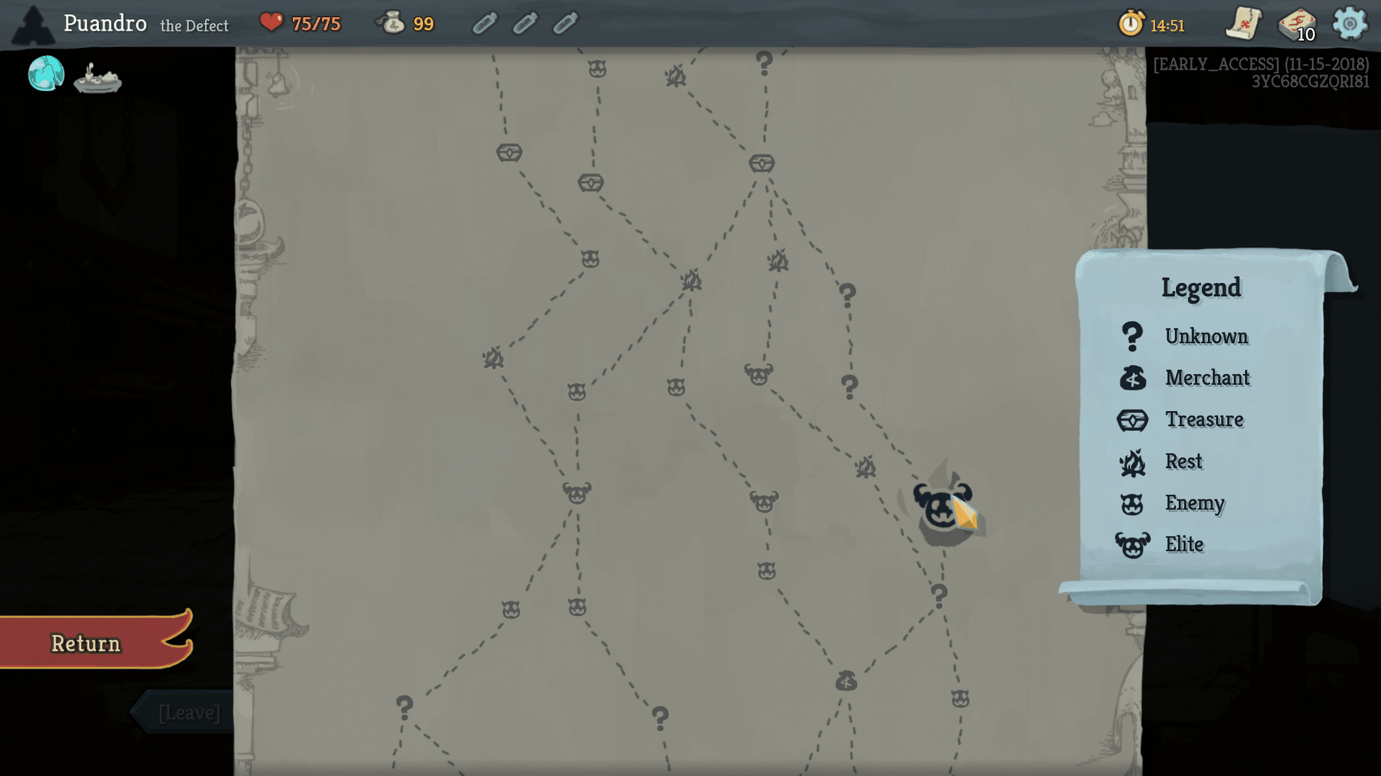
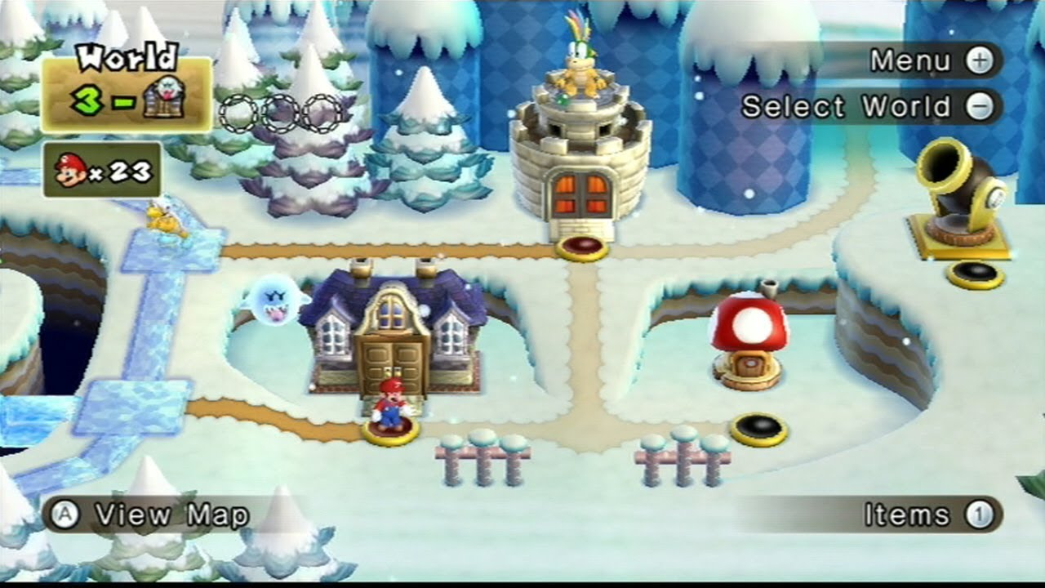
The Original Plan - Map
The game originally was going to have map inspired by games like Mario and Slay the Spire
Different “rooms”to traverse (combat encounters, treasure rooms, shops, and rest areas)
Player would unlock different paths as they entered each room.
The paths would eventually branch back to a final boss fight.
The “levels” were going to be each floor

Slide 5
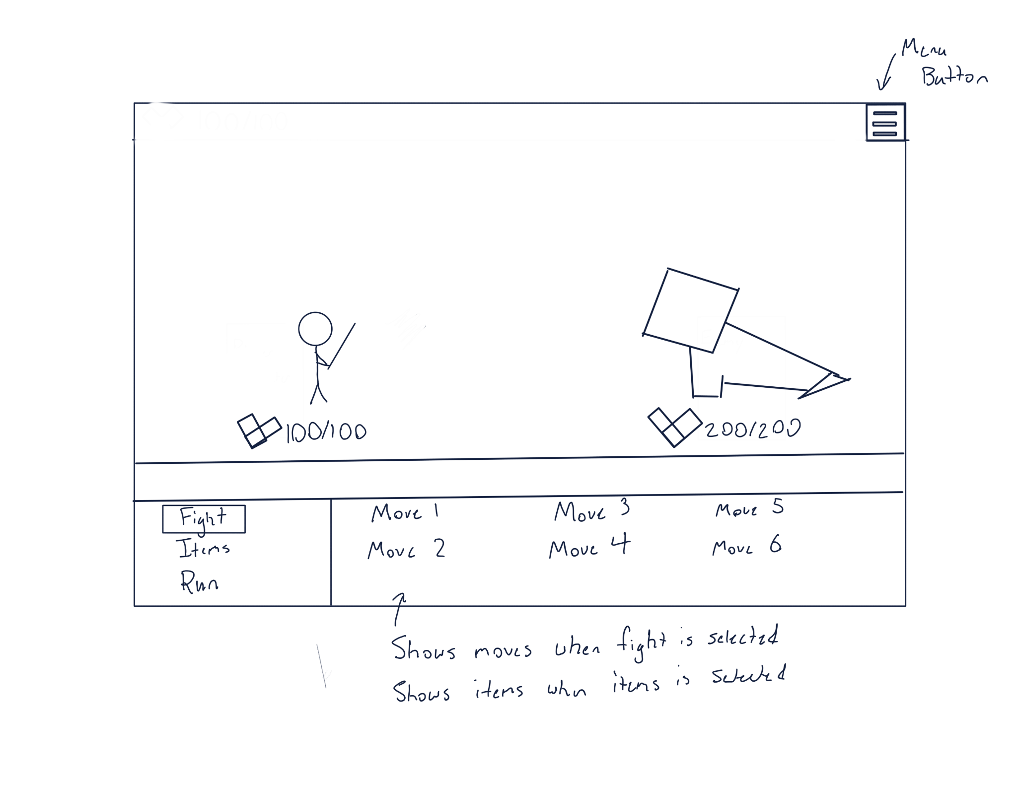
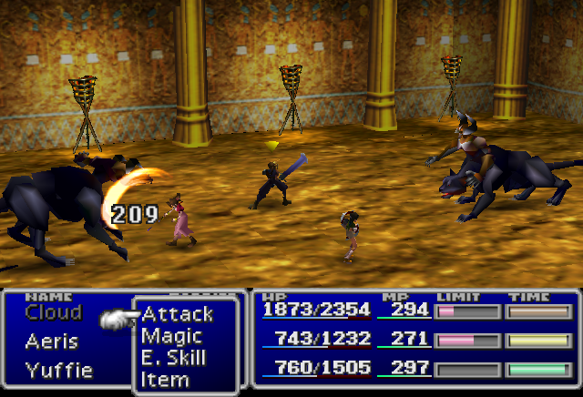
The Original Plan - Combat
Inspired by games like Final Fantasy, Persona, Pokémon
The game would center around “Basic Moves” and “Special Moves”.
Basic Moves would have no cooldown and could be used every turn.
Special Moves are either stronger attacks or buff the character but have a cooldown.
Player could use items they found or bought from the shop in order to.

Slide 6
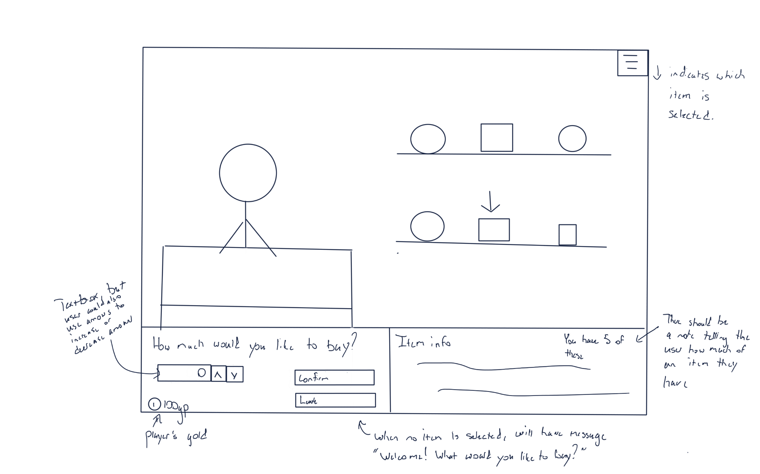
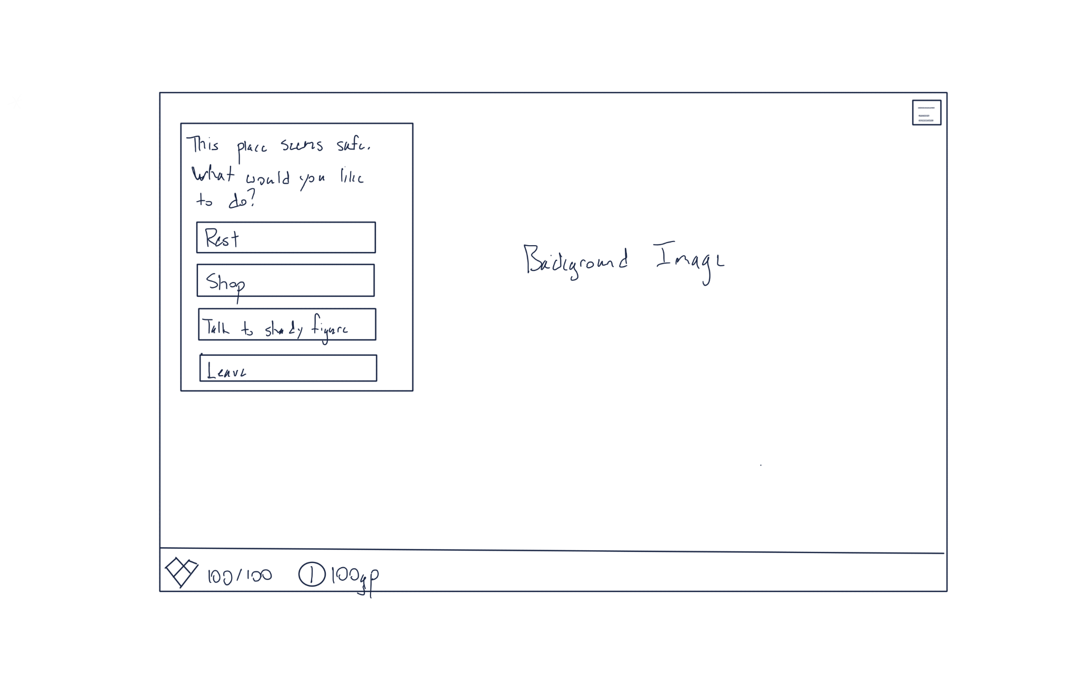
The Original Plan - Shop & Rest Area
Inspired by games like Final Fantasy, Persona, Pokémon
The game would center around “Basic Moves” and “Special Moves”.
Basic Moves would have no cooldown and could be used every turn.
Special Moves are either stronger attacks or buff the character but have a cooldown.
Player could use items they found or bought from the shop in order to.

Slide 7
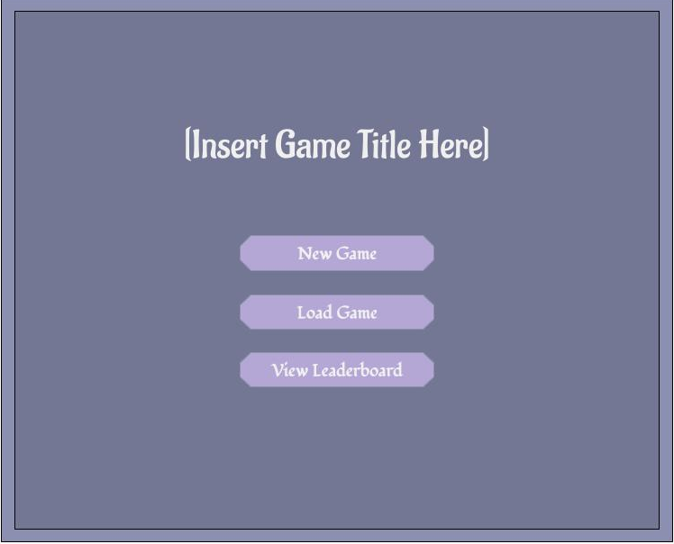
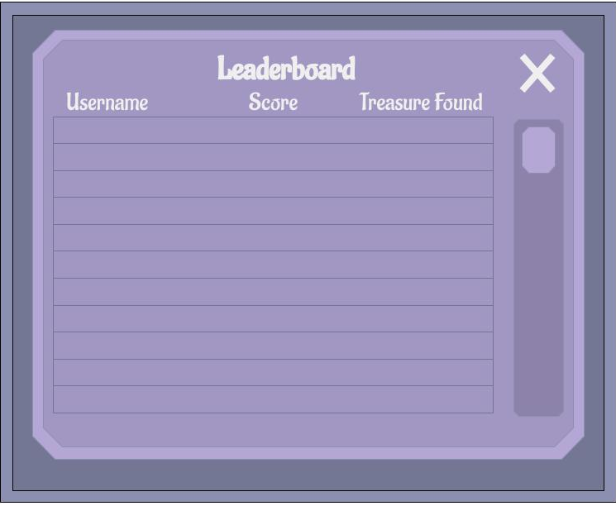
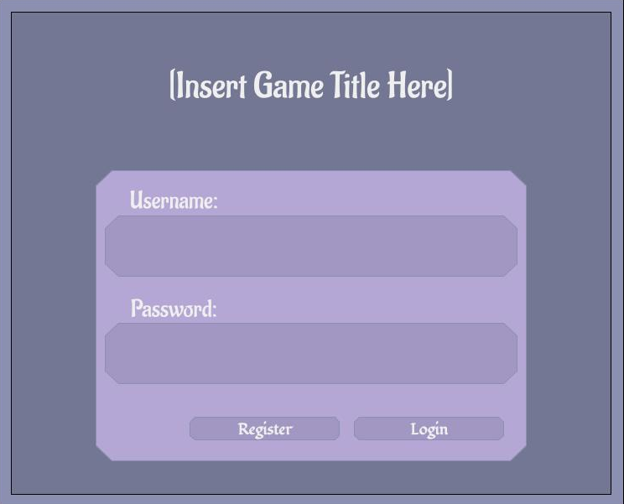
The Original Plan - Practical Features
Main Menu
Leaderboard
Login & Registration

Slide 8

How Development Started
Originally started with the databases, so we all had something to interface with and get data from.
From there, each part of the game, Main Menu, Login/Registration, Combat, Shop, and the Rest Area were split among the team members
Originally using a Flask backend and a mix of the Bootstrap Framework and Phaser
And everything was fine…

Slide 9
Problems Encountered Through Development
Phaser and other frameworks
Phaser works great for platformers and STATIC UI needs.
Implementing combat was an absolute pain, as players’ moves and item lists could be variable length, which was really hard to implement.
After extensive searching as well, it was really hard to find any framework like Phaser that might be more RPG/UI oriented.
Solution: Well… Why not use purely Bootstrap?
Scope
Each level being a different floor was daunting, and originally, every “room” was going to have to have either a varied combat encounter, a shop or treasure room.
Solution: Simplify the scope: Each combat encounter would be a level, there would only be ONE shop with ONE inventory, and until all of that is finished, then we could add more.

Slide 10
Moving Forward and Finishing Development
After these problems were fixed, there were no major setbacks.
Only minor ones
Item database needed an extra value in each entry to keep track of attack stat.
Enemy database needed to be created, so enemies could be reused.
Ran out of time to make proper assets, needed to use what we could find on the internet, editing them to better fit in together
Etc.
We each finished our parts throughout Sprint 3, each part being thoroughly tested by the time the final part, combat was done, with only minor bug fixes/play testing after that (which was mostly uneventful).
Changes included changing prices of items in the shop, editing enemy damage to make it more fair, among other things.
Which leads us to…

Slide 11
Our Demo!

