Slide 1
Multi monitor for YouTube
By Peter Gionfriddo
5/9/2022

Slide 2
introduction
Objectives
What does the app do?
Used YouTube API

Slide 3

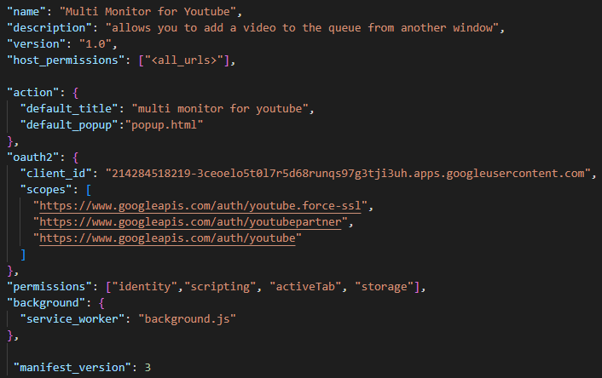



manifest

Slide 4
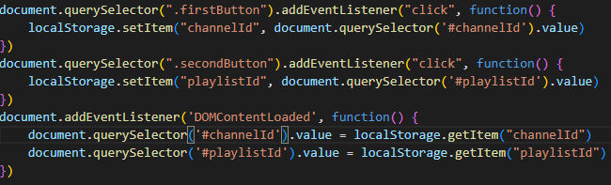
settings

Slide 5
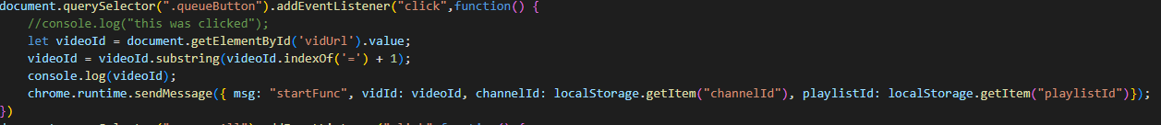
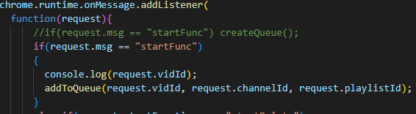
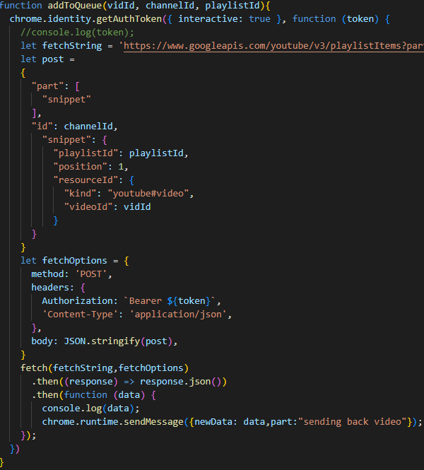
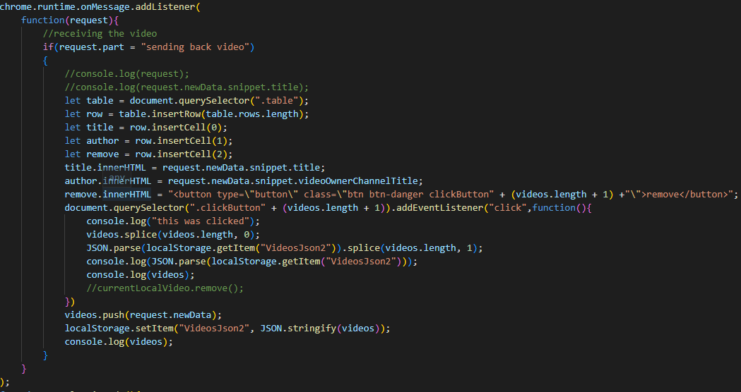
Adding to the queue

Slide 6
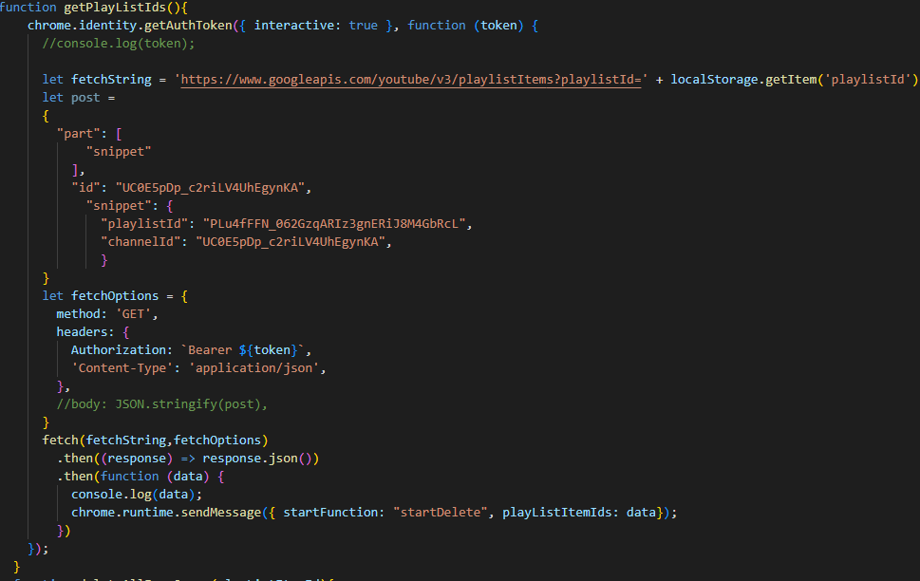
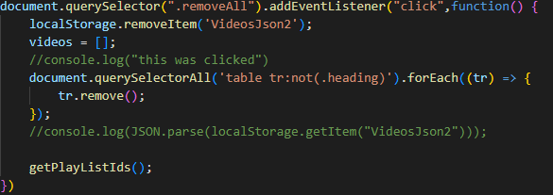
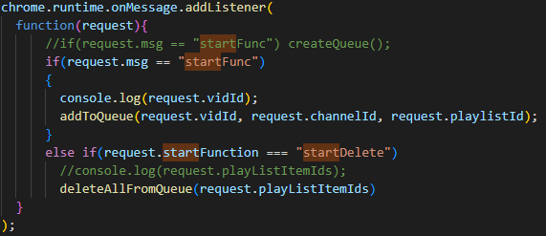
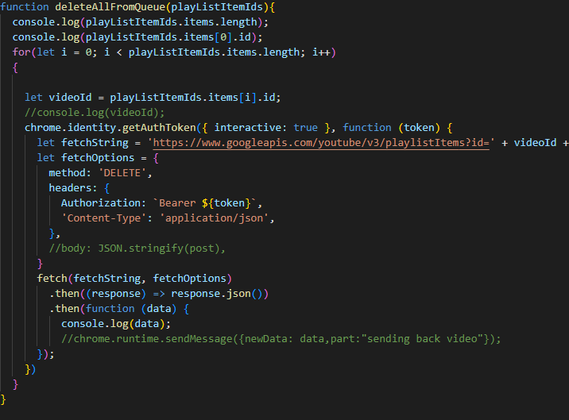
Removing from the queue

Slide 7
Demo!

Slide 8
Conclusion / summary
Difficulties
What I would do to further improve the extension
Youtube API
Using Fetch

Slide 9


Questions?

