Slide 1
Mandatory FAFSA Charts
Reflects completions as of July 31 of each year
FAFSA data from FSA Data Center
Demographic data from U.S. Census Bureau (2018-2022 ACS)
I was able to link Census data to FSA datasets for communities representing >95% of FAFSAs at public high schools each year
Alabama: Slides 2-11
California: Slides 12-21
Illinois: Slides 22-31
Louisiana: Slides 32-41
Texas: Slides 42-51
All pre-2024 mandate states: Slides 52-58
Nationwide: Slides 59-65
*I don’t include Colorado or Maryland due to significant policy variations

Slide 2
Alabama

Slide 3
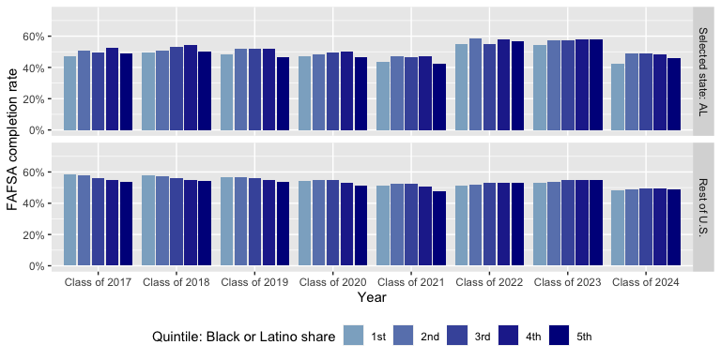
Alabama vs. Rest of U.S.: Completion Rate by Race/Ethnicity
1st quintile = Lowest share of demographic; 5th quintile = Highest share of demographic.

Slide 4
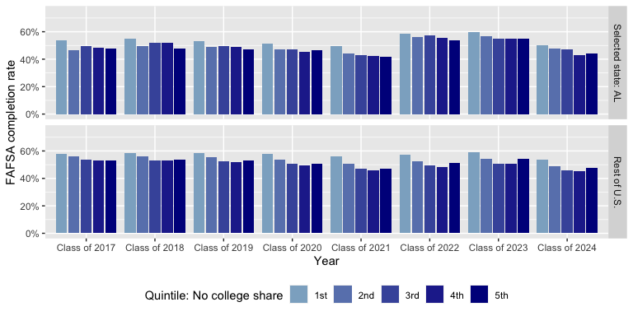
Alabama vs. Rest of U.S.: Completion Rate by Degree Attainment
1st quintile = Lowest share of demographic; 5th quintile = Highest share of demographic.

Slide 5
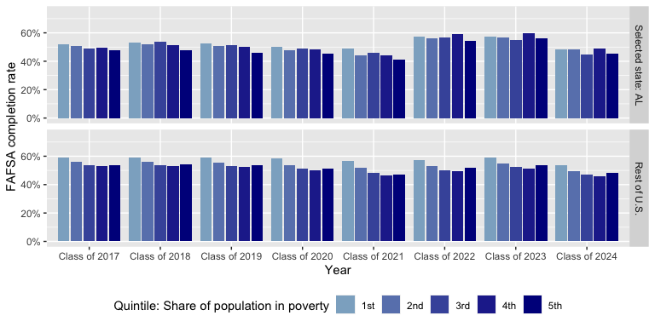
Alabama vs. Rest of U.S.: Completion Rate by Poverty Level
1st quintile = Lowest share of demographic; 5th quintile = Highest share of demographic.

Slide 6
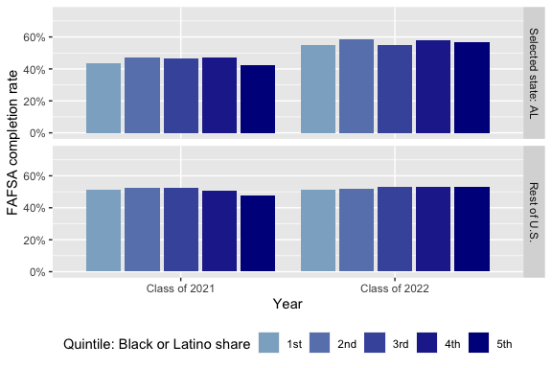
Alabama vs. Rest of U.S.: Completion Rate by Race/Ethnicity (Before/After Policy)
1st quintile = Lowest share of demographic; 5th quintile = Highest share of demographic.

Slide 7
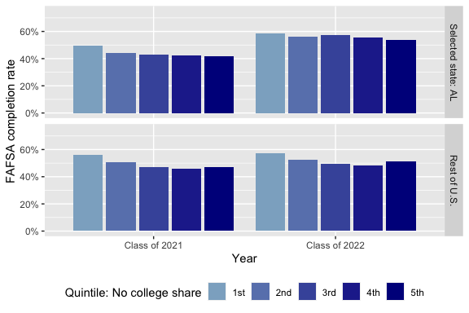
Alabama vs. Rest of U.S.: Completion Rate by Degree Attainment (Before/After Policy)
1st quintile = Lowest share of demographic; 5th quintile = Highest share of demographic.

Slide 8
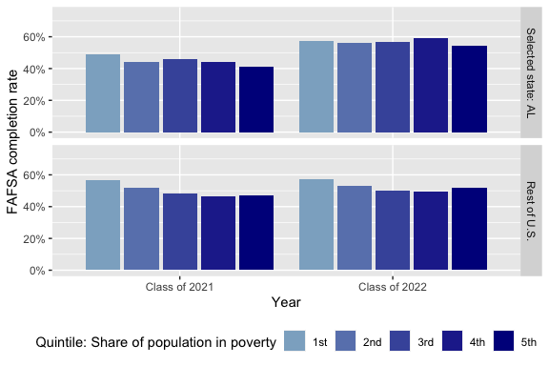
Alabama vs. Rest of U.S.: Completion Rate by Poverty Level (Before/After Policy)
1st quintile = Lowest share of demographic; 5th quintile = Highest share of demographic.

Slide 9
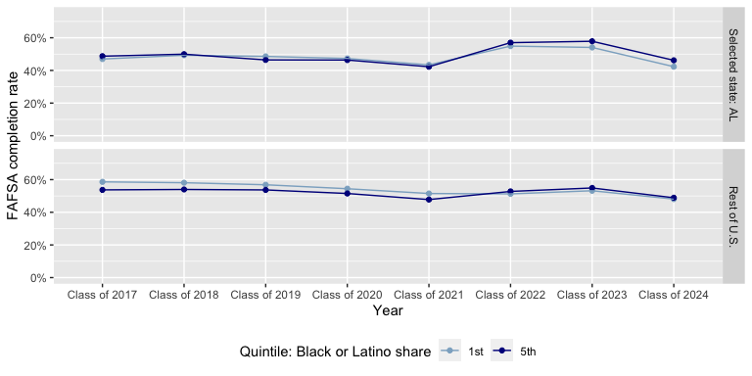
Alabama vs. Rest of U.S.: Completion Rate by Race/Ethnicity (1st & 5th Quintiles)
1st quintile = Lowest share of demographic; 5th quintile = Highest share of demographic.

Slide 10
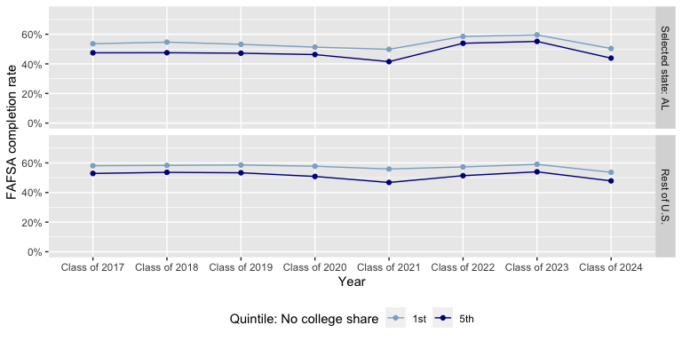
Alabama vs. Rest of U.S.: Completion Rate by Degree Attainment (1st & 5th Quintiles)
1st quintile = Lowest share of demographic; 5th quintile = Highest share of demographic.

Slide 11
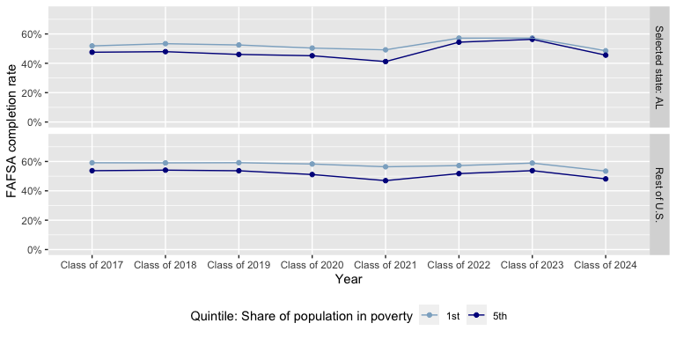
Alabama vs. Rest of U.S.: Completion Rate by Poverty Level (1st & 5th Quintiles)
1st quintile = Lowest share of demographic; 5th quintile = Highest share of demographic.

Slide 12
California

Slide 13
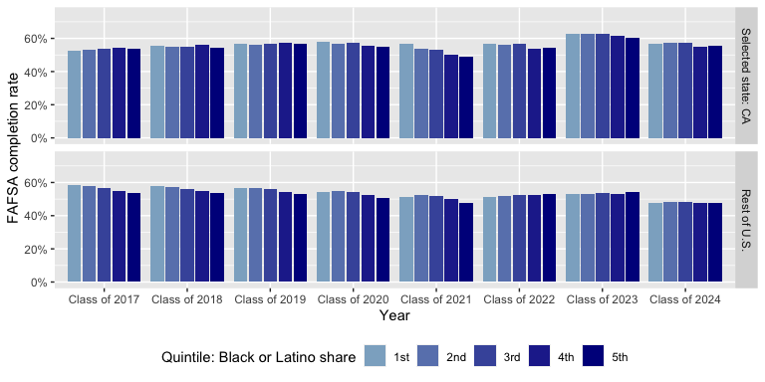
California vs. Rest of U.S.: Completion Rate by Race/Ethnicity
1st quintile = Lowest share of demographic; 5th quintile = Highest share of demographic.

Slide 14
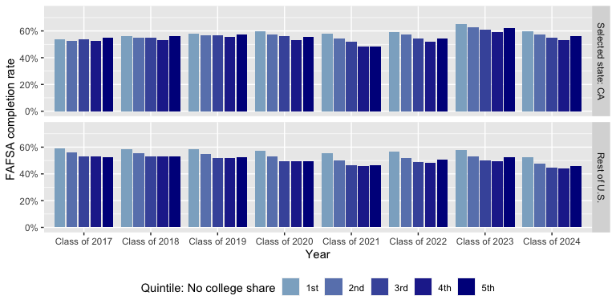
California vs. Rest of U.S.: Completion Rate by Degree Attainment
1st quintile = Lowest share of demographic; 5th quintile = Highest share of demographic.

Slide 15
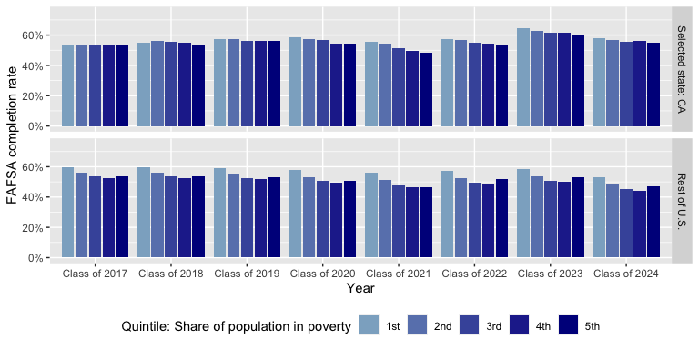
California vs. Rest of U.S.: Completion Rate by Poverty Level
1st quintile = Lowest share of demographic; 5th quintile = Highest share of demographic.

Slide 16
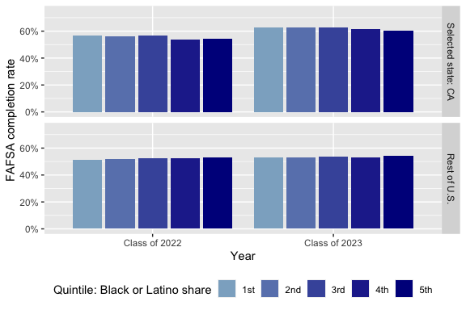
California vs. Rest of U.S.: Completion Rate by Race/Ethnicity (Before/After Policy)
1st quintile = Lowest share of demographic; 5th quintile = Highest share of demographic.

Slide 17
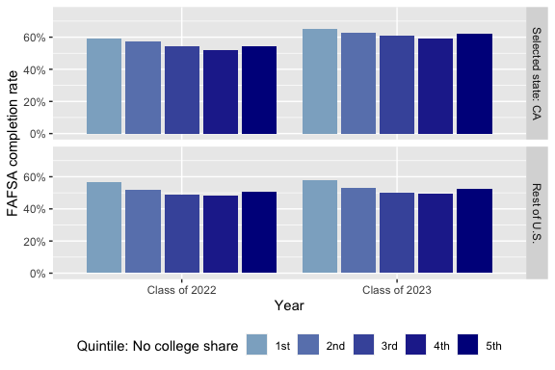
California vs. Rest of U.S.: Completion Rate by Degree Attainment (Before/After Policy)
1st quintile = Lowest share of demographic; 5th quintile = Highest share of demographic.

Slide 18
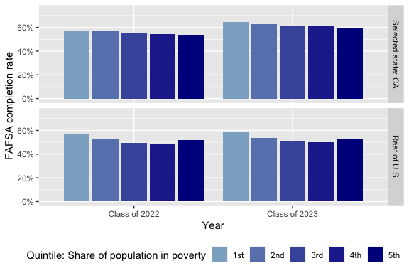
California vs. Rest of U.S.: Completion Rate by Poverty Level (Before/After Policy)
1st quintile = Lowest share of demographic; 5th quintile = Highest share of demographic.

Slide 19
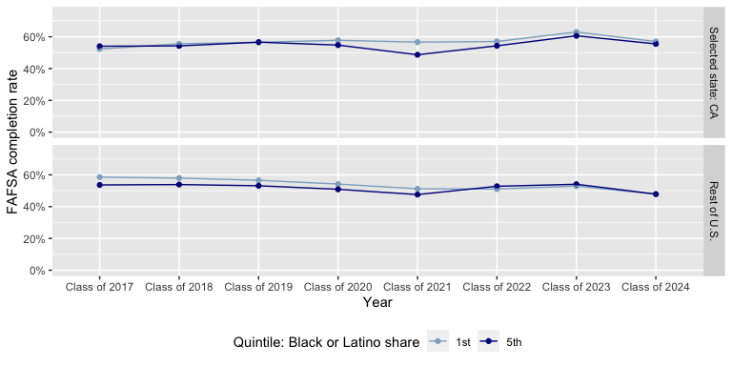
California vs. Rest of U.S.: Completion Rate by Race/Ethnicity (1st & 5th Quintiles)
1st quintile = Lowest share of demographic; 5th quintile = Highest share of demographic.

Slide 20
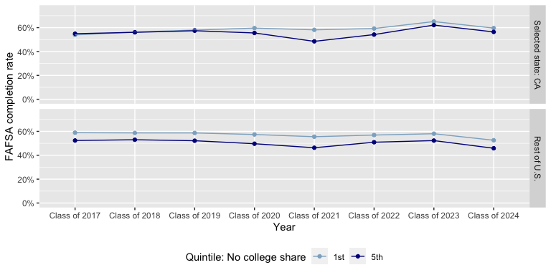
California vs. Rest of U.S.: Completion Rate by Degree Attainment (1st & 5th Quintiles)
1st quintile = Lowest share of demographic; 5th quintile = Highest share of demographic.

Slide 21
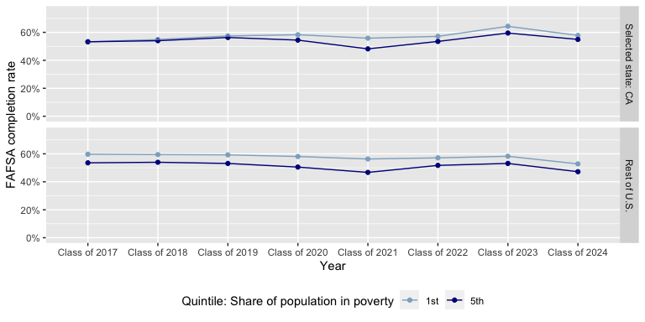
California vs. Rest of U.S.: Completion Rate by Poverty Level (1st & 5th Quintiles)
1st quintile = Lowest share of demographic; 5th quintile = Highest share of demographic.

Slide 22
Illinois

Slide 23
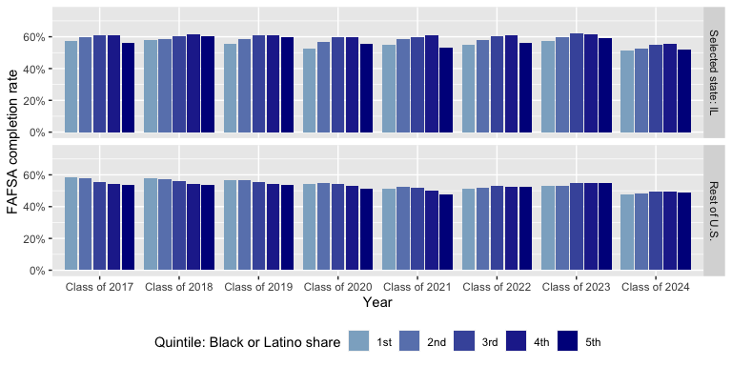
Illinois vs. Rest of U.S.: Completion Rate by Race/Ethnicity
1st quintile = Lowest share of demographic; 5th quintile = Highest share of demographic.

Slide 24
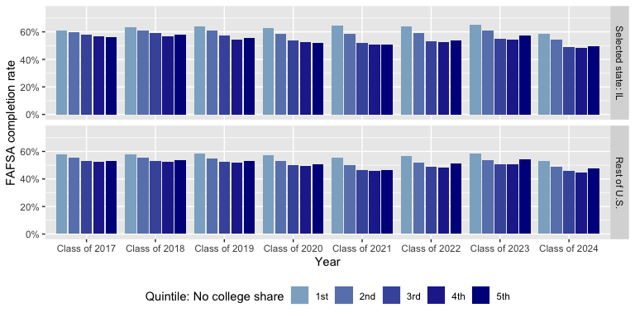
Illinois vs. Rest of U.S.: Completion Rate by Degree Attainment
1st quintile = Lowest share of demographic; 5th quintile = Highest share of demographic.

Slide 25
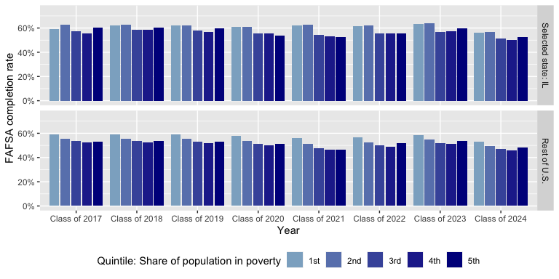
Illinois vs. Rest of U.S.: Completion Rate by Poverty Level
1st quintile = Lowest share of demographic; 5th quintile = Highest share of demographic.

Slide 26
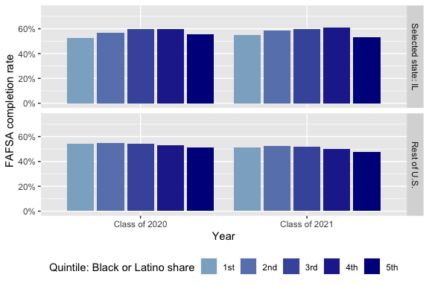
Illinois vs. Rest of U.S.: Completion Rate by Race/Ethnicity (Before/After Policy)
1st quintile = Lowest share of demographic; 5th quintile = Highest share of demographic.

Slide 27
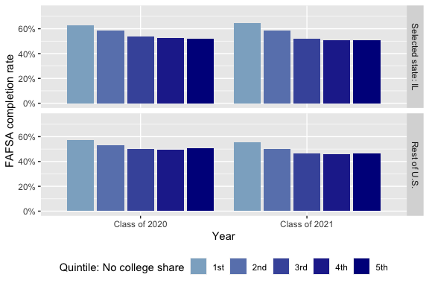
Illinois vs. Rest of U.S.: Completion Rate by Degree Attainment (Before/After Policy)
1st quintile = Lowest share of demographic; 5th quintile = Highest share of demographic.

Slide 28

Illinois vs. Rest of U.S.: Completion Rate by Poverty Level (Before/After Policy)
1st quintile = Lowest share of demographic; 5th quintile = Highest share of demographic.

Slide 29
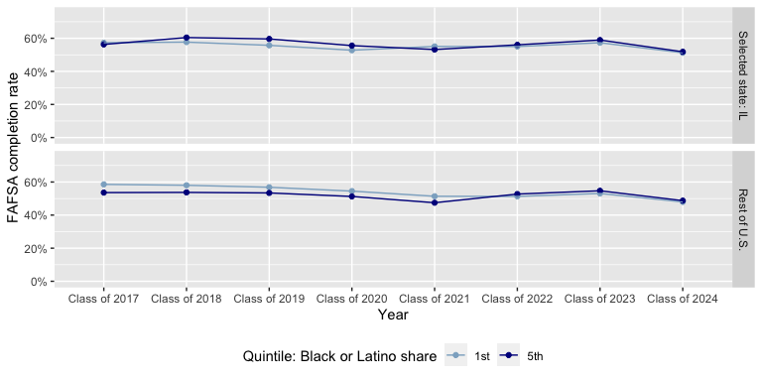
Illinois vs. Rest of U.S.: Completion Rate by Race/Ethnicity (1st & 5th Quintiles)
1st quintile = Lowest share of demographic; 5th quintile = Highest share of demographic.

Slide 30
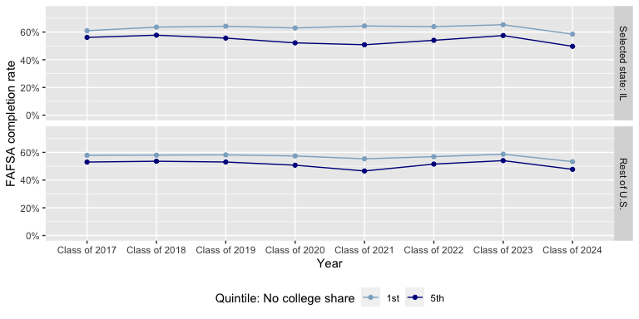
Illinois vs. Rest of U.S.: Completion Rate by Degree Attainment (1st & 5th Quintiles)
1st quintile = Lowest share of demographic; 5th quintile = Highest share of demographic.

Slide 31
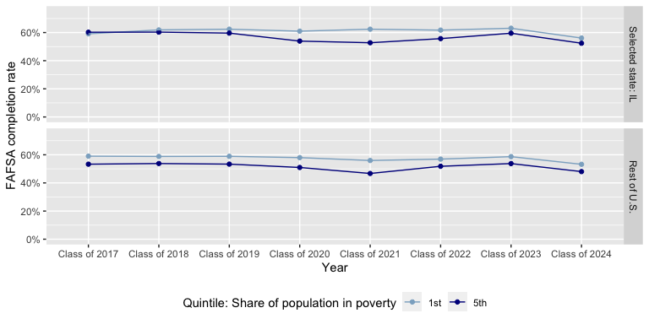
Illinois vs. Rest of U.S.: Completion Rate by Poverty Level (1st & 5th Quintiles)
1st quintile = Lowest share of demographic; 5th quintile = Highest share of demographic.

Slide 32
Louisiana

Slide 33
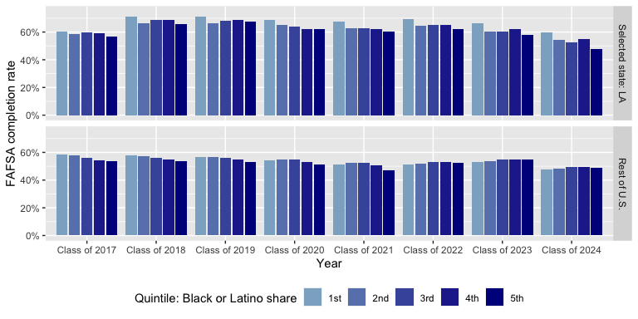
Louisiana vs. Rest of U.S.: Completion Rate by Race/Ethnicity
1st quintile = Lowest share of demographic; 5th quintile = Highest share of demographic.

Slide 34
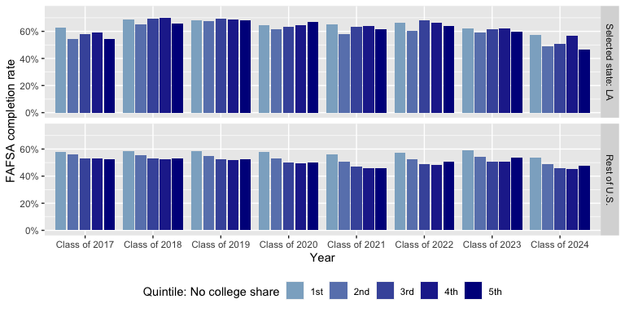
Louisiana vs. Rest of U.S.: Completion Rate by Degree Attainment
1st quintile = Lowest share of demographic; 5th quintile = Highest share of demographic.

Slide 35
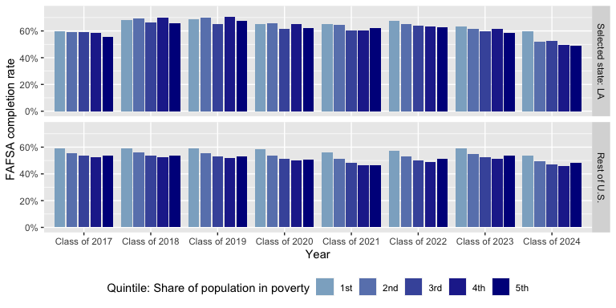
Louisiana vs. Rest of U.S.: Completion Rate by Poverty Level
1st quintile = Lowest share of demographic; 5th quintile = Highest share of demographic.

Slide 36
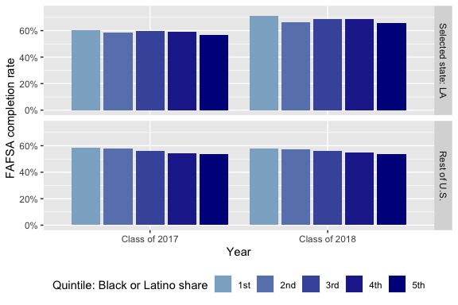
Louisiana vs. Rest of U.S.: Completion Rate by Race/Ethnicity (Before/After Policy)
1st quintile = Lowest share of demographic; 5th quintile = Highest share of demographic.

Slide 37

Louisiana vs. Rest of U.S.: Completion Rate by Degree Attainment (Before/After Policy)
1st quintile = Lowest share of demographic; 5th quintile = Highest share of demographic.

Slide 38
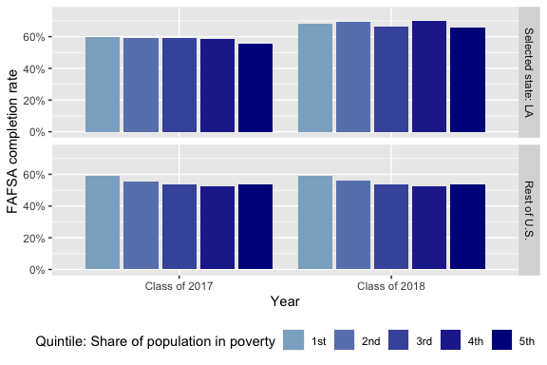
Louisiana vs. Rest of U.S.: Completion Rate by Poverty Level (Before/After Policy)
1st quintile = Lowest share of demographic; 5th quintile = Highest share of demographic.

Slide 39
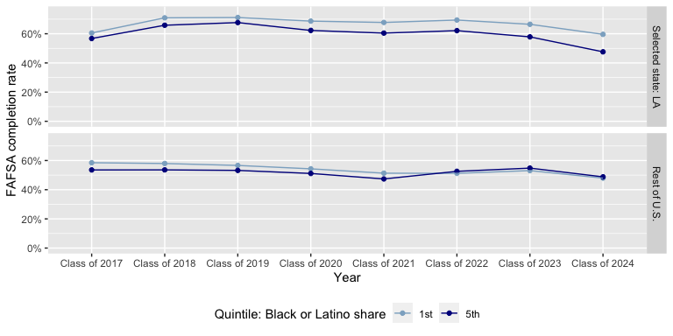
Louisiana vs. Rest of U.S.: Completion Rate by Race/Ethnicity (1st & 5th Quintiles)
1st quintile = Lowest share of demographic; 5th quintile = Highest share of demographic.

Slide 40
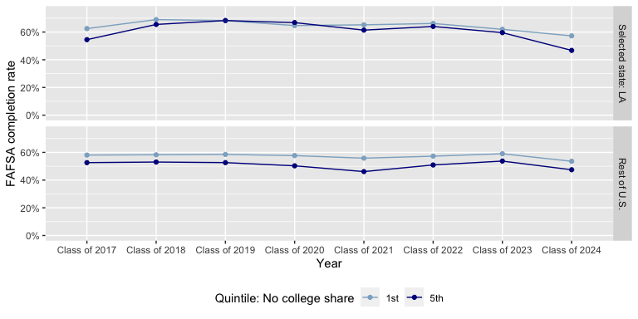
Louisiana vs. Rest of U.S.: Completion Rate by Degree Attainment (1st & 5th Quintiles)
1st quintile = Lowest share of demographic; 5th quintile = Highest share of demographic.

Slide 41
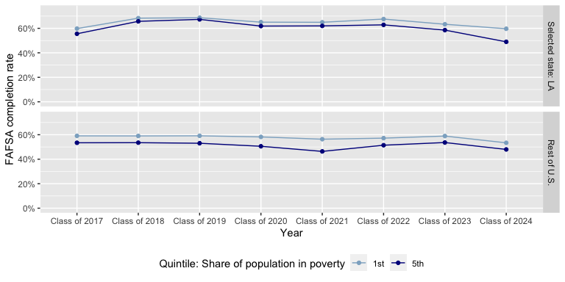
Louisiana vs. Rest of U.S.: Completion Rate by Poverty Level (1st & 5th Quintiles)
1st quintile = Lowest share of demographic; 5th quintile = Highest share of demographic.

Slide 42
Texas

Slide 43
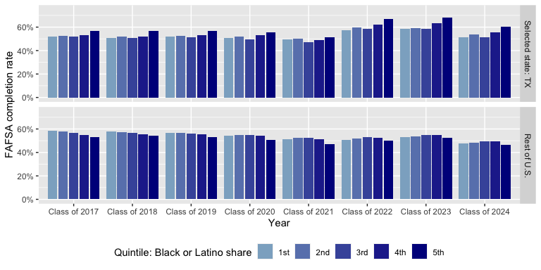
Texas vs. Rest of U.S.: Completion Rate by Race/Ethnicity
1st quintile = Lowest share of demographic; 5th quintile = Highest share of demographic.

Slide 44
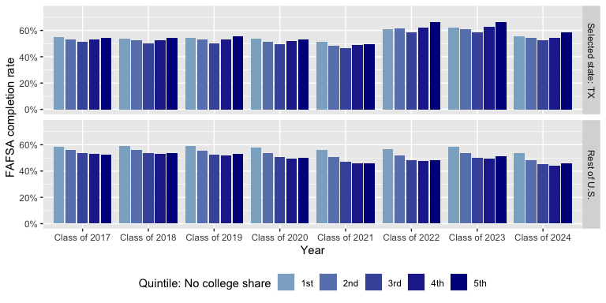
Texas vs. Rest of U.S.: Completion Rate by Degree Attainment
1st quintile = Lowest share of demographic; 5th quintile = Highest share of demographic.

Slide 45
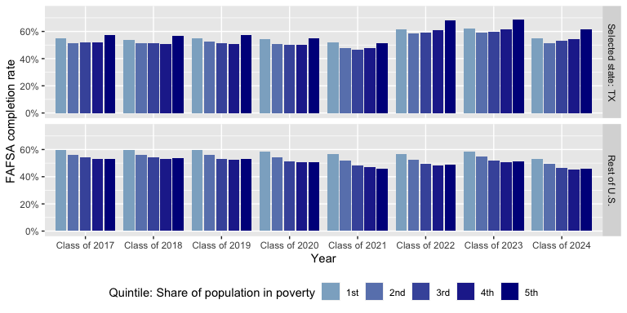
Texas vs. Rest of U.S.: Completion Rate by Poverty Level
1st quintile = Lowest share of demographic; 5th quintile = Highest share of demographic.

Slide 46
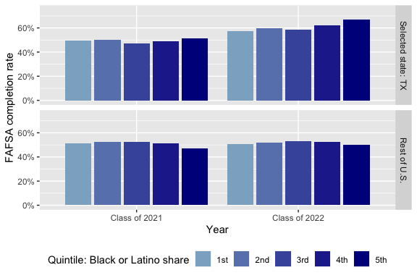
Texas vs. Rest of U.S.: Completion Rate by Race/Ethnicity (Before/After Policy)
1st quintile = Lowest share of demographic; 5th quintile = Highest share of demographic.

Slide 47
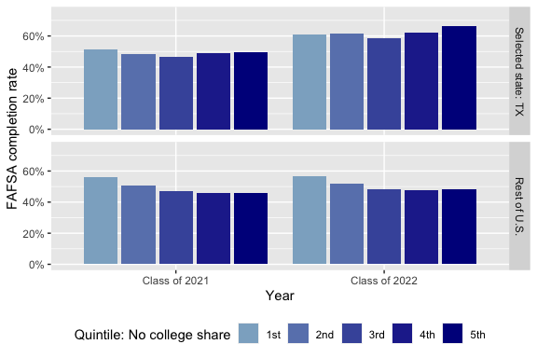
Texas vs. Rest of U.S.: Completion Rate by Degree Attainment (Before/After Policy)
1st quintile = Lowest share of demographic; 5th quintile = Highest share of demographic.

Slide 48
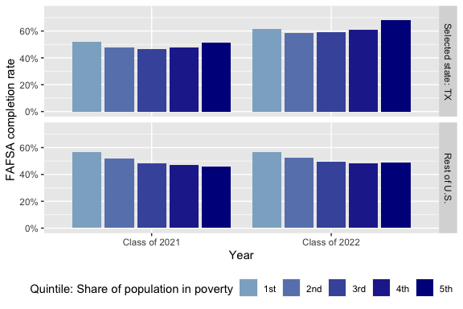
Texas vs. Rest of U.S.: Completion Rate by Poverty Level (Before/After Policy)
1st quintile = Lowest share of demographic; 5th quintile = Highest share of demographic.

Slide 49
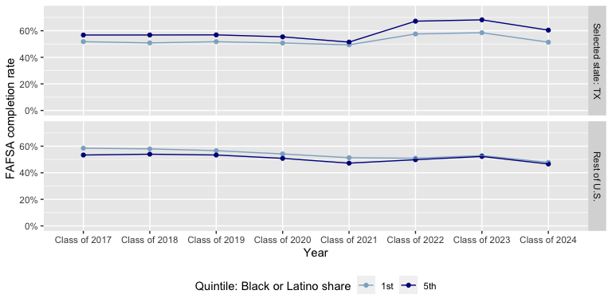
Texas vs. Rest of U.S.: Completion Rate by Race/Ethnicity (1st & 5th Quintiles)
1st quintile = Lowest share of demographic; 5th quintile = Highest share of demographic.

Slide 50
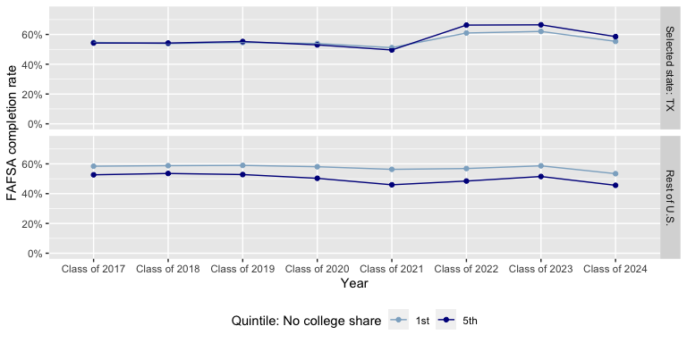
Texas vs. Rest of U.S.: Completion Rate by Degree Attainment (1st & 5th Quintiles)
1st quintile = Lowest share of demographic; 5th quintile = Highest share of demographic.

Slide 51
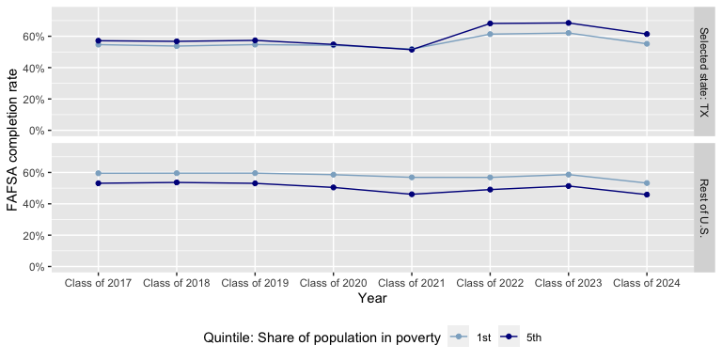
Texas vs. Rest of U.S.: Completion Rate by Poverty Level (1st & 5th Quintiles)
1st quintile = Lowest share of demographic; 5th quintile = Highest share of demographic.

Slide 52
All pre-2024 full mandate states (AL, CA, IL, LA, TX)

Slide 53
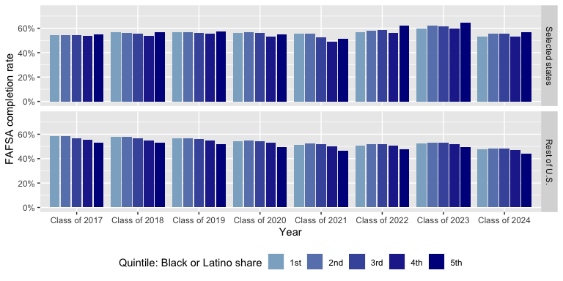
All mandate states vs. Rest of U.S.: Completion Rate by Race/Ethnicity
1st quintile = Lowest share of demographic; 5th quintile = Highest share of demographic.

Slide 54
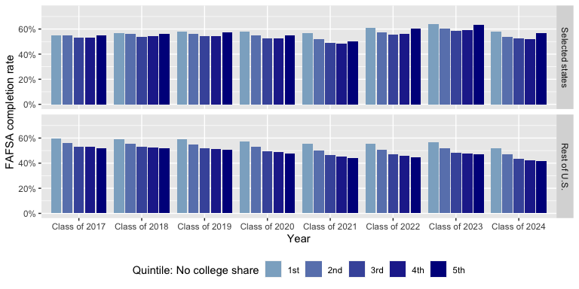
All mandate states vs. Rest of U.S.: Completion Rate by Degree Attainment
1st quintile = Lowest share of demographic; 5th quintile = Highest share of demographic.

Slide 55
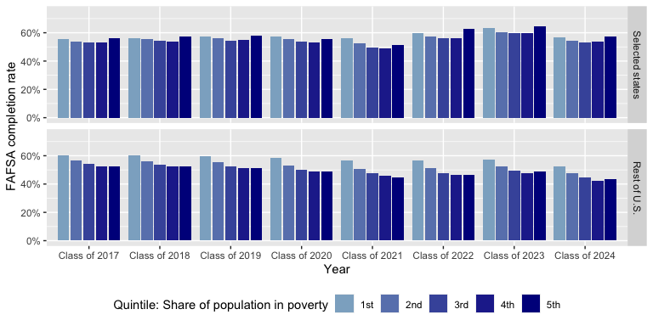
All mandate states vs. Rest of U.S.: Completion Rate by Poverty Level
1st quintile = Lowest share of demographic; 5th quintile = Highest share of demographic.

Slide 56
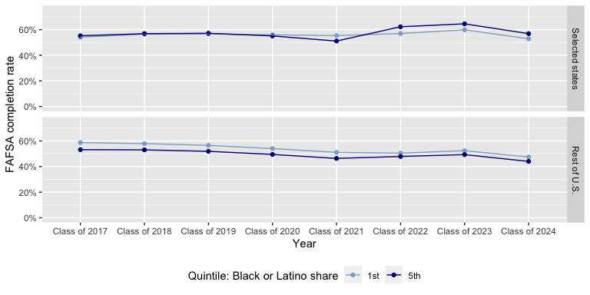
All mandate states vs. Rest of U.S.: Completion Rate by Race/Ethnicity (1st & 5th Quintiles)
1st quintile = Lowest share of demographic; 5th quintile = Highest share of demographic.

Slide 57
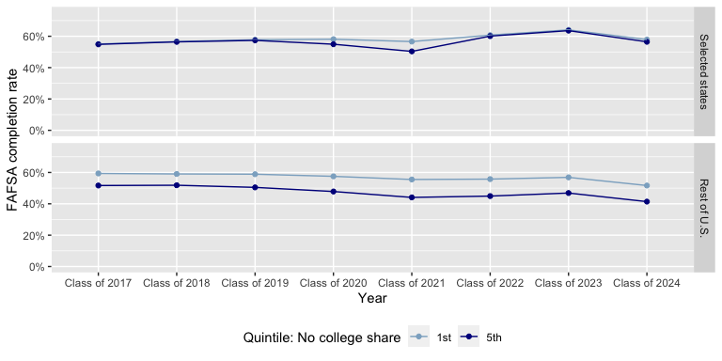
All mandate states vs. Rest of U.S.: Completion Rate by Degree Attainment (1st & 5th Quintiles)
1st quintile = Lowest share of demographic; 5th quintile = Highest share of demographic.

Slide 58
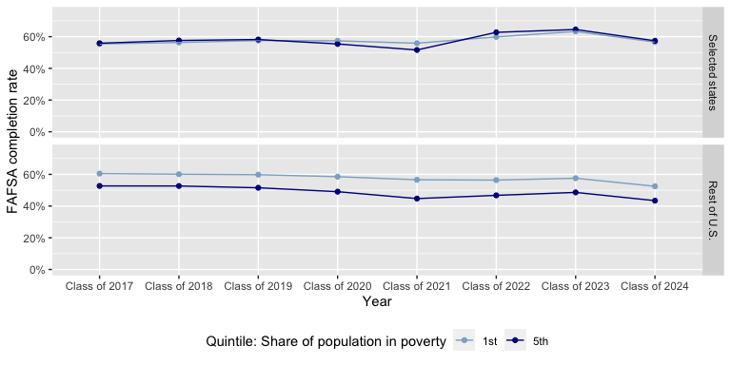
All mandate states vs. Rest of U.S.: Completion Rate by Poverty Level (1st & 5th Quintiles)
1st quintile = Lowest share of demographic; 5th quintile = Highest share of demographic.

Slide 59
National

Slide 60
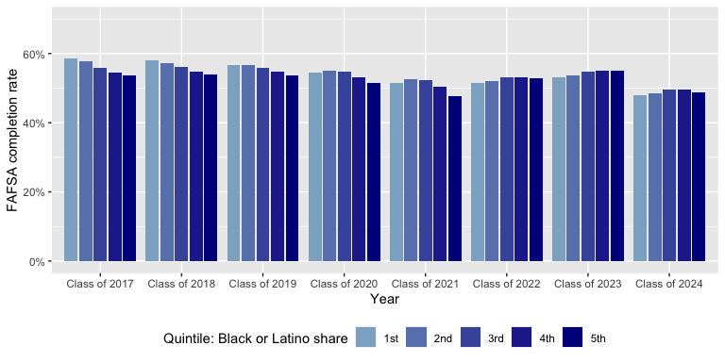
Nationwide: Completion Rate by Race/Ethnicity
1st quintile = Lowest share of demographic; 5th quintile = Highest share of demographic.

Slide 61

Nationwide: Completion Rate by Degree Attainment
1st quintile = Lowest share of demographic; 5th quintile = Highest share of demographic.

Slide 62

Nationwide: Completion Rate by Poverty Level
1st quintile = Lowest share of demographic; 5th quintile = Highest share of demographic.

Slide 63

Nationwide: Completion Rate by Race/Ethnicity (1st & 5th Quintiles)
1st quintile = Lowest share of demographic; 5th quintile = Highest share of demographic.

Slide 64

Nationwide: Completion Rate by Degree Attainment (1st & 5th Quintiles)
1st quintile = Lowest share of demographic; 5th quintile = Highest share of demographic.

Slide 65

Nationwide: Completion Rate by Poverty Level (1st & 5th Quintiles)
1st quintile = Lowest share of demographic; 5th quintile = Highest share of demographic.

