Slide 1
The asymmetric effect of uncertainty on monetary transmission Péter Horváth
10th PhD Workshop of the Hungarian Society of Economics at the University of Pécs

Slide 2
Motivation
Empirical research
Monetary policy
Uncertainty
Asymmetry
Recent „hot topics”:

Slide 3
Motivation
Empirical research
Monetary policy
Uncertainty
Asymmetry
Recent „hot topics”:
Hypothesis
The monetary transmission mechanism is less effective when economic uncertainty is high – meaning it’s less able to anchor inflation and only able to do so with a higher drop in economic activity.

Slide 4
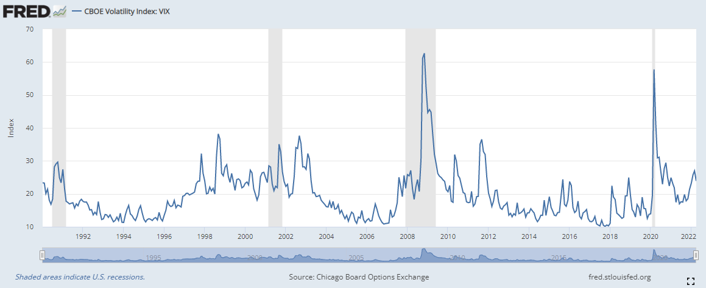
How do we measure uncertainty?
Source: FRED

Slide 5
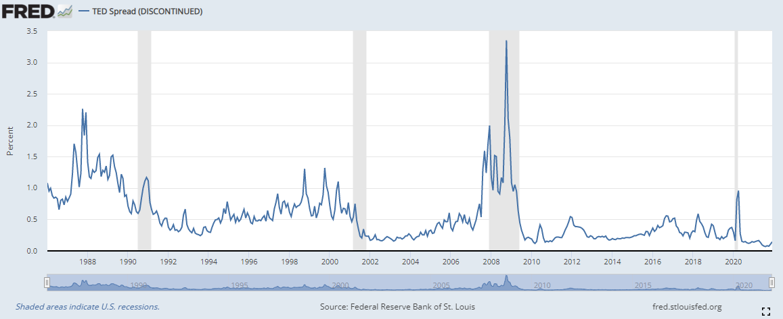
How do we measure uncertainty?
Source: FRED

Slide 6
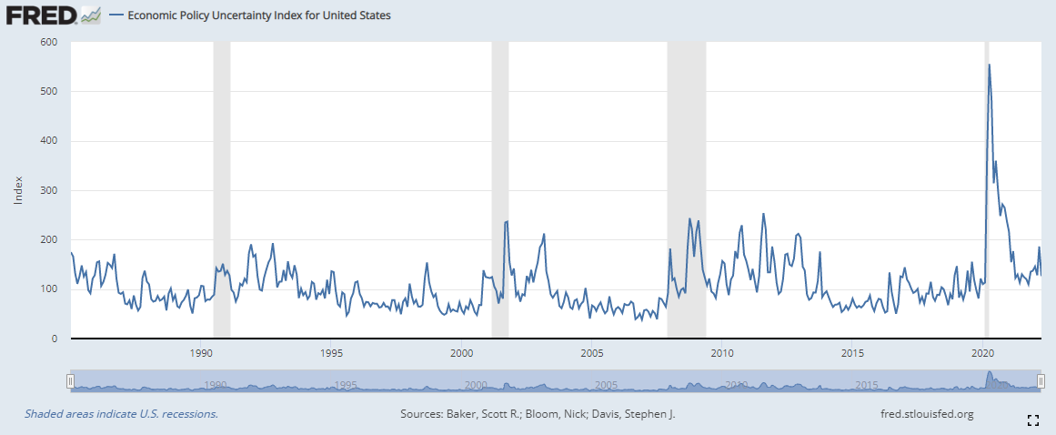
How do we measure uncertainty?
Source: FRED

Slide 7
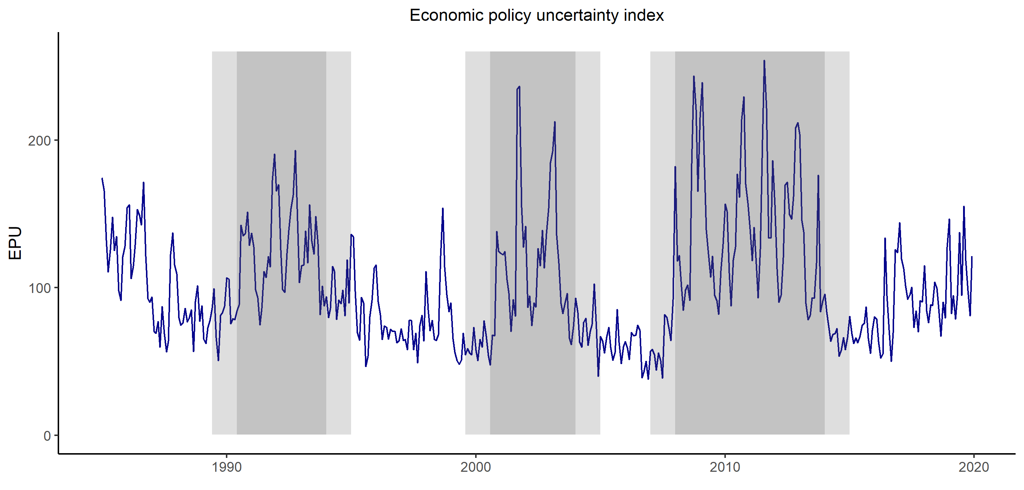
How do we measure uncertainty?
Baker, S. R., Bloom, N., & Davis, S. J. (2016). Measuring economic policy uncertainty. The quarterly journal of economics, 131 (4), 1593-1636.

Slide 8
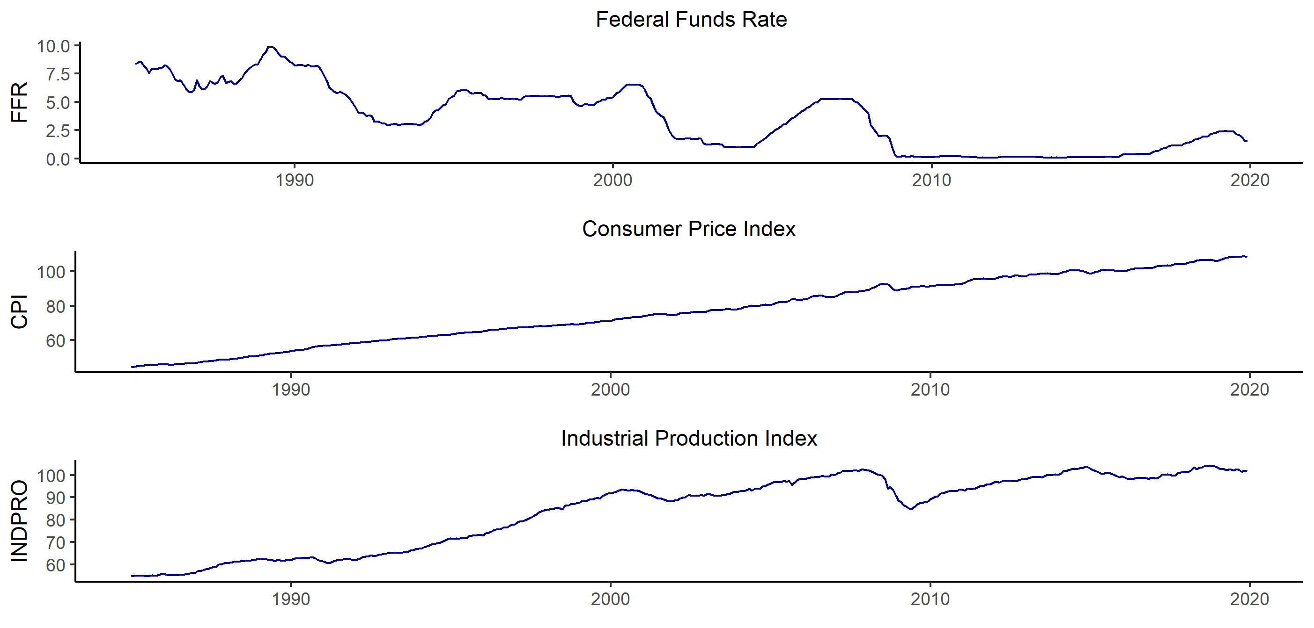
Data
Monthly US Data
Range: January 1985 to December 2019
As used in the model:
FFR – level
CPI – 1st difference (monthly inflation)
INDPRO – 1st difference (monthly growth in output)

Slide 9
Methodology
Vector-Autoregression
Estimate a baseline model
VAR with time varying paramtere assumption
Estimate VAR-s in 60 month rolling window
Impulse responses for assessing results
Point-by-point median aggregation

Slide 10
An empirical challange along the way
The price puzzle
Monetary aggregates?
Commodity prices?
Sign restriction!

Slide 11
Methodology (continued)
Interest rate | ↑
Inflation rate | ↓
Industrial growth | ↓
Sign restriction:
Only monetary shock is identified
Uhlig, H. (2005). What are the effects of monetary policy on output? Results from an agnostic identification procedure. Journal of Monetary Economics, 52 (2), 381-419.
Penalty method vs. rejection method

Slide 12
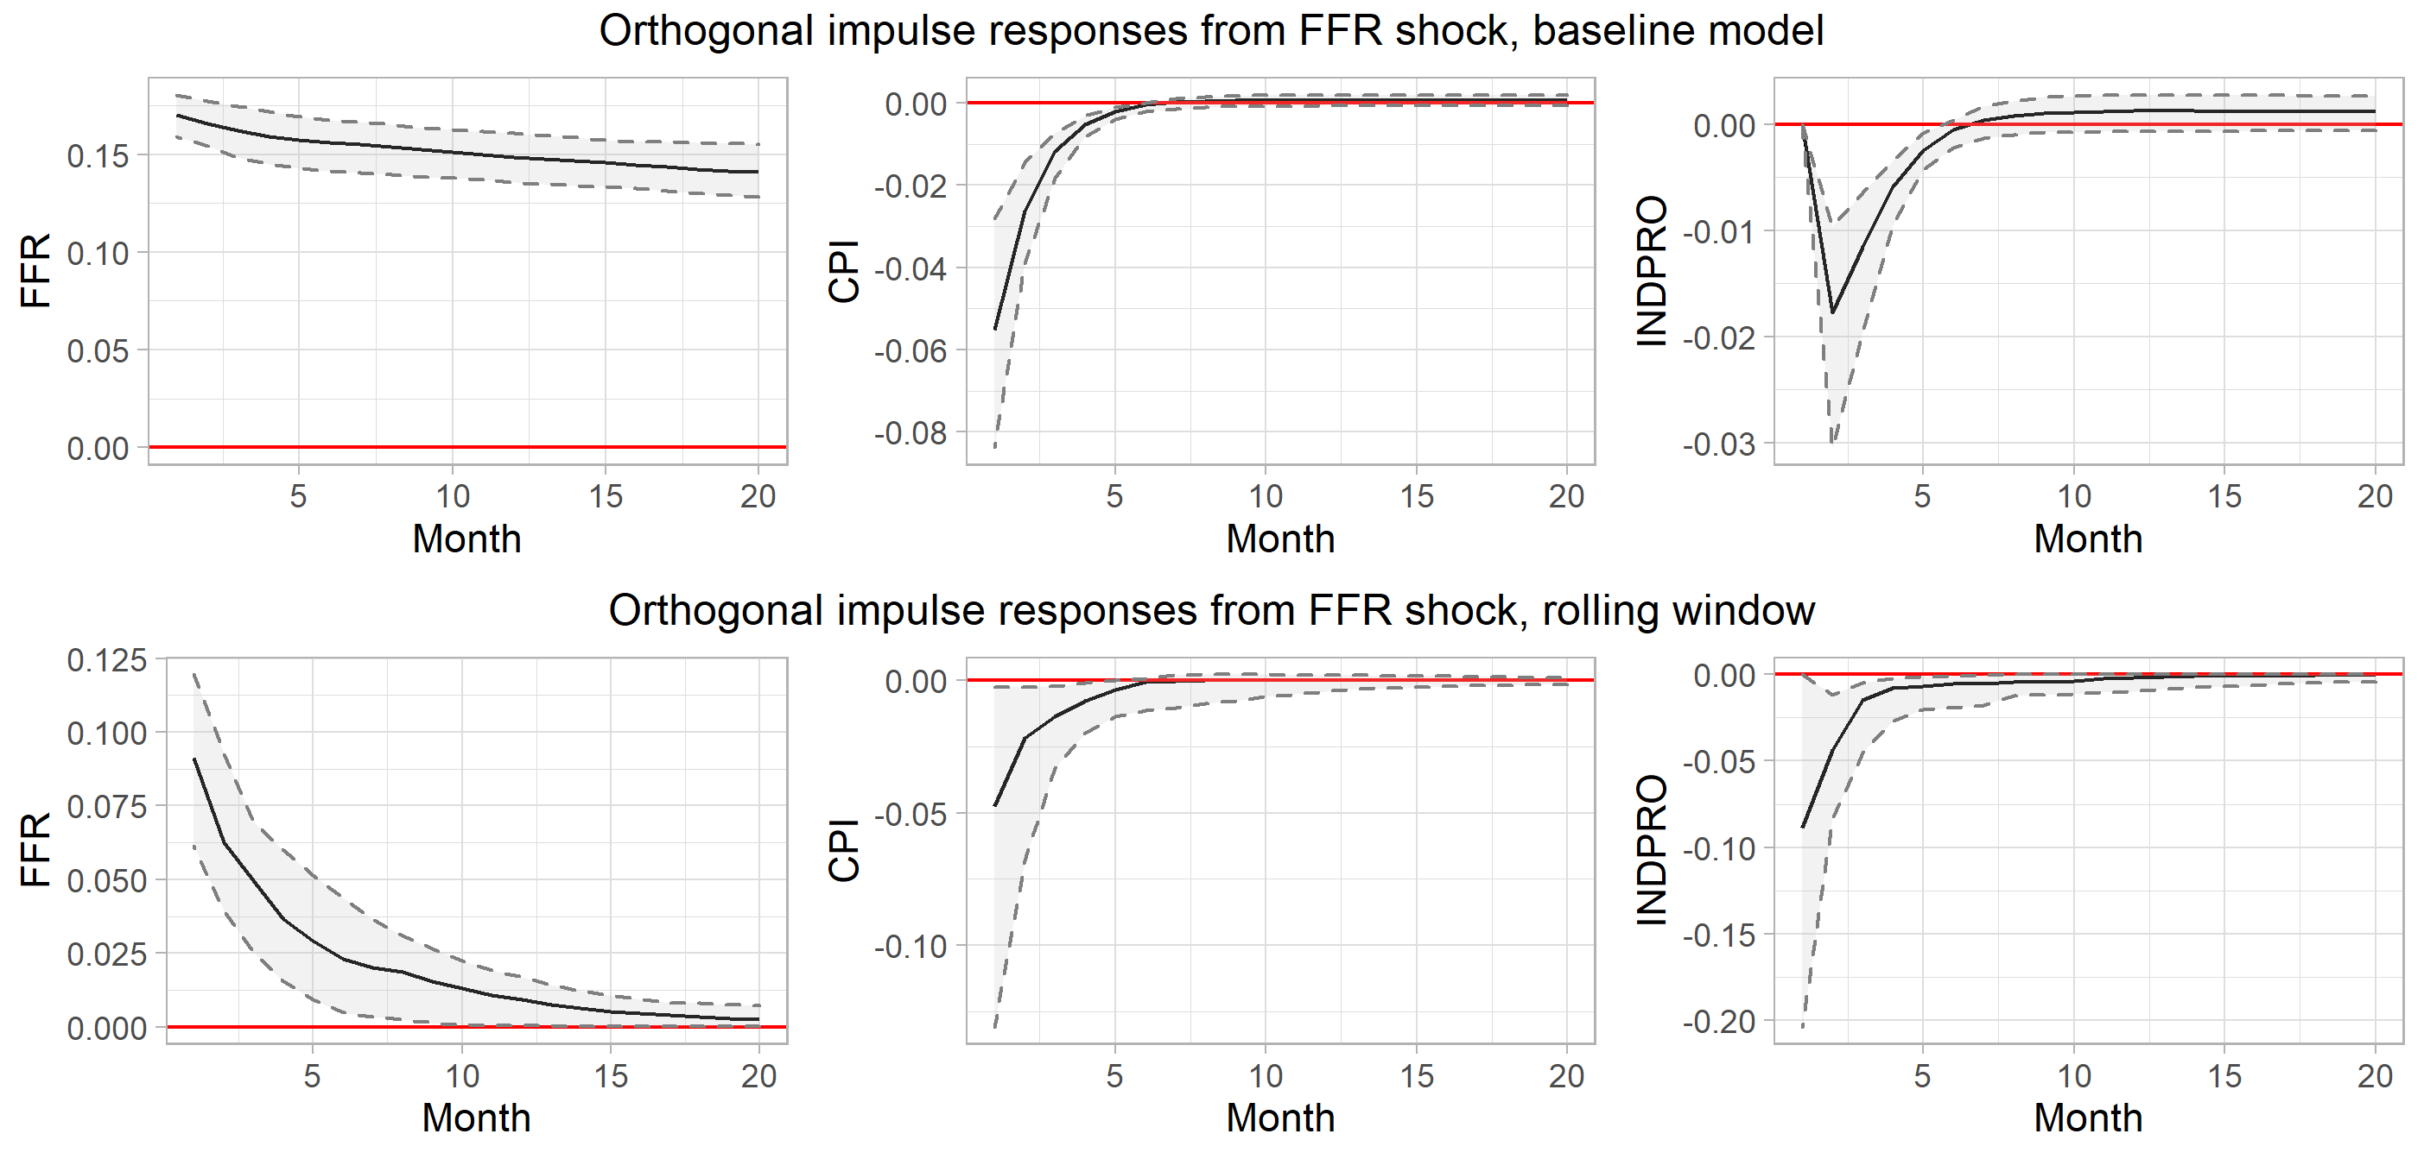
Evaluating results

Slide 13
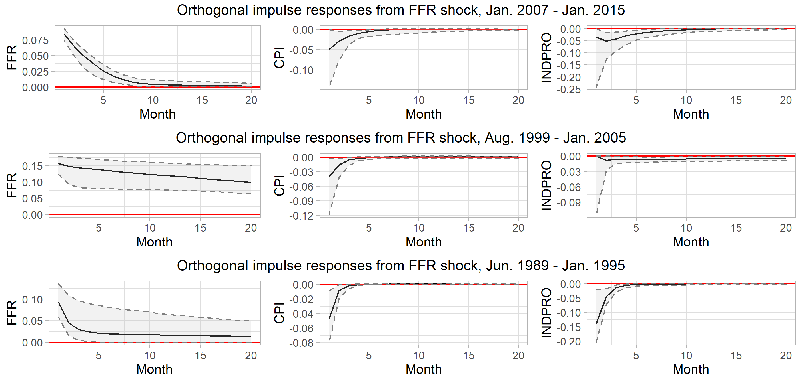
Dissecting the high uncertainty time periods

Slide 14
Moving forward
More emphasis on time varying parameter assumption
Is monthly data appropriate for my purposes?
More elegant methodology for modelling assymmetries – TVAR / Switching VAR

Slide 15
Most important references
Baker, S. R., Bloom, N., & Davis, S. J. (2016). Measuring economic policy uncertainty. The quarterly journal of economics, 131 (4), 1593-1636.
Uhlig, H. (2005). What are the effects of monetary policy on output? Results from an agnostic identification procedure. Journal of Monetary Economics, 52 (2), 381-419.

Slide 16
Thank you for your attention!

