Slide 1
Network Chatroom
Presenter: Peter Harlan

Slide 2

Outline
Implementation (Languages and etc.)
Algorithm
Known Problems
Demo
References

Slide 3

Implementation (language and etc.)

Slide 4
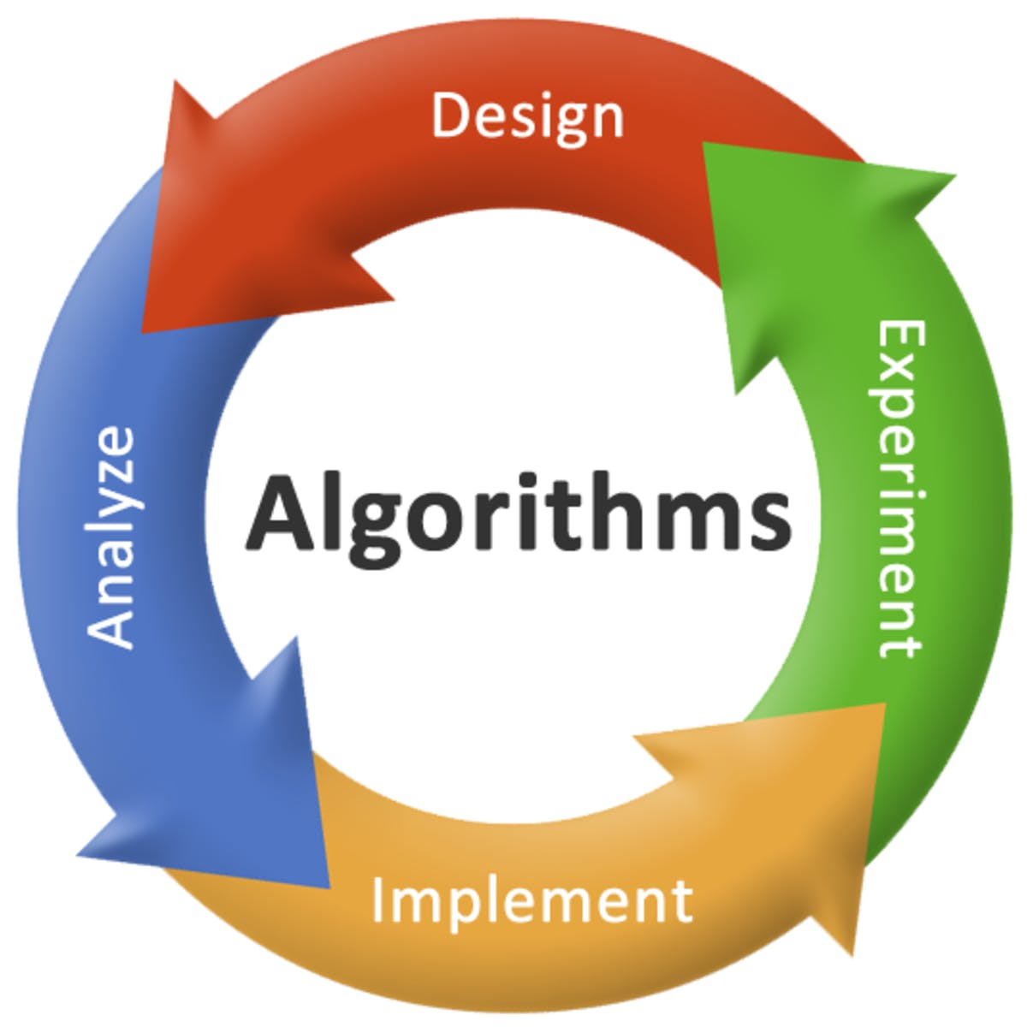
Algorithm
Different Objects
Server
Client
Lobby
User
Rooms

Slide 5
Known Problems
Limitation/Unimplemented Feature
Does not store history of chatroom in in output file.
Does not limit history (Lead to DoS attack).
Server sends too many messages
Clients uses up resources if history is large

Slide 6
Demo
http://people.wku.edu/peter.harlan996/tic-tac-toe.html

Slide 7
References
< https://filezilla-project.org/>
<https://www.sublimetext.com/>
<https://cdn.forbesmiddleeast.com/en/wp-content/uploads/sites/3/2018/01/shutterstock_524344900-1635x1084.jpg>
<https://medium.com/the-mission/what-is-the-algorithm-for-success-8d820ce167b0>
<https://www.iconsdb.com/green-icons/checkmark-icon.html>
<https://codeburst.io/15-free-ebooks-to-learn-python-c299943f9f2c>
<https://github.com/PeterHarlan/PythonChatroom>
<https://steelkiwi.com/blog/working-tcp-sockets/>

