Slide 1
UFO Showdown
Presenter: Peter Harlan & Mary Odenthal

Slide 2

Outline
Implementation (Languages and etc.)
Algorithm
Interface Design
Known Problems
Demo
References

Slide 3



Implementation (language and etc.)
HTML
Content
CSS
Style
JavaScript
Function
JQuery
Function
Bootstrap
Function and style

Slide 4

Implementation (cont.)
Used a sprite sheet (sliding window to display explosion)
Grab x and y coordinates of mouse from listener and used atan2 to get degrees in radian
The generated degree used for cannon rotation.
GameArea object with awake, clear, and stop functions
Components object for each of the element (holds x, y, x1, y1, image, etc.)
FixedUpdate() – called every 60ms or .06 of a sec.

Slide 5
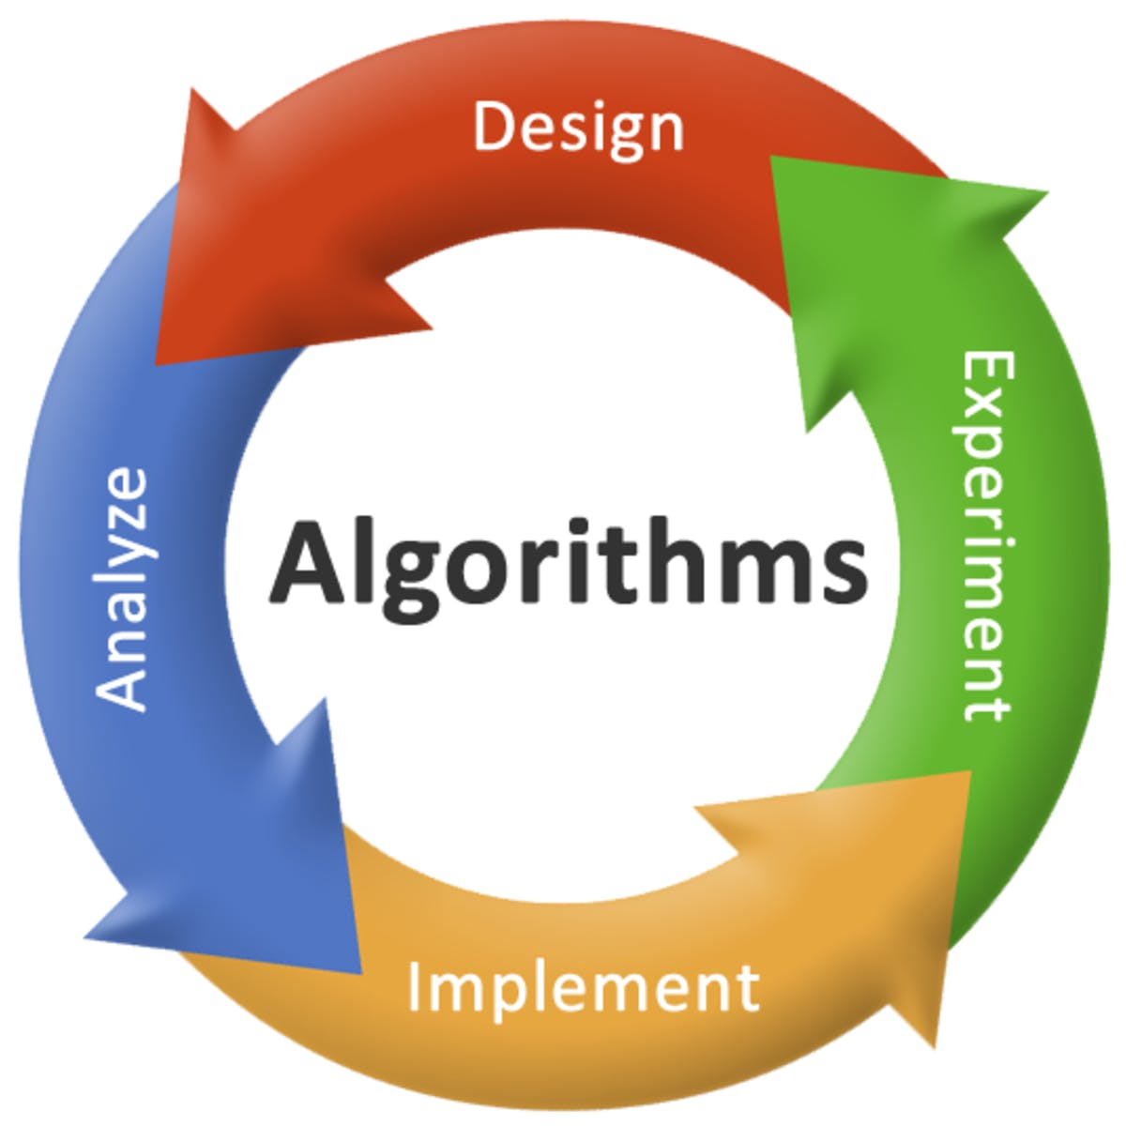
Algorithm
Awake:
Create/Initialize UI Elements
Fixed Update:
If(collision)
Update score and play collision animation
Update UI element positions
Draw the UI elements
Interrupts/Listeners
Mouse click to launch cannon ball
Mouse drag to change rotation of cannon

Slide 6
Interface Design
Bootstrap
Grid Layout (row and col classes)
Desk top responsiveness (scalability)
Modal
Align test class
Button color class (secondary and danger)
JQuery
Listen for clicks
Get components (shortens .js getElementById())

Slide 7

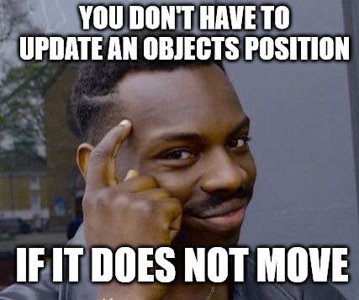

Known Problems
Limitation/Unimplemented Feature
Although the application scales on a desktop, it does not scale on a mobile device. Need more time with jQuery to address this issue.

Slide 8
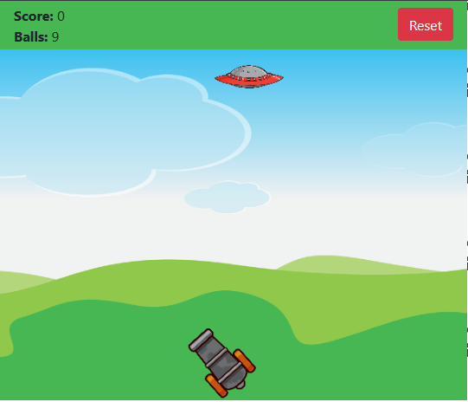

Demo

Slide 9
References
< https://getbootstrap.com/>
< https://www.wku.edu/its/websites/>
< https://filezilla-project.org/>
<https://www.sublimetext.com/>
<https://www.w3schools.com/jquery/>
<https://www.kisspng.com/free/jquery.html>
<https://medium.com/the-mission/what-is-the-algorithm-for-success-8d820ce167b0>
<https://imgflip.com/memegenerator/Roll-Safe-Think-About-It>
<https://www.iconsdb.com/green-icons/checkmark-icon.html>

