Slide 1
UFO
Presenter: Peter Harlan

Slide 2

Outline
Implementation (Languages and etc.)
UI Design
Main Interface
Algorithms
Known Problems
Demo
References

Slide 3


Implementation (language and etc.)

Slide 4
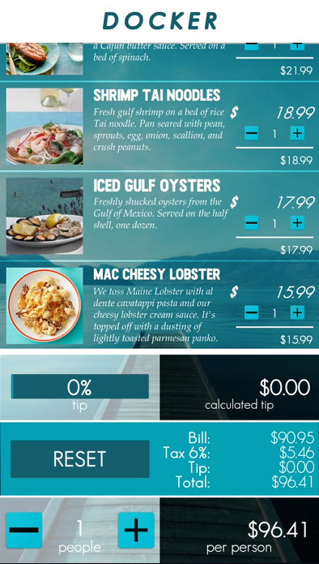
Database Design
Menu Items
Description
Title
Quantity manipulation
Price Calculation
Bill (subtotal w/o tax and tip)
Tax 6%
Tip
Total (sum of everything)
People Count
Per Person Cost
Reset Button
Tip Slider

Slide 5

Algorithm
Each menu Item is an object class called food (Inherent from Scriptable object instead of Monobehavior)
Title
Description
Quantity
Per unit cost
Calculated Cost
Image
Create prefab for the general layout
Instantiate the prefab for unique food items

Slide 6

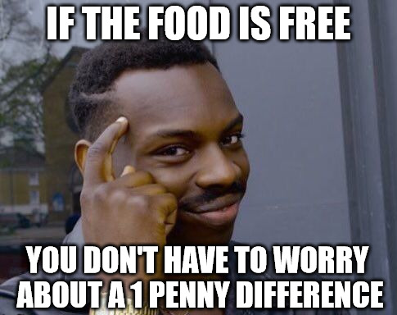

Known Problems
Most of the requirements are met except for the one penny difference calculation

Slide 7

Demo

Slide 8
References
<https://imgflip.com/memegenerator/Roll-Safe-Think-About-It>
<https://www.iconsdb.com/green-icons/checkmark-icon.html>
<https://melbournechapter.net/explore/pirate-cannon-clipart/#gal_post_423_pirate-cannon-clipart-5.png>
<https://fallout.gamepedia.com/Cannonball>

