Slide 1
Evaluating the Effect of Covid-19 on Emotional and Mental Health
Peter hart
Department of Electrical Engineering and Computer Science, Cleveland State University

Slide 2
Motivation
Because of Covid-19, there has been over 270k deaths, 49 million unemployed, and 100k businesses permanently closed in US alone
Covid-19 pandemic has potential to negatively impact emotional and mental health
Twitter can be used as a data source to assess the change of the public’s sentiment and emotions

Slide 3
Research objectives
Visualize how the general sentiment of the US and Ohio has changed seven months before and after COVID-19
Visualize how the emotion of the US and Ohio residents has changed seven months before and after COVID-19 in order to identify specific areas potentially in need of more immediate help
Visualize how the general sentiment and the emotion of the residents of US compares with the residents of Mexico and Canada seven months before and after the COVID-19 pandemic.

Slide 4
Approach

Slide 5
Data collection
5,678,432 geotagged tweets from Twitter Stream API
July 2019 to early September 2020
Created separate dataset using hashtags and emojis on tweets mapped to 1 of 4 emotions: anger, fear, joy, sadness to train the model

Slide 6
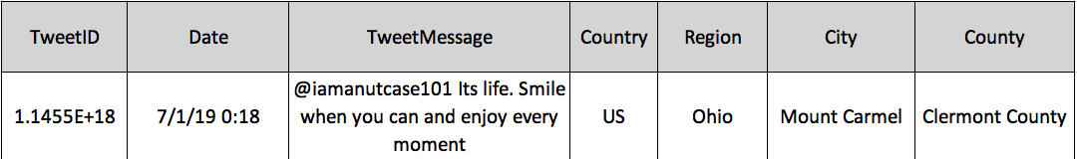
Data cleaning and Reverse Geocoding
Preprocessing
Removing links usernames, char repetitions, common stop words and transforming emojis to text. The characters are then all converted to lowercase.
Additional fields for country, city, region, and county were added, based on longitude/latitude (reverse geocoding)

Slide 7
Sentiment analysis
Technique that will classify each tweet as positive (+1), neutral (0), or negative (-1) representing the emotion of the author toward the tweet’s subject
VADER is a sentiment analysis tool that will score tweets from -1 to 1
Experimentally determined thresholds classify those values as positive, neutral or negative. Values above 0.5 are positive, values below -0.5 are negative and values in between are neutral.

Slide 8
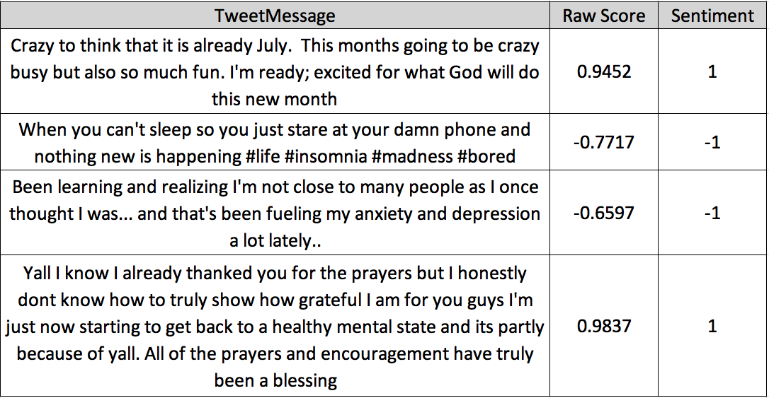
VADER examples

Slide 9
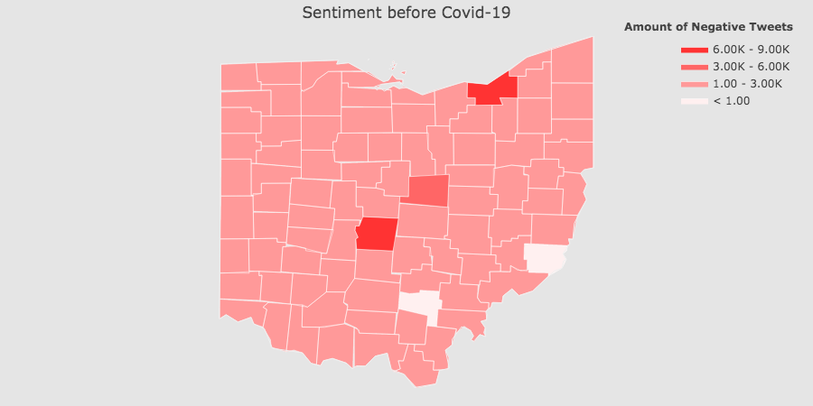
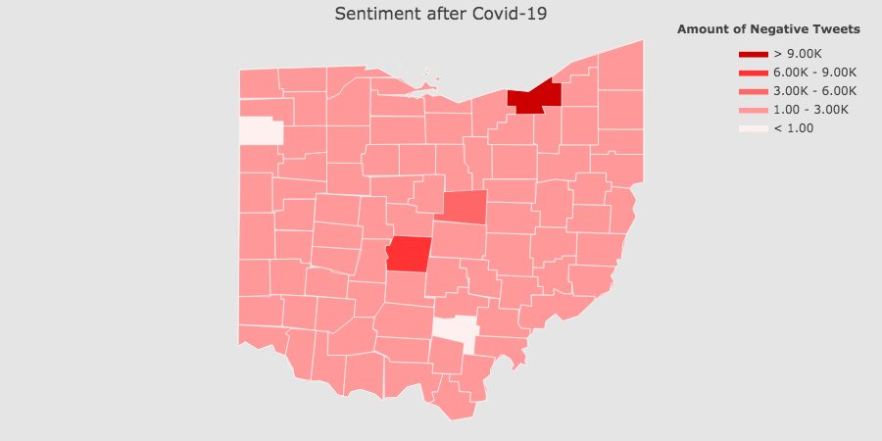
Ohio Sentiment Analysis
Sentiment | Before Covid-19 | After Covid-19 | % Change
Negative | 34369 | 44021 | 28.0834
Positive | 33462 | 34324 | 2.57606
Total Dataset | 86545 | 90609 | 4.69582

Slide 10
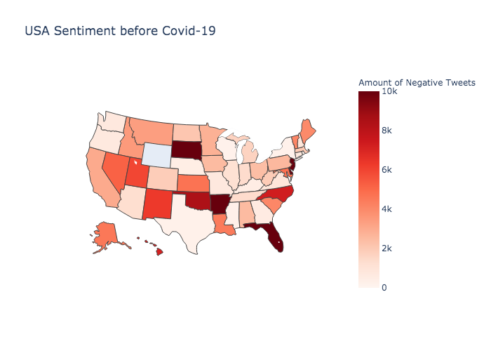
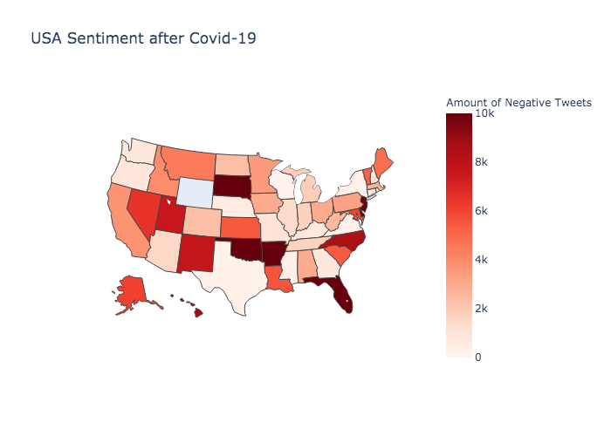
US sentiment Analysis
Sentiment | Before Covid-19 | After Covid-19 | % Change
Negative | 211943 | 263074 | 24.1249
Positive | 169924 | 201991 | 18.8714
Total Dataset | 446756 | 544023 | 21.7718

Slide 11
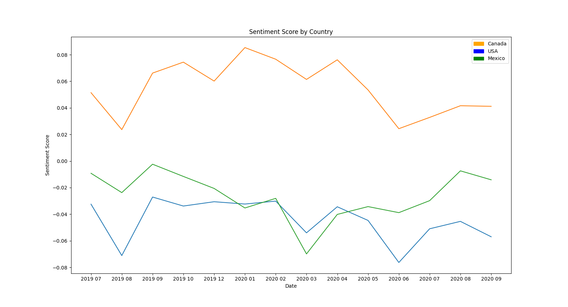
North America sentiment analysis
Sentiment | Before Negative | Before Positive | Total | After Negative | After Positive | Total | Total % Change | Pos % Change | Neg % Change
USA | 211943 | 169924 | 446756 | 263074 | 201991 | 544023 | 21.77 | 18.8714 | 24.124
CANADA | 37552 | 43834 | 98895 | 37110 | 41226 | 97764 | -1.14 | -5.95 | -1.18
MEXICO | 3933 | 2958 | 12661 | 3863 | 2567 | 12252 | -3.230 | -13.218 | -1.78

Slide 12
Emotion analysis
Many machine learning algorithms compared
Logistic Regression, Linear Discriminant Analysis, KNeighbors Classifier, Decision Tree Classifier, GaussianNB, Support Vector machine, and Convolutional Neural Network (CNN) Long-Short Term Memory (LSTM).
Evaluated using Accuracy, macro f1-score, recall, and precision
Best algorithm determined to be CNN LTSM
Each tweet is run through the model and given a score for each of the four emotions. Whichever score is the highest, indicates the prevalent emotion for that tweet.

Slide 13
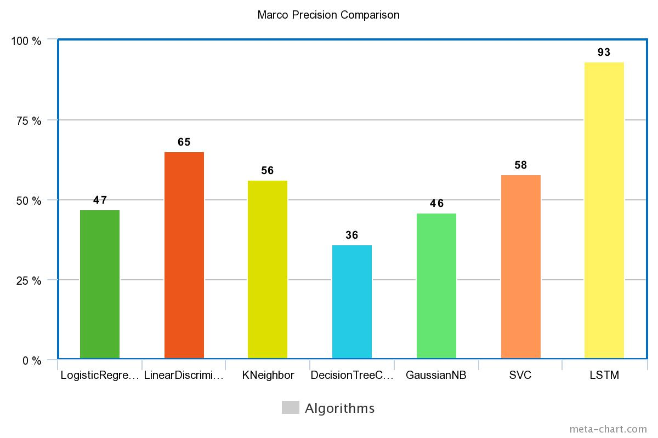
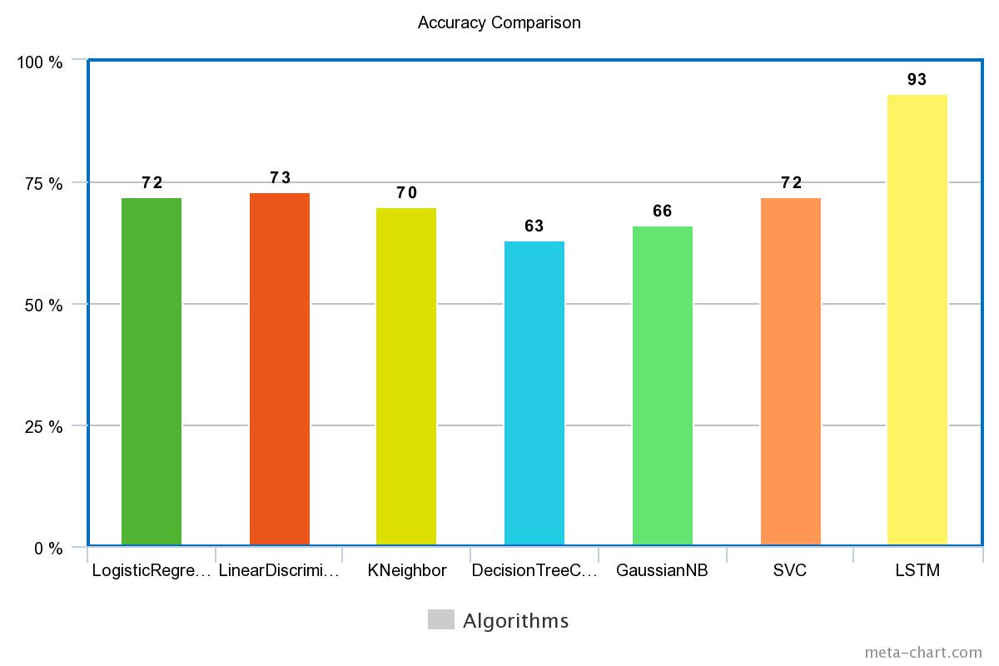
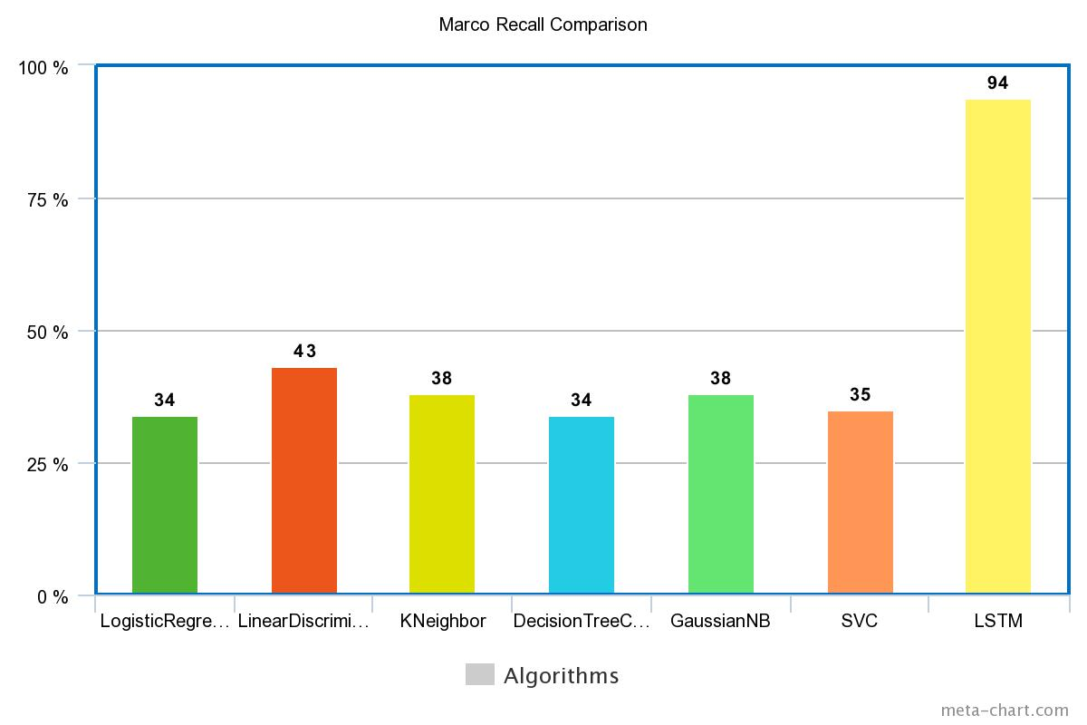
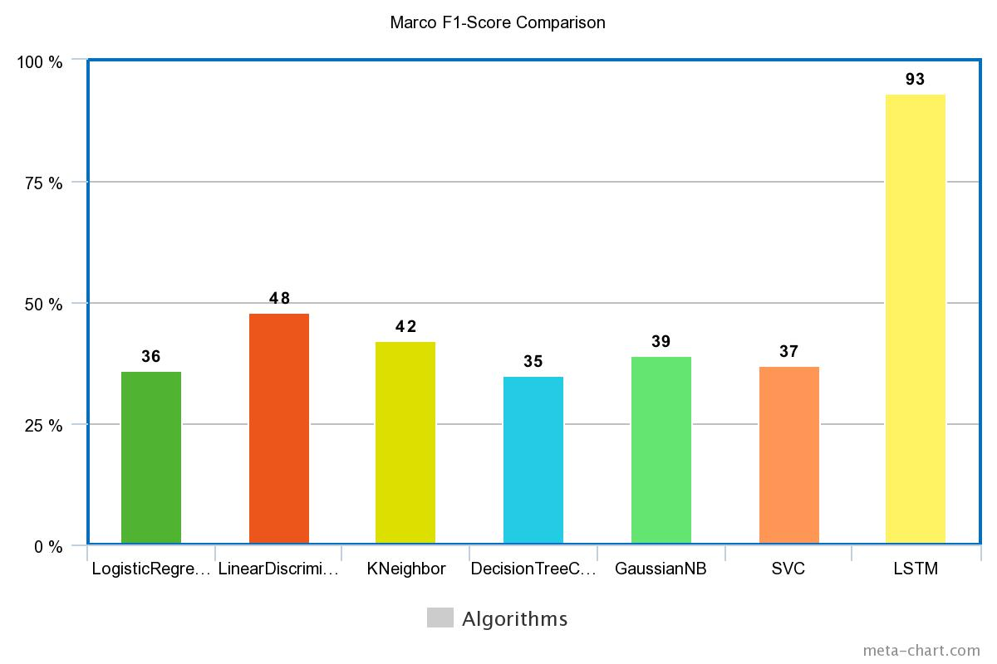
Emotion Analysis Model Comparison

Slide 14
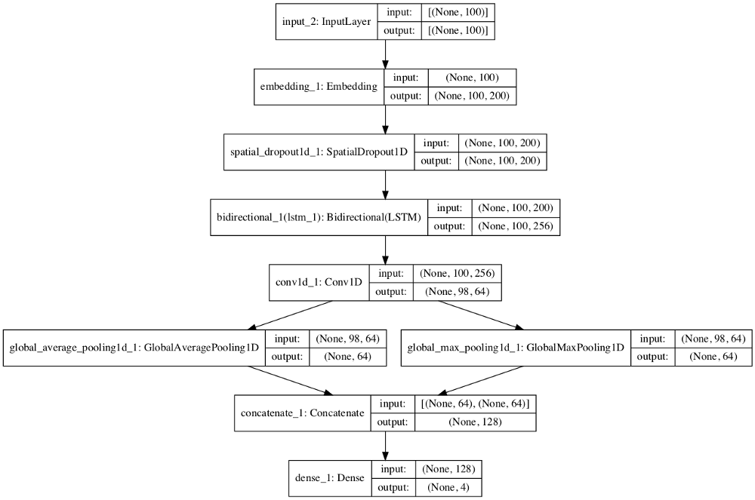
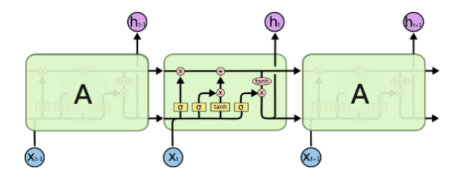
Convolutional Neural Network (CNN) Long-Short Term Memory (LSTM)
Uses the CNN layers to extract features from the input data and combines with the LSTM layer to support sequence prediction

Slide 15
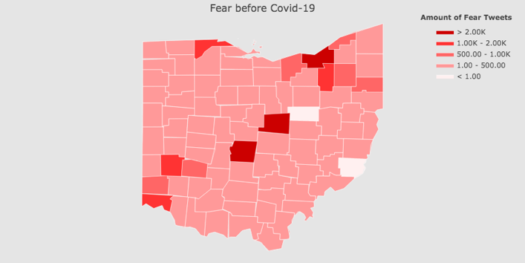
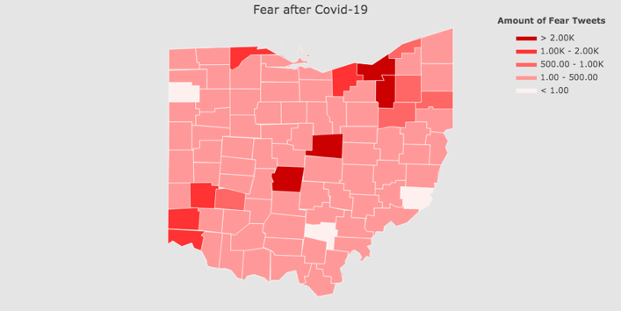
Ohio emotion analysis
Emotion | Before Covid-19 | After Covid-19 | % Change
Anger | 6064 | 6604 | 8.9
Fear | 35638 | 46325 | 29.99
Joy | 22802 | 23123 | 1.41
Sadness | 14469 | 14802 | 2.24
Total Dataset | 86545 | 90609 | 4.69

Slide 16
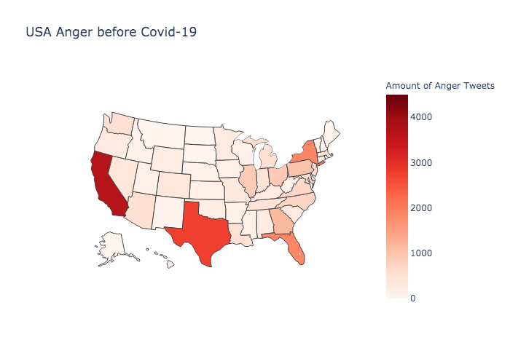
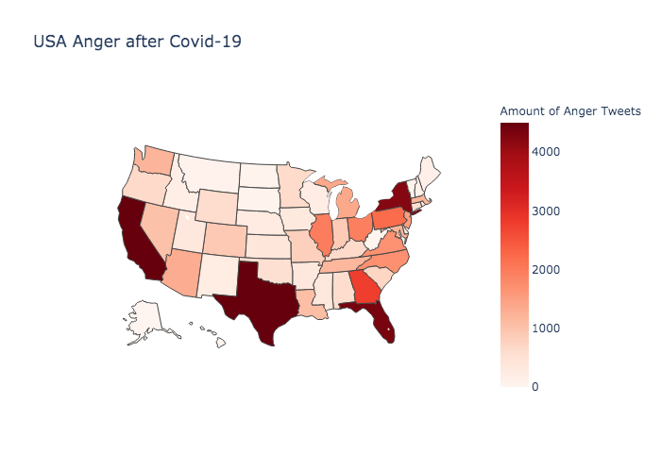
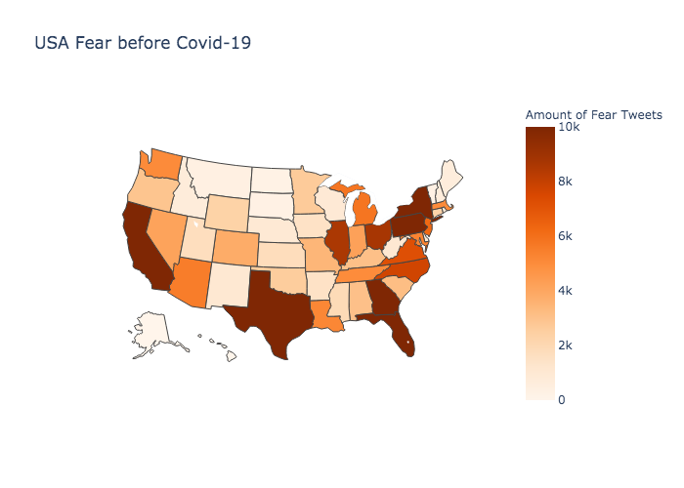
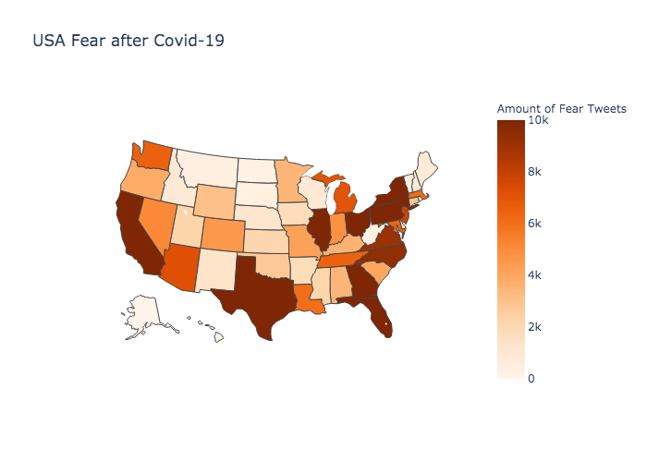
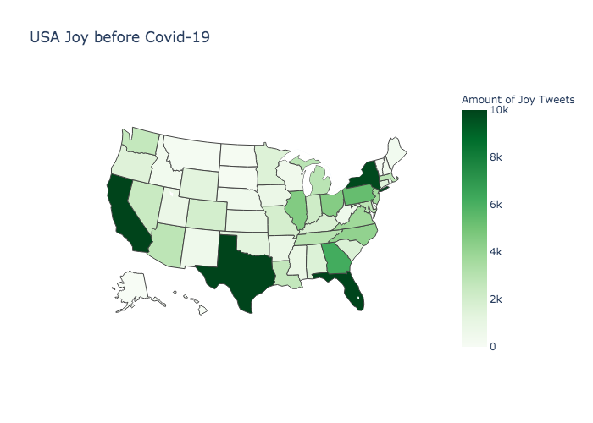
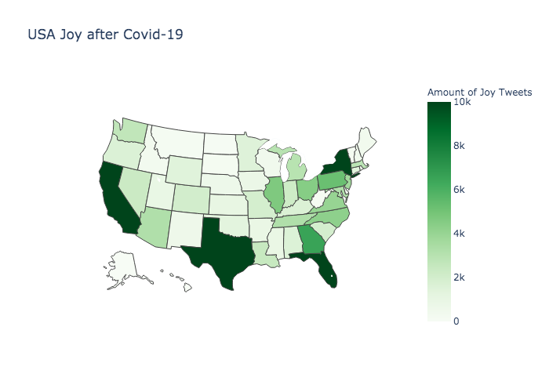
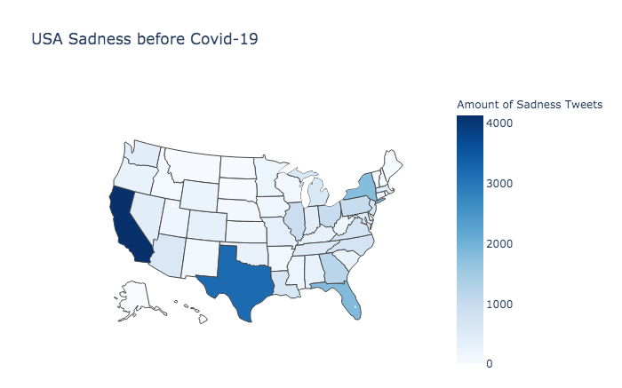

US Emotion analysis
Anger
Fear
Joy
Sadness

Slide 17
Us Emotion cont.
Emotion | Before Covid-19 | After Covid-19 | % Change
Anger | 25340 | 58597 | 131.20
Fear | 255450 | 544023 | 112.97
Joy | 139142 | 142739 | 2.56
Sadness | 26824 | 29095 | 8.46
Total Dataset | 446756 | 774454 | 73.35

Slide 18
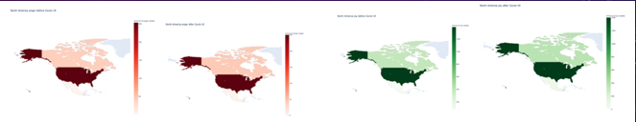
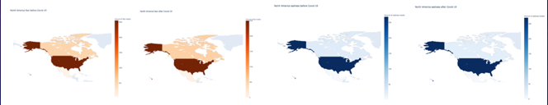
North America emotion analysis
Anger
Joy
Fear
Sadness

Slide 19
North America emotion analysis Cont.
USA Emotion | Before Covid-19 | After Covid-19 | % Change
Anger | 25340 | 58597 | 131.2
Fear | 255450 | 544023 | 112.97
Joy | 139142 | 142739 | 2.585
Sadness | 26824 | 29095 | 8.46
Total Dataset | 446756 | 774454 | 73.35
Canada Emotion | Before Covid-19 | After Covid-19 | % Change
Anger | 4180 | 4353 | 4.14
Fear | 53408 | 53743 | 0.63
Joy | 38528 | 37409 | -2.9
Sadness | 2779 | 2286 | -17.74
Total Dataset | 98895 | 97791 | -1.12
Mexico Emotion | Before Covid-19 | After Covid-19 | % Change
Anger | 127 | 83 | -34.65
Fear | 5016 | 4809 | -4.13
Joy | 7377 | 7212 | -2.24
Sadness | 141 | 155 | 9.93
Total Dataset | 12661 | 12259 | -3.18

Slide 20
Conclusions
Overall sentiment of both Ohio and the USA have sharply declined because of Covid-19
Emotion Recognition showed that USA was affected more significantly by Covid-19 than its fellow North American countries.

